Slide 1
Introduction to Algebraic Multigrid Solver: Part 9

Slide 2
Highlights of Multigrid: Recursion

Slide 3
Highlights of Multigrid: Storage: , must be stored each level
In 1-d, each coarse grid has about half
the number of points as the finer grid.
In 2-d, each coarse grid has about one-
fourth the number of points as the finer
grid.
In d-dimensions, each coarse grid has
about the number of points as the
finer grid.
Storage cost:
less than 2, 4/3, 8/7 the cost of storage on the fine grid
for 1, 2, and 3-d problems, respectively.

Slide 4
AMG setup costs: a bad rap
Many geometric MG methods need to compute prolongation and coarse-grid operators
The only additional expense in the AMG setup phase is the coarse grid selection algorithm
AMG setup phase is only 10-25% more expensive than in geometric MG and may be considerably less than that!

Slide 5
How’s it perform (vol I)? Regular grids, plain, old, vanilla problems
The Laplace Operator:

Slide 6
How’s it perform (vol II)? Laplacian operator, unstructured Grids

Slide 7
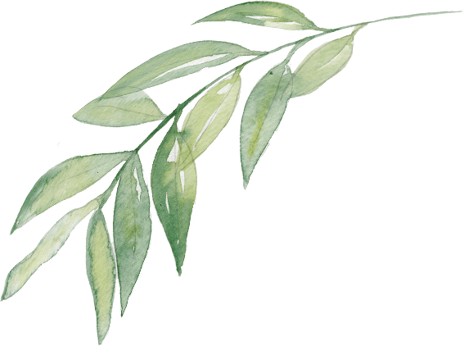
THANK YOU
PPT模板下载：www.1ppt.com/moban/ 行业PPT模板：www.1ppt.com/hangye/
节日PPT模板：www.1ppt.com/jieri/ PPT素材下载：www.1ppt.com/sucai/
PPT背景图片：www.1ppt.com/beijing/ PPT图表下载：www.1ppt.com/tubiao/
优秀PPT下载：www.1ppt.com/xiazai/ PPT教程： www.1ppt.com/powerpoint/
Word教程： www.1ppt.com/word/ Excel教程：www.1ppt.com/excel/
资料下载：www.1ppt.com/ziliao/ PPT课件下载：www.1ppt.com/kejian/
范文下载：www.1ppt.com/fanwen/ 试卷下载：www.1ppt.com/shiti/
教案下载：www.1ppt.com/jiaoan/
字体下载：www.1ppt.com/ziti/

