Slide 1
Image System
Data Structure and Object Oriented Programming
Instructor: Sai Keung Wong
National Yang Ming Chiao Tung University, Taiwan

Slide 2
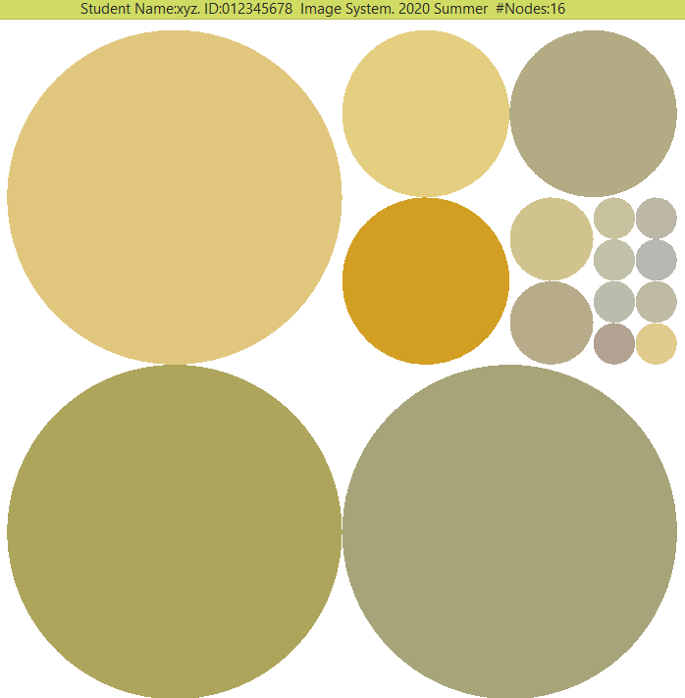
Marking scheme
Use the mouse to explore an image correctly
Reset the image
Count the number of nodes that are shown

Slide 3
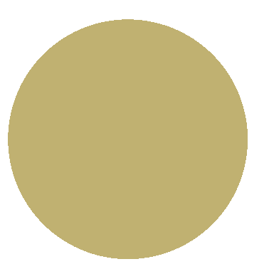
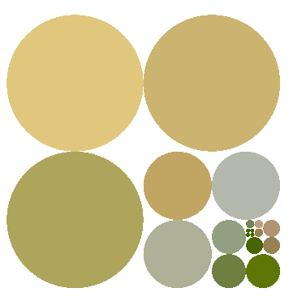
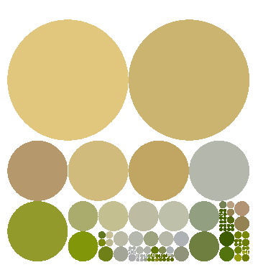
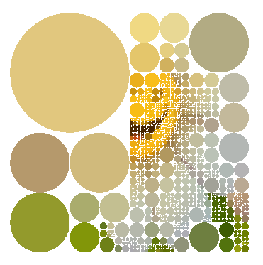
Main task
A user can move the mouse to explore an image in a hierarchical manner. When the mouse cursor hits an unexplored region, the region is split into four smaller regions. The splitting process is terminated when a region is small enough.

Slide 4
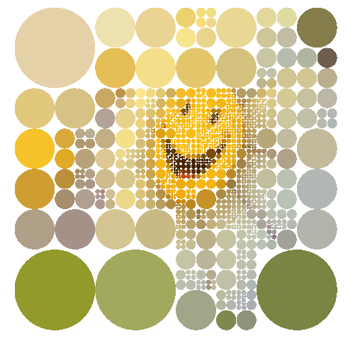
Purpose
A square image 256x256 is loaded.
Partition the image into a set of image blocks in a hierarchical manner.
Each image block is a square.
Each image block can be divided into four children of the same dimension.
The smallest image block is 1x1.
Draw each image block as a filled disk.
The color of the filled disk is the average color of the image block.

Slide 5
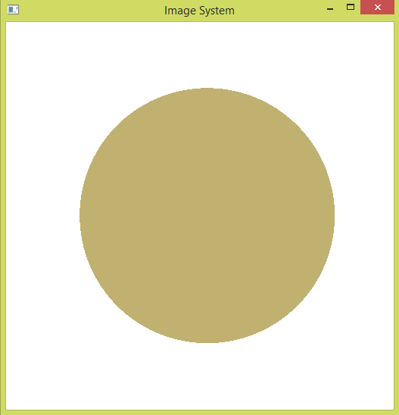
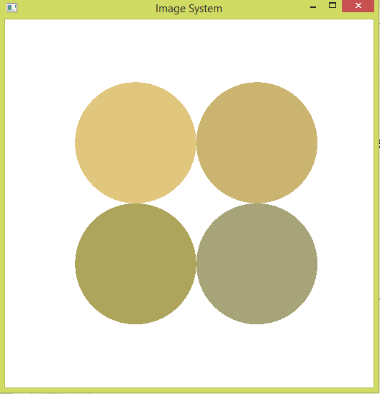
How to play?
Passive mouse events: move the mouse without pressing any buttons.
When the mouse cursor lies inside the disk of a block, ‘explore’ the image block.
How to ‘explore’ a block?
Partition the block into four sub-blocks of the same dimension.
Press ‘r’ to reset. That’s that there is only one block of the original image.
Explore a block

Slide 6
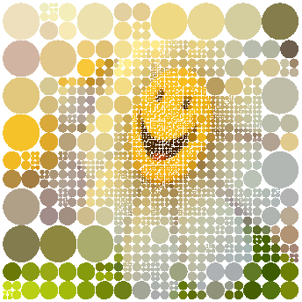
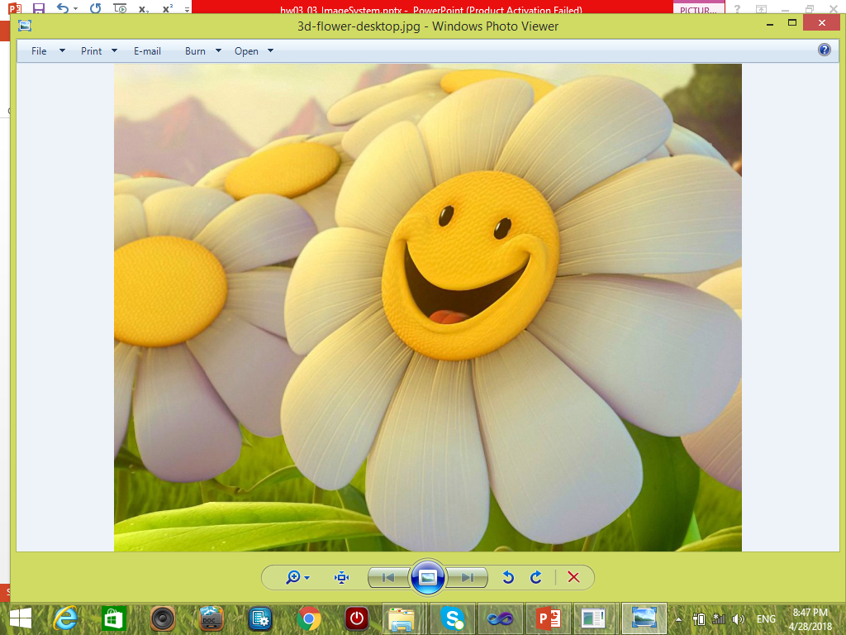
How to draw the image?
The original dimension of the image is 256x256.
We scale it up by a factor of two.
How to achieve this?
Draw the filled disk by a scaling factor of two.
For example, the radius of the filled disk is 256 instead of 128 for the root node.
Thus, the center of the filled disk is (256,256) instead of (128,128).
Input image
(after modification)
256x256
Result in our system.
The dimension of the image is 256x256.

Slide 7
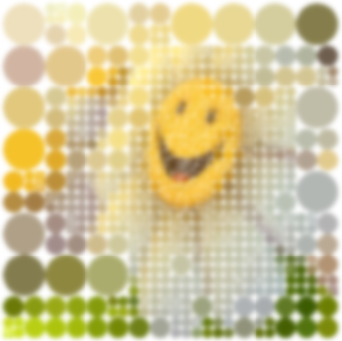
How do we draw a filled disk? But wait! What is the radius of the filled disk?
Given a square image block with dimension (w,w), what is the radius of the filled disk?
radius =?
radius = (w/2)*2 = w
This is because we scale it up by a factor of two.
2w
w
Input image
(after modified)
256x256
Result in our system.
The dimension of the image is still 256x256.

Slide 8
How do we know the center of the filled disk?
Given a square image block with dimension (w,w) and its lower left corner coordinates (x,y), what are the coordinates of the center of the filled disk?
center = (2x+w, 2y+w)
Now, we can draw the filled disk if we know its color.
Why do we have (2x, 2y)?
2w
w
(2x,2y)
(x,y)
(x,y)
Input image
(after modified)
256x256
Result in our system.
The dimension of the image is still 256x256.

Slide 9
How do we draw the filled disk?
Given a square image block with dimension (w,w) and its lower left corner coordinates (x,y), what are the coordinates of the center of the filled disk?
radius = w
center = (2x+w, 2y+w)
The color of the filled disk is the average color of the image block.
2w
w
(2x,2y)
(x,y)
(x,y)
Input image
(after modified)
256x256
Result in our system.
The dimension of the image is still 256x256.

Slide 10
Data structure : IMAGE_NODE
bool flg_explored; // is the blocked explored?
float r, g, b; // color of the block
float radius; // radius of the filled disk
int cur_depth; // current depth of this block
// lower left corner pixel coordinates
int start_x; int start_y;
int w; // width of the block
int h; // height of the block
float sx; float sy; // scale factor
// where do we draw the filled disk? This is the center.
float draw_x, draw_y;
IMAGE_NODE *children[4];

Slide 11
IMAGE_NODE
float radius;
int start_x;
int start_y;
int w;
int h;
float draw_x;
float draw_y;
2w
w
(2x,2y)
(x,y)
(x,y)
start_x = x;
start_y = y
draw_x = 2x
draw_y = 2y;
radius = 2;
Input image
(after modified)
256x256
Result in our system.
The dimension of the image is still 256x256.

Slide 12
Implementation :Explore the image
IMAGE_SYSTEM::handlePassiveMouseEvent( double x, double y )
IMAGE_SYSTEM::exploreImageNode(IMAGE_NODE *node, double x, double y)
Check if the mouse cursor hits the circular disk of the node:
float dx = x - node->draw_x;
float dy = y - node->draw_y;
float d2 = dx*dx + dy*dy;
float r2 = node->radius*node->radius;
if (d2 > r2) return;

Slide 13
Implementation :Explore the image
IMAGE_SYSTEM::exploreImageNode(IMAGE_NODE *node, double x, double y)
Divide the node into four children.
A child’s radius = ?
2w
w
(2x,2y)
(x,y)
(x,y)

Slide 14
Implementation :Explore the image
IMAGE_SYSTEM::exploreImageNode(IMAGE_NODE *node, double x, double y)
Divide the node into four children.
A child’s radius = w/2
2w
w
(2x,2y)
(x,y)
(x,y)

Slide 15
Implement countNodes
Count the number of nodes that are shown.
Also, implement
getNumberOfNodes

Slide 16
Implementation : Create a node of IMAGE_NODE
IMAGE_NODE(
int cur_depth,
int start_x, int start_y,
int w, int h,
float sx, float sy,
float radius
)

Slide 17
Implementation: Compute Position for Drawing a node
for (int i =0; i <4; ++i) {
computeNodeColor(children[i]);
children[i]->computeDrawPosition(
wImage, hImage
);
node->children[i] = children[i]; // set children
}

Slide 18
Implementation :Explore the image
IMAGE_SYSTEM::handlePassiveMouseEvent( double x, double y )
Check if the mouse cursor hits the circular disk of a node:
float dx = x - node->draw_x;
float dy = y - node->draw_y;
float d2 = dx*dx + dy*dy;
float r2 = node->radius*node->radius;
if (d2 > r2) return;

Slide 19
Implementation: Average Color Computation
IMAGE_SYSTEM::computeNodeColor(IMAGE_NODE *node)
IMAGE_SYSTEM::computeAverageColor(
int start_x, int start_y,
int w, int h,
float &r, float &g, float &b
) const
Hint: call m_Image->getPixelColor(i, j, pr, pg, pb); to get color at pixel (i,j)

Slide 20
Implementation: Draw the disks hierarchically
IMAGE_SYSTEM::draw_Disks_Dynamic( ) const
IMAGE_SYSTEM::draw_Disks_Dynamic( const IMAGE_NODE *node) const
Draw an IMAGE_NODE *node:
int wImage, hImage;
m_Image->getInfo(wImage, hImage);
node->drawDisk_TriangleFan( wImage, hImage);

Slide 21
Implementation: reset
Reset the hierarchical to an initial state (unexplored state)
IMAGE_SYSTEM::reset()

Slide 22
Now, you know the basic idea to draw the image.
What do you need to do next?

Slide 23
Major Steps
What do you need to do next?
Get the image information. You need to know the image pointer and image dimension.
Handle the passive mouse event. You need to know the mouse coordinates.
Then you can partition the image into blocks hierarchically.
Each block corresponds to one filled disk.
Finally, you can draw the hierarchical structure of the filled disks.

Slide 24
There are some bugs in the demo program. Could you find them?

Slide 25
Enjoy programming

