Slide 1
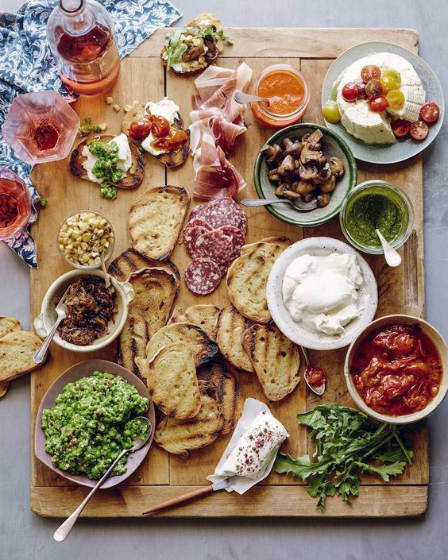
Group 2
Members : Henry Jason Jimmy Jennie
Notes:
Hi everyone , we are group two.

Slide 2
Seefood
Notes:
Now i`m going to talk about our project seefood.

Slide 3
Contents
What does seefood do?(our idea)
Procedures in our project
Combine our homework
Set our default keywords
Call google search
Catch subsites
Create trees
Calculate scores of supersite and all of its subsites
Re-rank our supersites
Print out results
Webrize our search engine
What difficulties do we face?
Demo our search engine—seefood!
Notes:
Call google search(要講google內建的搜尋方法)
Create trees(一個母網頁一個)
there are four main parts in the content
First is our main idea,
second is the procedure in our project
third is the difficulties that we had faced
and the last part is showing our demo—seefood

Slide 4
What does seefood do?(our idea)
Seefood can find restaurants which have discounts for students.
Surely, our goal is beating google with our better results.
Notes:
So let`s begin our first part,
our main idea is that people can find restaurant that is cheap or have discount.

Slide 5
Procedures in our project
Combine our homework
Set our default keywords
Call google search
Catch subsites
Create trees
Calculate scores of supersite and all of its subsites
Re-rank our supersites
Print out results
Webrize our search engine
Notes:
The second part is the procedure that I talked early and I gonna talk detailed
Call google search(要講google內建的搜尋方法)
Create trees(一個母網頁一個)

Slide 6
1. Combine our homework
We reuse those classes in our homework.
--Keyword…
We create a new class to help print out our results.
--Rerank
Notes:
First step we combine the homework that ta taught us.
We reuse the classed and also create a new one rerank

Slide 7
2. Set our default keywords
We define some default keywords to make our results more precisely and meet our needs
E.g. 折價、餐廳、優惠、折抵、折扣、打折、生日、壽星、學生、特約
Notes:
Second step – set our default keywords. Such as :
Discount , restaurant
.(以搜尋結果的網頁，去比對以下關鍵字是否有出現在那些網頁內，若有，則乘上權重10)

Slide 8
3. Call google search
We add “intitle:” in our call google search
Call google to search keywords(user input)
Special: we use google built-in searching method to make our results more precisely.
Notes:
Third is calling google to search keywords. Specially, we use intitle in our google
Search ,it is a built-in method that can make our search more precisely
.(搜尋”標題中有關鍵字”的連結，而非一般的搜尋文章內有關鍵字)

Slide 9
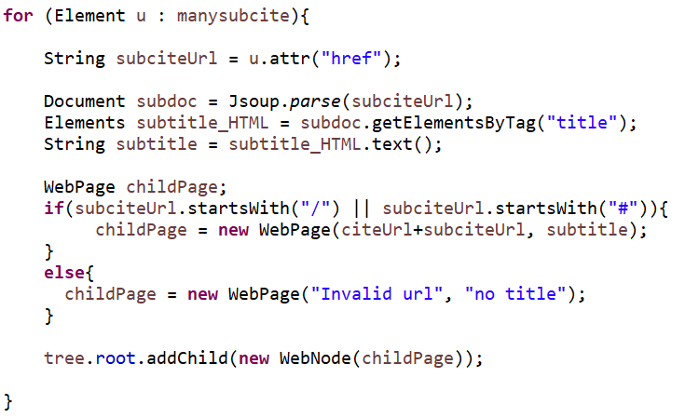
4. Catch subsites
We use a for loop to catch subsites in the for loop which we catch supersites.
Detail codes at right side.
Notes:
fourth is catching subsites

Slide 10
5. Create trees
Create a tree for each supersite
Its children are their subsites
Notes:
fifth step we create a tree for each supersites
(一個母網頁一個tree)

Slide 11
6. Calculate scores of supersite and all of its subsites
Before we calculate scores, we create a new method to separate keywords if users input many keywords in a long string.
Then, we call setPostOrderScore() method in webtree class to calculate the scores of our tree, that is, scores of supersite and all of its subsites.
Notes:
sixth step is to calculate all the score,but before calculate the scores we create a new method to separate keywords if users input is a long string,
And then call setPostOrderScore() method to calculate all the score

Slide 12
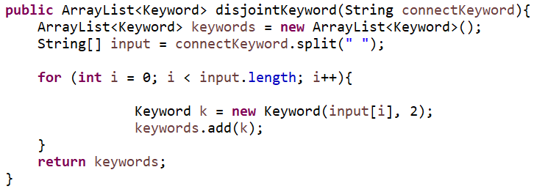
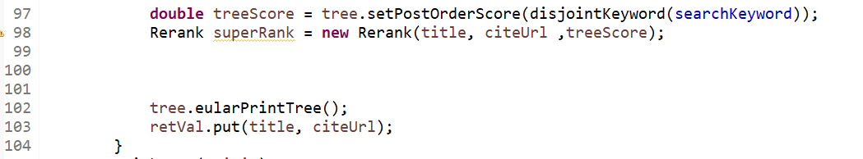
Notes:
Disjointkeyword() ------ a new method to separate keywords if users input many keywords in a long string.
Setpostoderscore() ----- ,calculate the scores of our tree

Slide 13
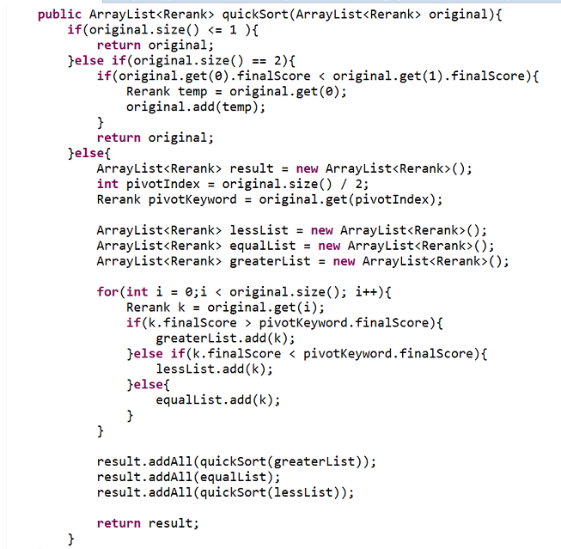
7. Re-rank our supersites
We use QuickSort to re-rank our results(supersites)
Notes:
and then we use quicksort to rank our results

Slide 14
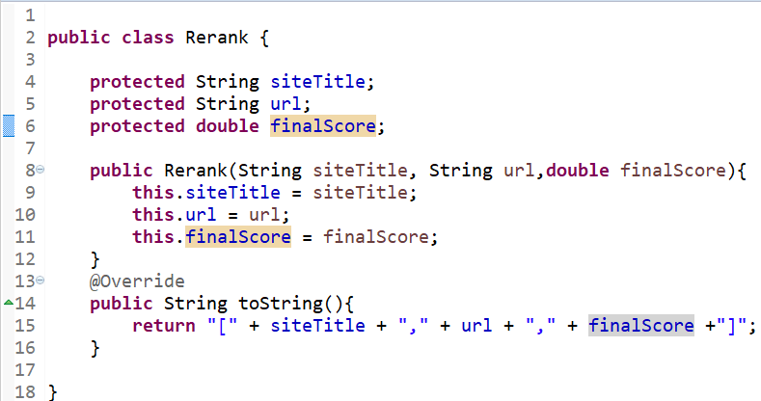
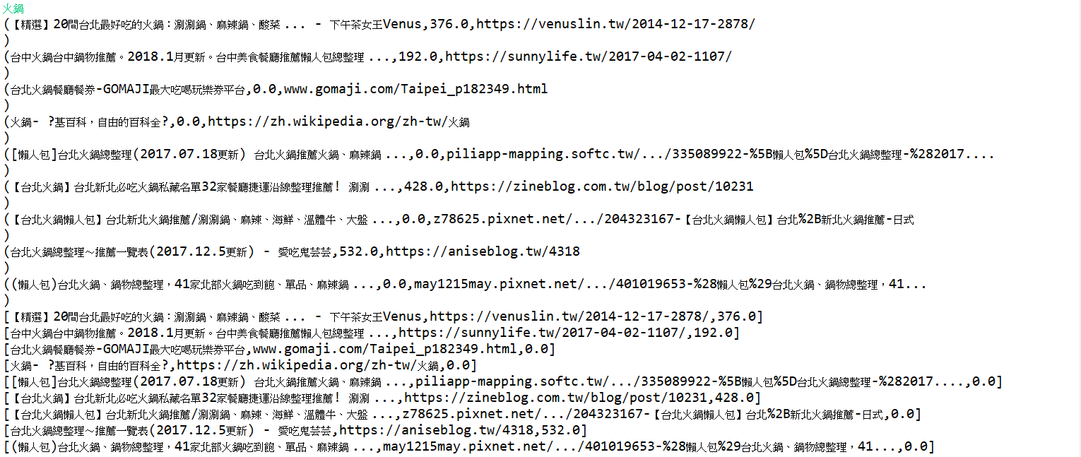
8. Print out results
We create an object, called Rerank, to help us store three attributes of tree.
siteTitle, url, finalScore
Use an arraylist to store Reranks, and print it out.
Notes:
last , we create an object to three attributes of the tree siteTitle, url, finalScore
and then use an arraylist to store rerank to print it out

Slide 15
9. Webrize our search engine
Use Apache-Tomcat to webrize our search engine.
Notes:
after all the above have been made we Webrize it

Slide 16
What difficulties do we face?
MalformedURLException
Notes:
when we do the project we face some difficulties –two exception
one is MalformedURLException and the other is nullpointerexception

Slide 17
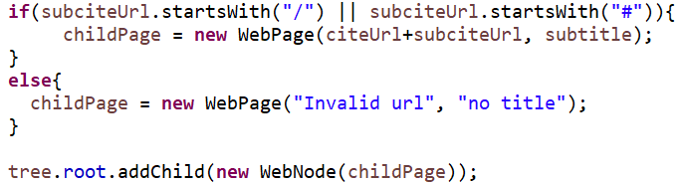
difficulty: subsites’ url has to start with “http://”, while the value in attribute “href” is not this case.
solution: we find that the value in attribute “href” should be attached after supersite’s url.
Notes:
for the difficulty in the MalformedURLException is that not all attribute herf startwith http://
so we find attribute herf should be added after supersite`s url

Slide 18
What difficulties do we face?
NullPointerException
Notes:
for the other difficulty in nullpointerexception is that java can`t load the herf so we use the try catch to solve the problem

Slide 19
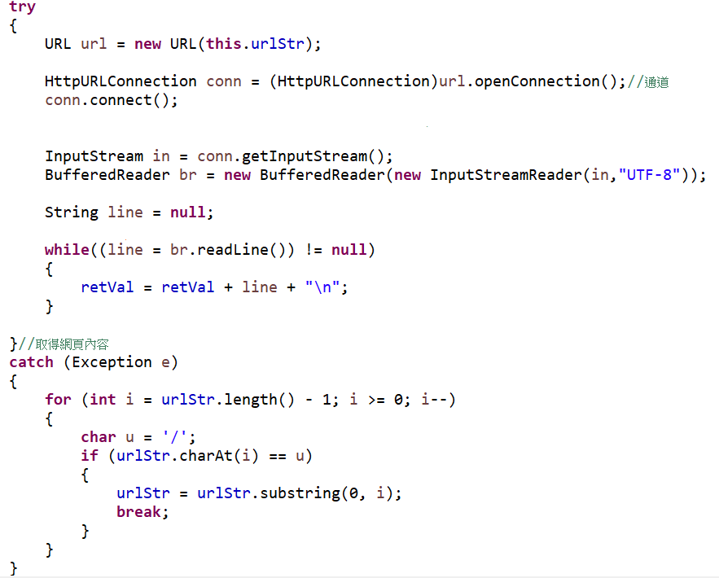
difficulty: the url in attribute “href” isn’t complete, so java can’t load it.
solution: we use a try-catch to solve this problem.

Slide 20
Let’s demo our search engine—seefood!

Slide 21
Thanks!
Any questions?

