Slide 1
Data Science Logistic Regression & Confusion Matrix

Slide 2
I. What is Logistic Regression? ii. Log, E, odds, and log odds III. Regression: From Linear to Logistic Iv. Interpreting coefficients V. Confusion Matrix
agenda

Slide 3
I . What is Logistic Regression?
Data science

Slide 4
What is Logistic regression?
Q: What is logistic regression?
A: A generalization of the linear regression model used for classification problems.
The output of logistic regression is a probability of being in a specific class, i.e. it falls between 0 and 1.

Slide 5
What is Logistic regression?
Why not just use Linear Regression with a threshold?
lm = LinearRegression()
lm.fit(X_train, y_train)
y_pred_prob = lm.predict(X_test)
y_pred = np.where(y_pred_prob < 0.5, 0, 1)

Slide 6
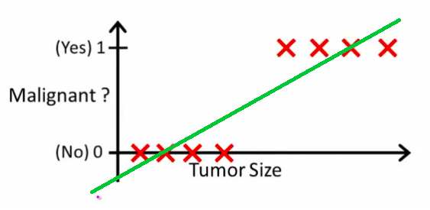
What is Logistic regression?
Source: Andrew Ng, “Introduction to Machine Learning”

Slide 7
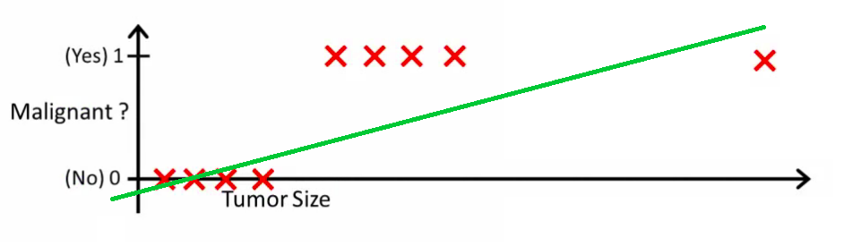
What is Logistic regression?
Source: Andrew Ng, “Introduction to Machine Learning”

Slide 8
II. Log, E, odds, and log odds
Data science

Slide 9
Log, E, odds, and log odds
e is the base rate of growth for continually growing processes
You may remember this from compound interest formulas.
When you see “log”, it usually means “ln”.
e and ln are inverses of each other.
e^{ln(x)} = x
ln(e^{x}) = x

Slide 10
Log, E, odds, and log odds
Probability is a measure of likelihood that an event will occur.
1 – Probability is the likelihood of an event not occurring.
The odds are the probability that an event will occur divided by the probability that it won’t occur.
The log odds are the natural logs of the odds.

Slide 11
Log, E, odds, and log odds
As the probability increases, the odds increase.
As the odds increase, the log odds increase.
Take three minutes to confirm that you get the numbers below for odds and log odds.
Probability | Odds | Log odds
0.01 | 0.0101 | -4.5951
0.25 | 0.3333 | -1.0986
0.50 | 1.0 | 0
0.75 | 3.0 | 1.0986
0.99 | 99 | 4.5951

Slide 12
III. Regression: From Linear to Logistic
Data science

Slide 13
Regression: From Linear to Logistic
In linear regression, we used a set of predictors to predict the value of a continuous response.
In logistic regression, we use a set of predictors to predict the probability of (binary) class membership.
These probabilities are mapped to class labels, allowing us to use this for classification.

Slide 14
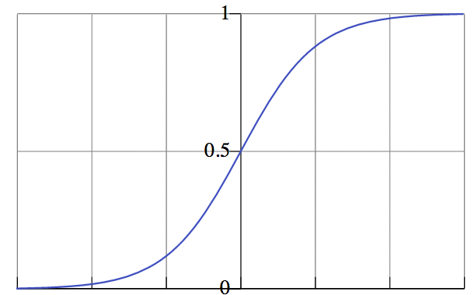

Regression: From Linear to Logistic
probability of
belonging to
class
NOTE
Probability predictions look like this.
value of predictor variable

Slide 15
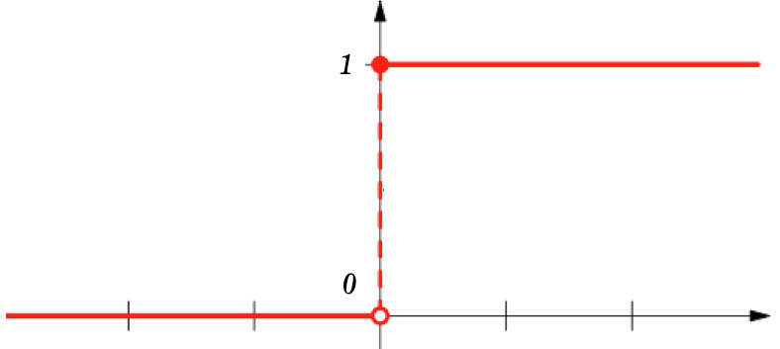
Regression: From Linear to Logistic
class label
NOTE
Probabilities are “snapped” to class labels (e.g., by threshholding at 50%).
value of predictor variable

Slide 16
Regression: From Linear to Logistic
Exercise: In the following examples, should linear or logistic regression be used?
Predict how much money you’ll spend on a rental from Air Bnb.
Predict whether an email is marked as spam or not.
Predict the salary of a new college grad.
Predict whether the salary of a new college grad is greater than or less than the median American income.

Slide 17
Regression: From Linear to Logistic
One of the key differences between linear and logistic regression is the response variable (what you’re predicting).
In linear regression, the response is modeled by a linear combination of the predictors.

Slide 18
Regression: From Linear to Logistic
In logistic regression, the log odds of the outcome is modeled by a linear combination of the predictors.

Slide 19
Regression: From Linear to Logistic
Solving the previous equation, we get…
We now have an equation to predict the probability of class membership.

Slide 20
IV. Interpreting coefficients
Data science

Slide 21
Interpreting coefficients
Now that we have an equation, what do the coefficients mean?
For every unit increase in X, there is a β increase in the log odds of class membership and vice versa.
For every unit increase in X, there is a e^{β} increase in the odds of class membership and vice versa.
This doesn’t mean for every increase in X, you add e^{β} to the previous odds. It means for every increase in X, you multiple e^{β} to the previous odds.

Slide 22
Interpreting coefficients
Let’s say I am trying to predict whether your heart is unhealthy or not, yes or no.
I have one predictor, number of cheeseburgers eaten.
If I fit a logistic regression model to my data, I get a coefficient of 0.16288268. This means for every cheeseburger I eat, I increase the odds of having an unhealthy heart by exp(0.16288268) = 1.18.
You could also interpret this as increase the odds by 18%.

Slide 23
V. Confusion Matrix
Data science

Slide 24
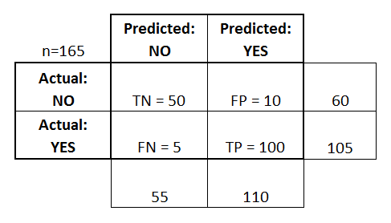
Confusion Matrix
Basic Terminology:
True Positives (TP)
True Negatives (TN)
False Positives (FP)
False Negatives (FN)
Accuracy:
Overall, how often is it correct?
(TP + TN) / total = 150/165 = 0.91
Misclassification Rate (Error Rate):
Overall, how often is it wrong?
(FP + FN) / total = 15/165 = 0.09

Slide 25
Confusion Matrix
Sensitivity:
When actual value is positive, how often is prediction correct?
TP / actual yes = 100/105 = 0.95
“True Positive Rate” or “Recall”
False Positive Rate:
When actual value is negative, how often is prediction wrong?
FP / actual no = 10/60 = 0.17
Specificity:
When actual value is negative, how often is prediction correct?
TN / actual no = 50/60 = 0.83

