Slide 1
Eclectic Eats Haven
CSET 120
Final Project– Fall 2023
Zachary short
Katy shi

Slide 2
Introduction
Title: Eclectic Eats Haven
A user-friendly restaurant website designed for the convenience of ordering.

Slide 3
Introduction (cont.)
Title: Software Requirements Specification (SRS)
Briefly discuss the importance of the SRS document
A document that outlines the features of the software
Mention key components covered in the SRS for the project

Slide 4
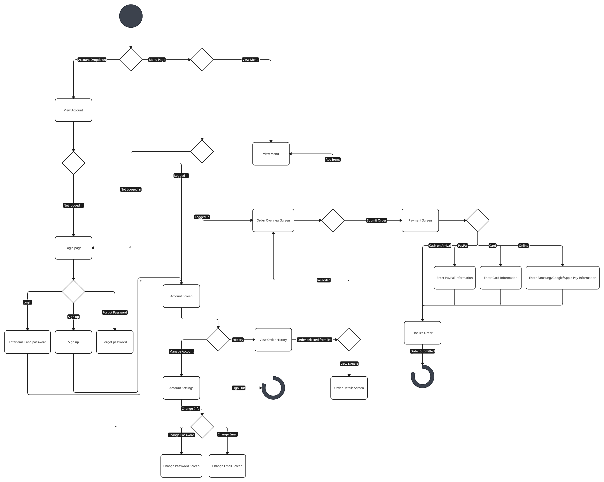
Activity Diagram

Slide 5
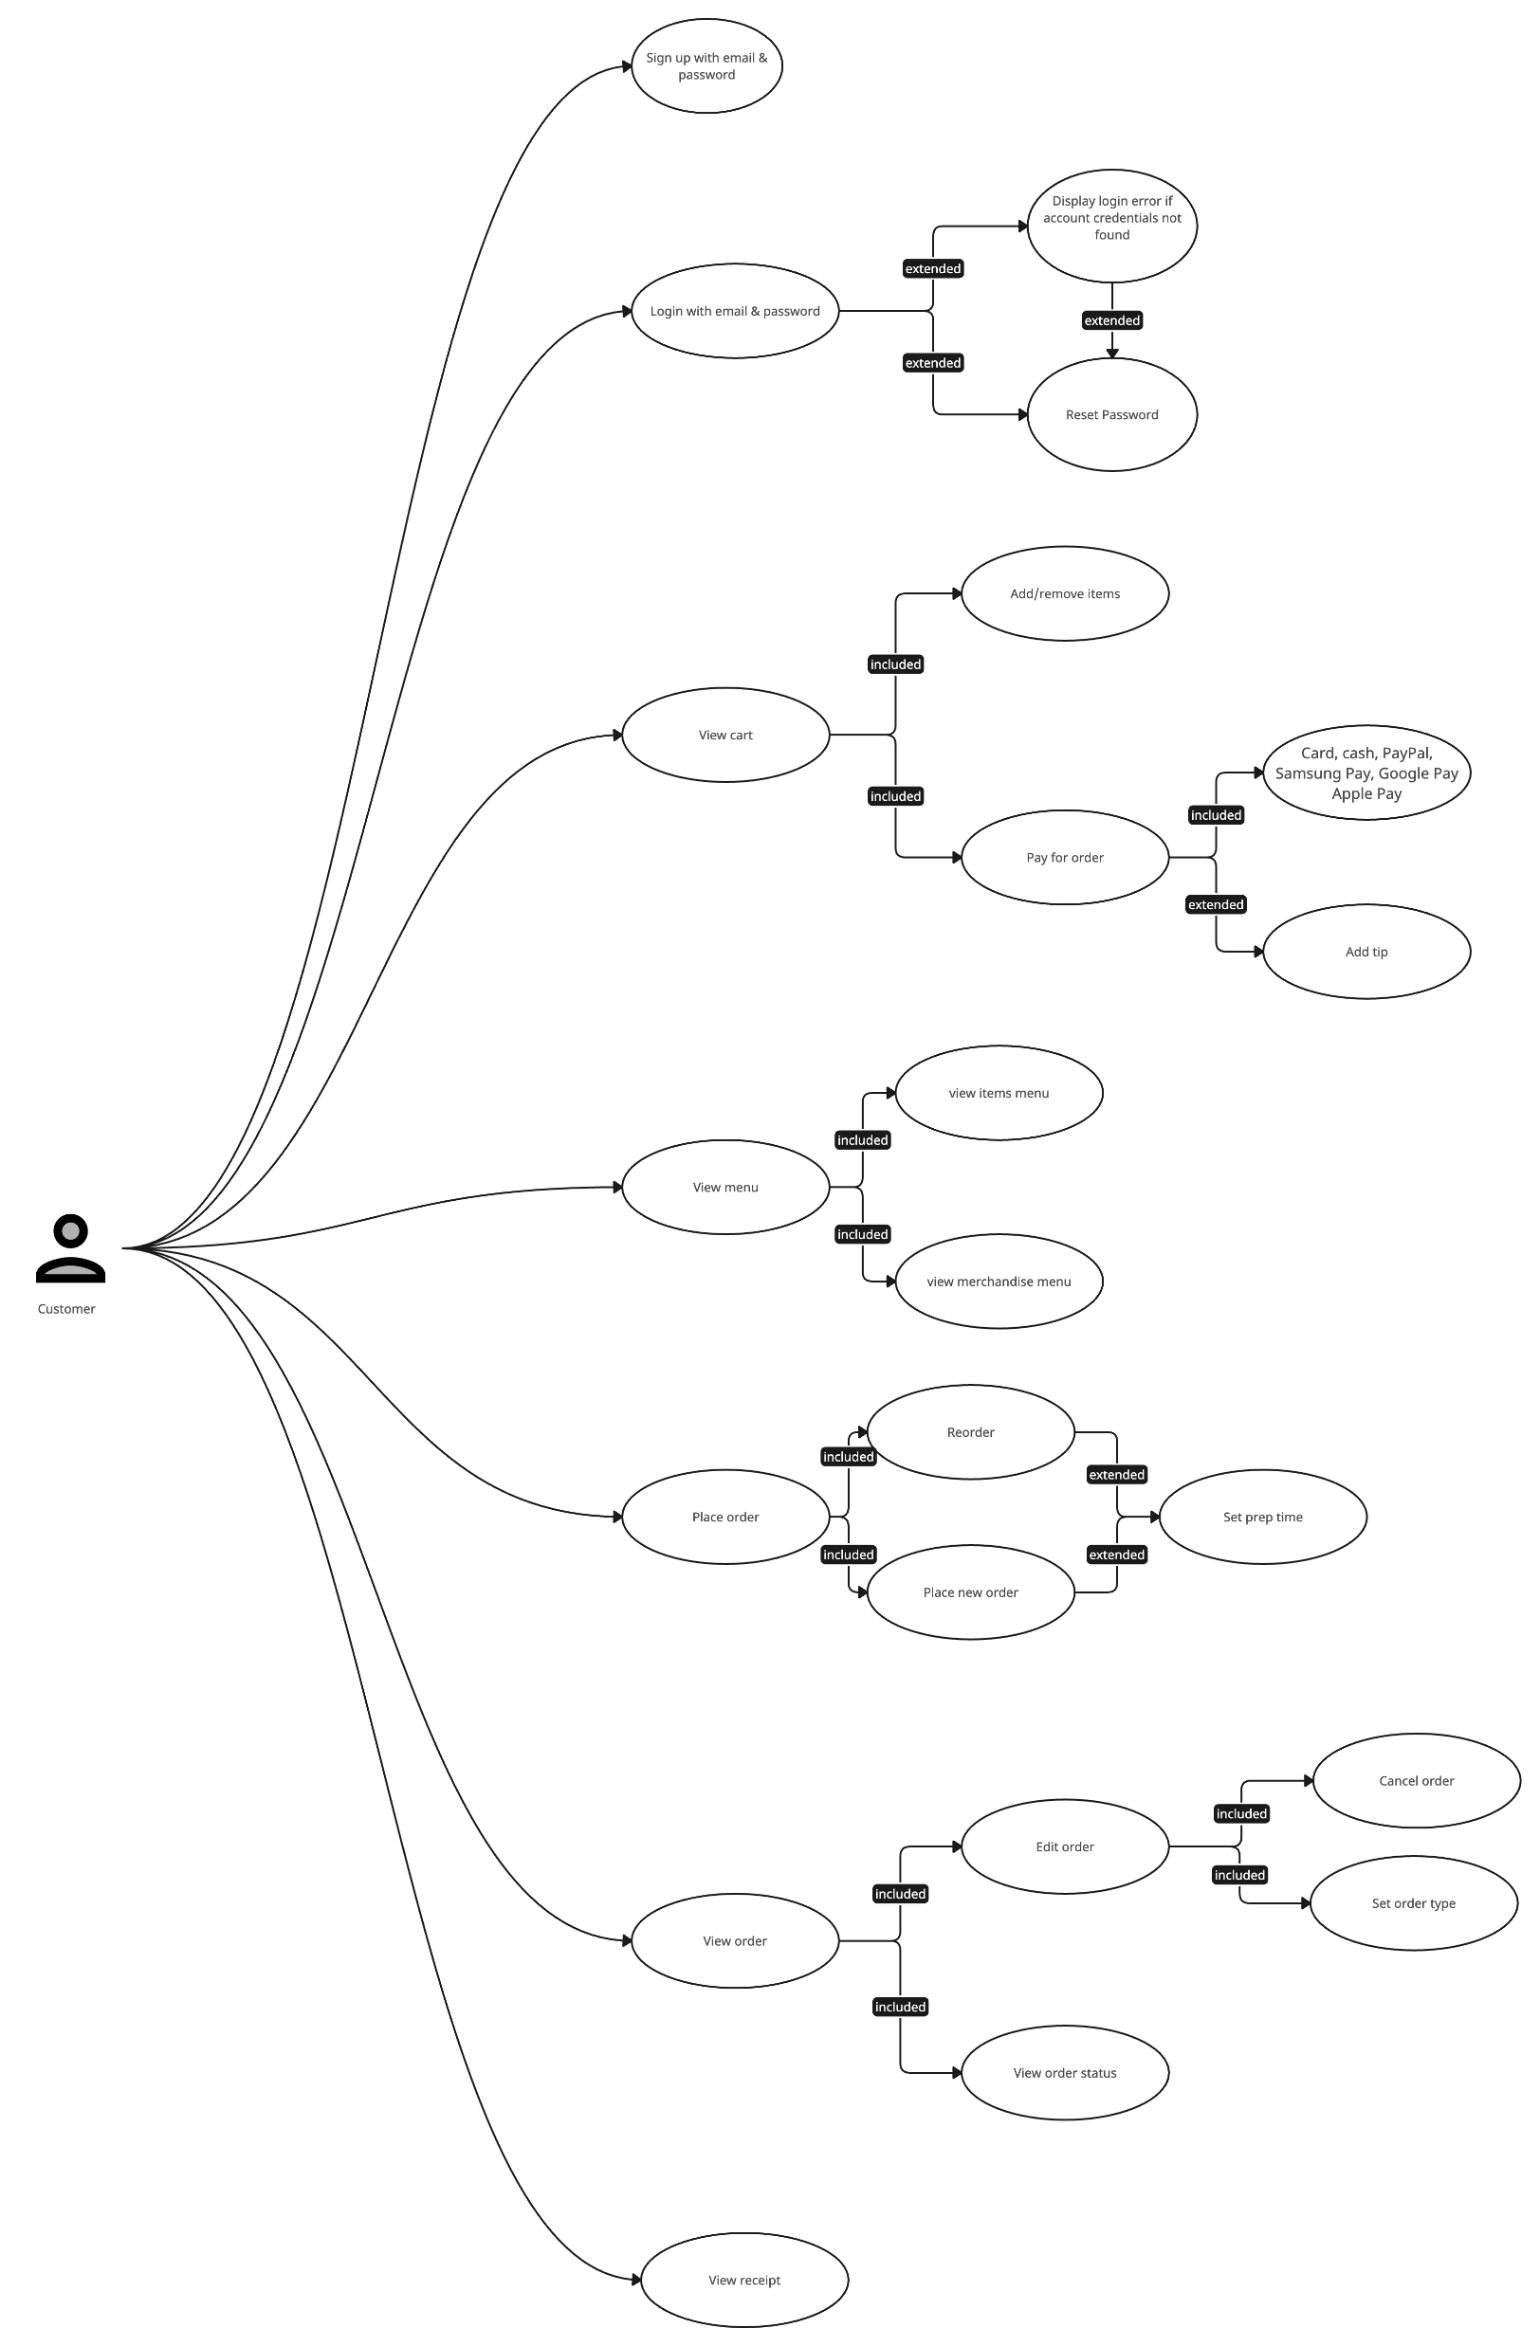
Use Case Diagram

Slide 6
User Authentication Module
Sign-up page for customers (initially show the user page for each visit or account for multiple customers)
Login page for customers and managers
Emphasize exclusivity to customers for sign-up

Slide 7
User Authentication Module (cont.)
Sign-up page for customers
Notes:
Create an account using desired email and password.
Password is hashed for security.
Email and password are stored for login purposes
Logged in after signing up
User is brought to the account management page

Slide 8
Diagrams yeah

Slide 9
Diagrams yeah (cont.)

Slide 10
User Authentication Module (cont.)
Login page for customers and managers
Notes:
After creating an account, users can login with their email and password.
After logging in, user is brought to the account management page

Slide 11
User Authentication Module (cont.)
Forgot Password Page
Notes:
Enter the email associated to the account to reset the password.
Since we cannot actually send an email, the password is set to 12345678

Slide 12
Menu Display Module
Describe the page that shows the menu
Highlight user-friendly interface and navigation
Notes:
Features six categories each with four items and a category for drinks
Each item features an image for an idea of what the food looks like
Customer can customize toppings before adding the item to the cart

Slide 13
Ordering Process
Final cart page for order review & payment options
Receipt and order details page

Slide 14
Ordering Process
Final cart page for order review & payment options
Notes:
Cart order review section displays the item, toppings, quantity, and price of each item
Customer can directly increase the quantity of the item and remove the item
Cart displays the subtotal, tax, and total of the order along with a tips section
After reviewing the order, customer can choose a payment method and be redirected to a payment page depending on which payment method was chosen

Slide 15
Ordering Process
Receipt and order details page
Notes:
Shows the item name, selected toppings of the items, quantity, and price of each item
Includes the customer’s name and email
Features the order number and payment method
Gives the customer an estimated time of when the order will be completed

Slide 16
Manager Functions
Manager’s menu page to add and delete items from the menu
Emphasize managerial control and ease of menu management

Slide 17
Manager Functions
Manager’s menu page
Notes:
Manager can enable and disable items and toppings

Slide 18
GitHub Repository
Provide the logical project name
List team members, including faculty
Emphasize collaboration and version control

Slide 19
Trello Agile Board
Describe the use of Trello for project management
Mention the organization of tasks and goals
Show a sample board with stories, goals, and task assignments
Notes:
Tasks are organized based on functionalities (the different pages, customer controls, manager controls)

Slide 20
Project Timeline
Highlight the importance of pre-coding planning
Indicate which part each team member will work on each week
Emphasize weekly goals and achievements on Trello
Notes:
Working on the SRS first allowed us to plan out what functionalities we wanted on the website.

Slide 21
Week 1 (Nov 15 - Nov 18)
K – completed most of the SRS
Z – started setting up the libraries ( Account manager, storage manager, helpers), set up navbar, worked on account login/signup/forgot password page
Week 2 (Nov 19 - Nov 25)
K – made About and Contact section of Home page. started on creating menu items and toppings
Z – worked on navigation manager for navbar. Finished account page
Week 3 (Nov 26 - Dec 2)
K – added images for menu items. Worked on adding more items and toppings. Worked on header section of home page. Started creating the menu page (items and toppings)
Z – set up actual account page (after logged in). More account manager. Started making classes

Slide 22
Week 4 (Dec 3 - Dec 9)
K – worked on setting up the cart, totals & tips, and payment method section. Implemented close buttons for toppings list and cart section. Started on the payment page. Worked on handling item duplicates and storing cart items using sessionStorage, although doesn’t restore cart when page refreshed
Z – deleted classes. set up orders history page on account management. Worked on manager menu library for toggling availability of items and toppings. Changed how accounts are stored. Worked on card validation
Week 5 (Dec 10 - Dec 12)
K – worked on presentation slides, worked on payment section and receipt
Z – re-creating entire menu code

Slide 23
Conclusion
Summarize key points from the presentation
Invite questions and feedback from the audience

Slide 24
Thank You!

Slide 25
Hi
https://1054009.github.io/CSET-120-FinalProject/

