Slide 1
Eclectic Eats Haven
Zachary short
Katy shi

Slide 2
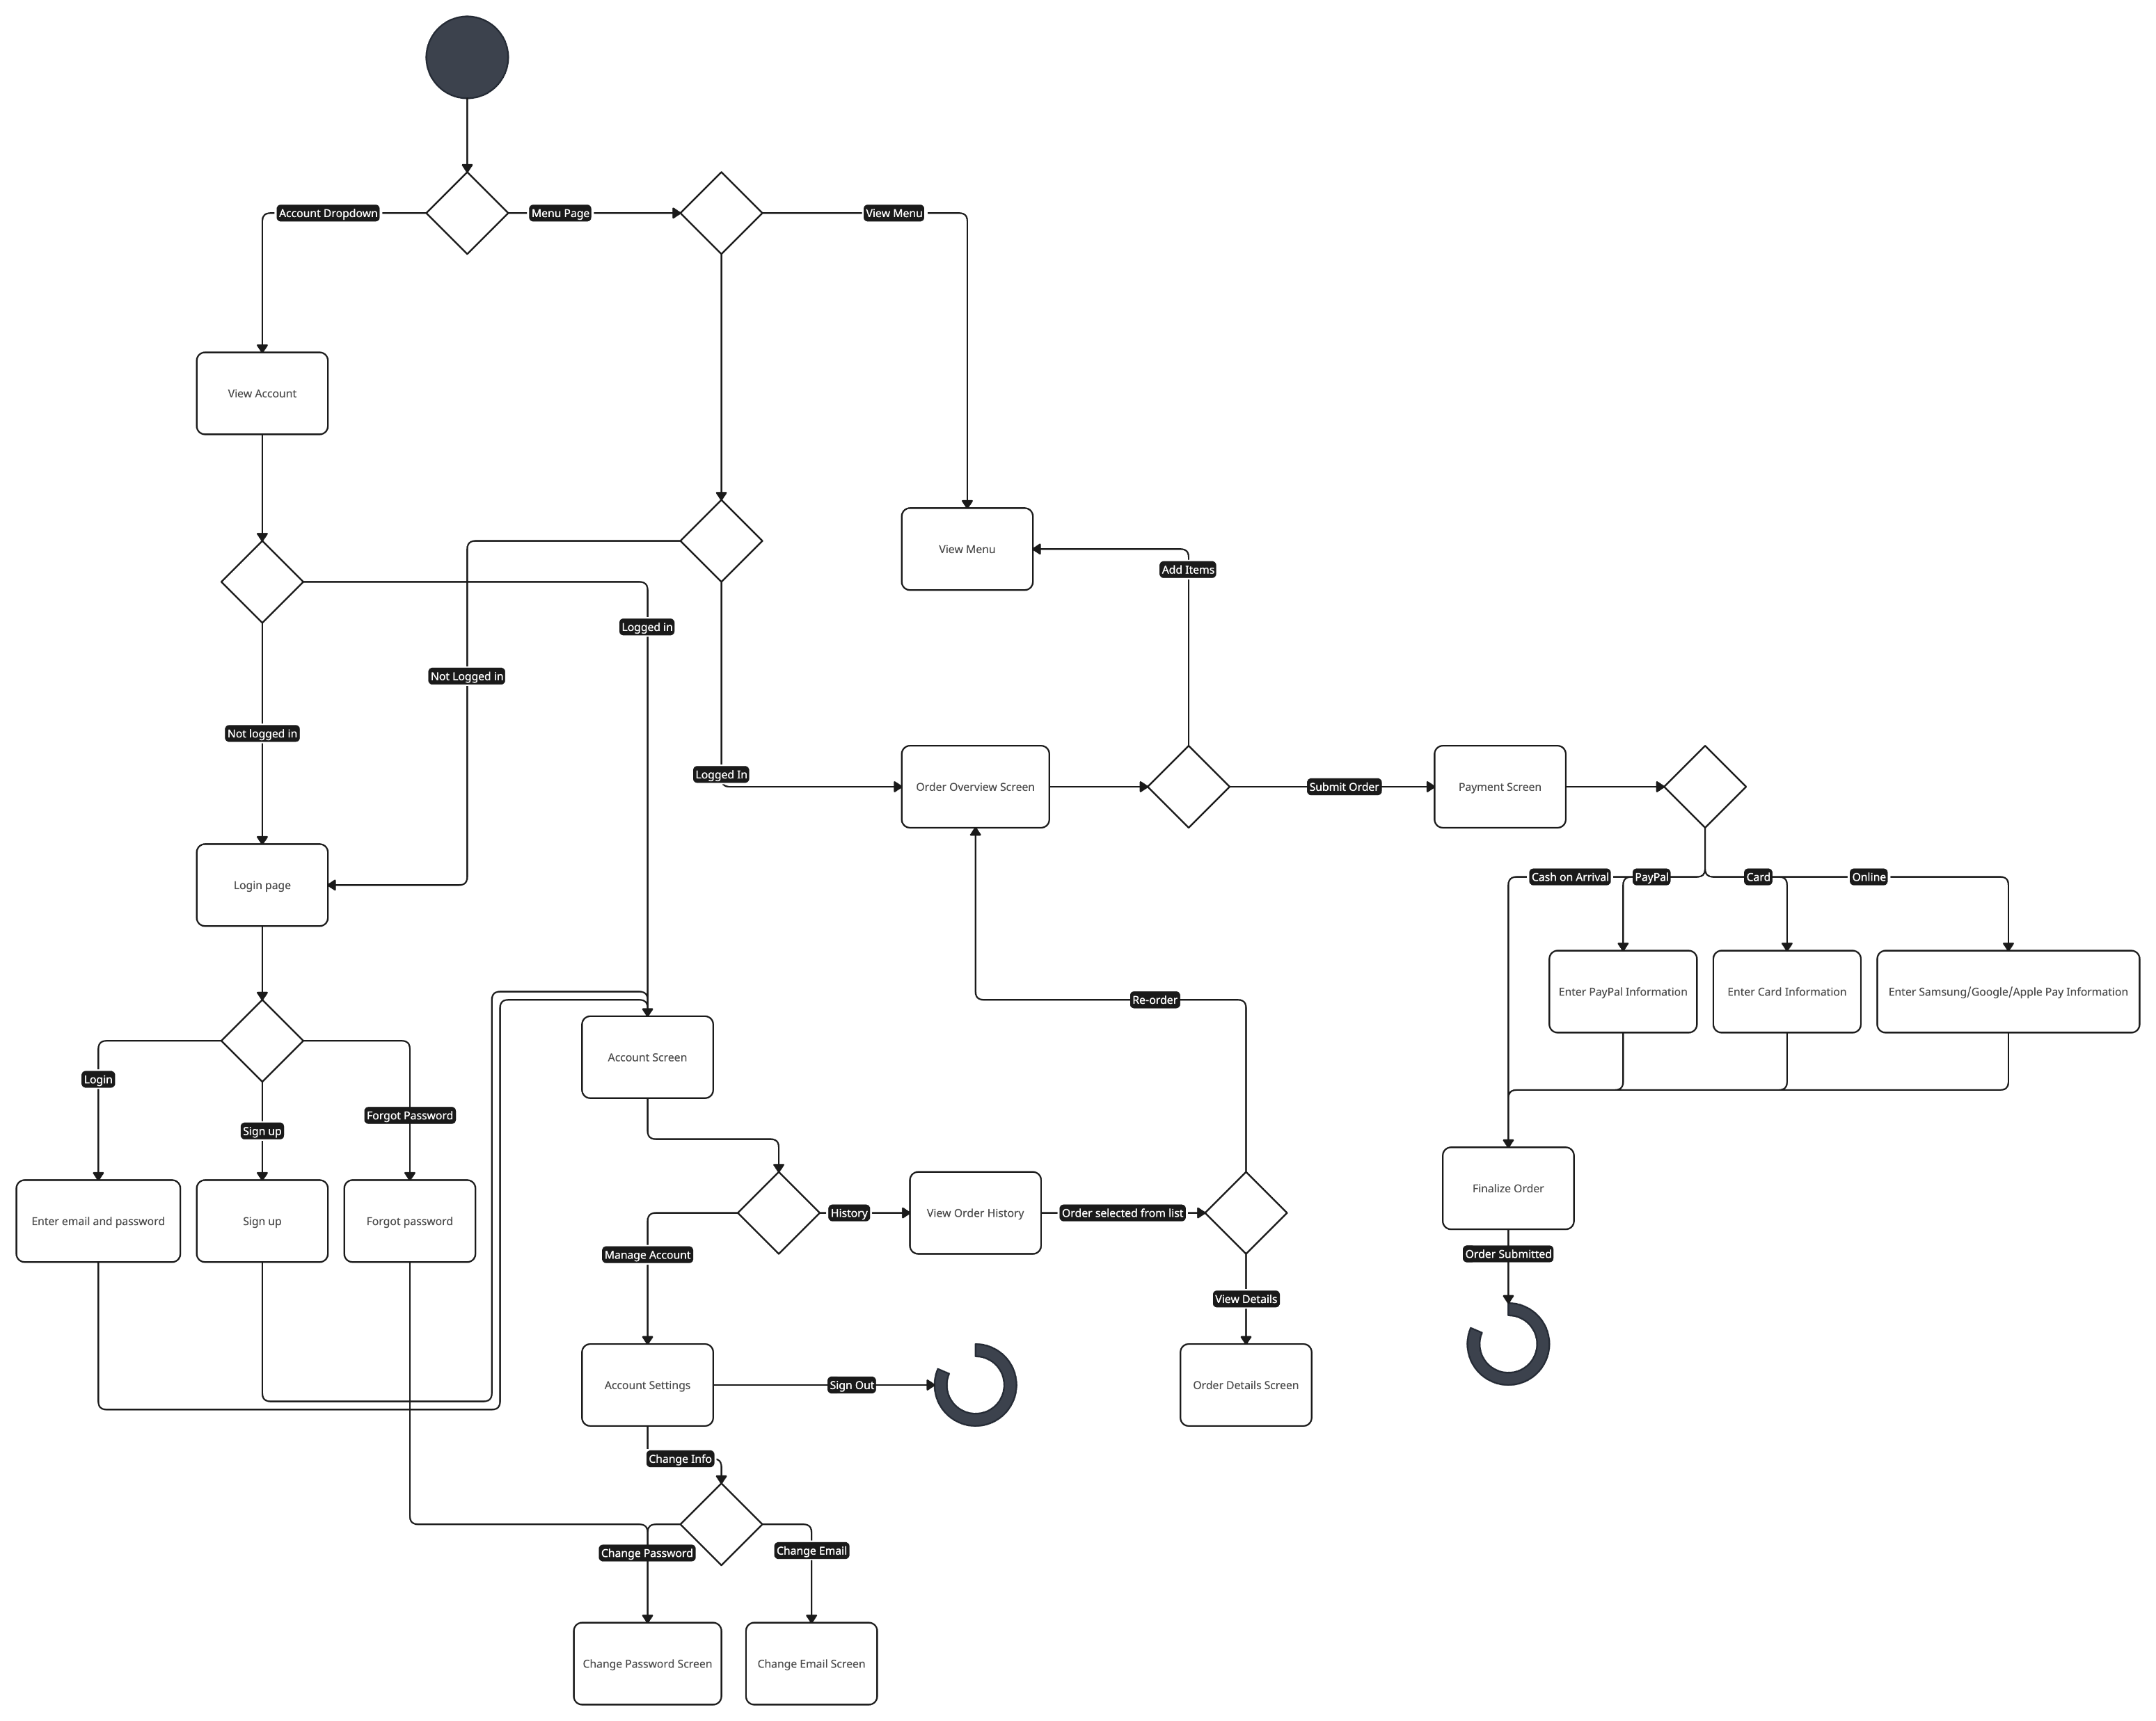
Diagrams yeah

Slide 3
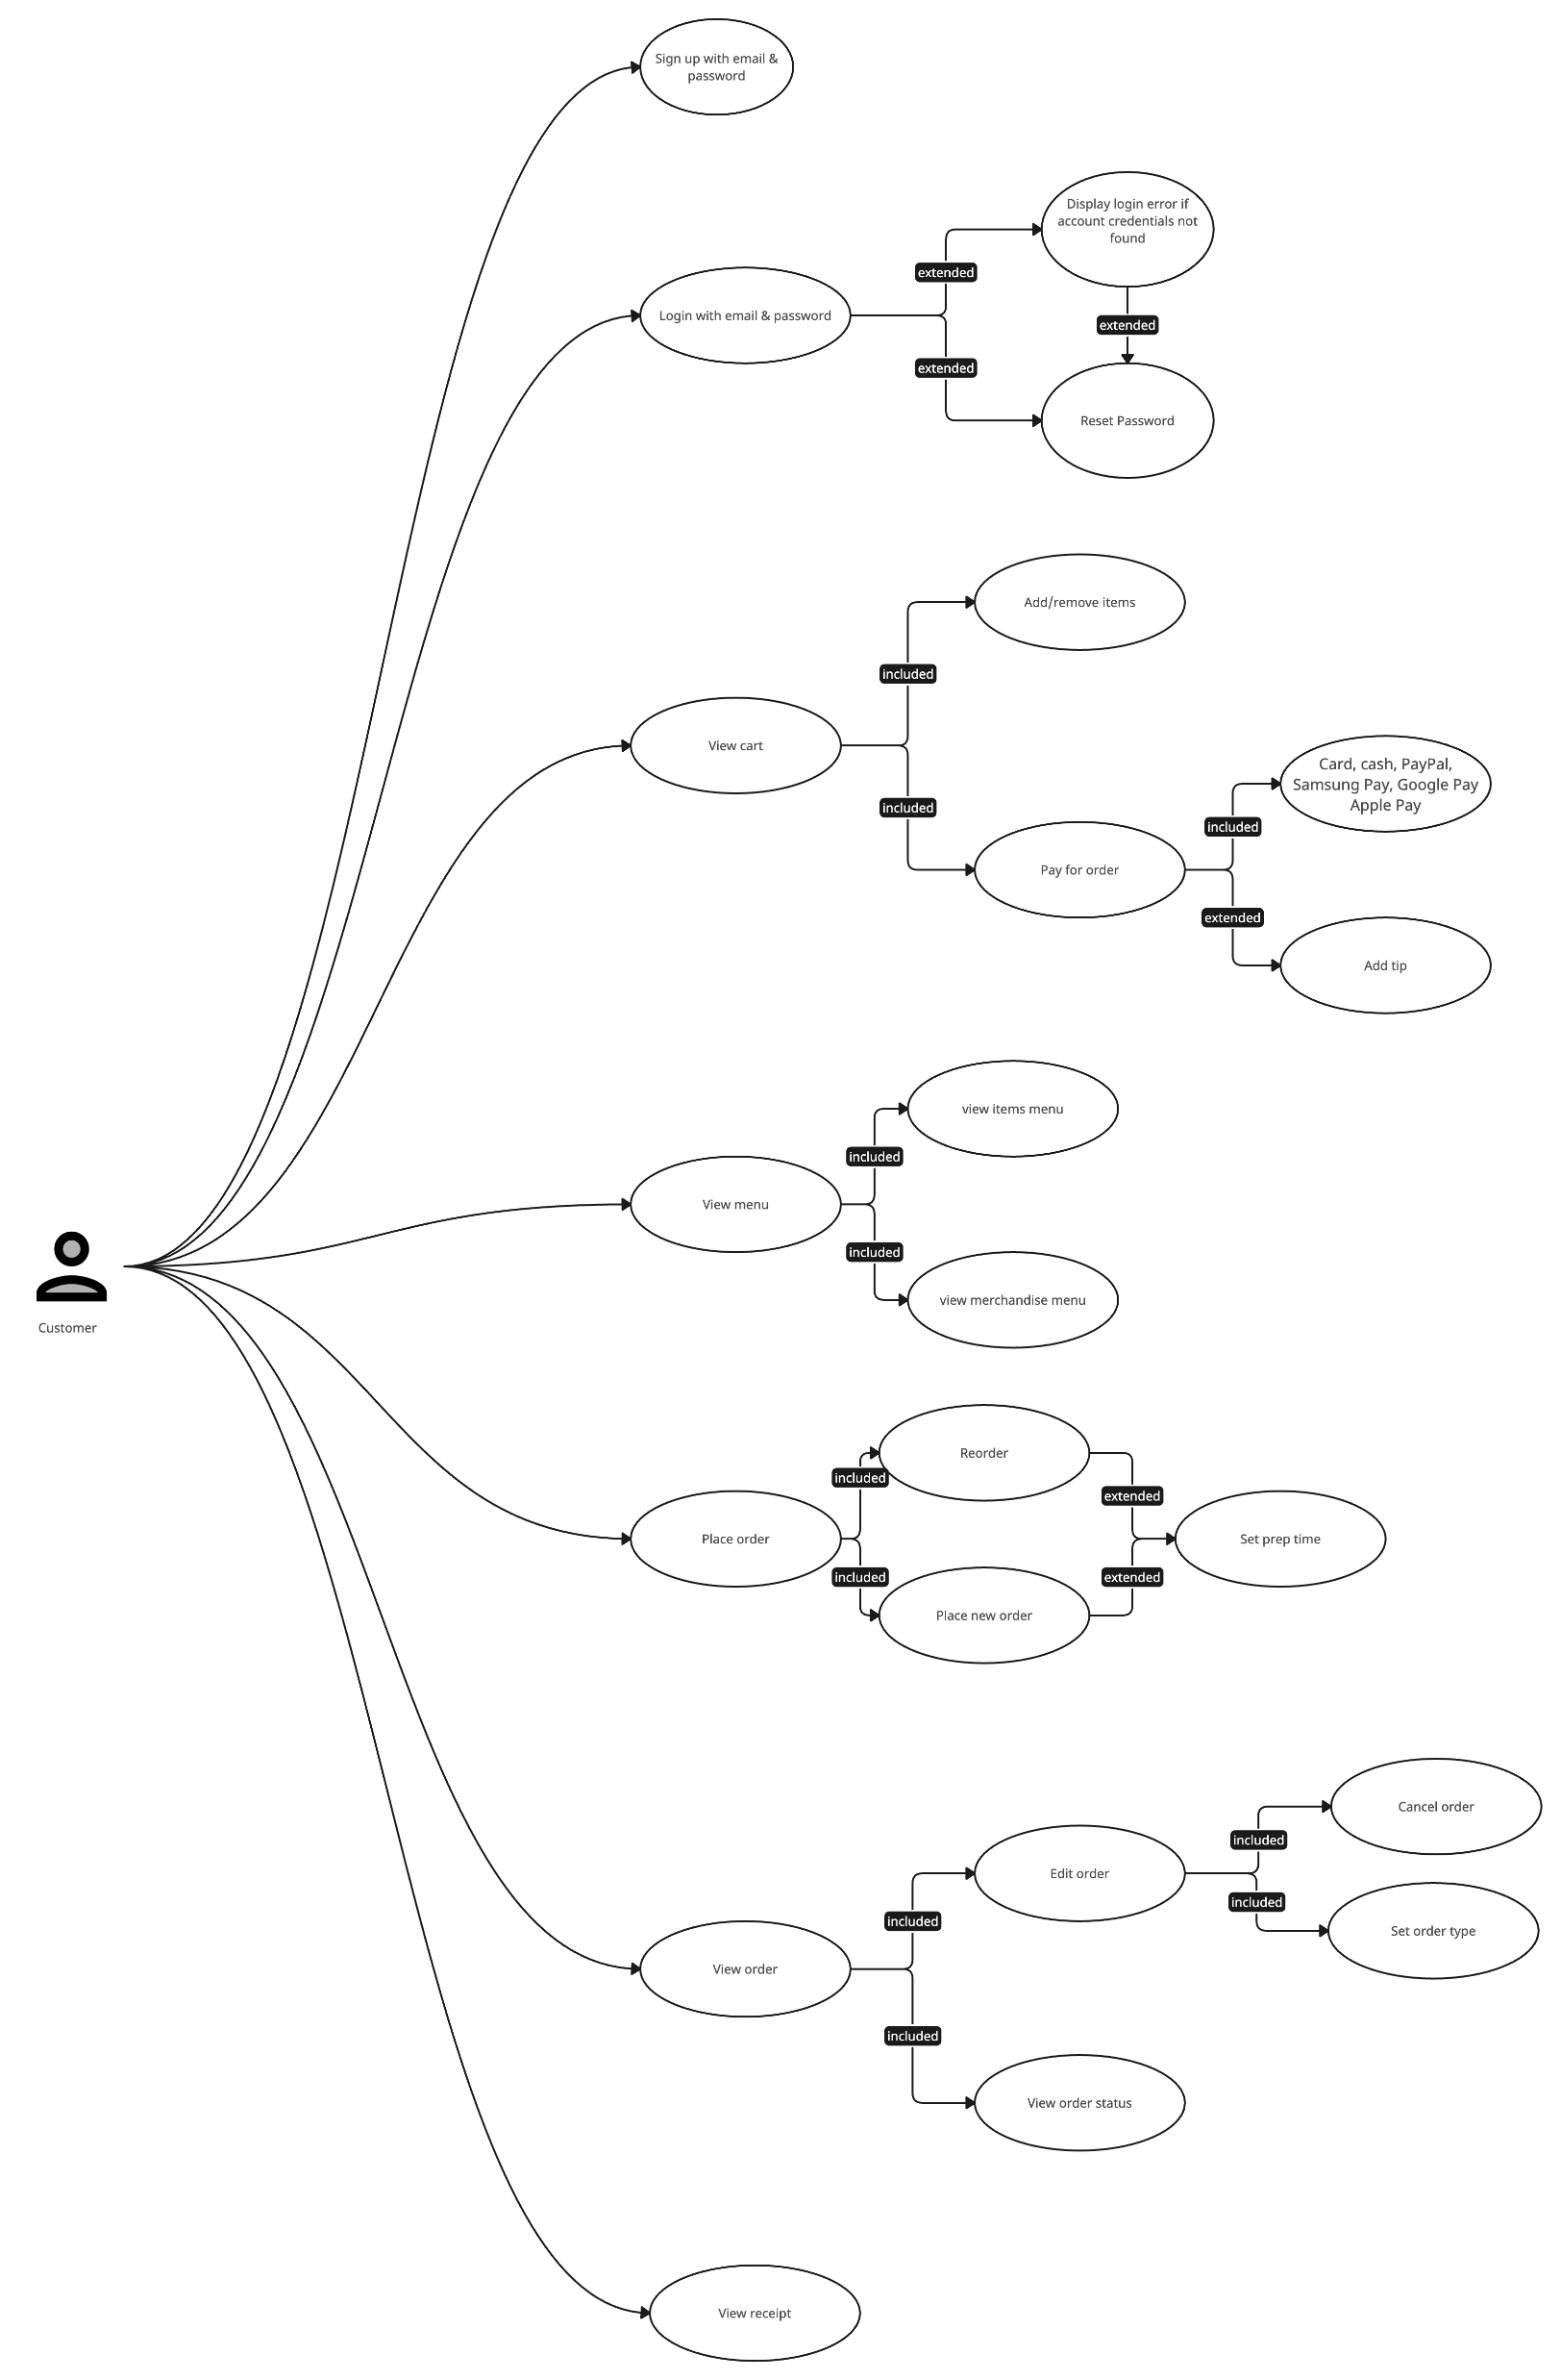
Diagrams yeah (cont.)

Slide 4
Hi
https://1054009.github.io/CSET-120-FinalProject/

