Slide 1

周报
2019.04.15
李冰川

Slide 2
本周总结：
1.代码实现给分割后的模型制作uvmap
2.给人脸重建精度评估程序添加界面，对比CNN建模和VAE建模。

Slide 3
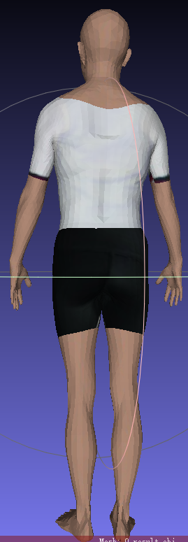
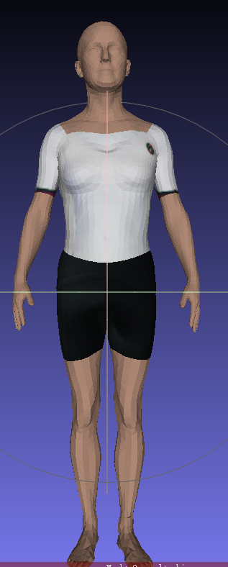
一.给分割后的模型制作uvmap

Slide 4
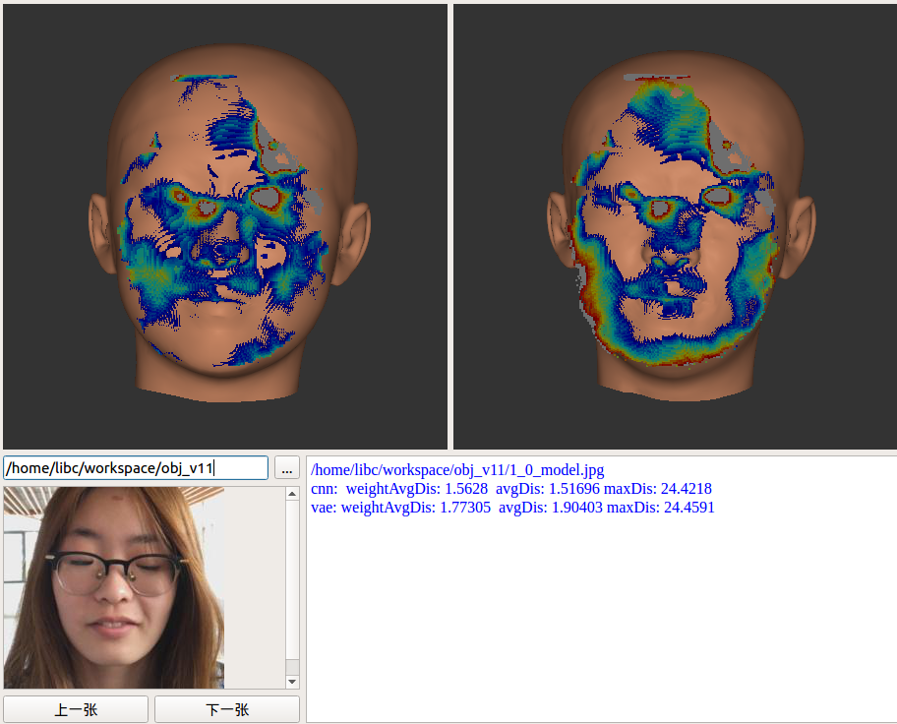
二.CNN建模和VAE建模对比
cnn: weightAvgDis: 1.5628 avgDis: 1.51696 maxDis: 24.4218
vae: weightAvgDis: 1.77305 avgDis: 1.90403 maxDis: 24.4591

Slide 5
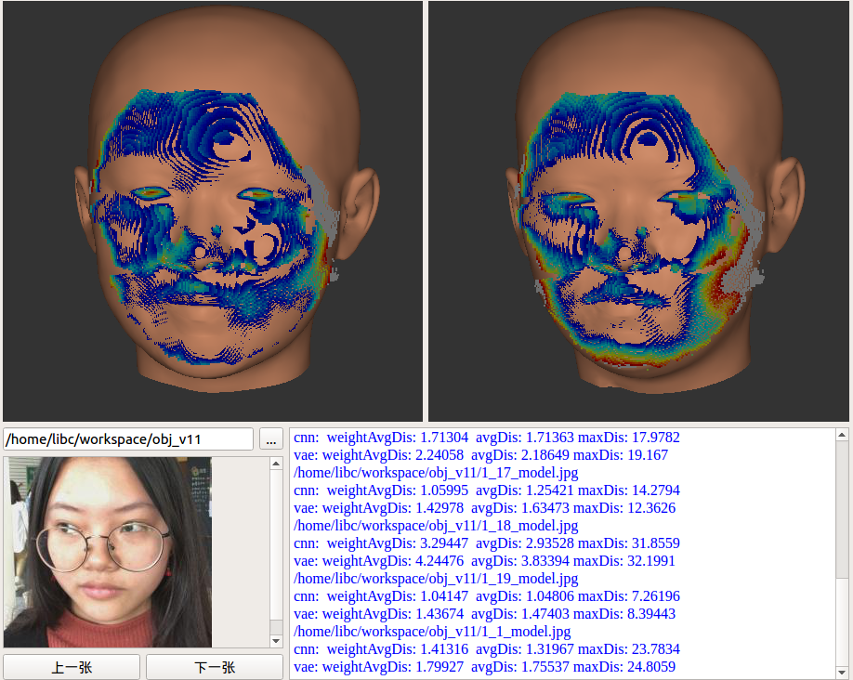
cnn: weightAvgDis: 1.41316 avgDis: 1.31967 maxDis: 23.7834
vae: weightAvgDis: 1.79927 avgDis: 1.75537 maxDis: 24.8059

Slide 6
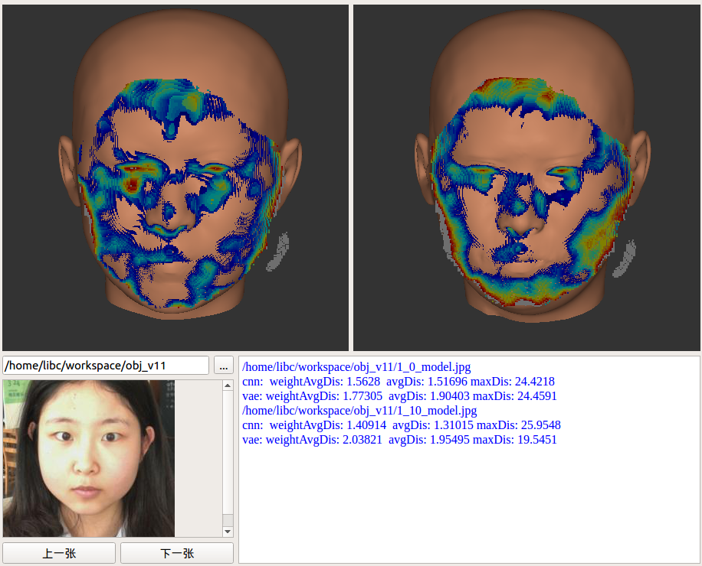
cnn: weightAvgDis: 1.40914 avgDis: 1.31015 maxDis: 25.9548
vae: weightAvgDis: 2.03821 avgDis: 1.95495 maxDis: 19.5451

Slide 7
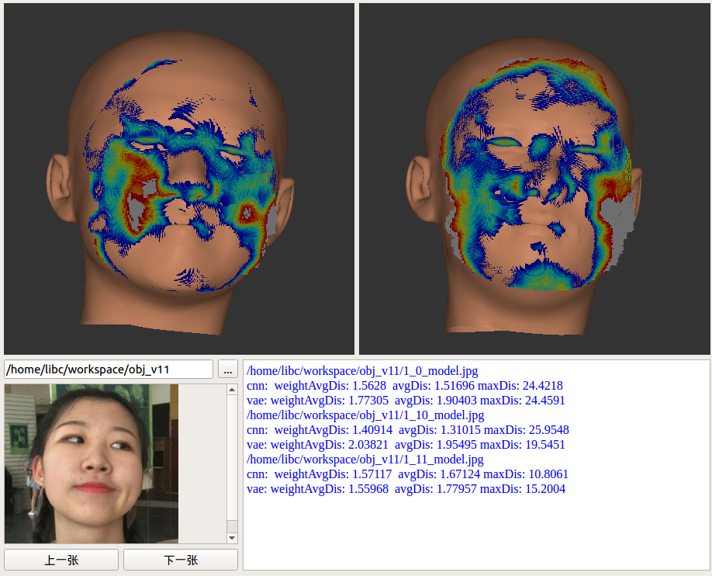
cnn: weightAvgDis: 1.57117 avgDis: 1.67124 maxDis: 10.8061
vae: weightAvgDis: 1.55968 avgDis: 1.77957 maxDis: 15.2004

Slide 8
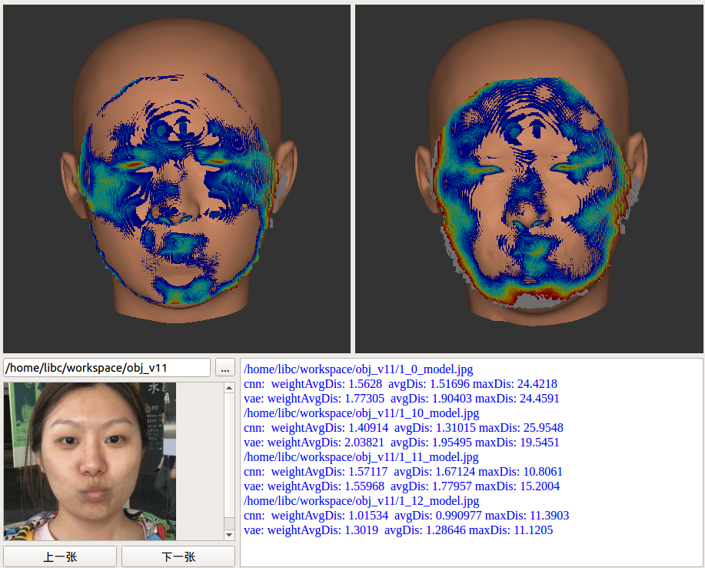
cnn: weightAvgDis: 1.01534 avgDis: 0.990977 maxDis: 11.3903
vae: weightAvgDis: 1.3019 avgDis: 1.28646 maxDis: 11.1205

Slide 9
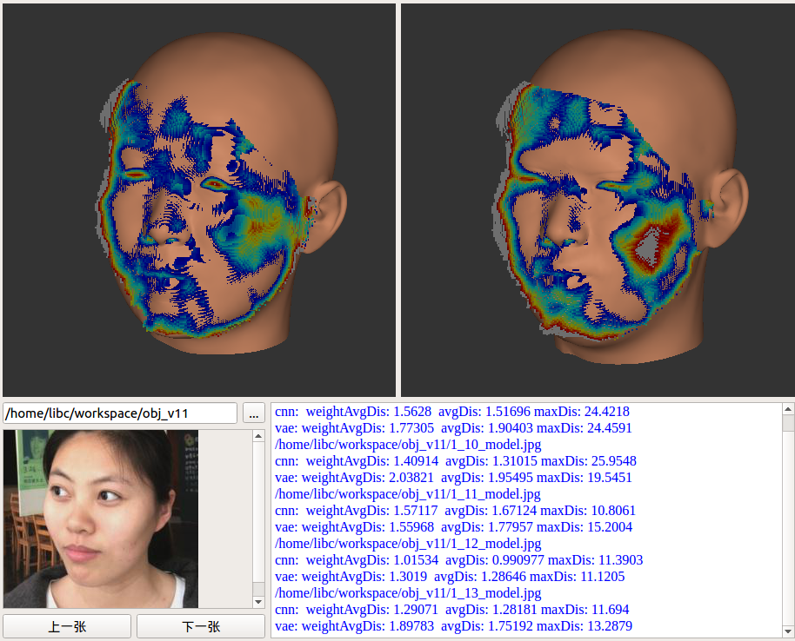
cnn: weightAvgDis: 1.29071 avgDis: 1.28181 maxDis: 11.694
vae: weightAvgDis: 1.89783 avgDis: 1.75192 maxDis: 13.2879

Slide 10
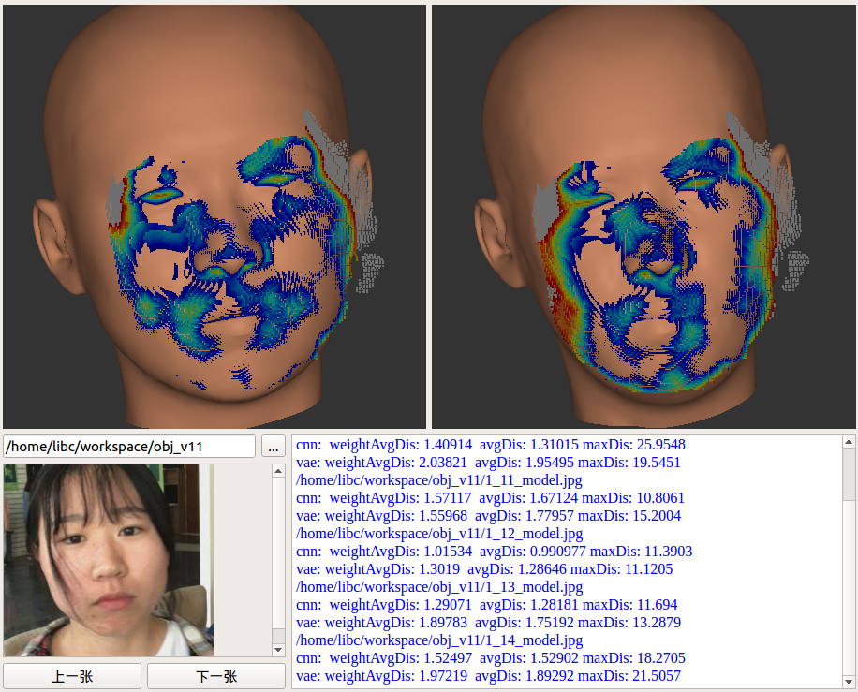
cnn: weightAvgDis: 1.52497 avgDis: 1.52902 maxDis: 18.2705
vae: weightAvgDis: 1.97219 avgDis: 1.89292 maxDis: 21.5057

Slide 11
cnn: weightAvgDis: 1.52497 avgDis: 1.52902 maxDis: 18.2705
vae: weightAvgDis: 1.97219 avgDis: 1.89292 maxDis: 21.5057

Slide 12
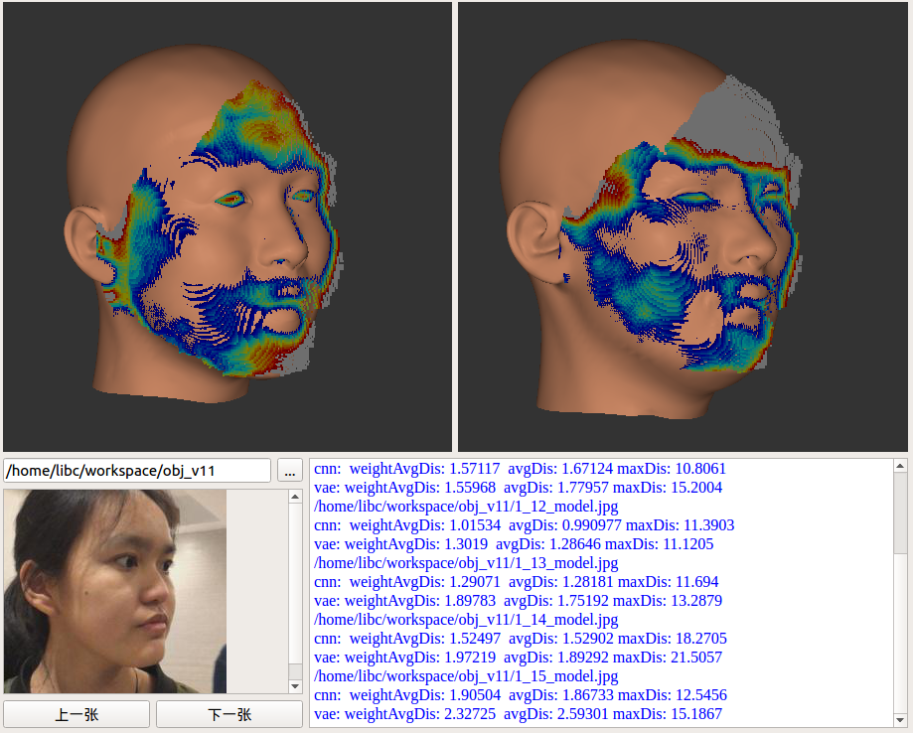
cnn: weightAvgDis: 1.90504 avgDis: 1.86733 maxDis: 12.5456
vae: weightAvgDis: 2.32725 avgDis: 2.59301 maxDis: 15.1867

Slide 13
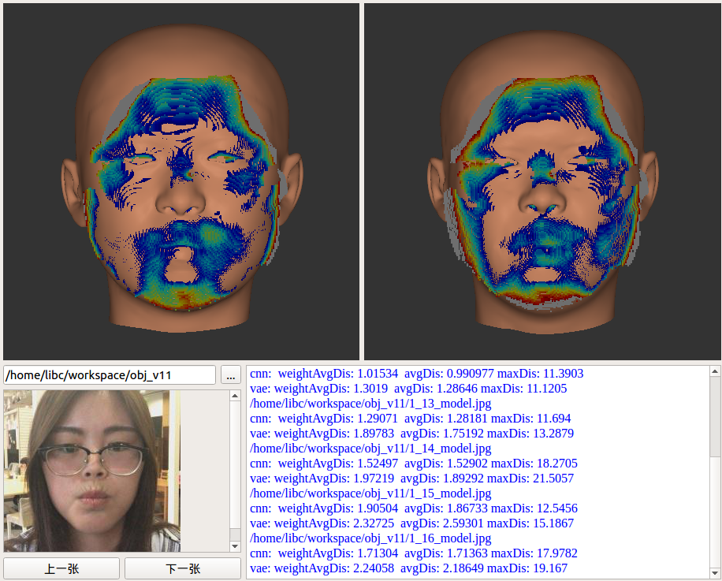
cnn: weightAvgDis: 1.71304 avgDis: 1.71363 maxDis: 17.9782
vae: weightAvgDis: 2.24058 avgDis: 2.18649 maxDis: 19.167

Slide 14
cnn: weightAvgDis: 1.05995 avgDis: 1.25421 maxDis: 14.2794
vae: weightAvgDis: 1.42978 avgDis: 1.63473 maxDis: 12.3626

Slide 15
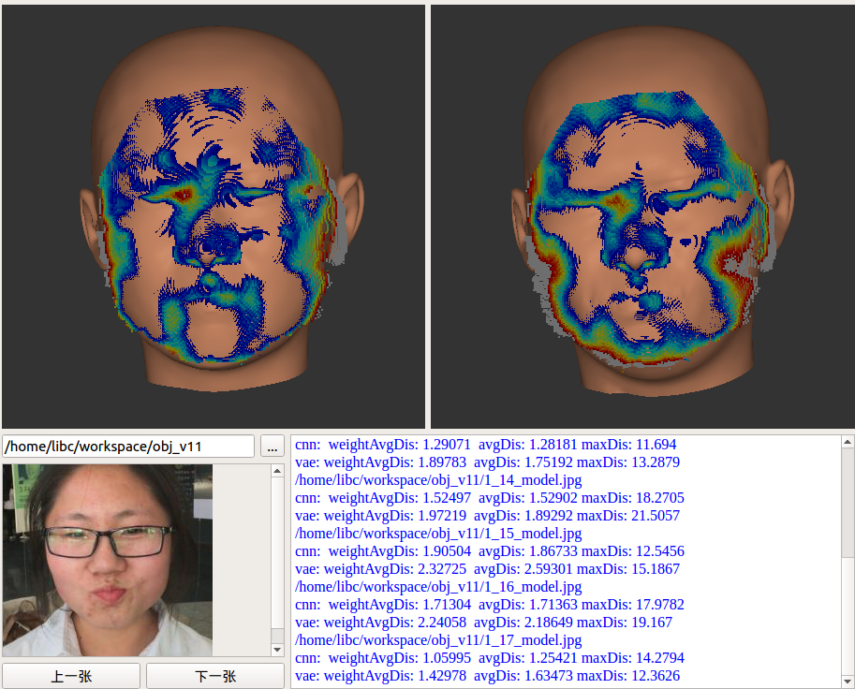
cnn: weightAvgDis: 1.05995 avgDis: 1.25421 maxDis: 14.2794
vae: weightAvgDis: 1.42978 avgDis: 1.63473 maxDis: 12.3626

Slide 16
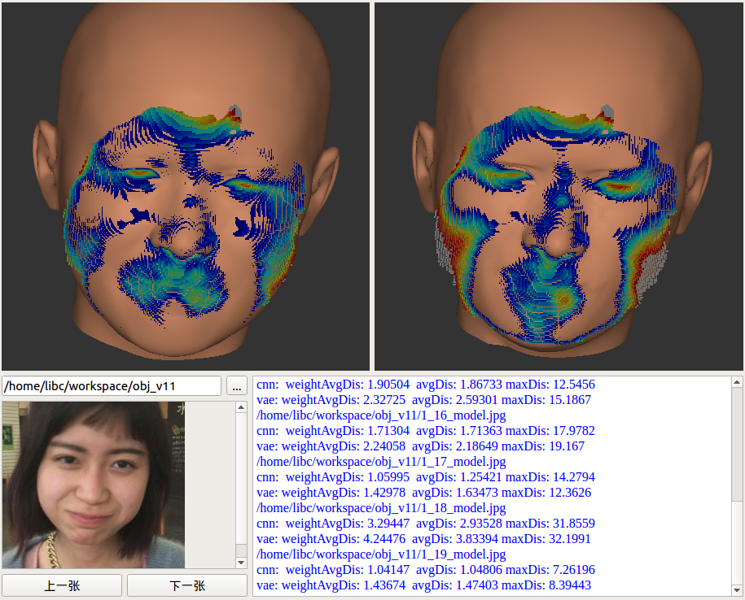
cnn: weightAvgDis: 1.04147 avgDis: 1.04806 maxDis: 7.26196
vae: weightAvgDis: 1.43674 avgDis: 1.47403 maxDis: 8.39443

Slide 17
thanks！

