Slide 1





Your Bot Framework Bot
Bot Builder
Developer Portal
Bot Directory
Tools and services to build great bots that converse wherever your users are.
Connect your bots to text/sms, Skype, Slack, Facebook Messenger, Office 365 mail and other channels.
Try, use, and add published bots to the world’s top conversation experiences.
Open source SDK on Github for Node.js, .NET and REST
From simple built-in prompts and command dialogs to simple to use yet sophisticated ‘FormFlow’ dialogs
Support for rich attachments (image, card, video, doc, etc.); support for calling (Skype)
Online/offline chat Emulator
Add bot smarts with Cognitive Services for language understanding and more
Register, connect, publish and manage your bot through your bot’s dashboard
Automatic card normalization across channels
Skype channel auto-configured
Embeddable Web chat control
Host your bot in your app via the Direct Line API
Fast, scalable message routing
Diagnostic tools
Public directory of bots registered and published with Microsoft Bot Framework
Users can try your bot from the directory via the Web chat control
Users can discover and add your bot to the channels on which it is configured when the Directory is made public to end users
Notes:
To use this to make images for Bot Framework docs, simply reshoot your screenshot, paste in and size as you see fit, place an outline around the sceenshot (light grey option 3) and ¼ wt line width, then screenshot the whole powerpoint page and save with the proper name in the proper folder.
This page is for ![REVISE IMAGE Bot Directory (coming soon)](/en-us/images/faq-overview/botframework_overview_july.png)

Slide 2
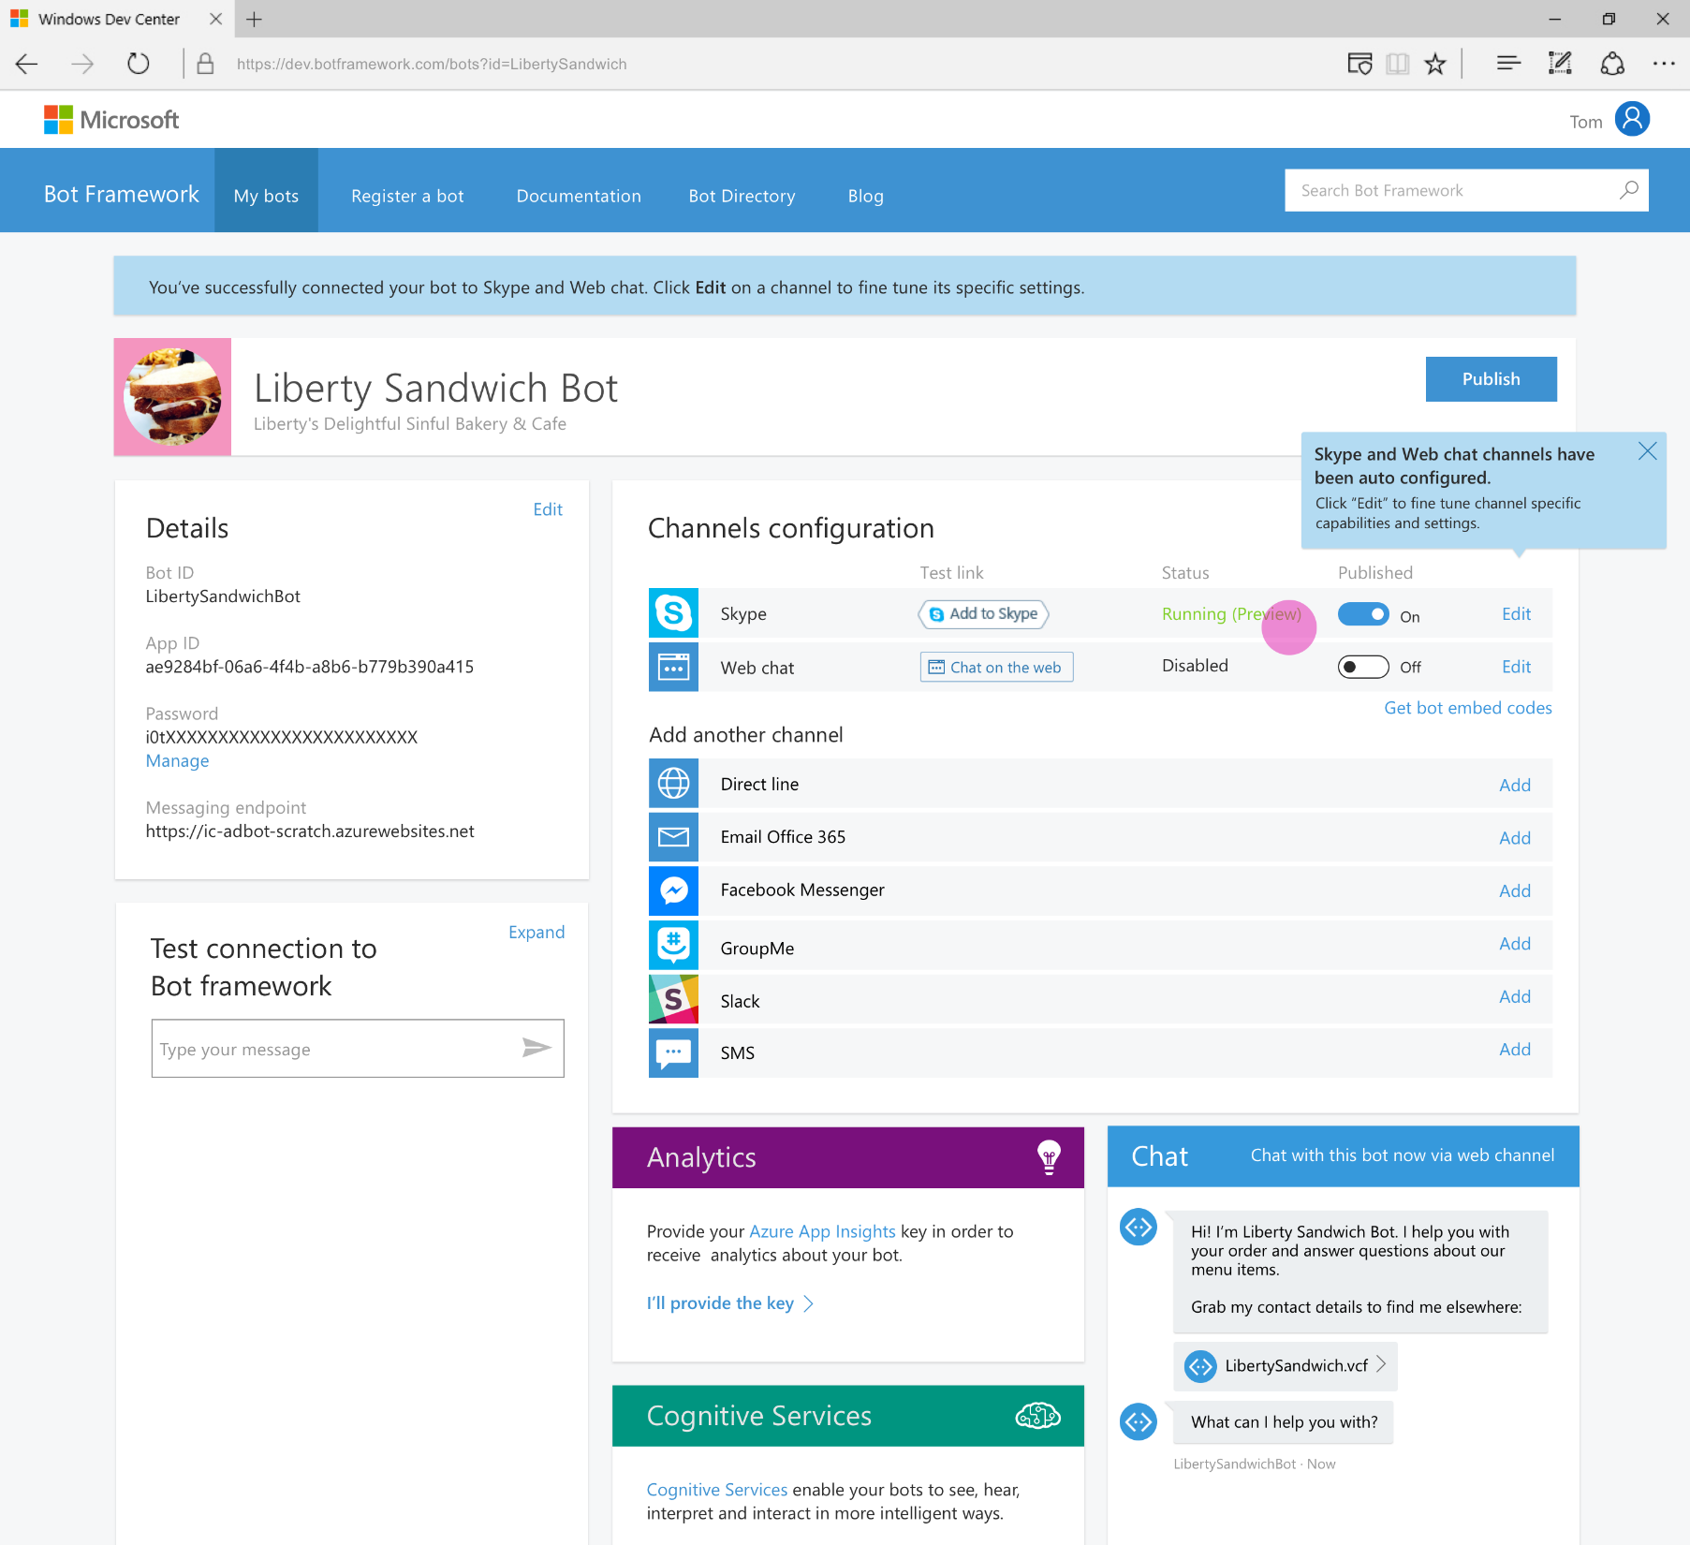
Developer Portal
Register your bot
Connect to channels
Test
Publish
Manage
Measure
Notes:
To use this to make images for Bot Framework docs, simply reshoot your screenshot, paste in and size as you see fit, place an outline around the sceenshot (light grey option 3) and ¼ wt line width, then screenshot the whole powerpoint page and save with the proper name in the proper folder.
This page is for ![REVISE IMAGE Bot Directory (coming soon)](/en-us/images/faq-overview/developer_portal_july.png)

Slide 3
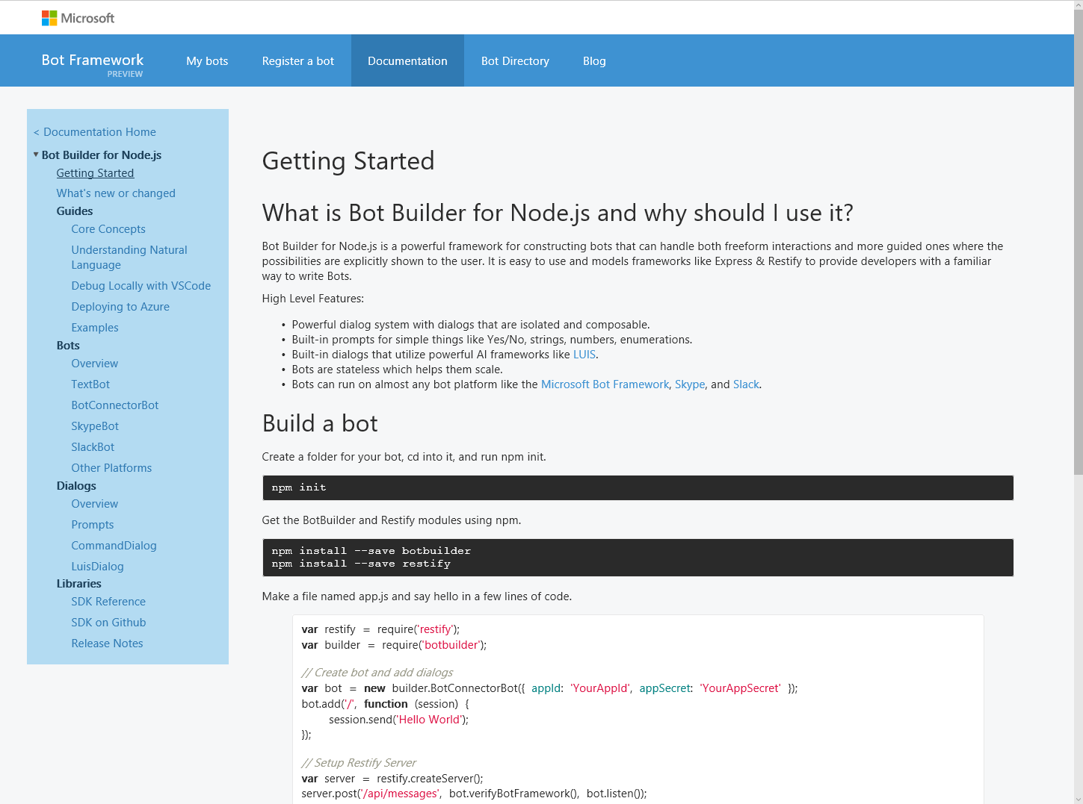
Bot Builder SDK
Node.js, .NET and REST
Dialogs to model conversation
Dialogs are reusable
Types of Dialogs include:
Built-in prompts
Yes/No, String, Number, Choices
FormFlow and form slot filling (branching, disambiguation, multi-turn)
Conversations are scalable to multiple machines
Rich interactions
Support for rich attachments (image, card, video, doc, etc.); support for calling (Skype)
Service extensions for language understanding (LUIS) and translation
Online/offline Chat Emulator
Notes:
To use this to make images for Bot Framework docs, simply reshoot your screenshot, paste in and size as you see fit, place an outline around the sceenshot (light grey option 3) and ¼ wt line width, then screenshot the whole powerpoint page and save with the proper name in the proper folder.
This page is for ![REVISE IMAGE Bot Directory (coming soon)](/en-us/images/faq-overview/bot_builder_sdk_july.png)

Slide 4
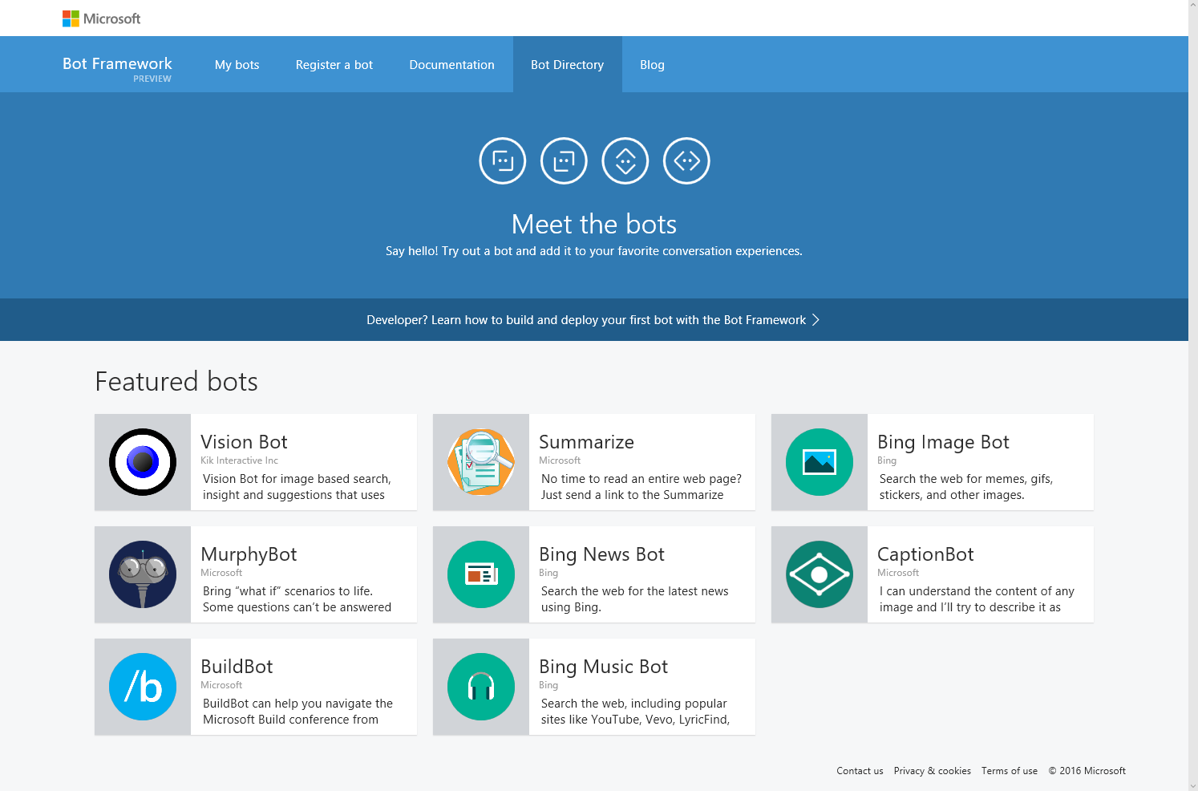
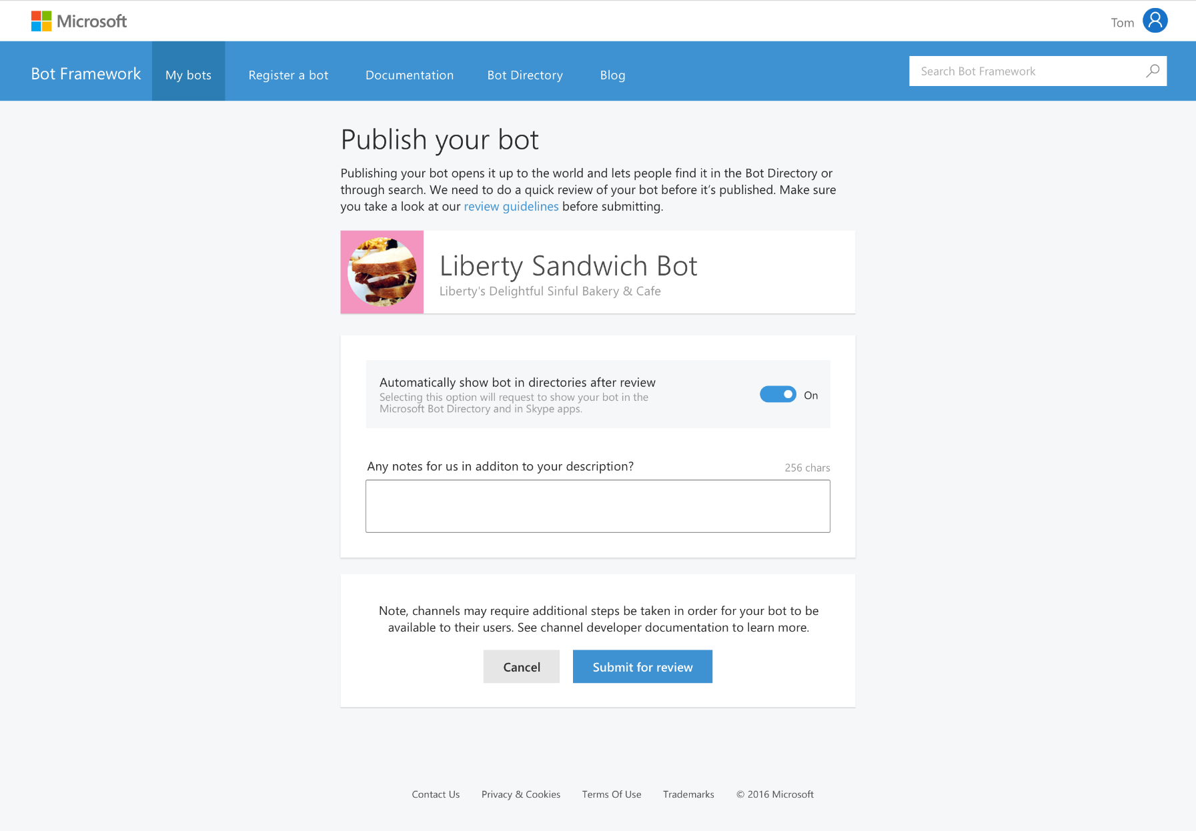
Bot Directory
Public Directory of Bot Framework Bots
Users can discover, try, and add bots to the conversation experiences on which the bot is configured (no app required)
Bots are public at developer discretion; bots must be submitted for review in order to appear in the directory
Searchable

