Slide 1
RPC Implementation

Slide 2
Overview
Objective
Introduction
Architecture
Technology Used
Let’s RUN
Future Work
References

Slide 3
Introduction
A remote procedure call is an interprocess communication technique that is used for client-server based applications.
A client has a request message that the RPC translates and sends to the server.
When the server receives the request, it sends the required response back to the client.
The client is blocked while the server is processing the call and only resumed execution after the server is finished.

Slide 4
Objective
RPC provides location and access transparency and removes the need for the programmer to manually implement the communication aspects.
It ensures basic properties of distributed systems including transparency, security, availability, scalability, and fault tolerance.
Our objective is to implement the RPC client-server model through which the above-mentioned properties can be achieved for efficient communication between client and server.
In our model various services provided by the server can be accessed by the client via the RPC mechanism.

Slide 5
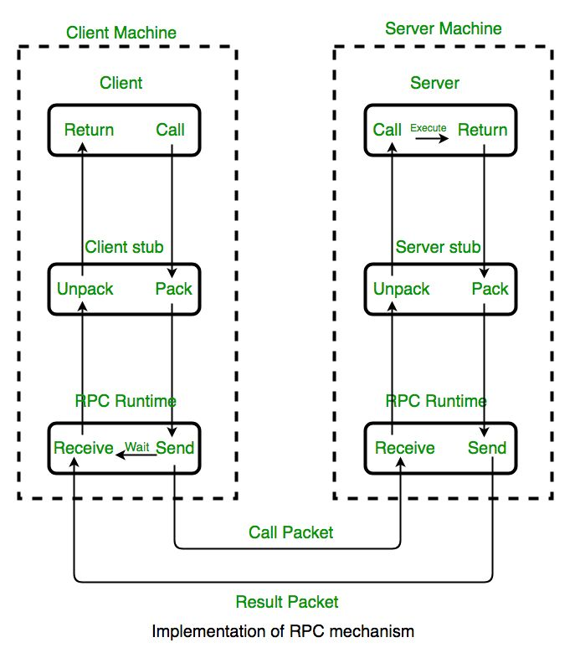
RPC Mechanism

Slide 6
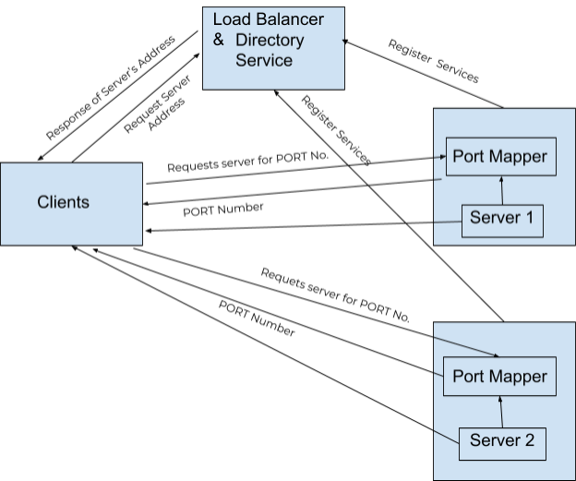
Architecture

Slide 7




Technology Used

Slide 8


Slide 9
Future Work
Many error detecting and correcting coding technique can be implemented on this system so that client on receiving the result of the service from server, can detect and correct the error or again request for the same service.
Similarly server can also detect the error if any from the client side and server can again ask for the corrected argument/parameters required for that service again.

Slide 10
References
https://users.cs.cf.ac.uk/Dave.Marshall/C/node33.html
https://www.sciencedirect.com/topics/computer-science/remote-procedure-call
https://blog.miguelgrinberg.com/post/the-flask-mega-tutorial-part-i-hello-world
https://www.geeksforgeeks.org/remote-procedure-call-rpc-in-operating-system/
https://www.tutorialsteacher.com/nodejs/nodejs-tutorials
https://docs.mongodb.com/manual/tutorial/

Slide 11
Thank you!
Presented By
ADESH SHUKLA - IEC2017088
SHIVANSH SRIVASTAVA - IEC2017054
ABDUL AHAD - IEC2017023
ANKIT GANGWAR - IEC2017504

