Slide 1
Visual studio code
Using a modern code editor to improve workflow for creating web applications

Slide 2
What is Visual Studio Code?
Visual Studio Code is a source code editor developed by Microsoft for Windows, Linux and macOS.
It is one of many popular options for editing code. Other popular options include Sublime text and Atom. Try each and pick your favourite.
For learning to code it is not necessary to have an editor. You can use an online integrated development environments like repl.it or Cloud 9 which allow you to work in the cloud on a project from any computer with an internet connection.
How you code isn't important. Use whatever editor suits your needs. Just do it regularly to improve your skills.

Slide 3
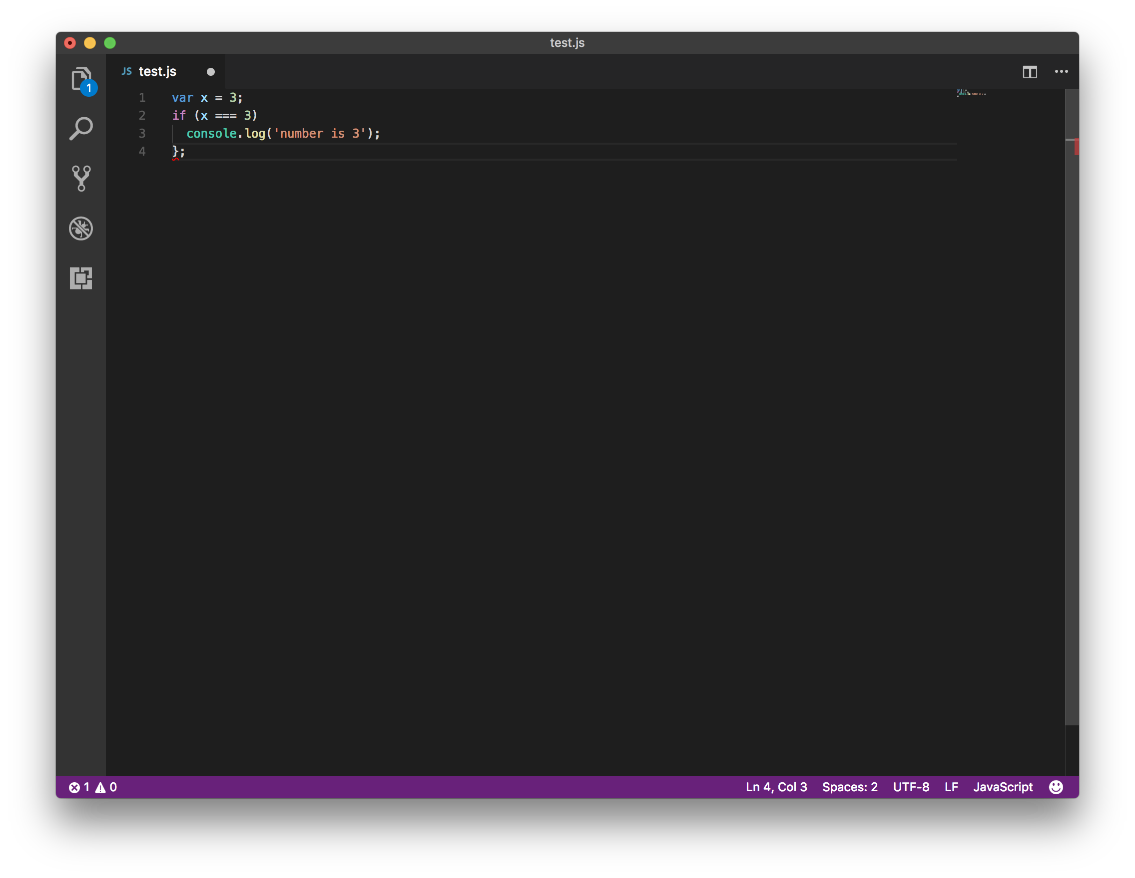
Highlights syntax errors
This IF statement has no opening curly bracket. The closing curly bracket has a red squiggle underneath to highlight it is missing an opening curly bracket.

Slide 4
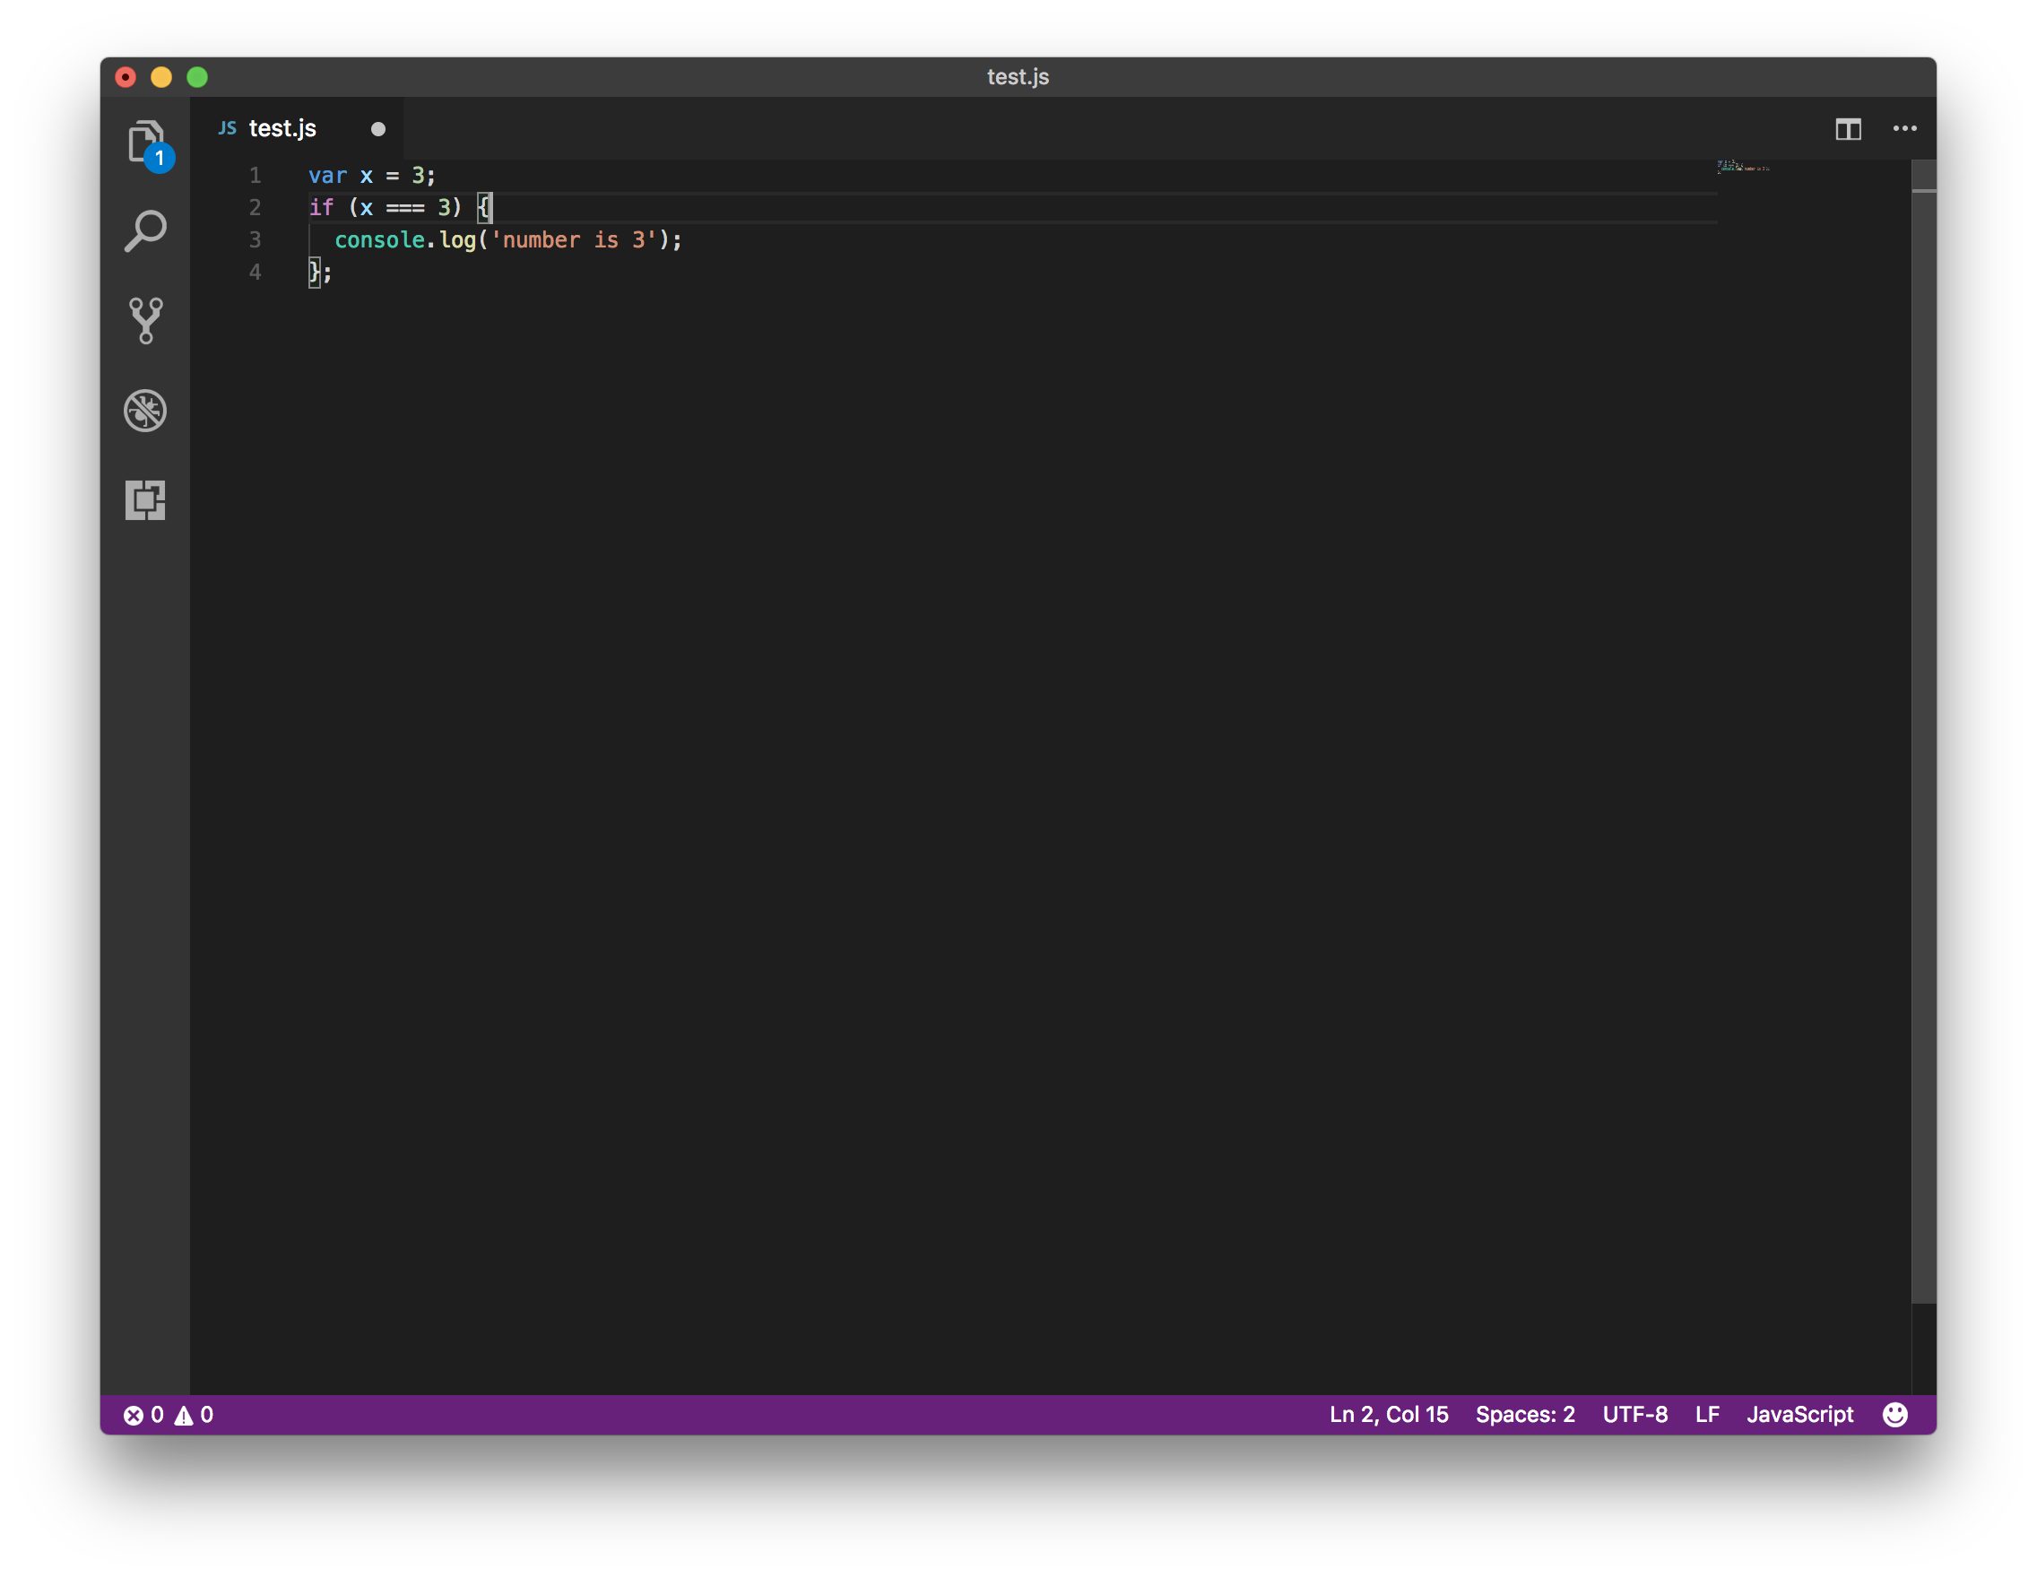
Colour coding of JavaScript
Visual Studio Code colour codes strings, integers, logic and methods differently. It makes easier to spot simple errors that can be difficult to debug when learning to code.

Slide 5
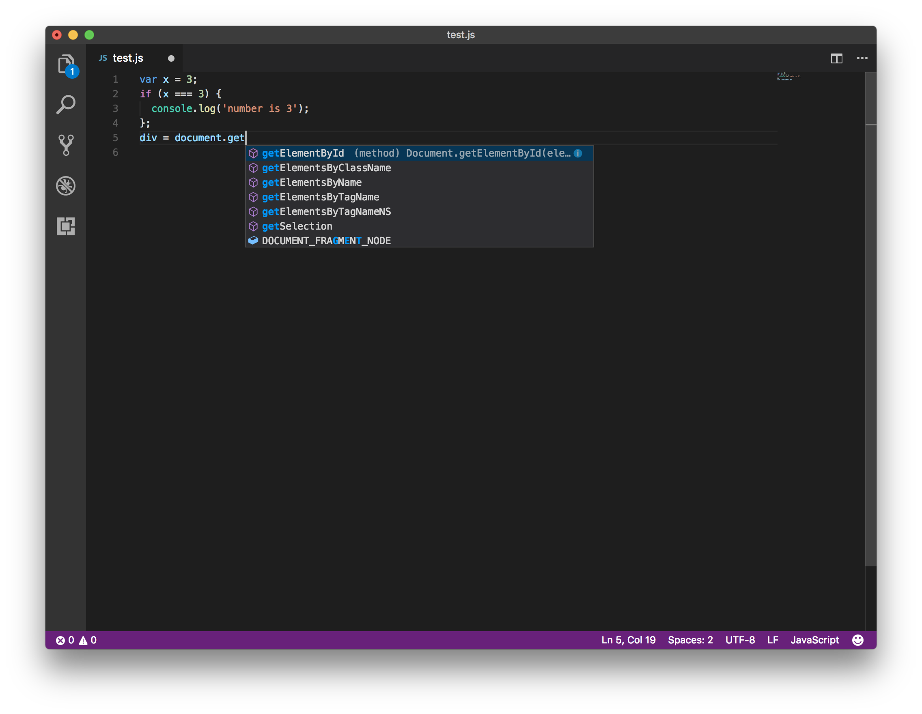
Autocomplete method names
Visual Studio Code includes common methods in JavaScript to allow us to autocomplete them without typing the full name. This is really helpful when learning JavaScript's camelcase convention. 'getElementbyId' as shown here will work but if we make a mistake but using 'getElementByID' the code will not work as expected.

