Slide 1
Visual studio code
Using a modern code editor to improve workflow for creating web applications

Slide 2
What is Visual Studio Code?
Visual Studio Code is a source code editor developed by Microsoft for Windows, Linux and macOS.
It is one of many popular options for editing code. Other popular options include Sublime text and Atom. Try each and pick your favourite.
For learning to code it is not necessary to have an editor. You can use an online integrated development environments like repl.it or Cloud 9 which allow you to work in the cloud on a project from any computer with an internet connection.
How you code isn't important. Use whatever editor suits your needs. Just do it regularly to improve your skills.

Slide 3
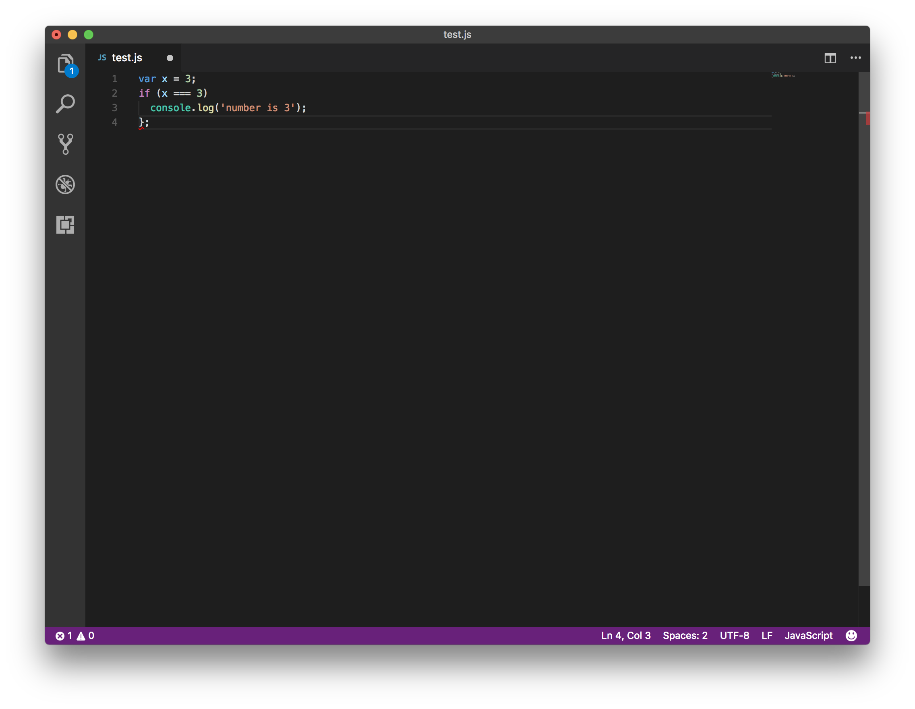
Highlights syntax errors
This IF statement has no opening curly bracket. The closing curly bracket has a red squiggle underneath to highlight it is missing an opening curly bracket.

Slide 4
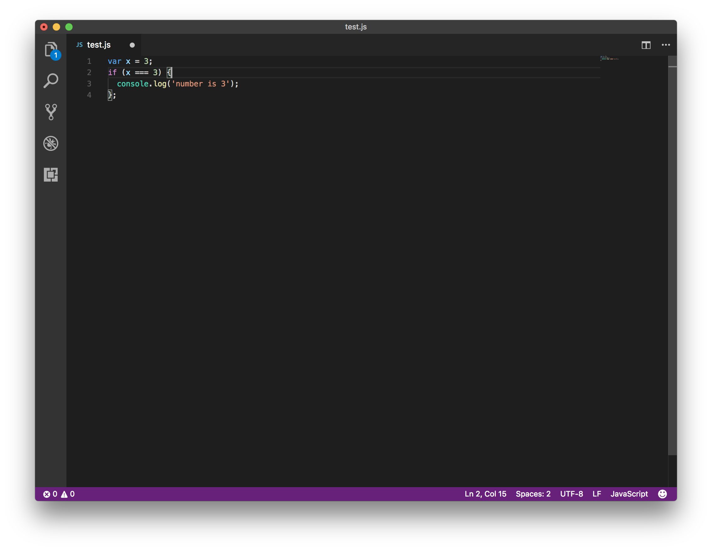
Colour coding of JavaScript
Visual Studio Code colour codes strings, integers, logic and methods differently. It makes easier to spot simple errors that can be difficult to debug when learning to code.

Slide 5
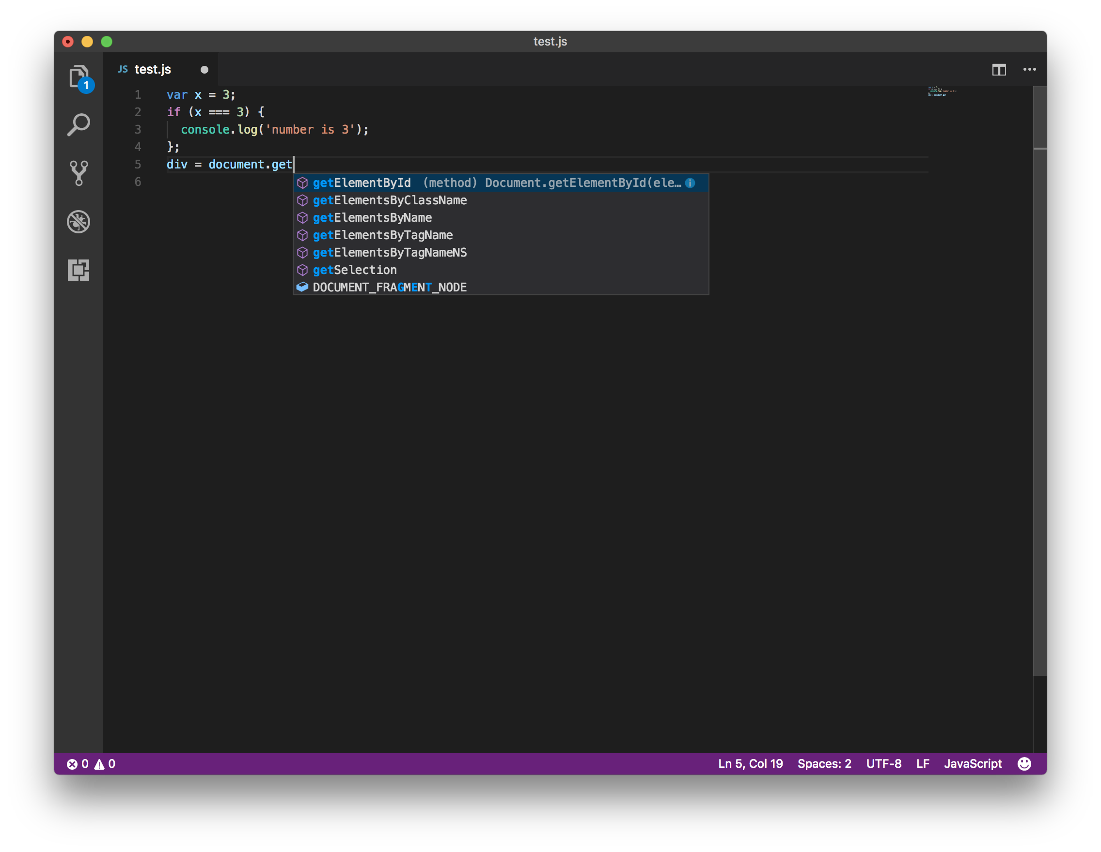
Autocomplete method names
Visual Studio Code includes common methods in JavaScript to allow us to autocomplete them without typing the full name. This is really helpful when learning JavaScript's camelcase convention. 'getElementbyId' as shown here will work but if we make a mistake but using 'getElementByID' the code will not work as expected.

Slide 6
Comment multiple lines
Once we have highlighted multiple lines we can use the '⌘' (command - apple, ctrl - windows) + '/' to comment out multiple lines of code. Useful when we are getting an error message but not sure what part of the code is causing the error.

Slide 7
Move multiple lines
Once we have highlighted multiple lines we can use the '⌥' (option - apple, alt - windows) + ↑ or ↓ arrows to move multiple lines of code. In the example shown we move the function declaration above the line where we call it.

Slide 8
Indent multiple lines
Once we have highlighted multiple lines we can use the '⌘' + ] or [ increase or decrease the indentation of multiple lines of code. This is useful as we refactor our code moving lines of code into its own function.

Slide 9
Multiple cursors
Using the '⌘' + d combination we can select multiple instances of a variable. Each time we press '⌘' + d we highlight the next instance of the variable. Once we start typing the input of the keyboard modifies each selection we have highlighted.

Slide 10
Multiple cursors (part II)
Using the '⌥' + with mouse clicks we can have multiple cursors. Each time we left click we get another cursor so long as we are holding the '⌥' key.

Slide 11
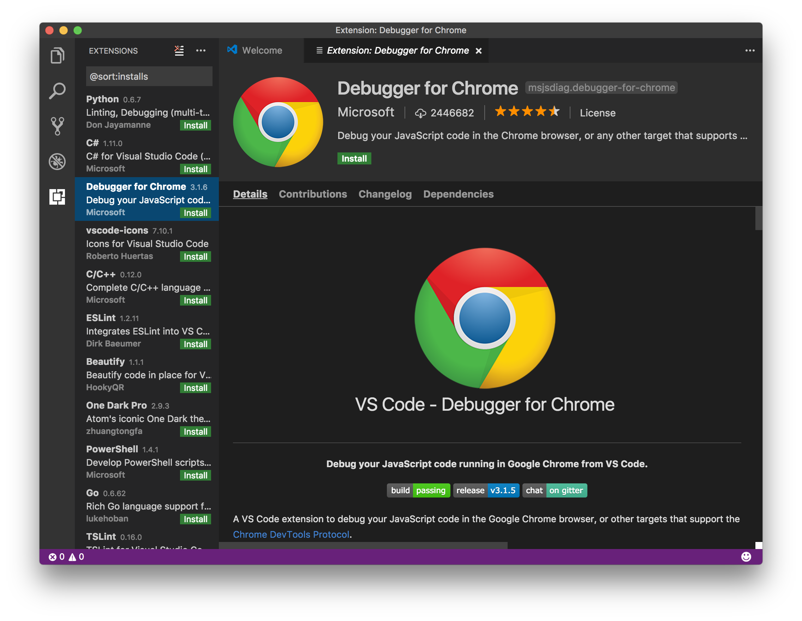
Extensions
Visual Studio Code is open source so anyone can contribute. There are lots of extensions available to help us. We can open the extension sidebar and browse and install any extension we think might help make writing and debugging JavaScript easier.

Slide 12
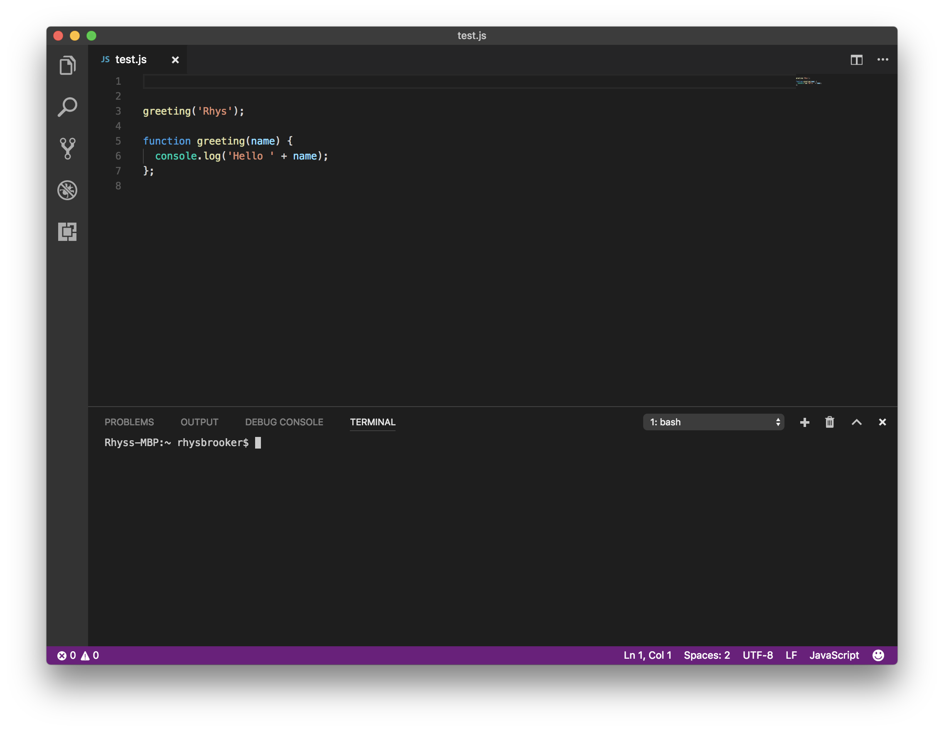
Integrated Terminal
Visual Studio Code includes an integrated terminal so we can use bash commands without having to open another window. This allows us to start and shut down our NodeJS server from the code editor.

Slide 13
Emmet for HTML
Visual Studio Code includes emmet. By using shortcuts outline in the emmet documentation (https://docs.emmet.io/cheat-sheet/) we can write HTML documents much faster. In the animation to the left by typing '!' And pressing tab emmet gives us the basic structure of a HTML5 document.

Slide 14
Markdown preview
Using '⌘' + Shift + V on a markdown file creates a new window with a preview of the file rendered as it would appear on GitHub. This allows us to check the appearance of our readme files for our repositories before we push to GitHub.

Slide 15
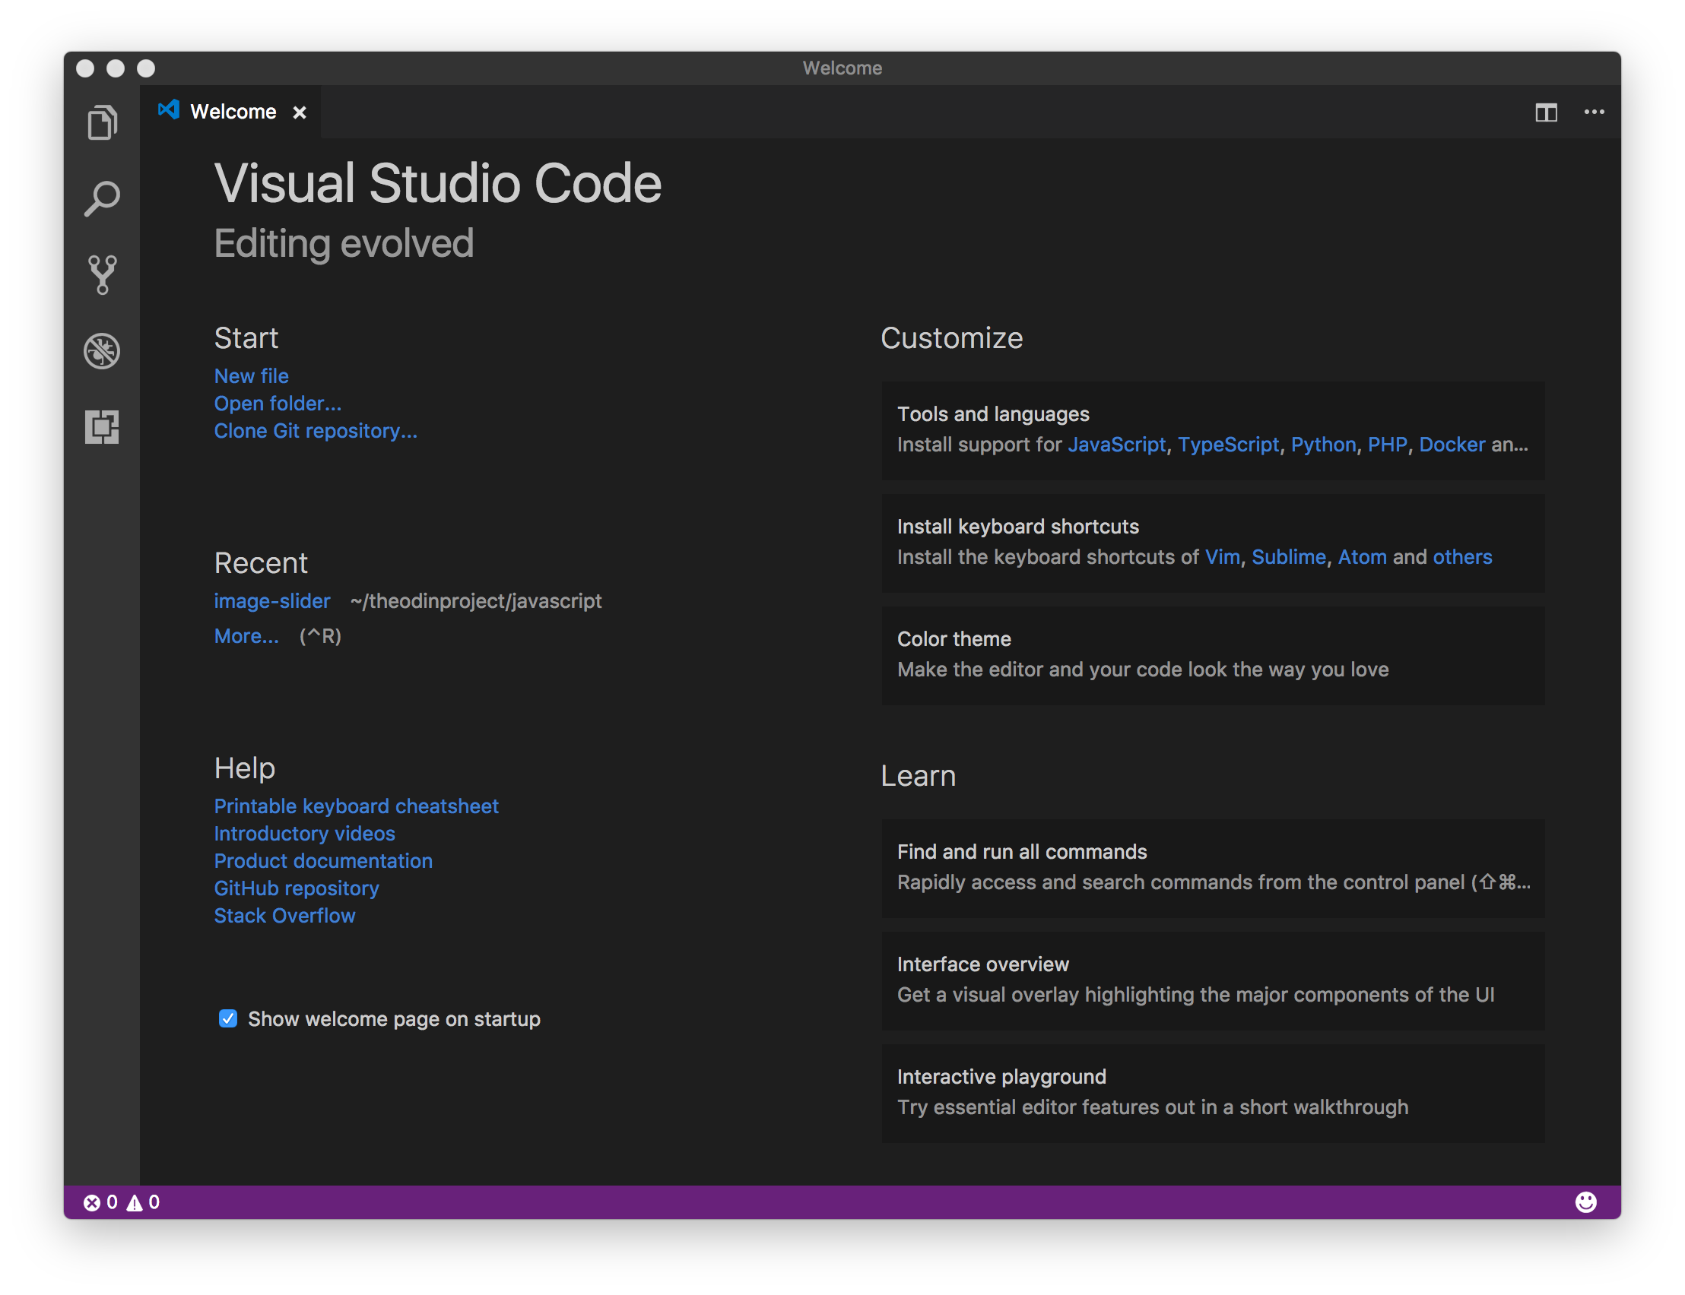
Summary
This is a brief summary of Visual Studio Code. There is a link on the welcome page to a keyboard shortcuts cheat sheet. There are lots of videos on YouTube and the official site also has lots of information available.

