Slide 1
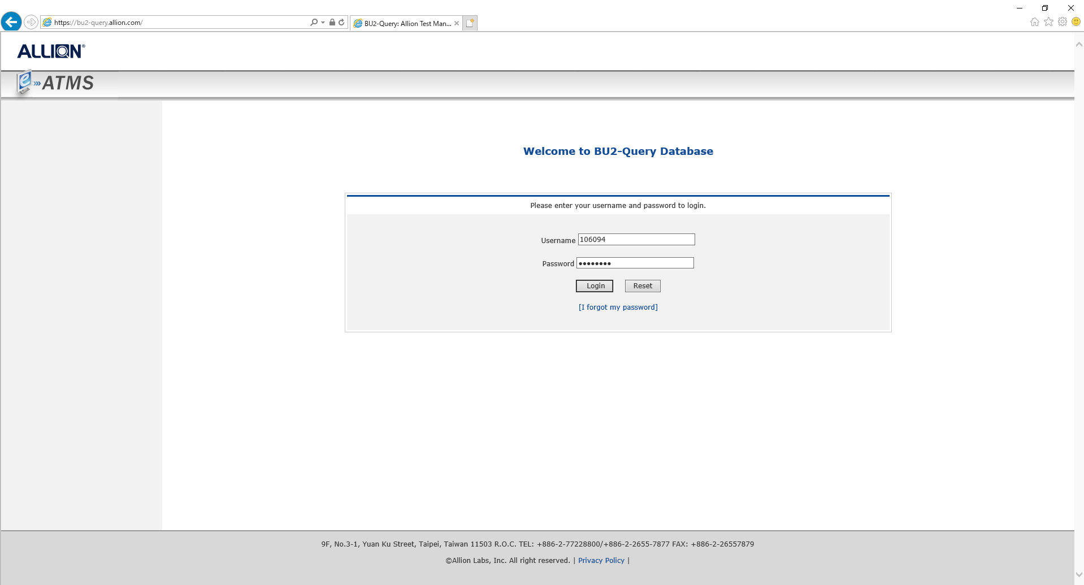
https://bu2-query.allion.com/

