Slide 1
NPL Wiki Plan Proposal
Allion NPL
2021.1.5

Slide 2
Concept -Main
Purpose
Systematic Management of data in documentation
A easier, smarter and faster way to get the information correctly
Benefit:
1 min query/document ->10 sec * 3 times *80 persons Total: 240min-> 40min/day
Accuracy Improvement
Conditions for the achievement
Systematic Management of documentation – Yes
Steady format – Yes

Slide 3
Concept -Main
Method
Create a tool to get data we need from the document->Database of Wiki
Create a GUI for user to search the data -> Application
Current Practice
Get data from [Release notes] for database (PowerShell for example)
Search by Machine ID/Phase to get result

Slide 4
Concept -Main
Future Plan
Create more database and auto maintenance (by period/instant) (Admin function)
A friendly search GUI (user application)
database and search GUI with flexible setting (Final Goal)

Slide 5
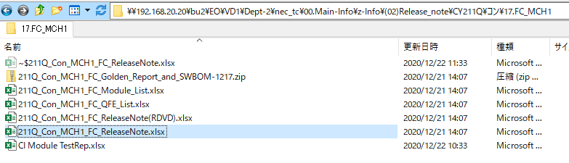
Current Practice
Details
Define document path/name (*ReleaseNote.xlsx)
Define which Information want to get (Q,CON/COM, Phase, file name, csup info, tools_list,OS Build, Description and Path)
Define rules to get the information
Q,CON/COM, Phase, file name, Path : from folder/path/filename information
csup info: “Csup File Information” add 1/1 column/raw
tools_list: if below of “Support OS” not empty, get -1 column
OS Build/ Description : find the line include “build” and fine the digital words matched with format d{5}.d{5/3/2}

Slide 6
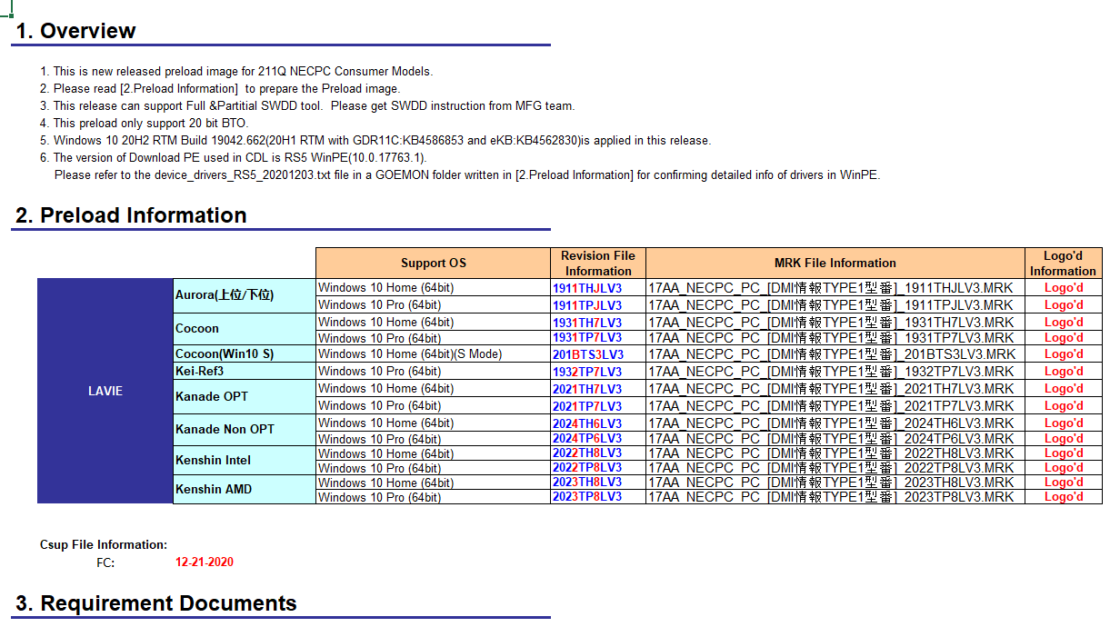
Current Practice

Slide 7
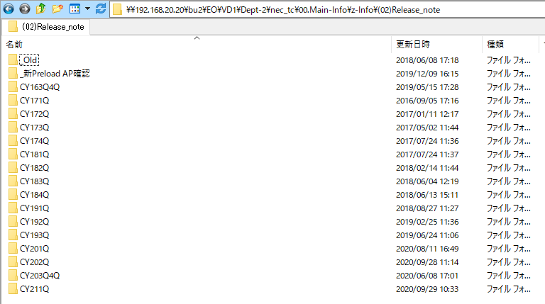
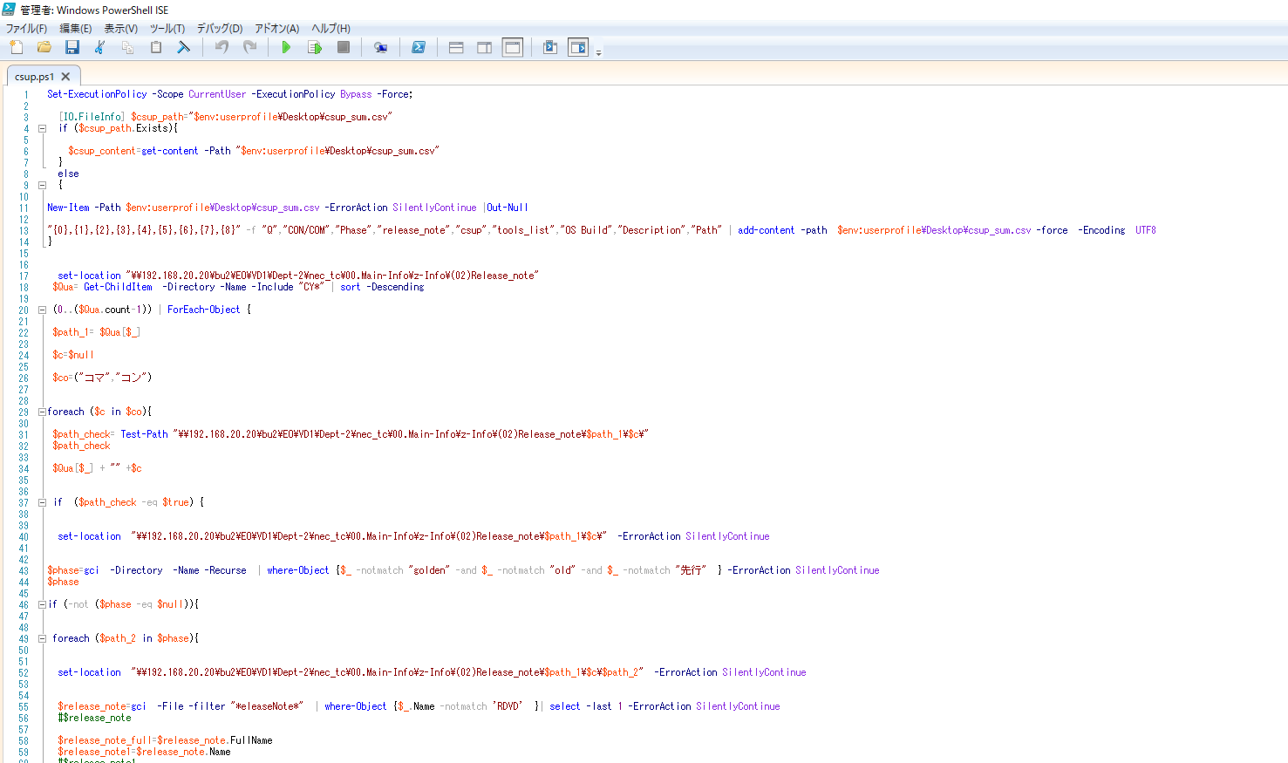

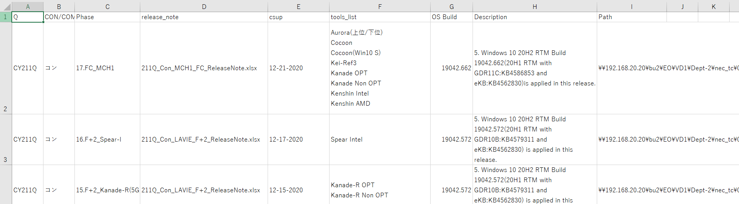
Current Practice
*ReleaseNote.xlsx
Auto Update
Database
https://docs.google.com/spreadsheets/d/1ZI_F3fz8SZkhNIHI3MYbFsL0T1lg_pPB_S894z3JfJg/edit#gid=640098707

Slide 8

GUI Proposal
NPL Wiki System
Release Note
Year Q:
202Q
Machine ID:
Aurora
Module list
CON
Con/Com:
Phase:
Final
BIOS
FW
…
媽媽再也不用擔心我找不到文件了！
及時更新、現在更新
自訂query項目
自訂Query欄位/順序
Admin新增自訂database format，新增Query項目

