Slide 1
Mock接口框架

Slide 2
Mock介绍
mock用来模拟接口，这里mock用的是moco框架，moco框架是github上的一个开源项目，可模拟http,https,Socket协议。http://repo1.maven.org/maven2/com/github/dreamhead/moco-runner
https://github.com/dreamhead/moco

Slide 3
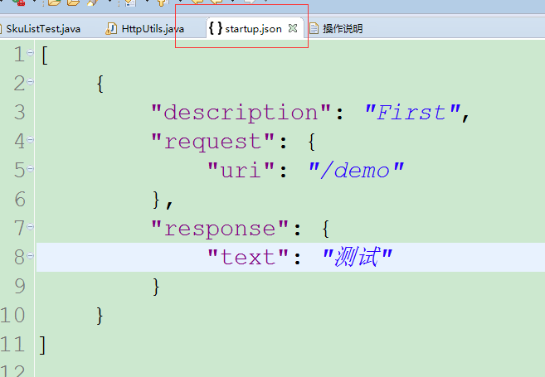
moco的启动及第一个demo
java -jar moco-runner-0.12.0-standalone.jar http -p 9999 -c startup.json

Slide 4
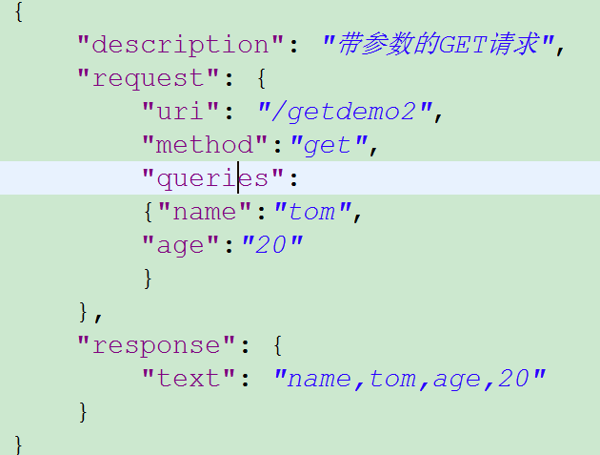
带参数的get方法实现

Slide 5
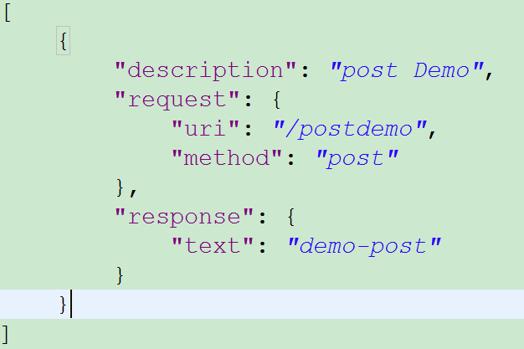
在moco中配置post请求

Slide 6
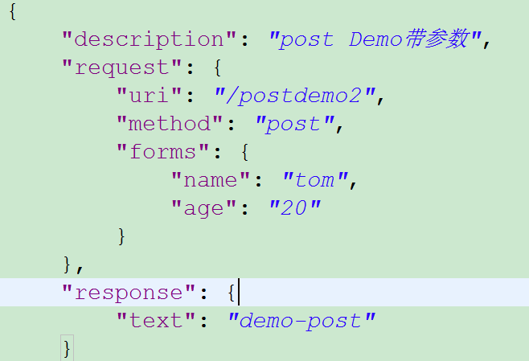
带参数的post方法实现

Slide 7
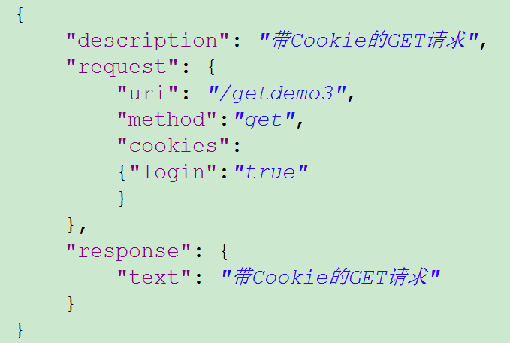
带cookies信息的get请求

Slide 8
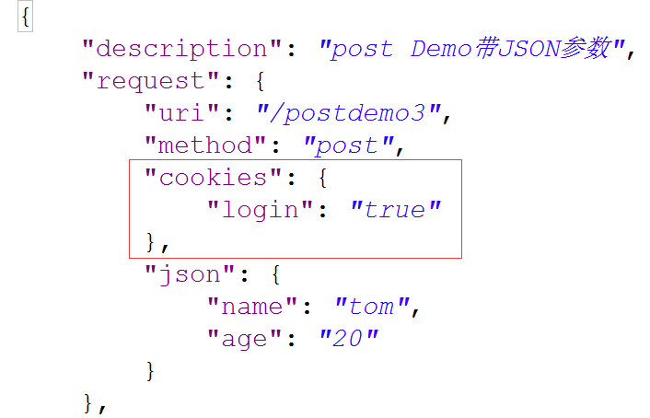
带cookies信息post请求

Slide 9
带有headers信息的mock请求
{
"description": "post demo5 for headers",
"request": {
"uri": "/postdemo5",
"method": "post",
"headers":{"content-type":"application/json"},
"json": {
"id": "1",
"name": "tom"
}
}

Slide 10
实现请求重定向
{
"description": "post demo6 for redirectorTo",
"request": {
"uri": "/postdemo6",
"method": "post",
"json": {
"id": "1",
"name": "tom"
}
},
"redirectTo":"/getdemo1“
//可以是其他的URL地址，例如“http://www.baidu.com”
}

