Slide 1
數位信號報告
班級:電子三乙
姓名:林鑫全
學號:106360233
指導教授:廖元甫

Slide 2

輸入訊號
輸入波形:
輸入頻譜:
輸入聲音:

Slide 3
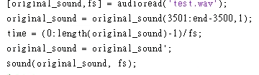
輸入訊號程式碼

Slide 4
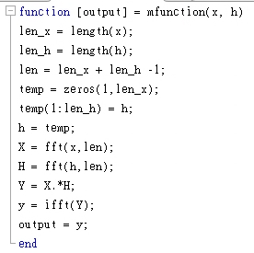
Function程式碼

Slide 5
Moving average
輸出波形:
頻譜:
聲音

Slide 6
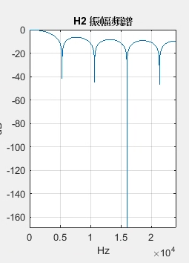
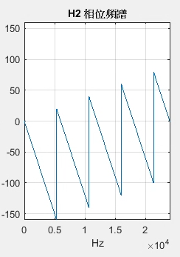

Moving average Frequency response 程式碼:

Slide 7
Ideal Delay
輸出波形:
頻譜:
聲音:

Slide 8
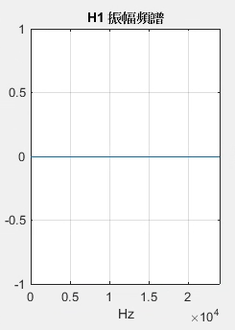
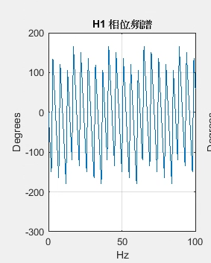

Ideal Delay Frequency response 程式碼:

Slide 9
Forward Difference
輸出波形:
頻譜:
聲音:

Slide 10
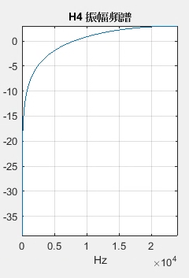
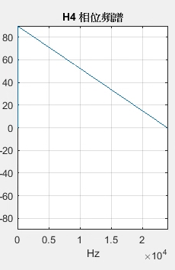

Forward Difference Frequency response 程式碼:

Slide 11
Backward Difference
輸出波形:
頻譜:
聲音:

Slide 12
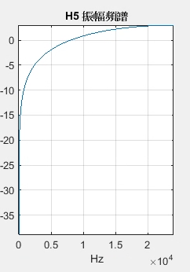
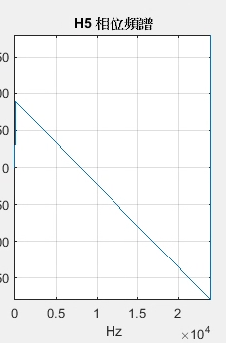

Backward Difference Frequency response 程式碼:

Slide 13
Accumlator
輸出波形:
頻譜:
聲音:

Slide 14
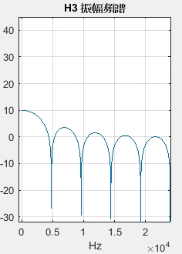
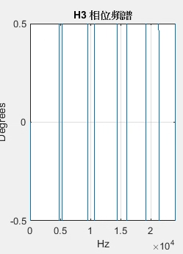

Accumlator Frequency response 程式碼:

