Slide 1
計算機實習

Slide 2

JavaFX 下載 (套件)
JavaFX 13
https://openjfx.io/

Slide 3
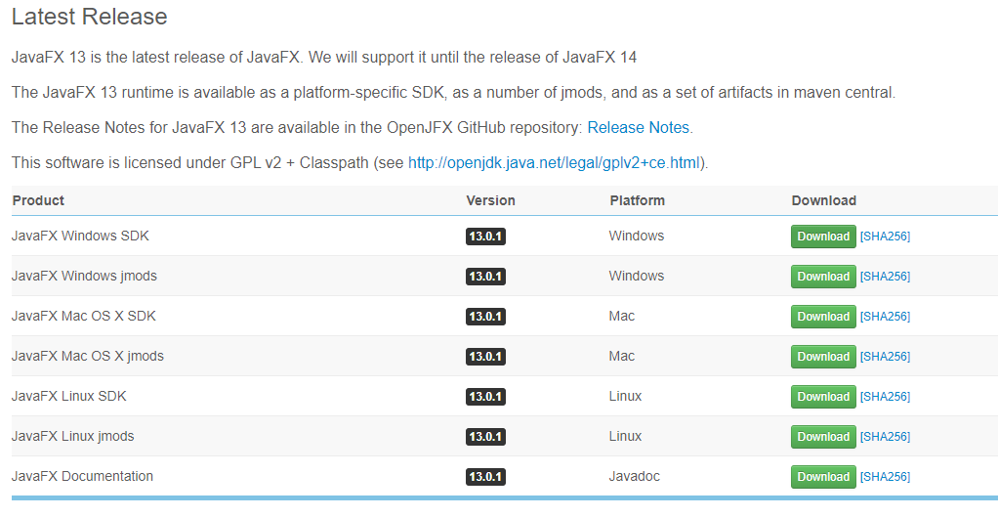
JavaFX 13

Slide 4
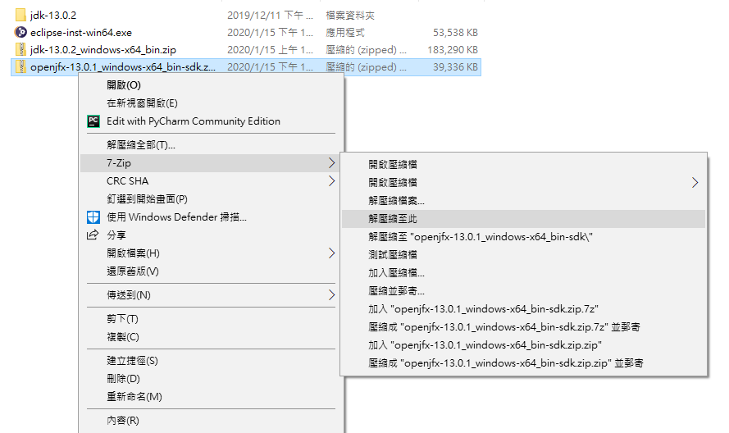
JavaFX 13

Slide 5
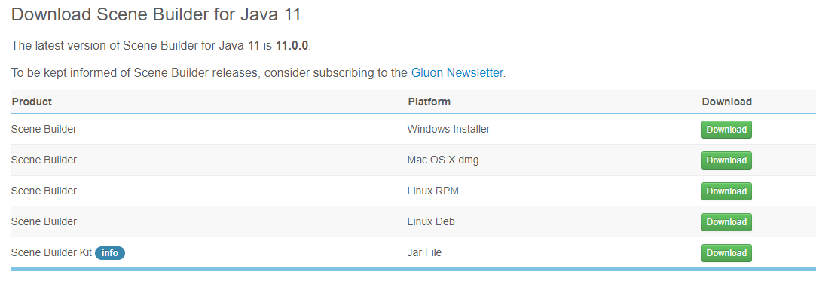
Scene Builder 下載 (介面)
Scene Builder for Java 11
https://gluonhq.com/products/scene-builder/

Slide 6
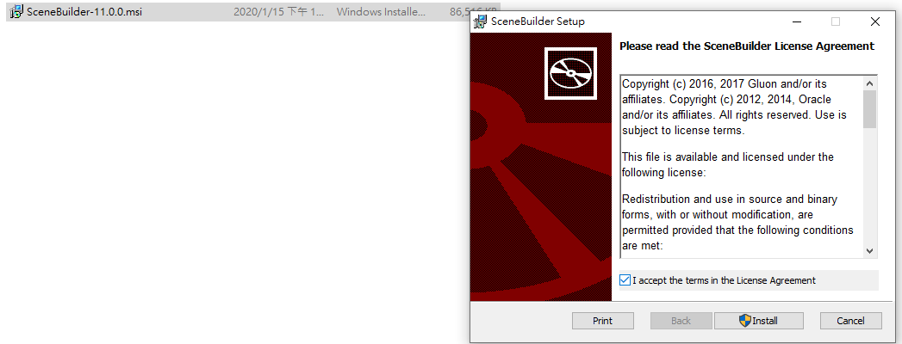
Scene Builder 安裝 – Step 1
預設儲存位置 C:\Program Files\SceneBuilder

Slide 7
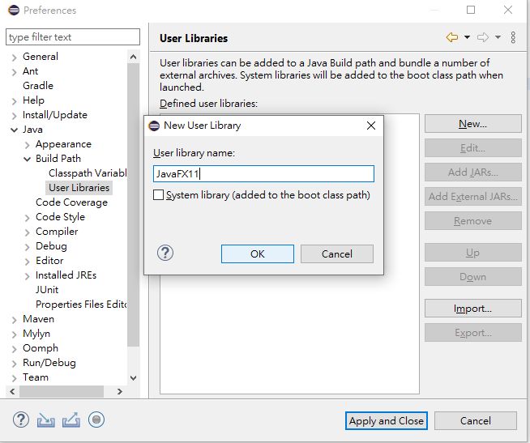
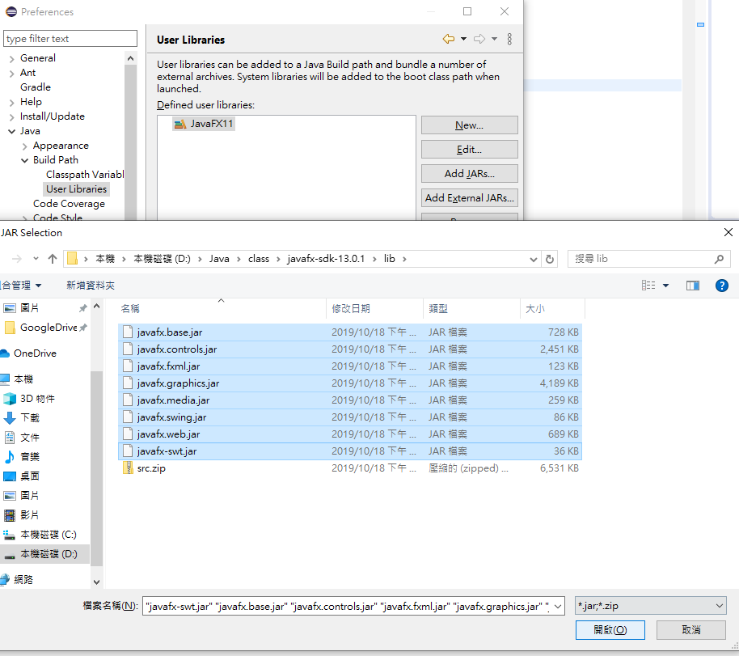
Create User Library– Step 2
Window -> Preferences -> Java -> Build Path -> User Libraries -> New
Javafx 下載位置

Slide 8
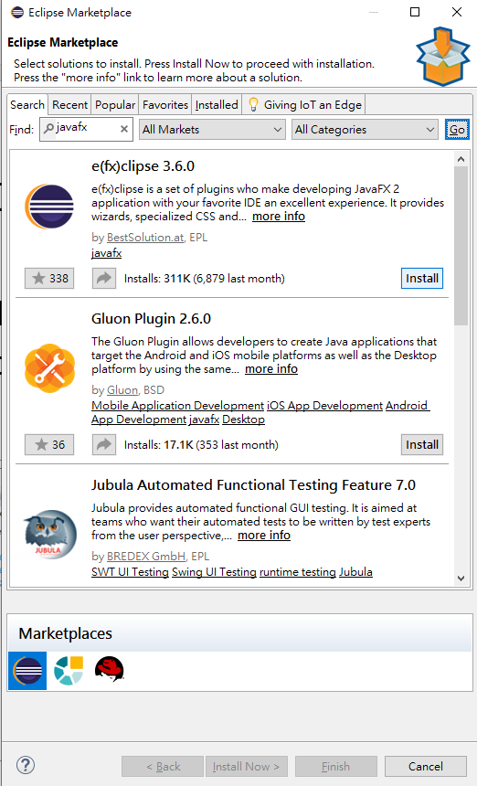
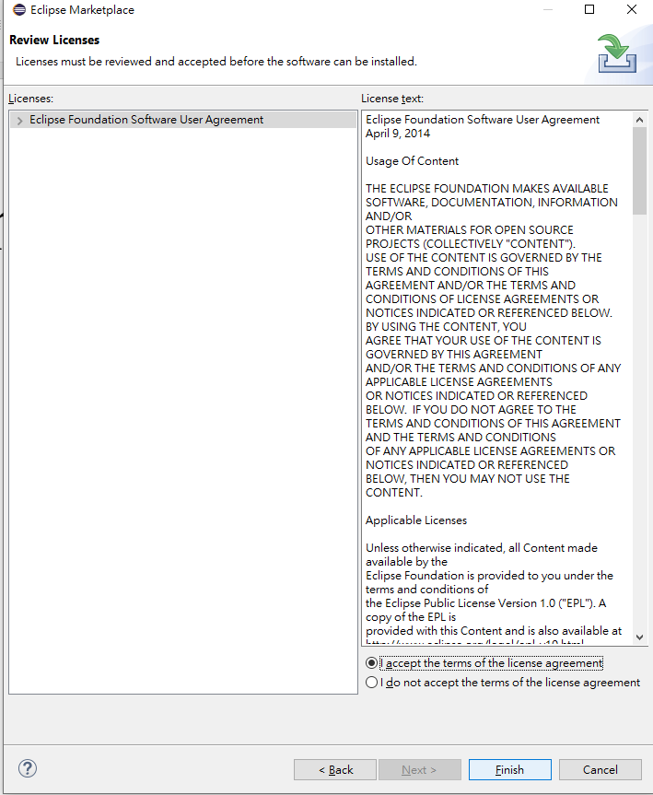
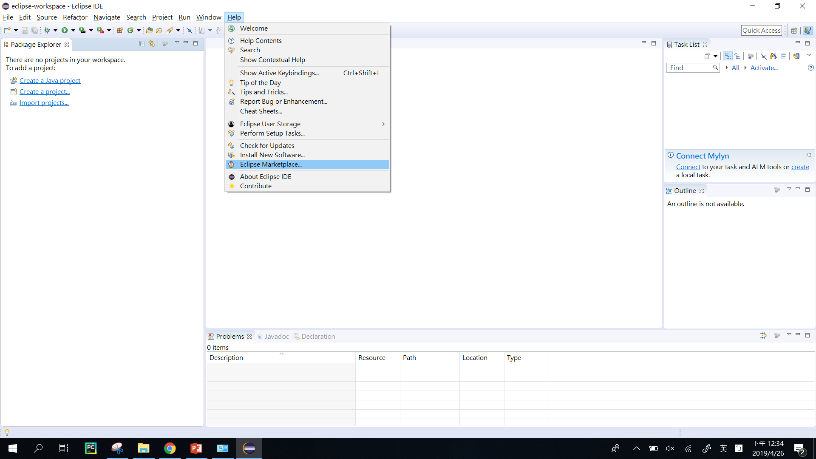
Install e(fx)clipse plugin– Step 3
1
2
3

Slide 9
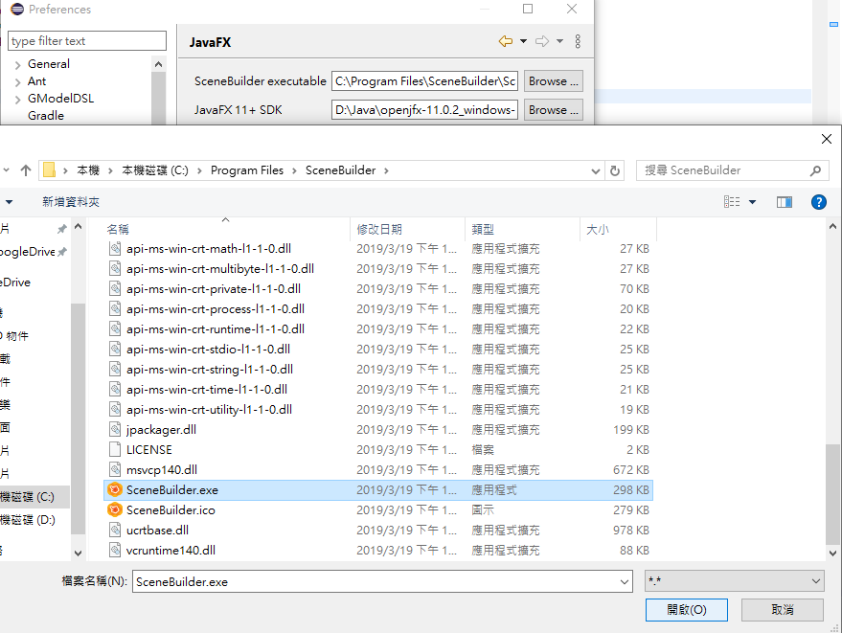
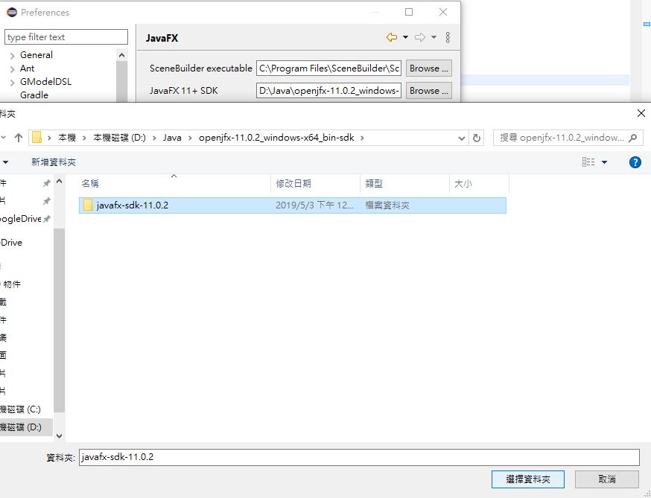
Install JavaFX scene builder–Step 4
Window -> Preferences -> JavaFX -> Browse Scene Builder executable

Slide 10
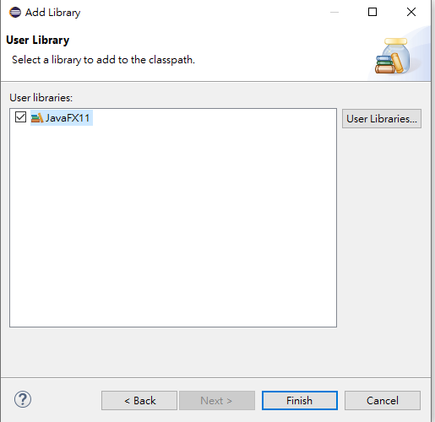
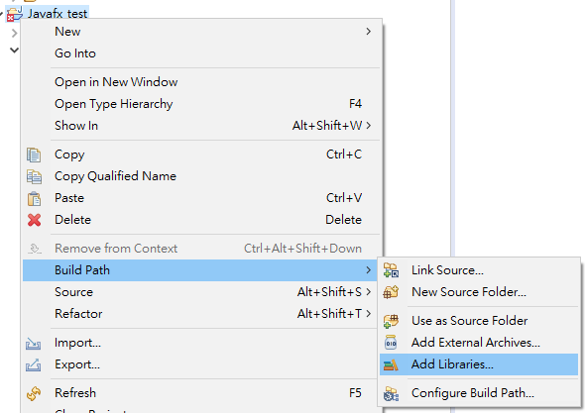
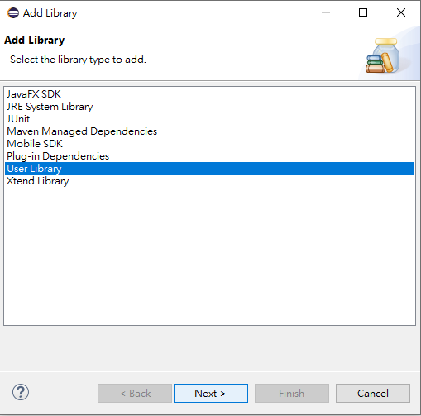
測試 – Step 1 添加套件入專案
新增一專案

Slide 11
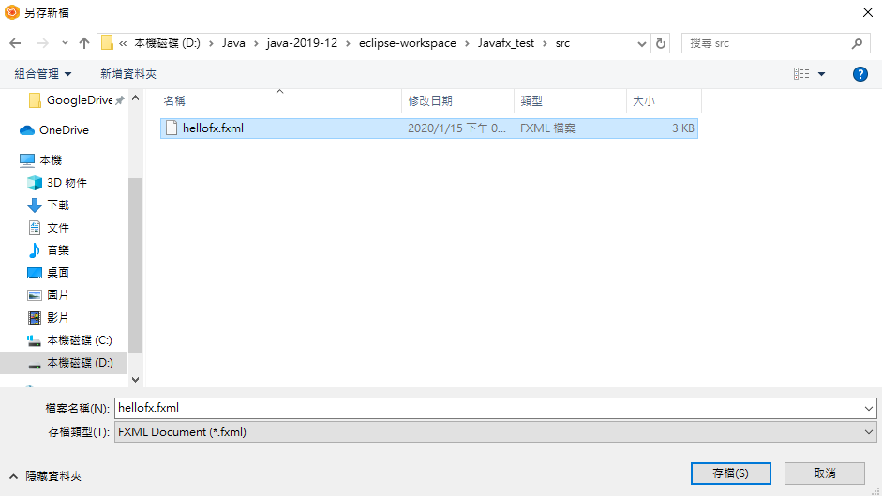
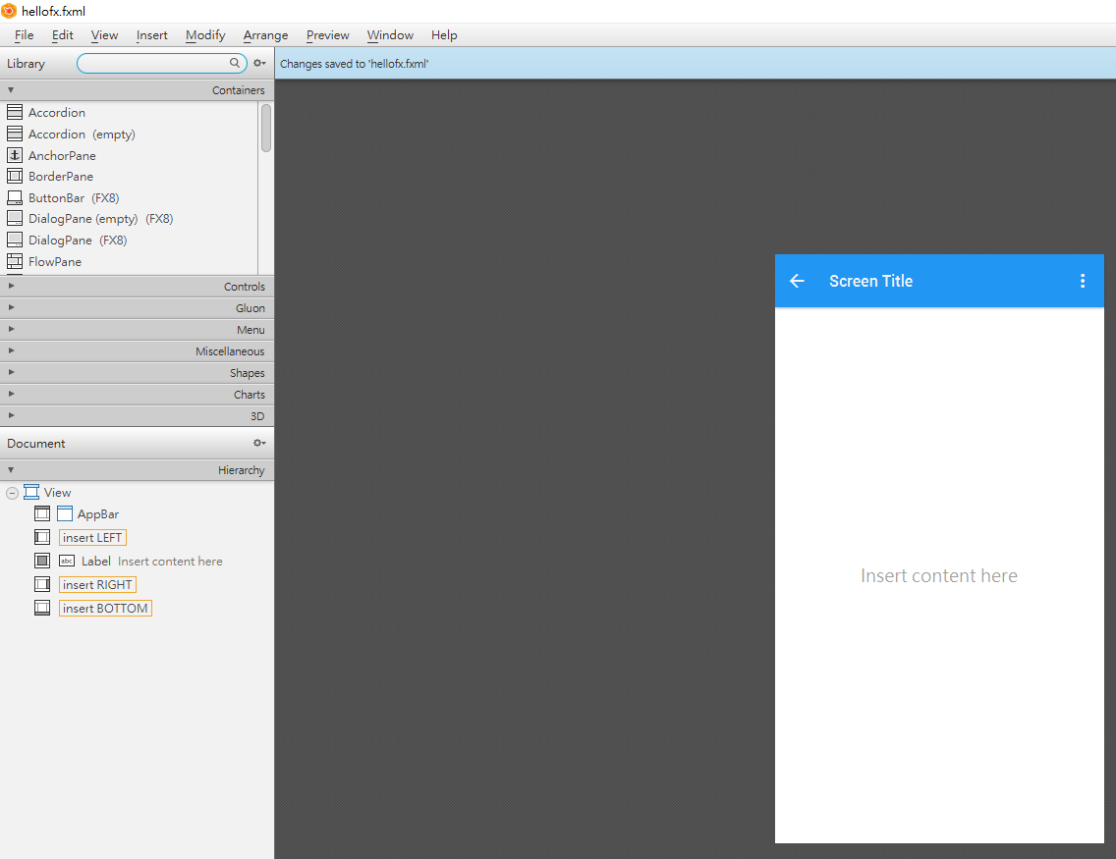
測試 – Step 2 開啟scene builder
開啟scene builder
File -> New from template -> choose anyone you like -> save
和主程式同一專案位置

Slide 12
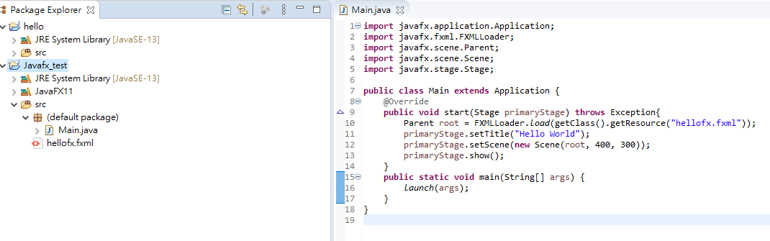
測試 – Step 3
主程式下的相對路徑

Slide 13
Main.java
package hellofx;
import javafx.application.Application;
import javafx.fxml.FXMLLoader;
import javafx.scene.Parent;
import javafx.scene.Scene;
import javafx.stage.Stage;
public class Main extends Application {
@Override
public void start(Stage primaryStage) throws Exception{
Parent root = FXMLLoader.load(getClass().getResource("hellofx.fxml"));
primaryStage.setTitle("Hello World");
primaryStage.setScene(new Scene(root, 400, 300));
primaryStage.show();
}
public static void main(String[] args) {
launch(args);
}
}

Slide 14
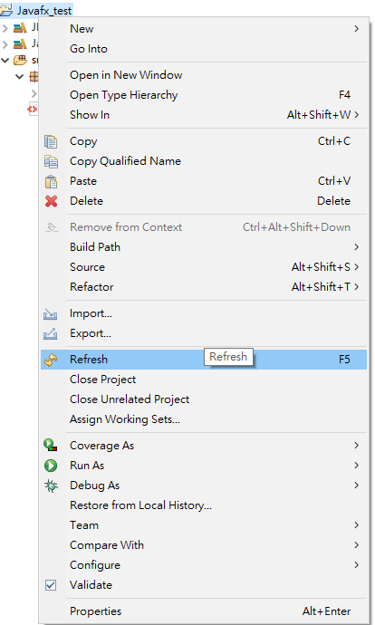
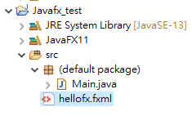
測試 – Step 4
刷新後才會出現

Slide 15
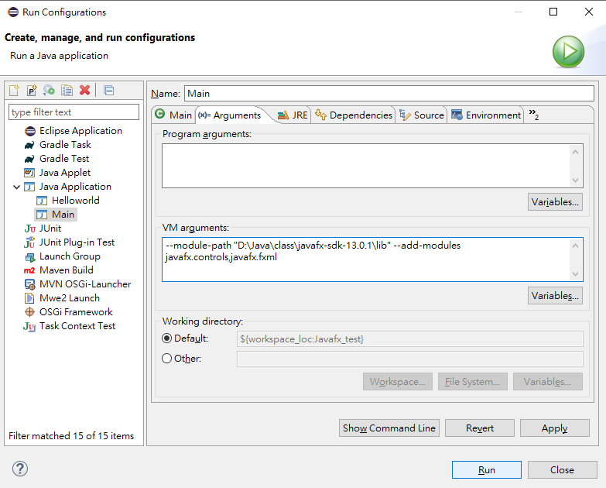
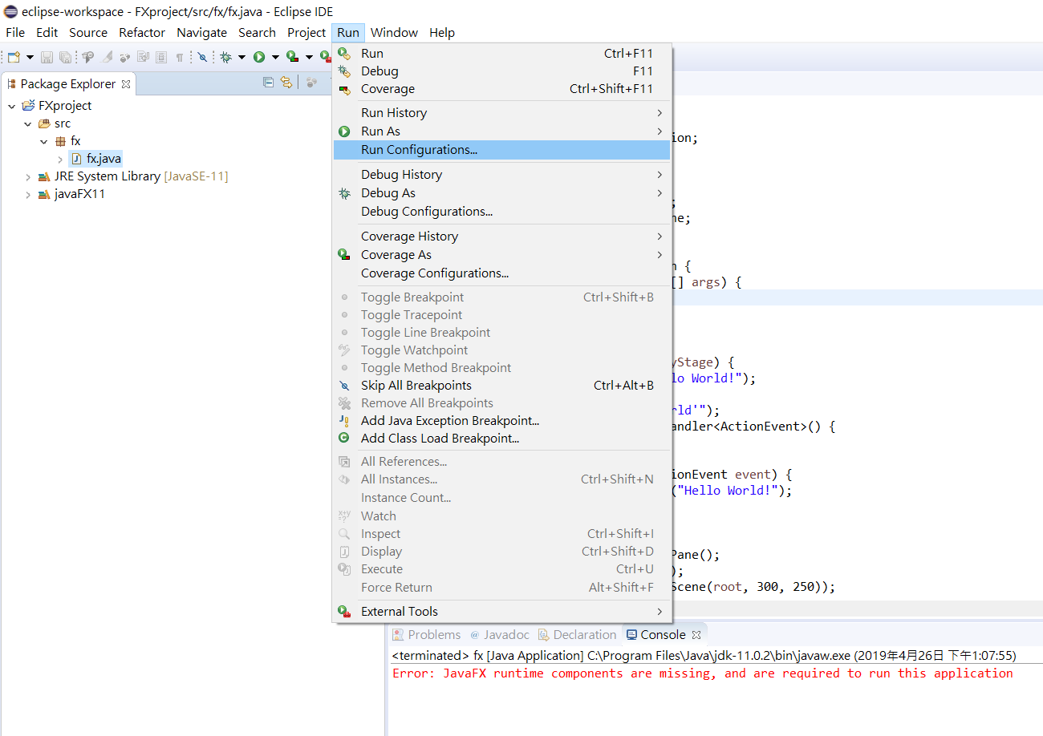
測試 – Step 5
Add this line in VM arguments:
--module-path "D:\Java\class\javafx-sdk-13.0.1\lib" --add-modules javafx.controls,javafx.fxml
*change this path to yours

Slide 16
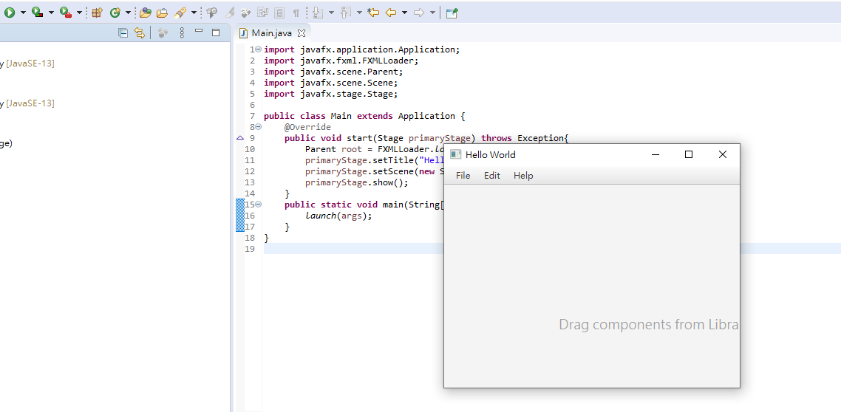
測試 – Step 6
執行
結果

