Slide 1
Attention model
Hung-Hsuan Chen

Slide 2
Overview
It is still challenging for an RNN (and its variants) to generate long sequences when the decoder can only access the final state from the encoder
Attention model improves the performance on long sequences

Slide 3
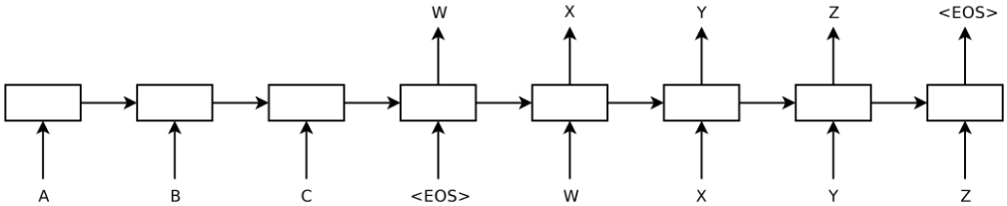
Encoder-decoder example (machine translation)
All input information are stored in one hidden vector, which is used by decoder to generate output sequence
If input is really long, one hidden vector could be problematic to store the initial inputs
Let’s allow the decoder refer to input sequence

Slide 4
Attention-based machine translation
Each output word comes from one or multiple input words
Build a model that learns to attend to only the relevant input words when producing a output word

Slide 5









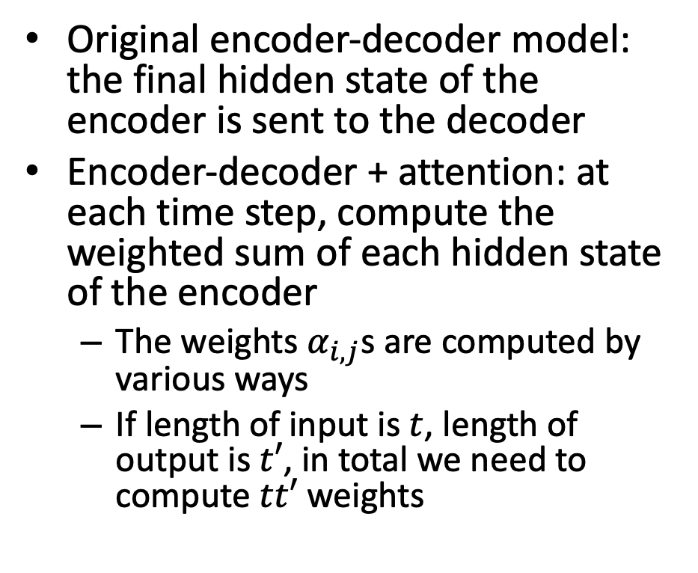














Encoder-decoder model + attention
Decoder
Original encoder-decoder model: the final hidden state of the encoder is sent to the decoder
Encoder-decoder + attention: at each time step, compute the weighted sum of each hidden state of the encoder
The weights $α_{i,j}$s are computed by various ways
If length of input is $t$, length of output is $t′$, in total we need to compute $tt′$ weights
$${\hat{y}}_{1}$$
$${\hat{y}}_{2}$$
$${\hat{y}}_{3}$$
$${\hat{y}}_{t′}$$
…
$$h_{1}$$
$$h_{2}$$
$$h_{3}$$
$$+$$
$$α_{3,1}$$
$$α_{3,2}$$
$$α_{3,t}$$
$$z_{1}$$
$$z_{2}$$
$$z_{t}$$
$$\overset{⃖}{h_{1}}$$
$$\overset{⃖}{h_{2}}$$
…
$$\overset{⃖}{h_{t}}$$
$$\vec{h_{1}}$$
$$\vec{h_{2}}$$
…
$$\vec{h_{2}}$$
$$x_{1}$$
$$x_{2}$$
$$x_{t}$$
Encoder: bidirectional RNN/LSTM/GRU/…
Bahdanau et al., Neural machine translation by jointly learning to align and translate. ICLR, 2015 (15000+ citations ~2020)

Slide 6
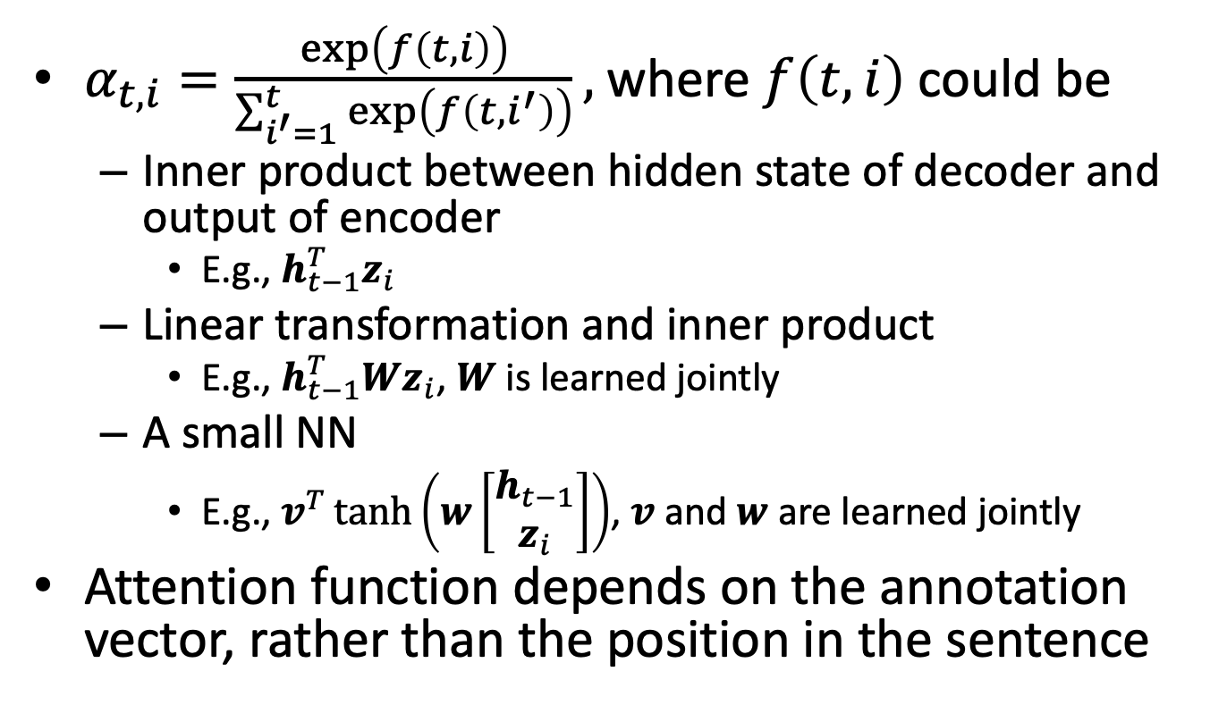
Various ways to compute the weights
$α_{t,i}=\frac{\exp\left(f\left(t,i\right)\right)}{\sum_{i^{′}=1}^{t}{\exp\left(f\left(t,i^{′}\right)\right)}},$ where $f\left(t,i\right)$ could be
Inner product between hidden state of decoder and output of encoder
E.g., $h_{t−1}^{T}z_{i}$
Linear transformation and inner product
E.g., $h_{t−1}^{T}Wz_{i}$, $W$ is learned jointly
A small NN
E.g., $v^{T}\tanh\left(w\left[\begin{matrix}h_{t−1} \\ z_{i}\end{matrix}\right]\right)$, $v$ and $w$ are learned jointly
Attention function depends on the annotation vector, rather than the position in the sentence

Slide 7
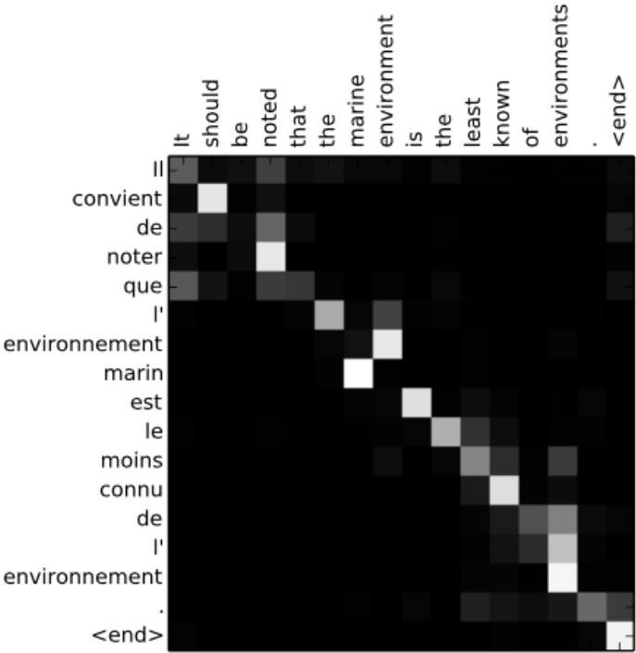
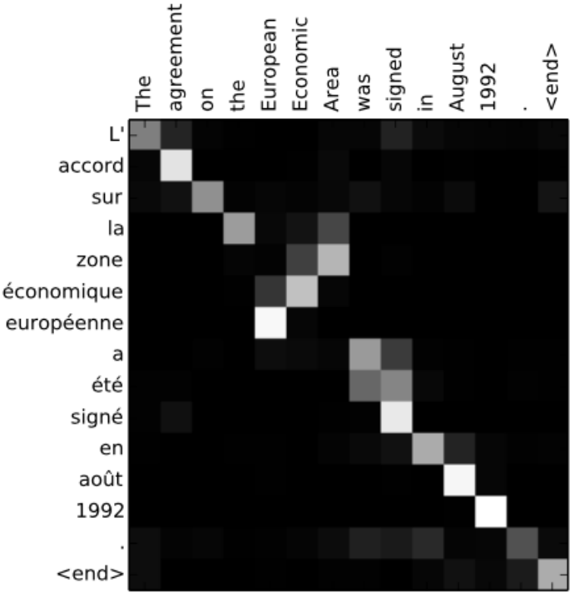
Visualization of attention map for machine translation

Slide 8
Caption generation by attention model
Task: take an image as input, generate the caption as output
Encoder: CovNet
Decoder: attention-based RNN
Xu et al. Show, Attend, and Tell: Neural Image Caption Generation with Visual Attention. ICML, 2015. (6000+ citations ~2020)

Slide 9
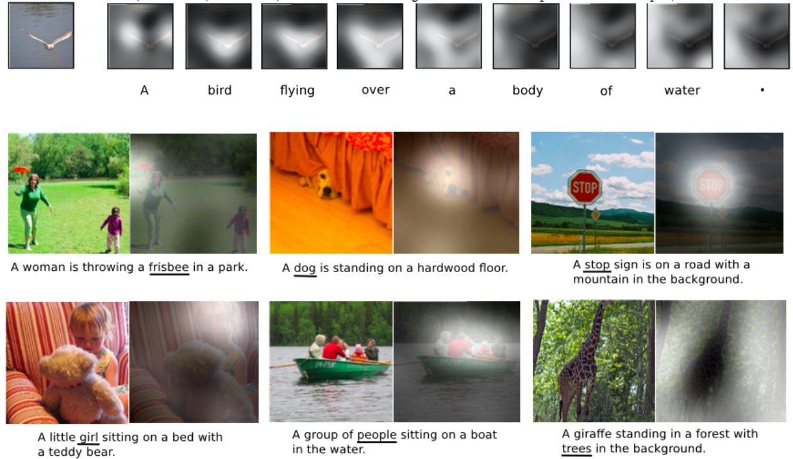
Visualization of attention map for caption generation

Slide 10
Main computational cost of RNN + Attention
It is hard to parallelize RNN

Slide 11
Transformer model
“Attention is all you need” by Google researchers
NIPS 2017
16000+ citations ~2020
Used in machine translation task
No recurrent layers and no convolution layers
Use attention to learn the importance of long term and short term vocabularies

Slide 12




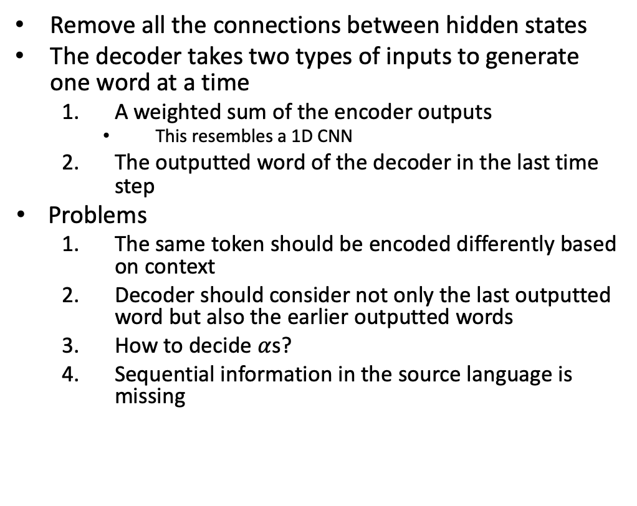






Proposed model v1
Remove all the connections between hidden states
The decoder takes two types of inputs to generate one word at a time
A weighted sum of the encoder outputs
This resembles a 1D CNN
The outputted word of the decoder in the last time step
Problems
The same token should be encoded differently based on context
Decoder should consider not only the last outputted word but also the earlier outputted words
How to decide $α$s?
Sequential information in the source language is missing
Decoder
How
are
you
doing
$$+$$
$$α_{3,1}$$
$$α_{3,2}$$
$$α_{3,3}$$
$$z_{1}$$
$$z_{2}$$
$$z_{3}$$
$$\vec{h_{1}}$$
$$\vec{h_{2}}$$
$$\vec{h_{3}}$$
你
好
嗎
Encoder

Slide 13
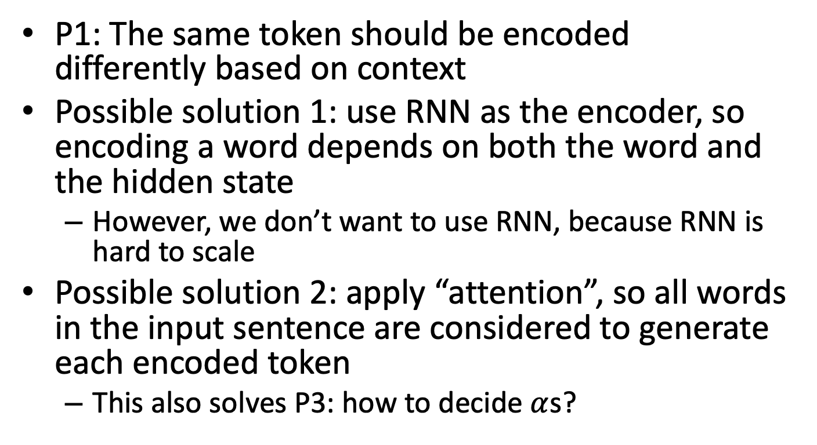
Dealing with problem 1 and problem 3
P1: The same token should be encoded differently based on context
Possible solution 1: use RNN as the encoder, so encoding a word depends on both the word and the hidden state
However, we don’t want to use RNN, because RNN is hard to scale
Possible solution 2: apply “attention”, so all words in the input sentence are considered to generate each encoded token
This also solves P3: how to decide $α$s?

Slide 14









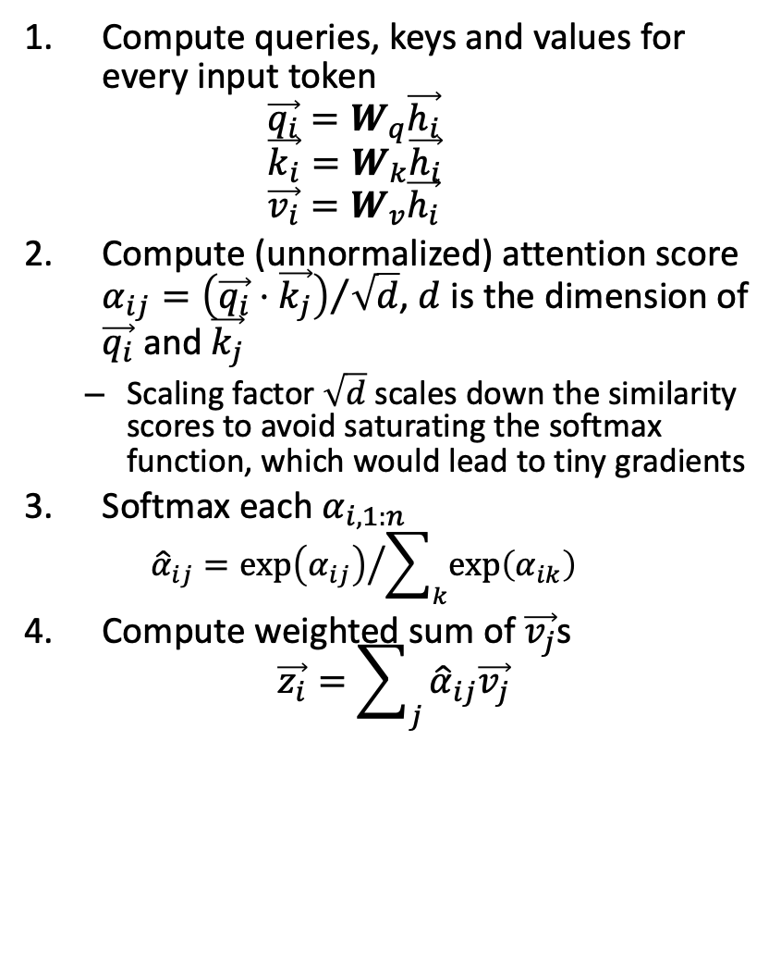














Self-attention at encoder
Encoding the 3rd input word (嗎)
$$\vec{z_{3}}$$
Compute queries, keys and values for every input token $\vec{q_{i}}=W_{q}\vec{h_{i}}$ $\vec{k_{i}}=W_{k}\vec{h_{i}}$ $\vec{v_{i}}=W_{v}\vec{h_{i}}$
Compute (unnormalized) attention score $α_{ij}={\left(\vec{q_{i}}⋅\vec{k_{j}}\right)}/{\sqrt{d}}$, $d$ is the dimension of $\vec{q_{i}}$ and $\vec{k_{j}}$
Scaling factor $\sqrt{d}$ scales down the similarity scores to avoid saturating the softmax function, which would lead to tiny gradients
Softmax each $α_{i,1:n}$
$${\hat{α}}_{ij}={\exp\left(α_{ij}\right)}/{\sum_{k}{\exp\left(α_{ik}\right)}}$$
Compute weighted sum of $\vec{v_{j}}$s $\vec{z_{i}}=\sum_{j}{{\hat{α}}_{ij}\vec{v_{j}}}$
Encoder
$${\hat{α}}_{31}$$
$${\hat{α}}_{32}$$
$$×$$
$$+$$
$$×$$
$${\hat{α}}_{33}$$
$$×$$
Softmax
$$α_{31}$$
$$α_{32}$$
$$α_{33}$$
$$\vec{q_{1}}$$
$$\vec{q_{2}}$$
$$\vec{q_{3}}$$
$$\vec{k_{1}}$$
$$\vec{k_{2}}$$
$$\vec{k_{3}}$$
$$\vec{v_{1}}$$
$$\vec{v_{2}}$$
$$\vec{v_{3}}$$
$$\vec{h_{1}}$$
$$\vec{h_{2}}$$
$$\vec{h_{3}}$$
你
好
嗎

Slide 15
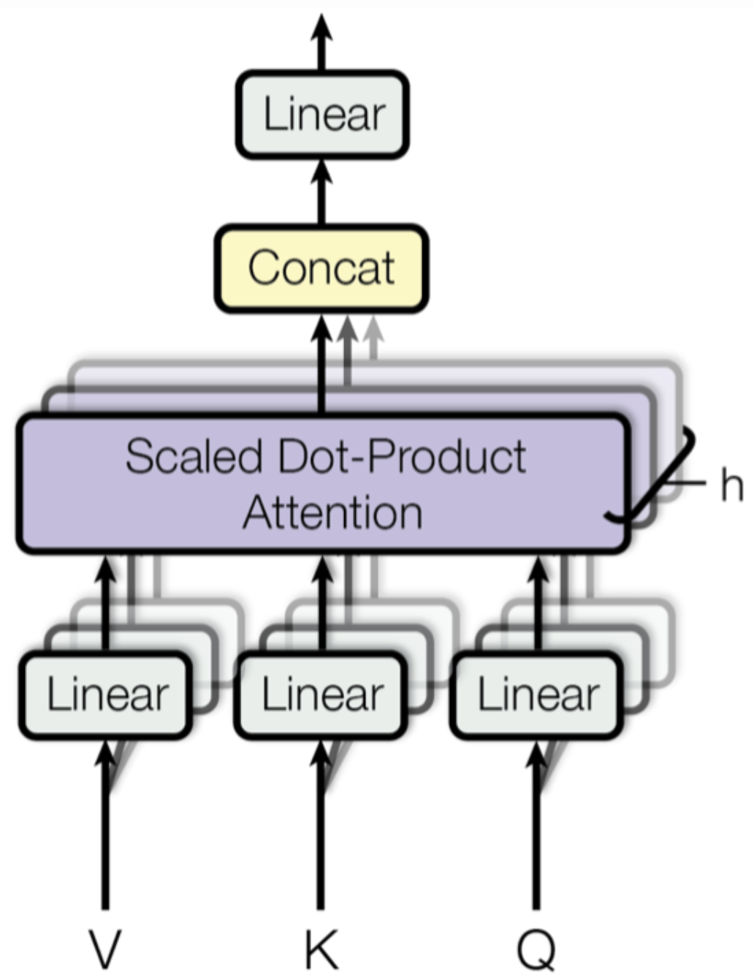

Multi-head self-attention at encoder
Multi-head attention computes attention multiple ($h$) times in parallel
The independent attention outputs are concatenated and linearly transformed into the expected dimensions

Slide 16













Multi-layer self-attention
Encoder
$$⋮$$
Each input token is “encoded” as one vector
We may stack many layers
$$\vec{z_{1}′′}$$
$$\vec{z_{2}′′}$$
$$\vec{z_{3}′′}$$
$$\vec{z_{1}′}$$
$$\vec{z_{2}′}$$
$$\vec{z_{3}′}$$
$$\vec{z_{1}}$$
$$\vec{z_{2}}$$
$$\vec{z_{3}}$$
$$\vec{h_{1}}$$
$$\vec{h_{2}}$$
$$\vec{h_{3}}$$
你
好
嗎

Slide 17











Output of self-attention encoder
$$z_{1}$$
$$z_{2}$$
$$z_{3}$$
The same token (e.g., “好”) may be encoded differently based on the contexts
你好嗎➔ fine
好厲害➔ very
Encoder
$$\vec{h_{1}}$$
$$\vec{h_{2}}$$
$$\vec{h_{3}}$$
你
好
嗎
$$z_{1}′$$
$$z_{2}′$$
$$z_{3}′$$
Encoder
$$\vec{h_{1}}$$
$$\vec{h_{2}}$$
$$\vec{h_{3}}$$
好
厲
害

Slide 18
Dealing with problem 2
P2: Decoder should consider not only the last outputted word but also the earlier outputted words
Masked self-attention
Apply attention to the already outputted words
At inference time, decoder can only access to the words it already output, not future words, so future words are “masked” during training
The machine generates the new token partially based on the weighted sum of the outputted tokens
To mask out future key/value pairs, simply add a very large negative value to the corresponding similarity scores before computing the softmax

Slide 19





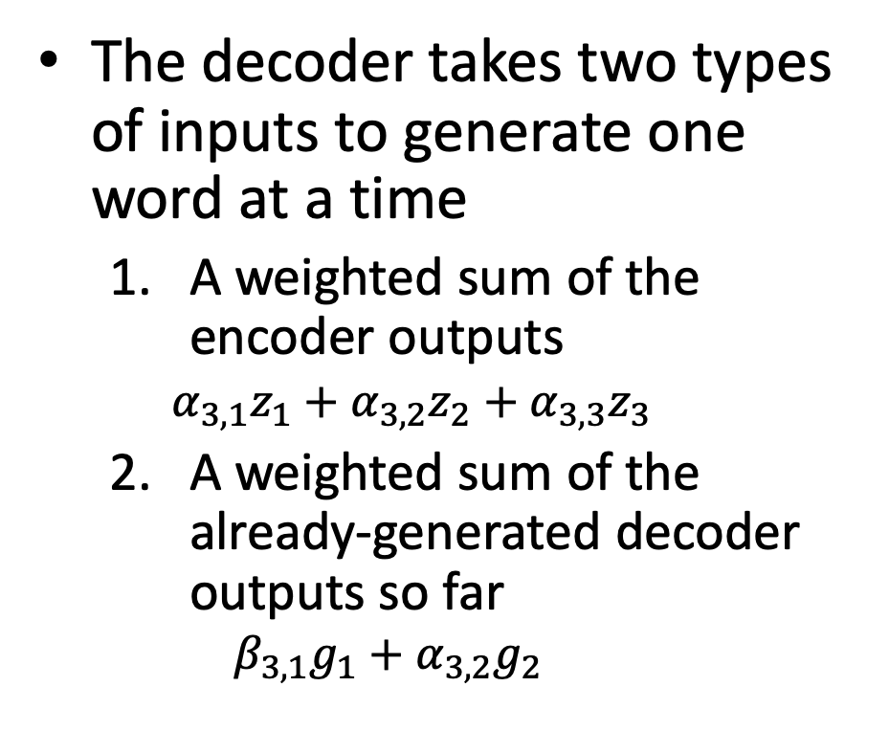






Encoder-decoder model with attention (no RNN)
Decoder
The decoder takes two types of inputs to generate one word at a time
A weighted sum of the encoder outputs
$$α_{3,1}z_{1}+α_{3,2}z_{2}+α_{3,3}z_{3}$$
A weighted sum of the already-generated decoder outputs so far
$$β_{3,1}g_{1}+α_{3,2}g_{2}$$
How
are
you
doing
$$\vec{g_{1}}$$
$$\vec{g_{2}}$$
$$\vec{g_{3}}$$
$$β_{3,1}$$
$$β_{3,2}$$
$$+$$
$$+$$
$$α_{3,1}$$
$$α_{3,2}$$
$$α_{3,3}$$
$$z_{1}$$
$$z_{2}$$
$$z_{3}$$
$$\vec{h_{1}}$$
$$\vec{h_{2}}$$
$$\vec{h_{3}}$$
你
好
嗎
Encoder

Slide 20
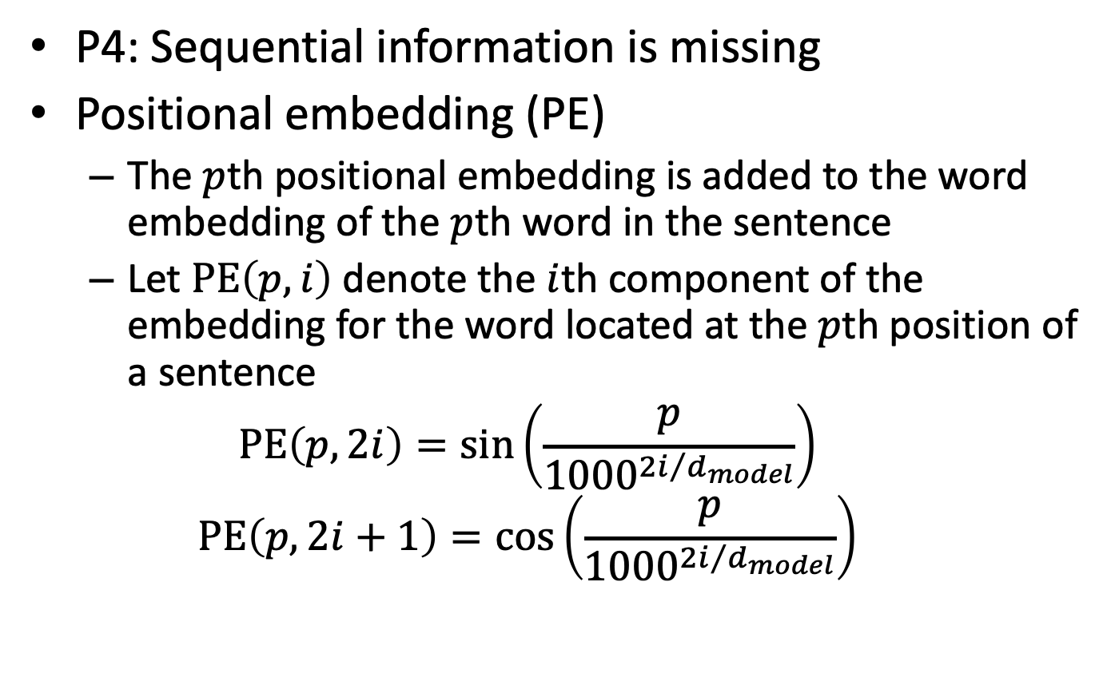
Solving problem 4
P4: Sequential information is missing
Positional embedding (PE)
The $p$th positional embedding is added to the word embedding of the $p$th word in the sentence
Let $PE\left(p,i\right)$ denote the $i$th component of the embedding for the word located at the $p$th position of a sentence
$$PE\left(p,2i\right)=\sin\left(\frac{p}{{1000}^{{2i}/{d_{model}}}}\right)$$
$$PE\left(p,2i+1\right)=\cos\left(\frac{p}{{1000}^{{2i}/{d_{model}}}}\right)$$

Slide 21
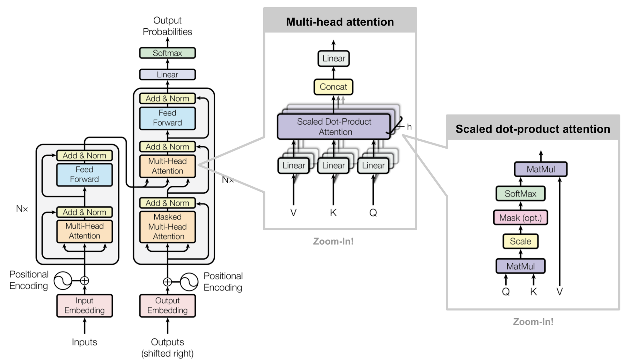
Put everything together

Slide 22
Summary
RNN encodes entire input sequence into one fixed-length vector
Attention mechanism allows network to refer the entire input sequence
The attention model motivates many following works
ELMo, ULMFiT, GPT, BERT, ALBERT, RoBERTa, Transformer-XL

