Slide 1
Review quizzes
What is gradient exploding and how to avoid it?
What is batch normalization?
Describe possible strategies to prevent overfitting in deep learning
What is a convolution?
Explain convolution layer in CNN
Explain pooling layer in CNN

Slide 2

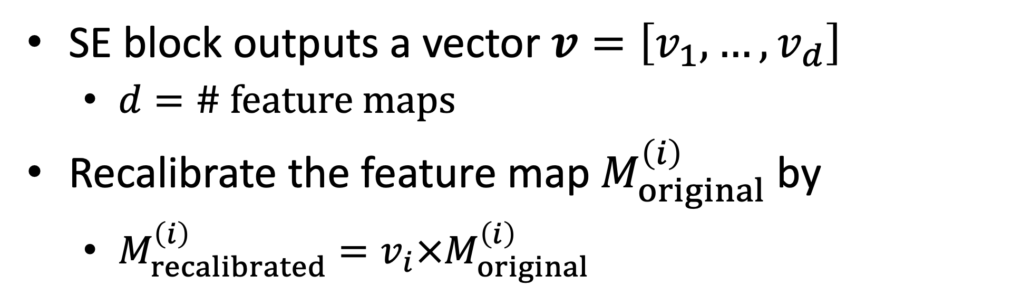
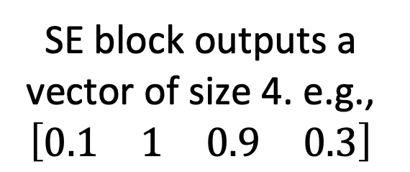
Integrate SE block into existing network architecture
# feature maps: 4
SE block outputs a vector of size 4. e.g., $\left[\begin{matrix}\begin{matrix}0.1 & 1\end{matrix} & \begin{matrix}0.9 & 0.3\end{matrix}\end{matrix}\right]$
SE block
$$×$$
Original feature maps
Elementwise product
Recalibrated feature maps
SE block outputs a vector $v=\left[v_{1},…,v_{d}\right]$
$d=\# feature maps$
Recalibrate the feature map $M_{original}^{\left(i\right)}$by
$M_{recalibrated}^{\left(i\right)}=v_{i}×M_{original}^{\left(i\right)}$

Slide 3
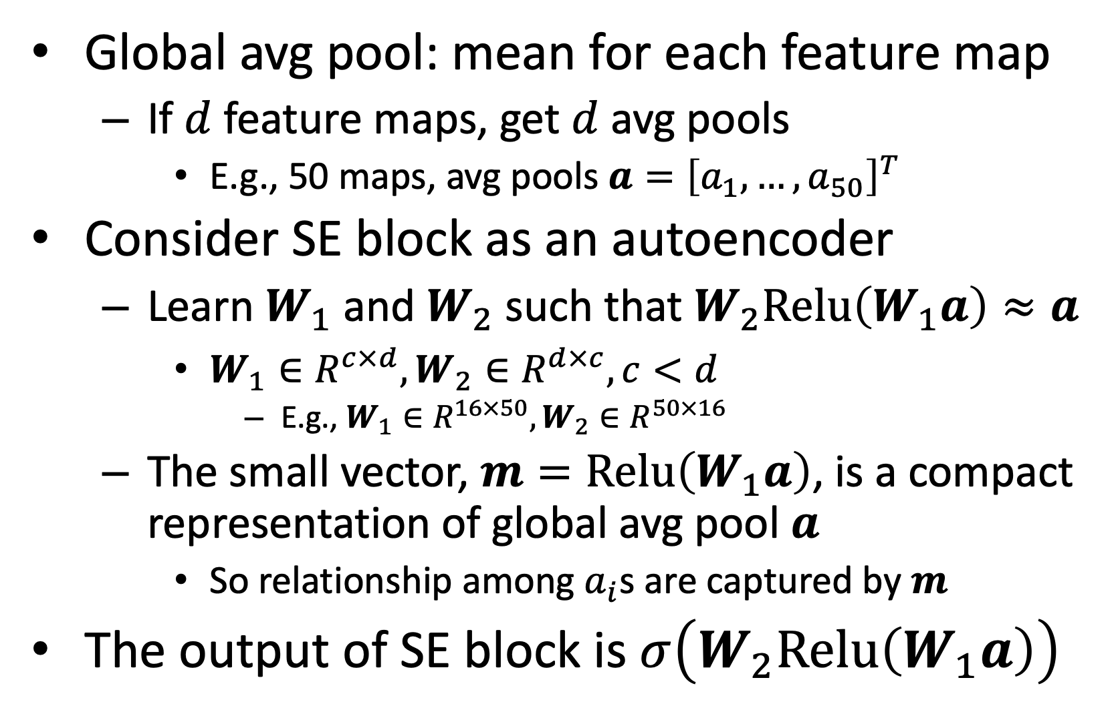
SE block architecture
Global avg pool: mean for each feature map
If $d$ feature maps, get $d$ avg pools
E.g., 50 maps, avg pools $a={\left[a_{1},…,a_{50}\right]}^{T}$
Consider SE block as an autoencoder
Learn $W_{1}$ and $W_{2}$ such that $W_{2}Relu\left(W_{1}a\right)≈a$
$W_{1}∈R^{c×d},W_{2}∈R^{d×c}, c<d$
E.g., $W_{1}∈R^{16×50},W_{2}∈R^{50×16}$
The small vector, $m=Relu\left(W_{1}a\right)$, is a compact representation of global avg pool $a$
So relationship among $a_{i}$s are captured by $m$
The output of SE block is $σ\left(W_{2}Relu\left(W_{1}a\right)\right)$
Dense
Dense
Global avg pool

