Slide 1
Introduction to Data Science
Hung-Hsuan Chen 陳弘軒
Computer Science and Information Engineering
National Central University
hhchen@ncu.edu.tw

Slide 2
Source: Drew Conway

Slide 3
When do we need machine learning?

Slide 4
Traditional vs data driven algorithm
Traditional algorithm: requires “prior” knowledge of the target problem
E.g., sorting
Some tasks are difficult to solve by prior knowledge
How to determine a face in a photo?
Data driven: learning from examples

Slide 5
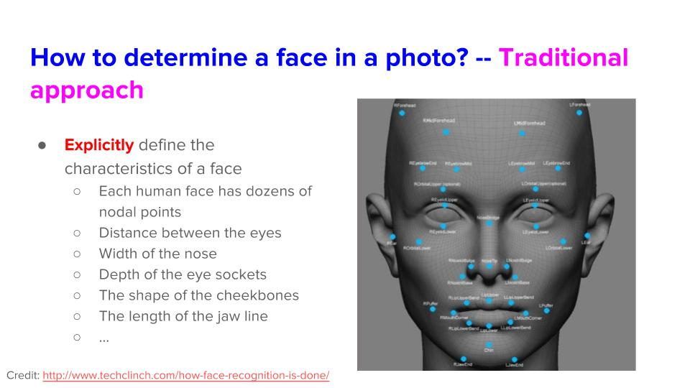

Slide 6
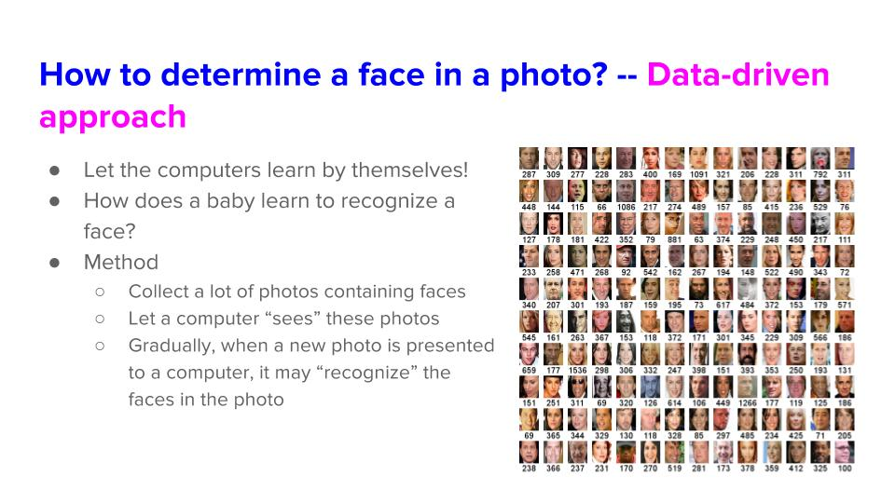

Slide 7
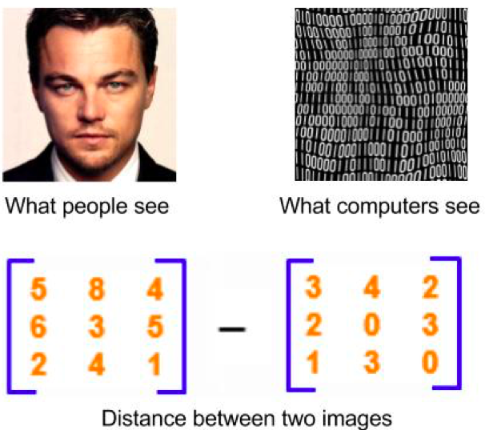
A naïve data driven approach to determine faces
Find the neighboring photos of the new photo
If most neighboring photos containing faces, the new photo probably contains faces
If most neighboring photos have no faces, the new photo probably contains no faces

Slide 8
Course information
Course website:
https://in.ncu.edu.tw/~hhchen/courses/data_science/
Staff
Instructor: Hung-Hsuan Chen (陳弘軒)
TAs: Tzu-Heng Lin (林子恆)、Kun-Ze Chen (陳堃澤)
Contact info is listed on the website
Meeting time and place: 14:00 - 16:50 Monday at A306
Lecture language: English

Slide 9
Materials
No single textbook is required
However, I suggest the following readings
The elements of statistical learning (T. Hastie, R. Tibshirani J. Friedman)
Deep Learning (I. Goodfellow, Y. Bengio and A. Courville)
They can be downloaded from the authors’ websites
Course materials are a mixture of slides and notes provided by different books, instructors, and me
I may use the whiteboard sometimes

Slide 10
Grading
Individual:
Exercises: 55%
Programming language: Python 3, unless otherwise mentioned
Submit your code to LMS
Reports must be typed
Submit the report to LMS (unless otherwise mentioned)
Others: 5%
Group:
Project proposal and progress presentation: 10%
Project demo and final report: 30%
For midterm, you will need to submit presentation slides; for final, you will need to submit (1) presentation slides, (2) a typed final report, and (3) experimental codes
Late submission penalties: 1 day: 10% off; 2 days: 20% off; 3 days or more: 0

Slide 11
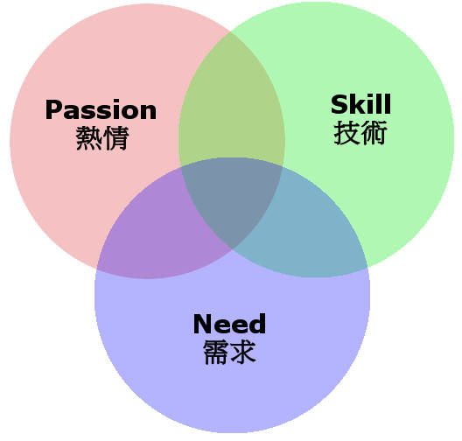
Characteristics of being a data scientist
Discover the problem or the need from real life
Equip with skills to solve the problem or fulfil the need
Math and stats
Hacking skills
Domain knowledge
Passion to try and realize the proposed solution

Slide 12

Characteristics of being a data scientist
Discover the problem or the need from real life
Equip with skills to solve the problem or fulfil the need
Math and stats
Hacking skills
Domain knowledge
Passion to try and realize the proposed solution
Through the mid-term and final projects.
We may have invited speakers
We will teach these in class
Need to rely on your own

Slide 13
FAQ
Will the instructor speak only English in class?
I might occasionally speak Chinese if needed, but I will make sure to repeat in English
Do I need to submit reports in English?
Not necessarily, since the TAs and I understand Chinese
Do I need to use English for oral presentation?
Yes if there are foreign students in the class
Do I need to ask questions in English?
Not necessarily. I will repeat your question in English. Please remind me if I forget to do so

Slide 14
FAQ
Will the instructor curve the scores?
59 → 60, 58 remains 58; 69 → 70, 68 remains 68
What will happen if I beg for a higher grade?
It is a waste of your time
What if I fake the project result?
Follow the “國立中央大學學生獎懲辦法”
You will get 0 on the course

Slide 15
Tips of selecting a topic for final project
Start from the dataset you’ve already have
I’ve already crawled posts on Dcard/PTT/Reddit, I’ll start from here…
Pick a dataset from Kaggle or other open data repo
Start from something you are interested or passionate
I like cooking. How to cook better or cook more creatively using data science?
Start from something you are specialized
My thesis is related to Computer Networking, how could I combine Computer Networking with Data Science?
Participate in (online or offline) communities, discuss, and get inspired
g0v, Data Science for Social Good, etc.
Participate in a competition

Slide 16
Books that may stimulate your project ideas
Freakonomics:A Rogue Economist Explores the Hidden Side of Everything (蘋果橘子經濟學)
Dataclysm：Who We Are(When We Think No One’s Looking) (我們是誰？大數據下的人類行為觀察)
The author is a co-founder of OkCupid
Social Physics: How Good Ideas Spread─The Lessons from a New Science (數位麵包屑裡的各種好主意)
Predictive Analytics: The Power to Predict Who Will Click, Buy, Lie, or Die (預測分析時代)

Slide 17
You may utilize your semi-finished or ongoing projects as part of the final project
You may combine your hobby project with data science
You may combine your undergraduate project with data science
You may combine your PhD/MS thesis with data science

Slide 18
Important dates
Proposal and progress presentation: 11/10 (midterm week)
Final project presentation: 1/5 (one week before the final week)
Final project report due: 1/11 (the final week)

Slide 19
Key card giving policy
The key cards will be given only when we have enough space
Senior students will have higher priority to get the key cards
PhD students ➔ senior MS students ➔ senior undergraduate students ➔ junior MS students ➔ junior undergraduate students

Slide 20
Confirmed speakers
Dr. Wen-Yu Hua (Amazon)
Time and location: 9/28 (Mon) 4:00 – 4:50 at A210
Title: Similarity Recommendation based on the Attention Mechanism
Dr. Tseng-Yi Chen
Time and location: TBA
Title: How to Cultivate a Green Decision Tree without Loss of Accuracy? (subject to change)

