Slide 1
Review quizzes
Illustrate an example in which using a traditional algorithm may be more appropriate than using a data-driven approach
Illustrate an example in which using a data-driven approach may be more appropriate than using a traditional algorithm
Explain kNN
Why features are usually scaled before using kNN?
Explain k-means

Slide 2
The Fizz Buzz joke
Source: http://joelgrus.com/2016/05/23/fizz-buzz-in-tensorflow/
Fizz Buzz
Print numbers between 1 and 100, except that if the number is divisible by 3 print “fizz”, if the number is divisible by 5 print “buzz”, and if it’s divisible by 15 print “fizzbuzz”
The interviewee uses a “data driven” approach to solve the problem
Modeled as a classification problem
Collect training data
Prediction: classify a number into “fizz”, “buzz”, “fizzbuzz”, or a number itself

Slide 3
Parameters vs hyper-parameters
Parameters: the unknown variables your models need to learn
E.g., y=ax+b, a and b are parameters
Hyper-parameter: the variables your models cannot learn (need to specified manually)
E.g., the variable k in the knn model
Sometimes we may abuse these terms
E.g., let’s fine tune the parameters to improve the performance…

Slide 4
Dealing with ties in KNN
KNN is based on one simple intuition: closer data points should be similar
How to deal with ties? ➔ You could do what ever you believe reasonable to break the tie
Common practices include
Randomly select a class
Gradually decrease k by one until you break the tie

Slide 5
KNN with different weights
In previous courses, we introduced knn with equal weights
All k closest neighbors are weighted equally
However, we may assign different weights to different neighbors
One common approach is to weight the neighbors based on the inverse of their distance

Slide 6
How to “evaluate” clustering result? (1/3)
No “correct” answer of clustering
Is “evaluating clustering result” reasonable?
If really want a quantified measurement, one possible way is to compute the ratio of inter-cluster distance and intra-cluster distance
Large ratio probably means better clustering
Various ways to define inter-cluster and intra-cluster distances

Slide 7
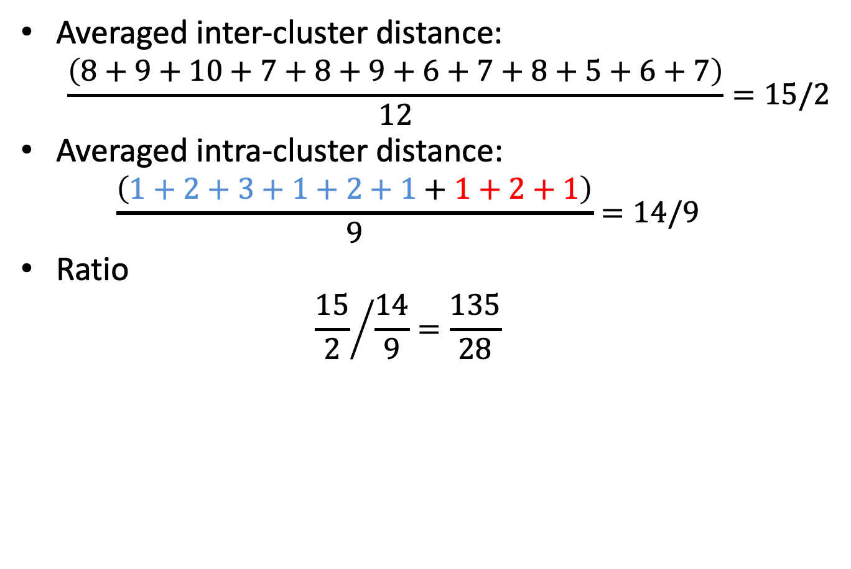
How to “evaluate” clustering result? (2/3)
1
2
3
4
9
10
11
Averaged inter-cluster distance:
$$\frac{\left(8+9+10+7+8+9+6+7+8+5+6+7\right)}{12}=15/2$$
Averaged intra-cluster distance:
$$\frac{\left(1+2+3+1+2+1+1+2+1\right)}{9}=14/9$$
Ratio
$${\frac{15}{2}}/{\frac{14}{9}=\frac{135}{28}}$$

Slide 8
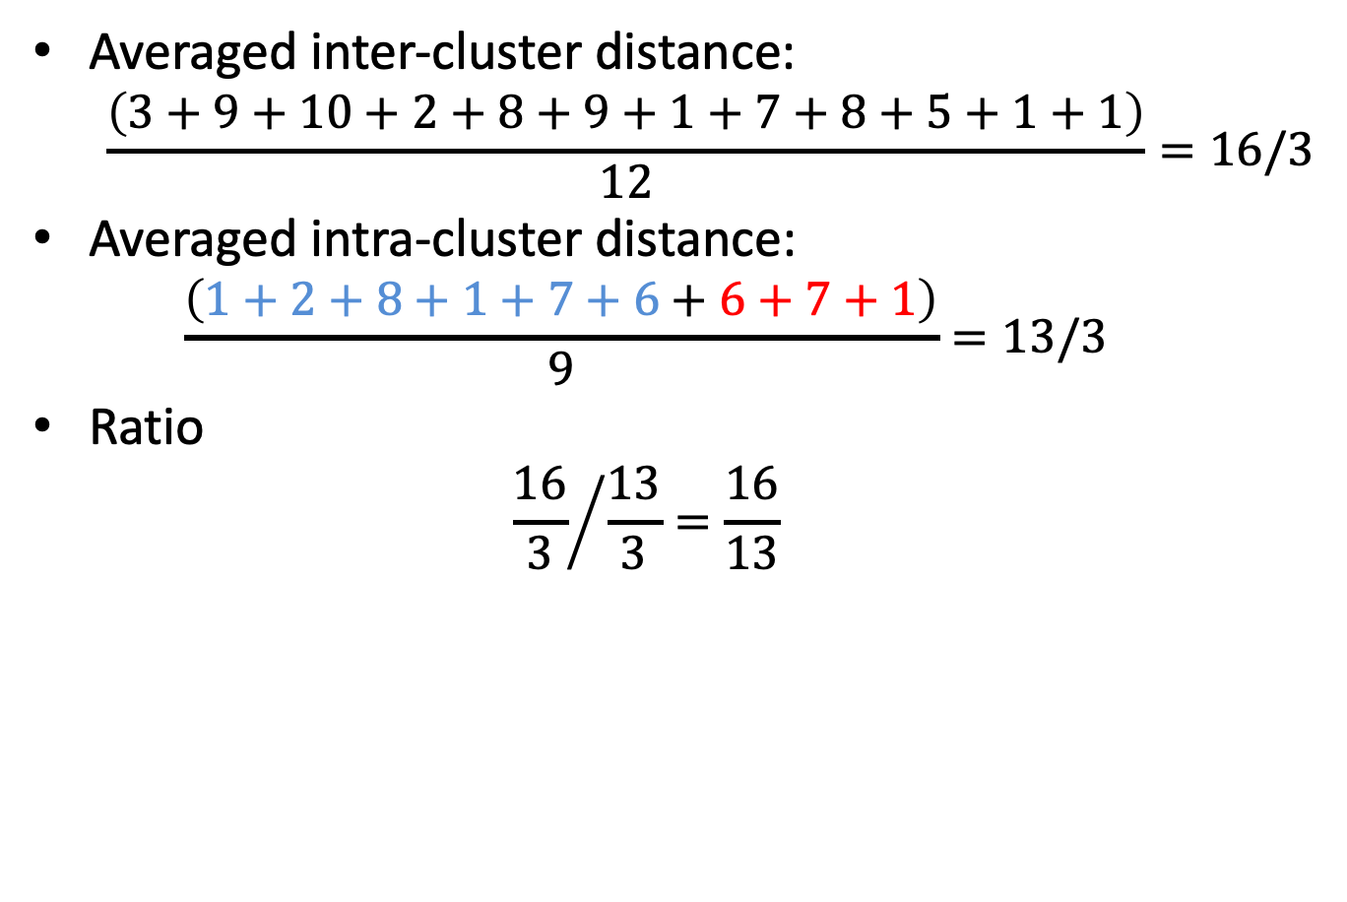
How to “evaluate” clustering result? (3/3)
1
2
3
4
9
10
11
Averaged inter-cluster distance:
$$\frac{\left(3+9+10+2+8+9+1+7+8+5+1+1\right)}{12}=16/3$$
Averaged intra-cluster distance:
$$\frac{\left(1+2+8+1+7+6+6+7+1\right)}{9}=13/3$$
Ratio
$${\frac{16}{3}}/{\frac{13}{3}=\frac{16}{13}}$$

Slide 9
How to do knn or k-means with categorical features?
If the definition of “distance” between categories is vague, consider one-hot encoding
Example:
Values of the “nationality” feature: “UK”, “Japan”, “Mexico”
We may encode UK as “1,0,0”, Japan as “0,1,0”, and “Mexico” as “0,0,1”
“Nationality feature” becomes three features: “UK or not”, “Japan or not”, “Mexico or not”

Slide 10
How to do knn or k-means with categorical features?
If the definition of “distance” between categories can be somewhat defined, perhaps use the definition
Example:
Values of “height”: tall, average, short
We may encode tall as 3, average as 2, short as 1

