Slide 1
Review quizzes
What is L2-norm?
What is L1-norm?
What are cosine similarity and cosine distance?
What is entropy?
What is the main difference between information gain and gain ratio?

Slide 2
Two different gini-indices
Decision tree
$Gini\left(D\right)=1−\sum_{i=1}^{m}{p_{i}^{2}}$
Income inequality
Gini-index = A/(A+B)

Slide 3
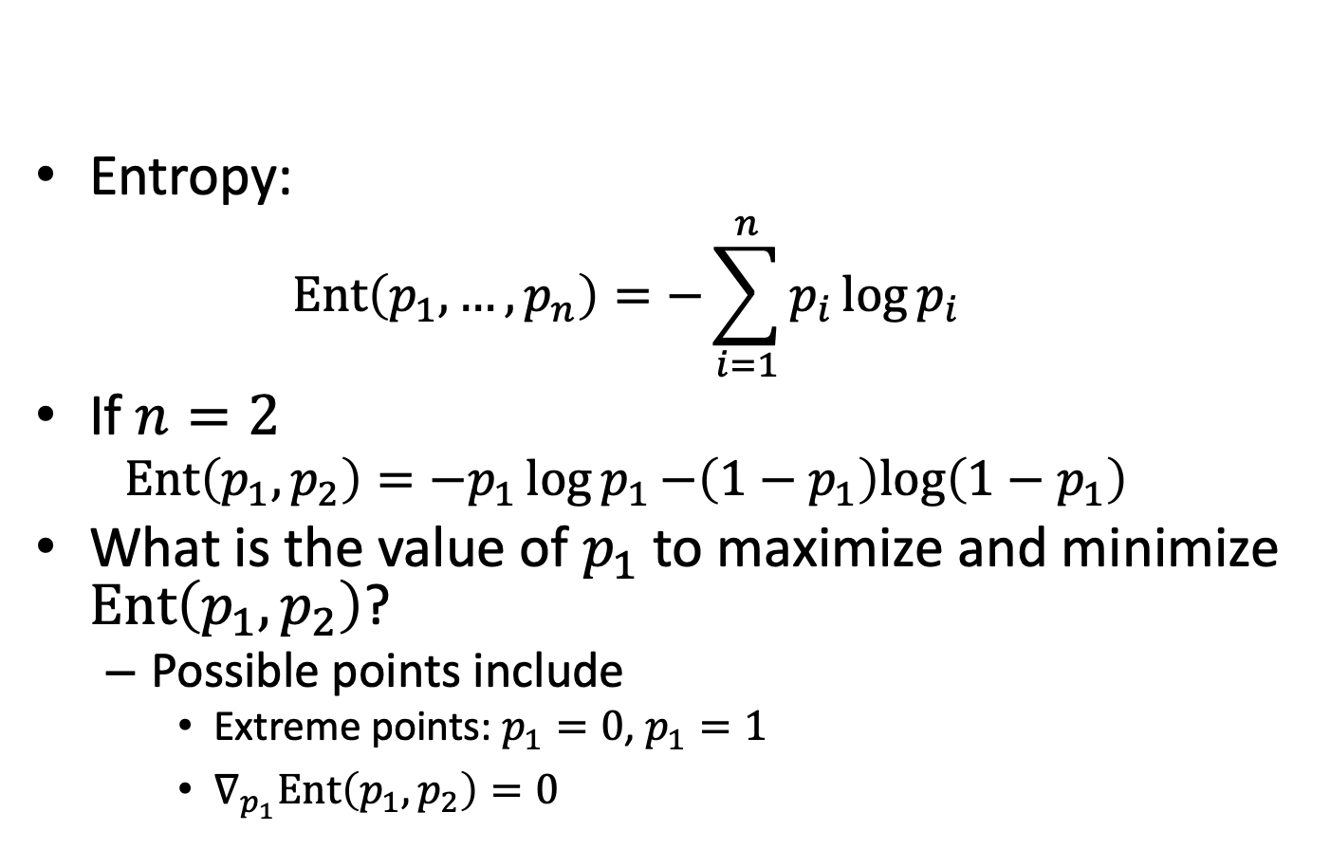
When $p_{i}$’s give maximum entropy and minimum entropy? (1/3)
Entropy:
$$Ent\left(p_{1},…,p_{n}\right)=−\sum_{i=1}^{n}{p_{i}\log{p_{i}}}$$
If $n=2$
$$Ent\left(p_{1},p_{2}\right)=−p_{1}\log{p_{1}−\left(1−p_{1}\right)log\left(1−p_{1}\right)}$$
What is the value of $p_{1}$ to maximize and minimize $Ent\left(p_{1},p_{2}\right)$?
Possible points include
Extreme points: $p_{1}=0$, $p_{1}=1$
$∇_{p_{1}}Ent\left(p_{1},p_{2}\right)=0$

Slide 4
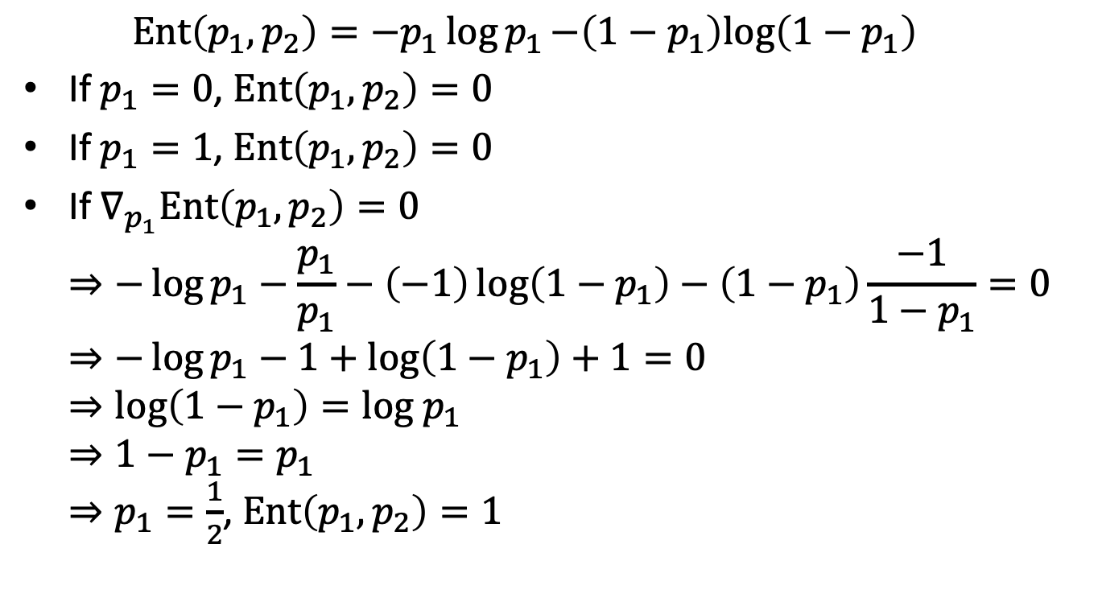
When $p_{i}$’s give maximum entropy and minimum entropy? (2/3)
$$Ent\left(p_{1},p_{2}\right)=−p_{1}\log{p_{1}−\left(1−p_{1}\right)log\left(1−p_{1}\right)}$$
If $p_{1}=0$, $Ent\left(p_{1},p_{2}\right)=0$
If $p_{1}=1$, $Ent\left(p_{1},p_{2}\right)=0$
If $∇_{p_{1}}Ent\left(p_{1},p_{2}\right)=0$ $⇒−\log{p_{1}}−\frac{p_{1}}{p_{1}}−\left(−1\right)\log\left(1−p_{1}\right)−\left(1−p_{1}\right)\frac{−1}{1−p_{1}}=0$ $⇒−\log{p_{1}}−1+\log\left(1−p_{1}\right)+1=0$ $⇒\log\left(1−p_{1}\right)=log p_{1}$ $⇒1−p_{1}=p_{1}$ $⇒p_{1}=\frac{1}{2}$, $Ent\left(p_{1},p_{2}\right)=1$

Slide 5
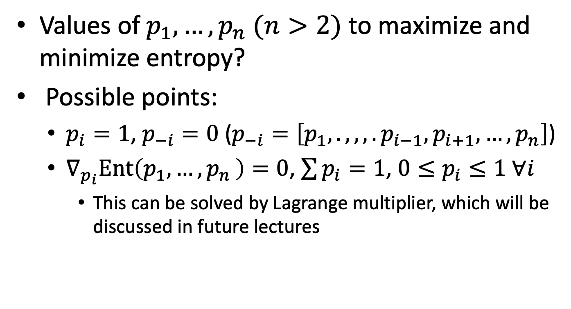
When $p_{i}$’s give maximum entropy and minimum entropy? (3/3)
Values of $p_{1},…,p_{n} (n>2)$ to maximize and minimize entropy?
Possible points:
$p_{i}=1$, $p_{−i}=0$ ($p_{−i}=\left[p_{1},.,,,.p_{i−1},p_{i+1},…,p_{n}\right]$)
$∇_{p_{i}}Ent\left(p_{1},{…,p}_{n}\right)=0$, $\sum{p_{i}}=1$, ${0≤p}_{i}≤1 ∀i$
This can be solved by Lagrange multiplier, which will be discussed in future lectures

Slide 6
Exercise 2
Requirement
Implement a decision tree classifier using Python. (50%)
You **cannot** use existing decision tree libraries (e.g., sklearn.tree.DecisionTreeClassifier)
Use your classifier to predict the class of the iris plants based on the Balance Scale Data Set (http://archive.ics.uci.edu/ml/datasets/Balance+Scale). (40%)
Separate the data into training (70%) and test (30%) datasets. Please make sure the dataset is split in a stratified fashion, i.e., the class distributions in the training and the test datasets are the same as the class distribution in the entire dataset.
Report both the training and the test error for k = 1, 2, 3, …, 20
A brief discussion of the results. (10%)
Please submit your code and report to new ee-class
Due date: 10/19 23:59:59

