Slide 1
SVM: Linear method with feature engineering vs kernel method
Hung-Hsuan Chen
Many are taken from Prof. C.-J. Lin’s slides

Slide 2
Support vector classification
Data point i: x_{i} = (x_{i1}, x_{i2}, …, x_{id})
Class label of i: y_{i}
Two classes
Class 1: y_{i} = 1
Class 2: y_{i} = -1
Find a hyperplane to separate the data points with maximal margin

Slide 3
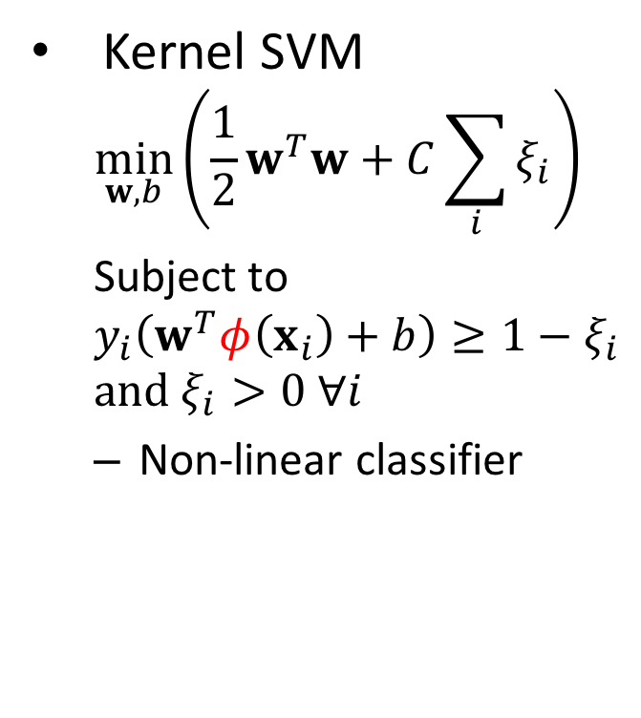
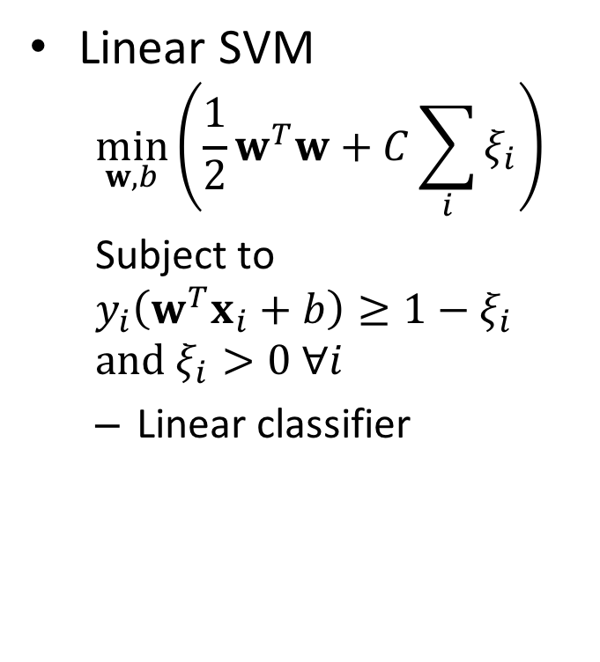
Linear SVM vs kernel SVM
Linear SVM
$$\min_{w,b}\left({\frac{1}{2}w}^{T}w+C\sum_{i}{ξ_{i}}\right)$$
Subject to
$$y_{i}\left(w^{T}x_{i}+b\right)≥1−ξ_{i}$$
$$and ξ_{i}>0 ∀i$$
Linear classifier
Kernel SVM
$$\min_{w,b}\left({\frac{1}{2}w}^{T}w+C\sum_{i}{ξ_{i}}\right)$$
Subject to
$$y_{i}\left(w^{T}φ\left(x_{i}\right)+b\right)≥1−ξ_{i}$$
$$and ξ_{i}>0 ∀i$$
Non-linear classifier

Slide 4
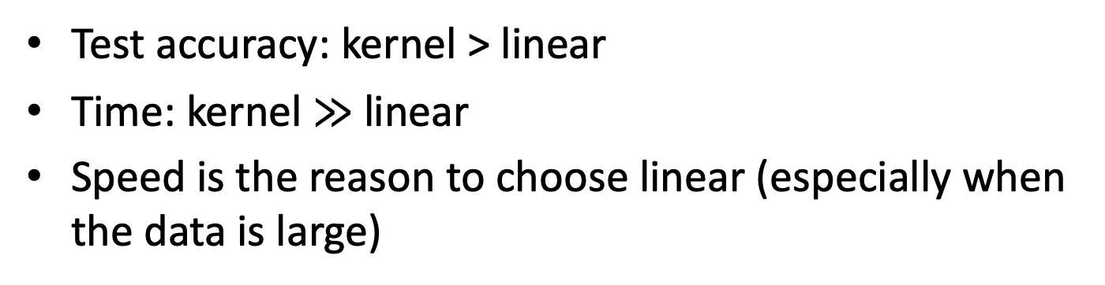
Pros and cons of linear and kernel SVM
Linear SVM
Faster in training and testing
If the dataset is non-linearly separable, linear SVM may not perform well
Kernel SVM
Could be much slower in training and testing
Can fit any curve
RBF kernel
Test accuracy: kernel > linear
Time: kernel $≫$ linear
Speed is the reason to choose linear (especially when the data is large)

Slide 5
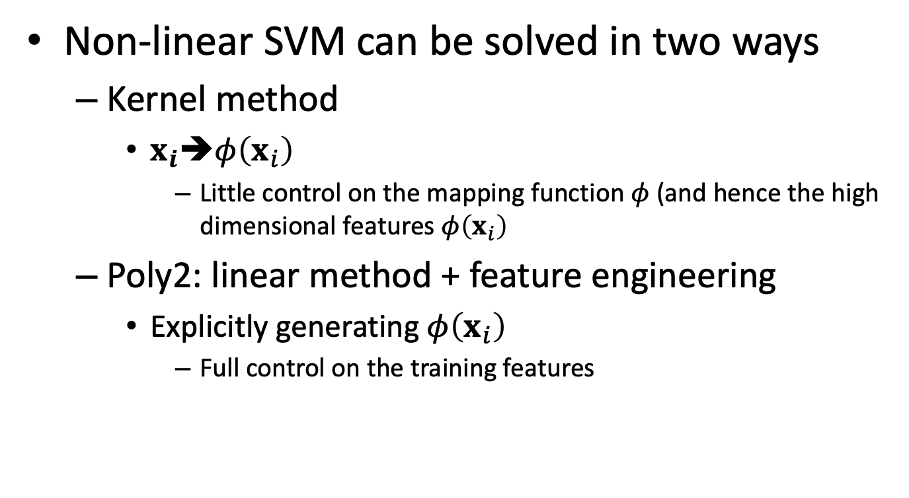
Solving non-linear SVM : poly2 vs kernel classification
Non-linear SVM can be solved in two ways
Kernel method
$x_{i}➔φ\left(x_{i}\right)$
Little control on the mapping function $φ$ (and hence the high dimensional features $φ\left(x_{i}\right)$
Poly2: linear method + feature engineering
Explicitly generating $φ\left(x_{i}\right)$
Full control on the training features

Slide 6
Popular kernels
Linear kernel (i.e., linear SVM)
$$K\left(x_{i},x_{t}\right)=x_{i}^{T}x_{t}=\left\langle x_{i},x_{t}\right\rangle$$
Polynomial kernel
$$K\left(x_{i},x_{t}\right)={\left(\left\langle x_{i},x_{t}\right\rangle +r\right)}^{d}, r>0$$
Gaussian (RBF) kernel
$$K\left(x_{i},x_{t}\right)=\exp\left(−γ{\left\|x_{i}−x_{t}\right\|}^{2}\right)$$
The dimension of $K\left(x_{i},x_{t}\right)$ could be infinity (e.g., RBF kernel), but the dimensions of $x_{i}$ and $x_{t}$ are finite

Slide 7
Poly-2 vs kernel, when data is sparse
When data is large and sparse
Accuarcy by linear SVM + poly2 is as good as kernel
Training and testing time of linear SVM + poly2 is much faster

Slide 8
Example: document classification
Using bag-of-words model to predict the labels of documents
Examples of labels: emotion (happy, angry, sad, etc.), author (J. K. Rowling, Dan Brown, etc.), genre (e.g., journal, poetry, ghost story, etc.), …
Bag-of-words
Every English word corresponds to a feature
Example
Original sentences
John likes to watch movies. Mary likes movies too.
John also likes to watch football games.
Bag-of-words representation of the two sentences
[ "John", "likes", "to", "watch", "movies", "Mary", "too", "also", "football", "games" ]
[1, 2, 1, 1, 2, 1, 1, 0, 0, 0]
[1, 1, 1, 1, 0, 0, 0, 1, 1, 1]
Features created by the bag-of-words are usually large and sparse
Large: kernel SVM is much slower than linear SVM
Sparse: high dimensional features are likely to be zero (i.e., unhelpful), sotest accuracy of linear SVM + poly2 is as good as kernel

Slide 9
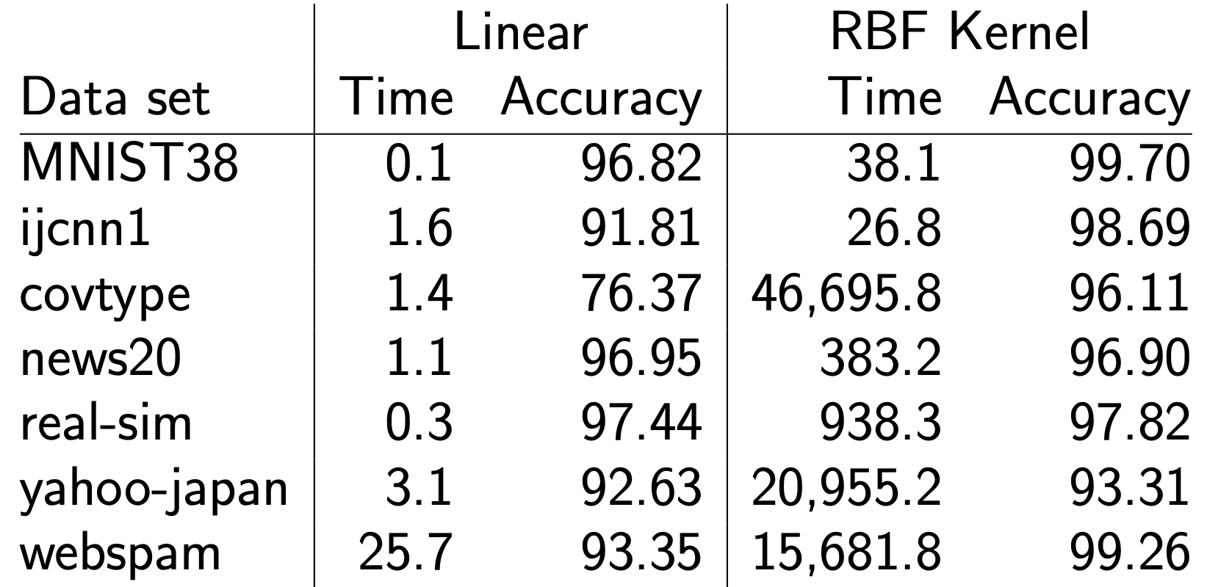
Linear SVM + poly2 vs kernel (training time & test accuracy)
Large and sparse datasets

Slide 10
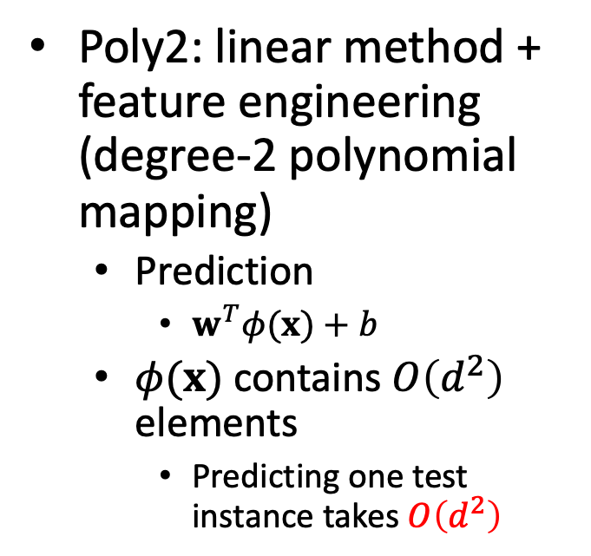
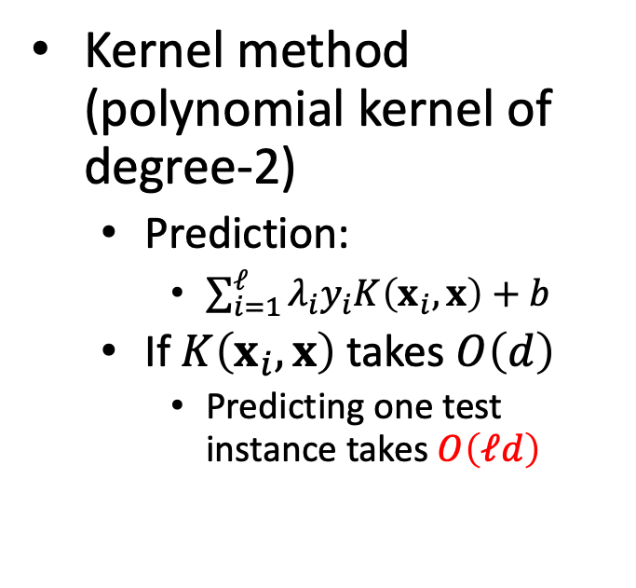
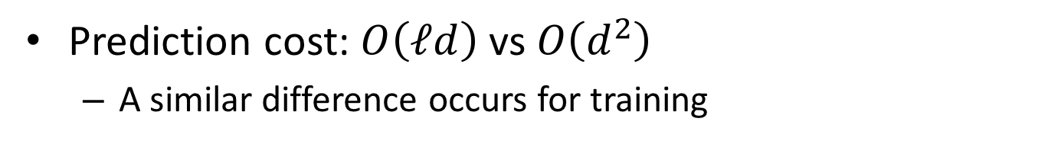
Prediction cost
Assuming x has d elements (features)
Kernel method (polynomial kernel of degree-2)
Prediction:
$\sum_{i=1}^{ℓ}{λ_{i}y_{i}K\left(x_{i}, x\right)}+b$
If $K\left(x_{i}, x\right)$ takes $O\left(d\right)$
Predicting one test instance takes $O\left(ℓd\right)$
Poly2: linear method + feature engineering (degree-2 polynomial mapping)
Prediction
$w^{T}φ(x)+b$
$φ(x)$ contains $O\left(d^{2}\right)$ elements
Predicting one test instance takes $O\left(d^{2}\right)$
Prediction cost: $O\left(ℓd\right)$ vs $O\left(d^{2}\right)$
A similar difference occurs for training

Slide 11
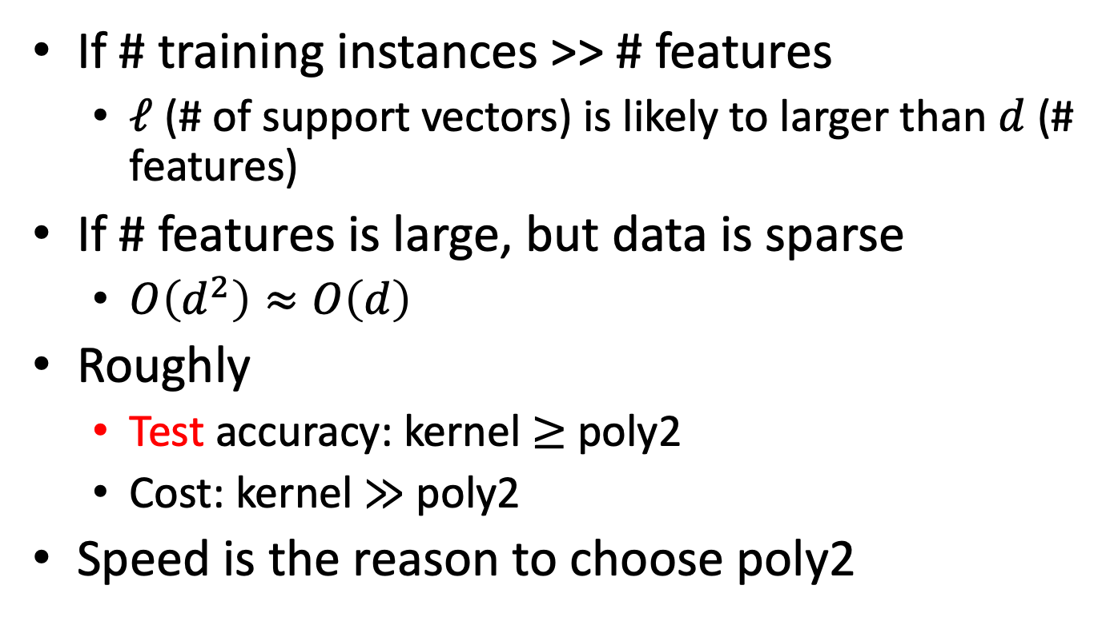
Cases where Linear SVM + poly-2 feature engineering is probably faster
If # training instances >> # features
$ℓ$ (# of support vectors) is likely to larger than $d$ (# features)
If # features is large, but data is sparse
$O\left(d^{2}\right)≈O\left(d\right)$
Roughly
Test accuracy: kernel $≥$ poly2
Cost: kernel $≫$ poly2
Speed is the reason to choose poly2

Slide 12
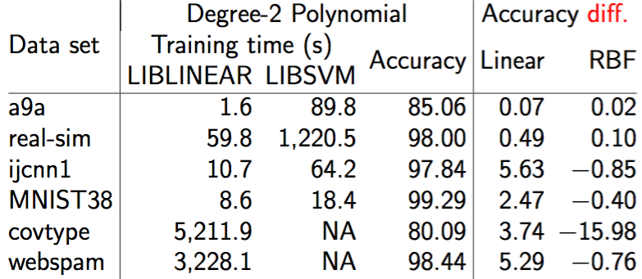
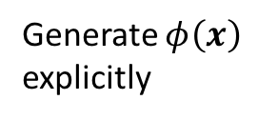
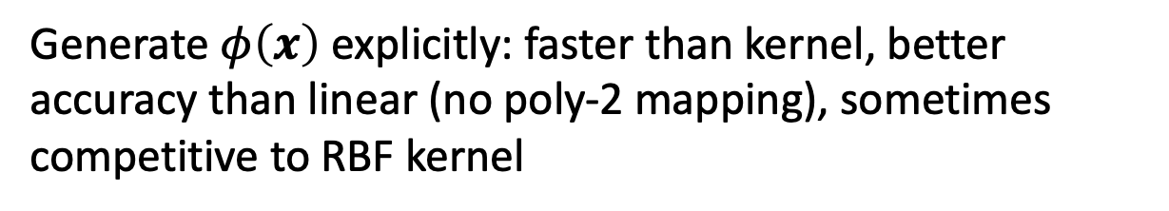
Test accuracy and training time
Generate $φ\left(x\right)$ explicitly
Kernel trick
Generate $φ\left(x\right)$ explicitly: faster than kernel, better accuracy than linear (no poly-2 mapping), sometimes competitive to RBF kernel

Slide 13
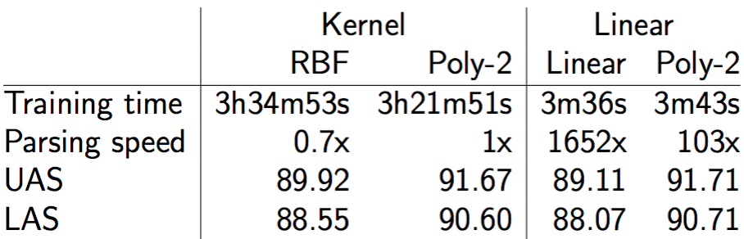
Dependency parsing
Linear SVM with feature engineering is fast in both training and testing, while maintain good accuracy
Dependency parsing is an NLP task
UAS: unlabeled attachment score
LAS: labeled attachment score

Slide 14
Discussion
Linear versus kernel is an important issue in practice.
It’s takes enormous computation resource to apply kernel SVM on large dataset (e.g., web-scale dataset)
You must decide when to use which

Slide 15
Quiz
If number of instances is much larger than number of features
Using polynomial kernel is much more efficient than using linear SVM + poly2 kernel (true or false)

