Slide 1
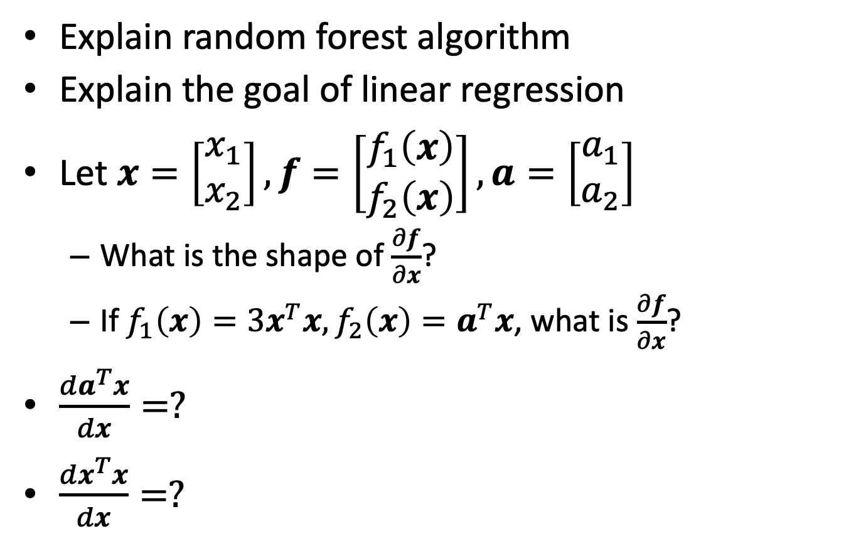
Review quizzes (1/2)
Explain random forest algorithm
Explain the goal of linear regression
Let $x=\left[\begin{matrix}x_{1} \\ x_{2}\end{matrix}\right], f=\left[\begin{matrix}f_{1}\left(x\right) \\ f_{2}\left(x\right)\end{matrix}\right],a=\left[\begin{matrix}a_{1} \\ a_{2}\end{matrix}\right]$
What is the shape of $\frac{∂f}{∂x}$?
If $f_{1}\left(x\right)=3x^{T}x, f_{2}\left(x\right)=a^{T}x$, what is $\frac{∂f}{∂x}$?
$\frac{da^{T}x}{dx}=?$
$\frac{dx^{T}x}{dx}=?$

Slide 2
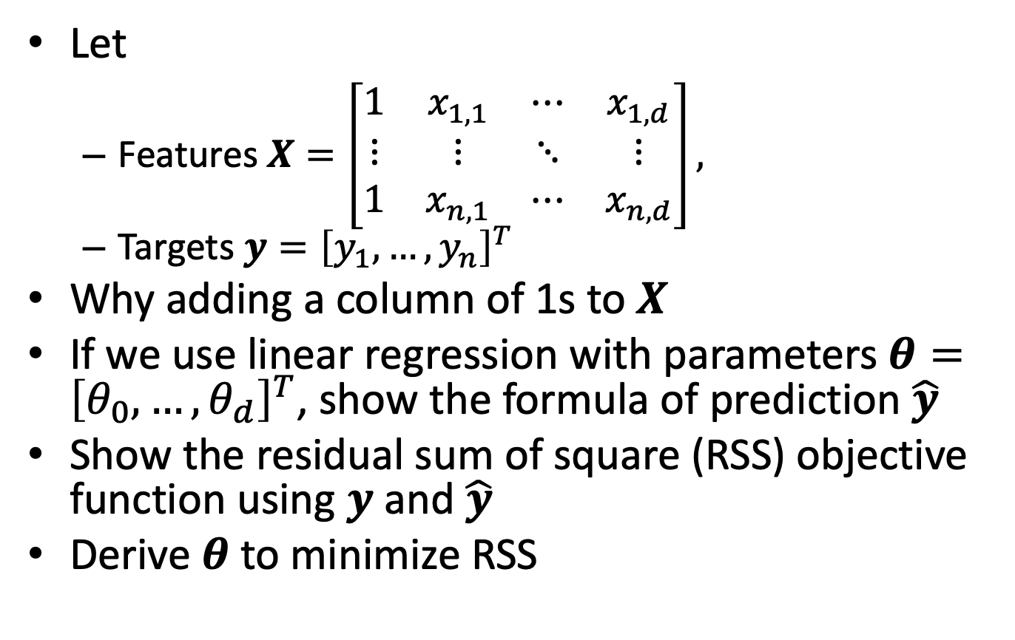
Review quizzes (2/2)
Let
Features $X=\left[\begin{matrix}1 & x_{1,1} & ⋯ & x_{1,d} \\ ⋮ & ⋮ & ⋱ & ⋮ \\ 1 & x_{n,1} & ⋯ & x_{n,d}\end{matrix}\right],$
Targets $y={\left[y_{1},…,y_{n}\right]}^{T}$
Why adding a column of 1s to $X$
If we use linear regression with parameters $θ={\left[θ_{0},…,θ_{d}\right]}^{T}$, show the formula of prediction $\hat{y}$
Show the residual sum of square (RSS) objective function using $y$ and $\hat{y}$
Derive $θ$ to minimize RSS

Slide 3
Exercise 2
Requirement
Coding (90%)
Implement a decision tree classifier using Python.
You **cannot** use existing decision tree libraries (e.g., sklearn.tree.DecisionTreeClassifier)
Use your classifier to predict the class based on the Balance Scale Data Set (http://archive.ics.uci.edu/ml/datasets/Balance+Scale).
Separate the data into training (70%) and test (30%) datasets. Please make sure the dataset is split in a stratified fashion, i.e., the class distributions in the training and the test datasets are the same as the class distribution in the entire dataset.
Report both the training and the test error
A brief discussion of the results. (10%)
Please submit your code and report to new ee-class
Due date: 10/19 23:59:59

Slide 4
Today’s schedule
My lecture: 2:00 – 4:20
Python introduction by TAs: 4:20 – 4:50

