Slide 1
Long Short-Term Memory(LSTM)
陳沿廷

Slide 2
Outline
RNN introduction
LSTM introduction
LSTM implementation

Slide 3
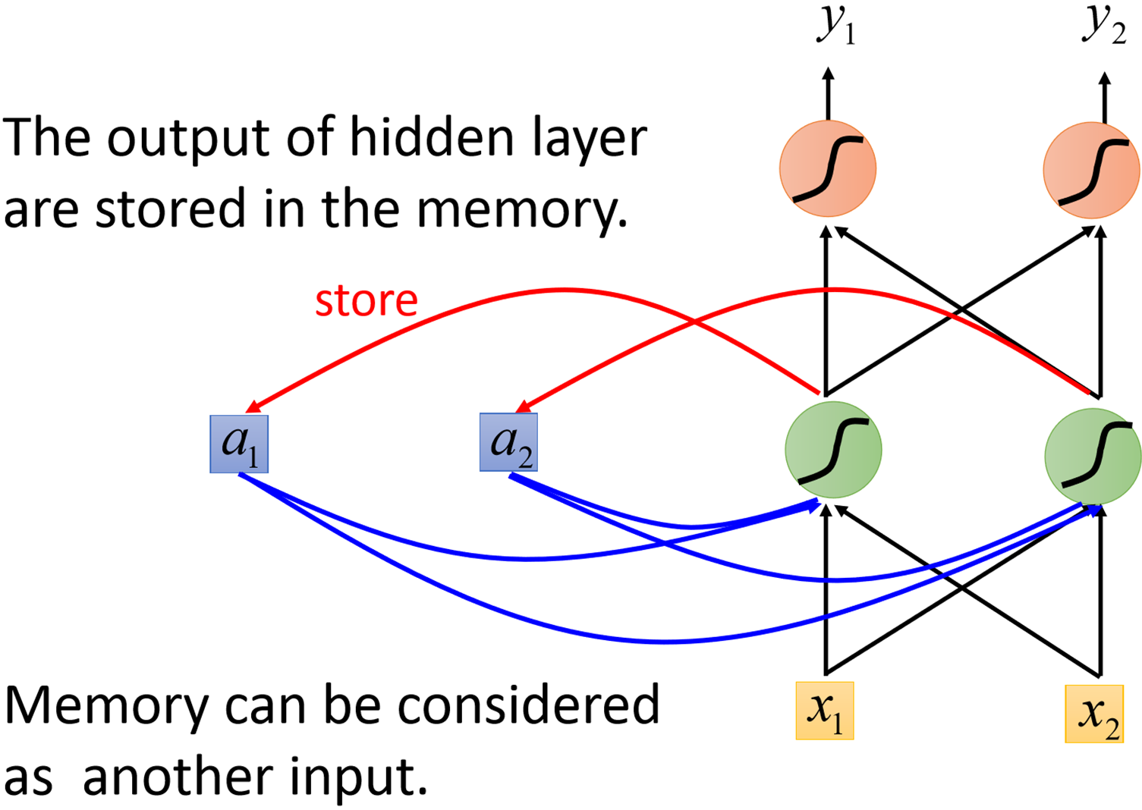
Recurrent Neural Network (RNN)
W

Slide 4
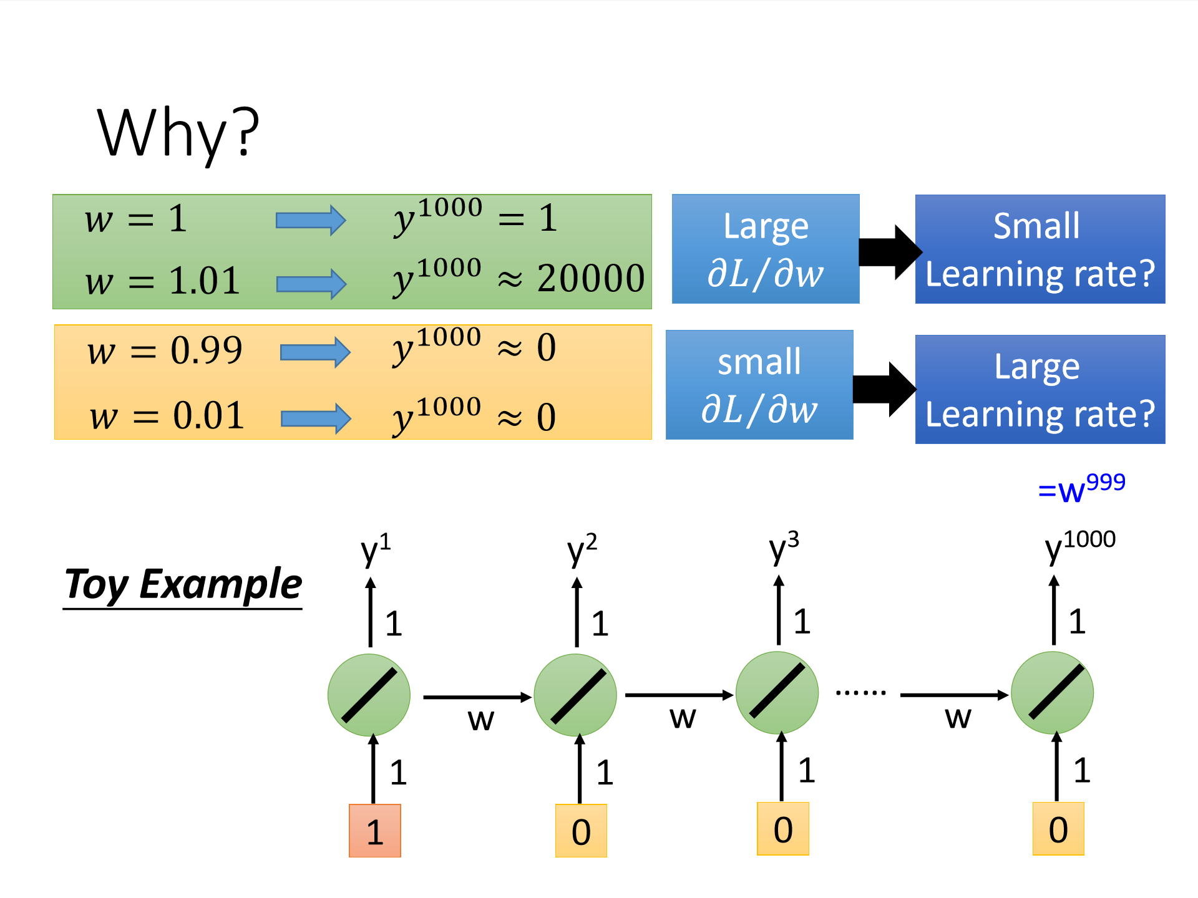
Training

Slide 5
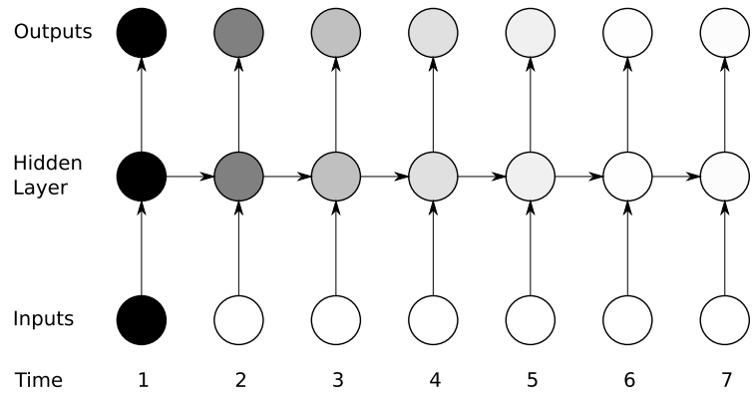
RNN problem : Long-Term Dependencies

Slide 6
LSTM introduction

Slide 7
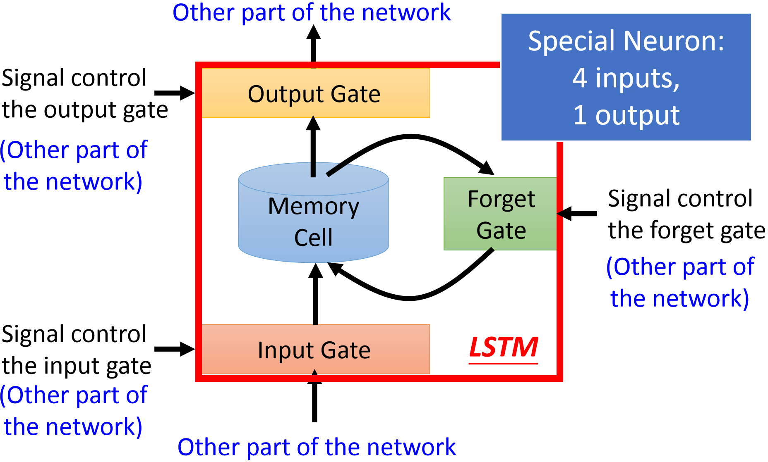
Long Short-term Memory (LSTM)

Slide 8

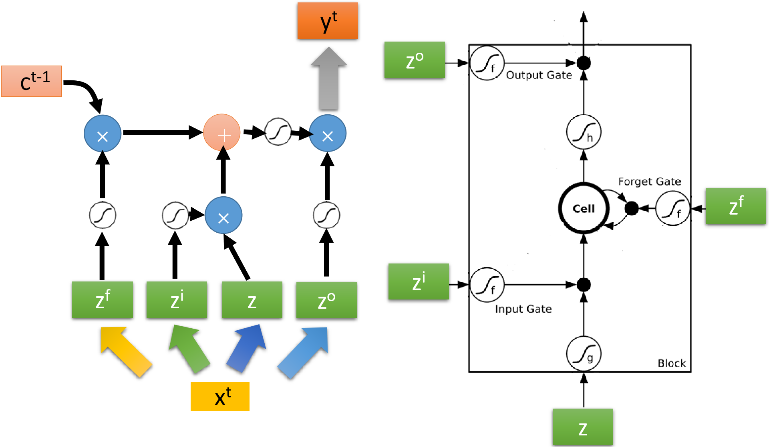


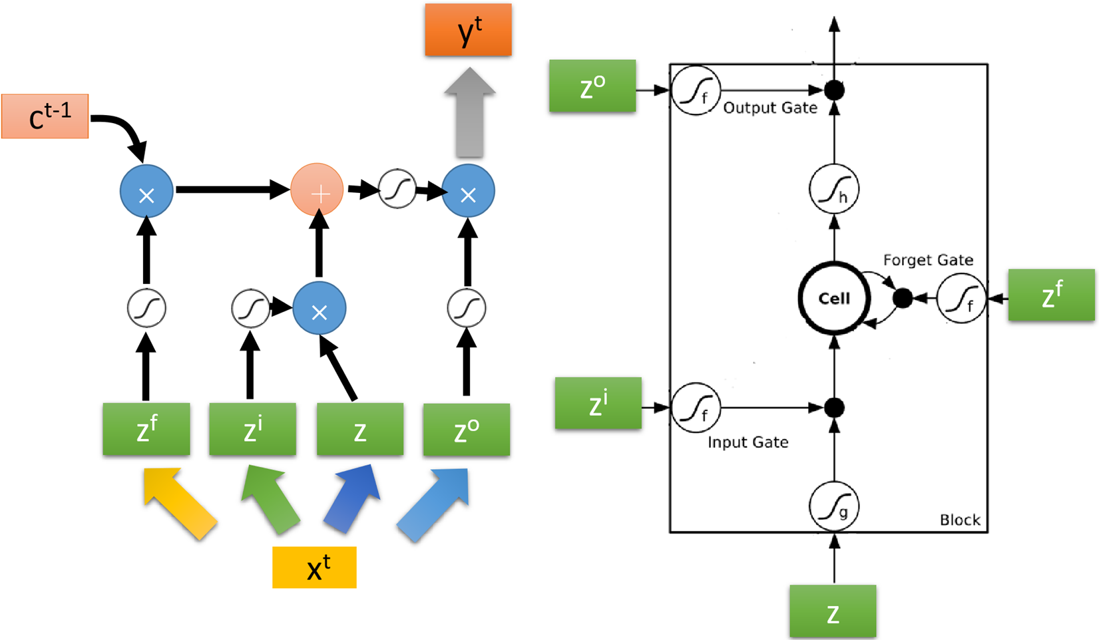

Slide 9
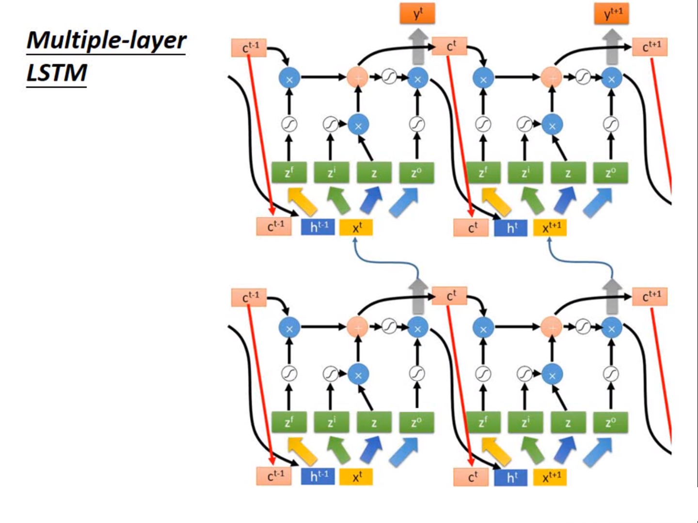

Slide 10
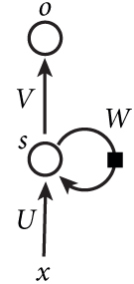
LSTM vs RNN
add
RNN
LSTM

Slide 11
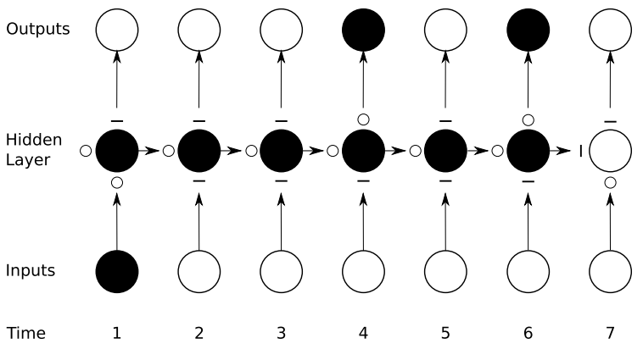
“ O ”: open
“ — ”: closed

Slide 12
LSTM Implementation

Slide 13
Dataset
Collect the number of NYC taxi passengers every 30 minutes during one day
Collection time: from July, 2014 to January, 2015
Training data : weekday without monday in July, 2014
Testing data : weekday without monday in August, 2014

Slide 14
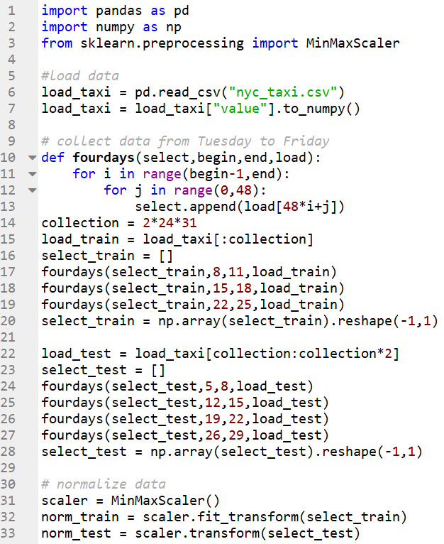

Slide 15
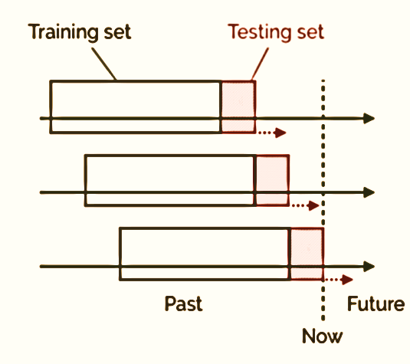
Labels – by using sliding window

Slide 16
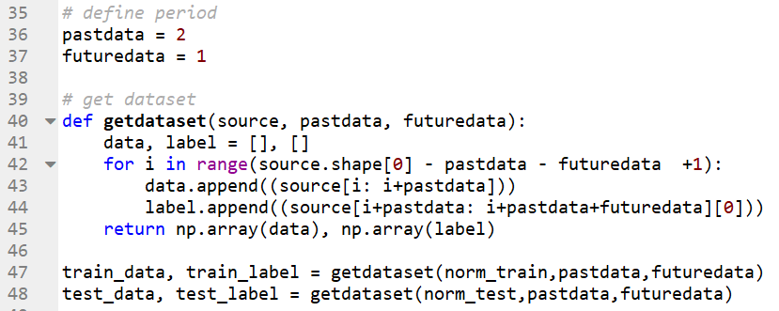

Slide 17
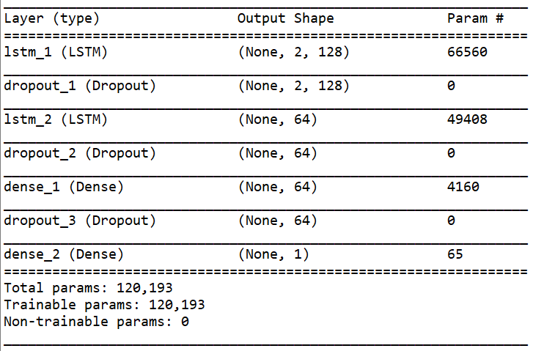
Training model

Slide 18
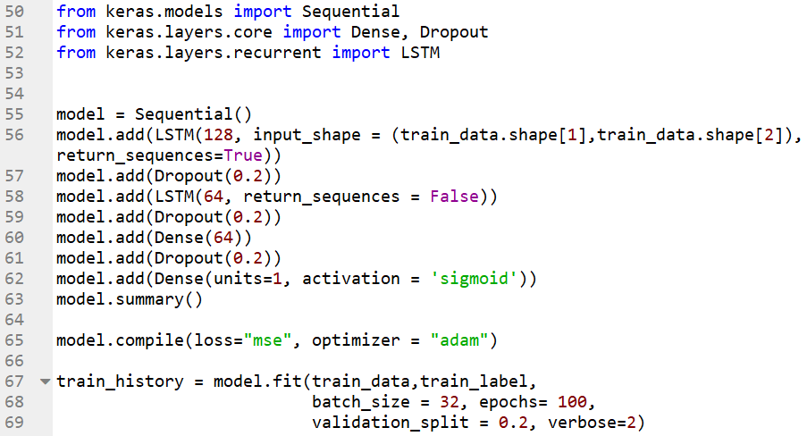

Slide 19
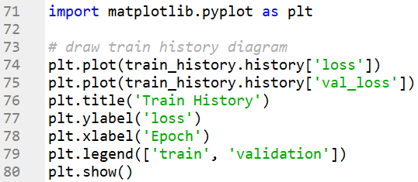
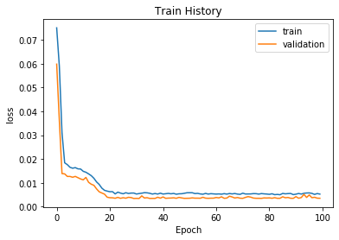
Result

Slide 20
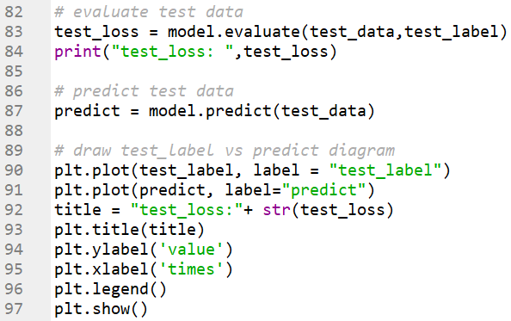
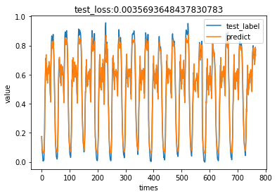
Comparison

Slide 21
Q & A

