Slide 1
機器學習環境安裝教學

Slide 2
Outline
Install anaconda
Install Tensorflow/keras
Anaconda Navigator

Slide 3
Install anaconda

Slide 4
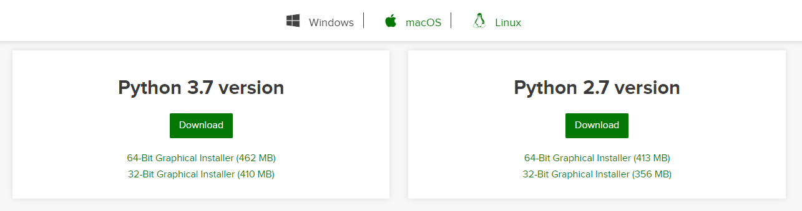
Install anaconda
https://www.anaconda.com/distribution/#windows

Slide 5
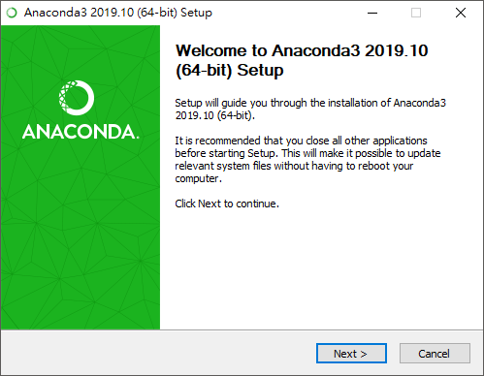
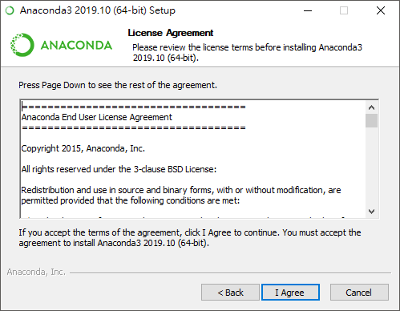
Install anaconda

Slide 6
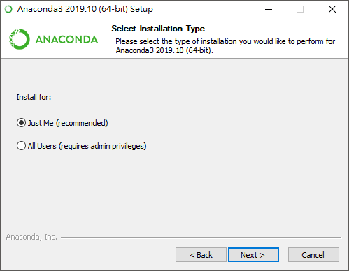
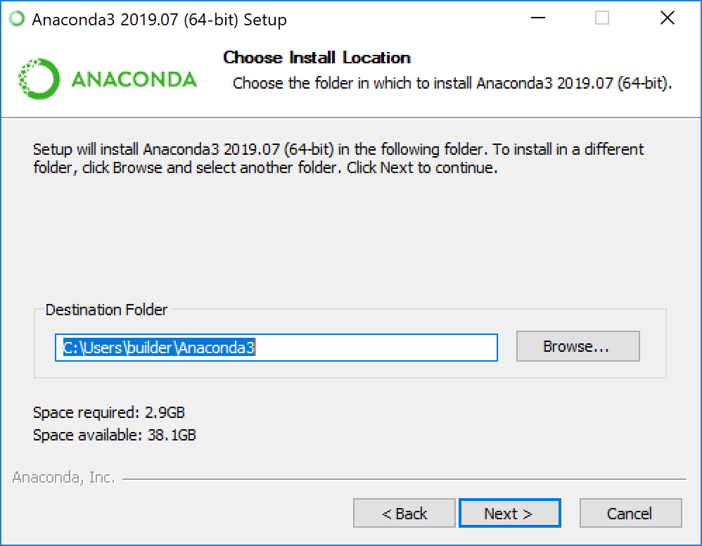
Install anaconda

Slide 7
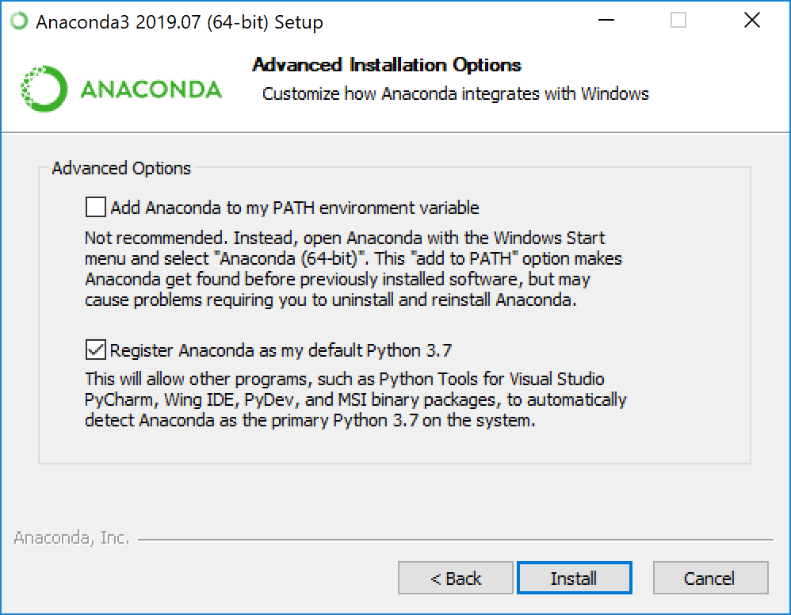
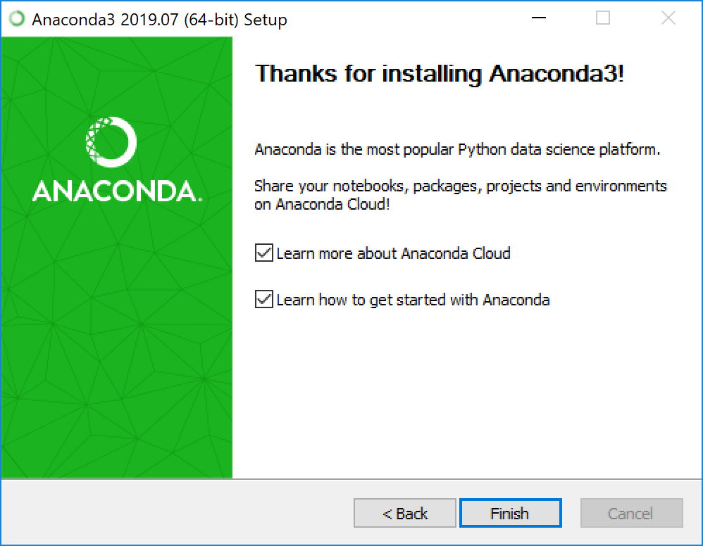
Install anaconda

Slide 8
Install Tensorflow/keras

Slide 9
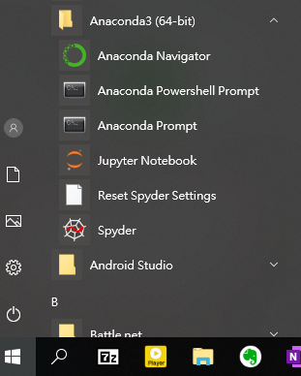
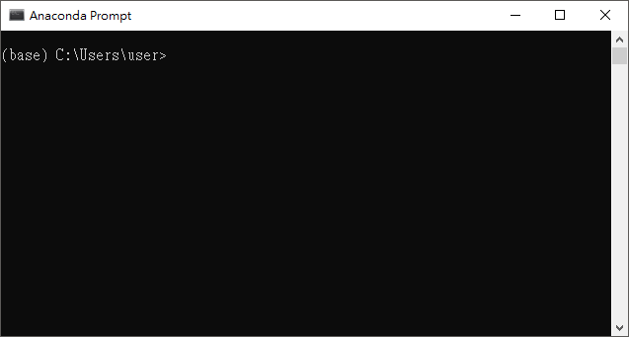
Install Tensorflow/keras
Execute Anaconda Prompt

Slide 10
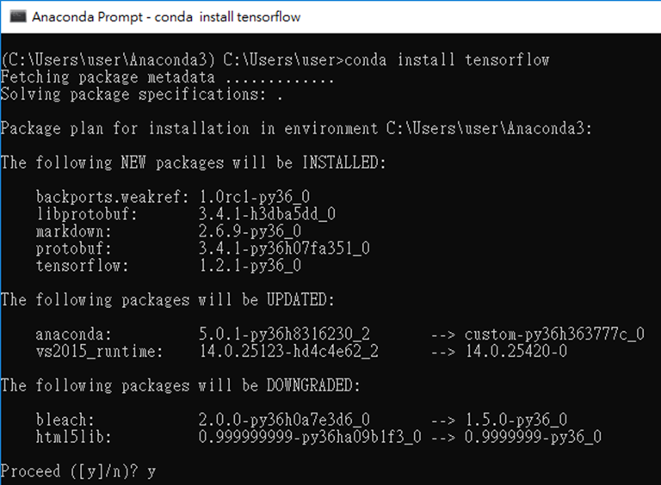
Install Tensorflow/keras
conda install tensorflow

Slide 11
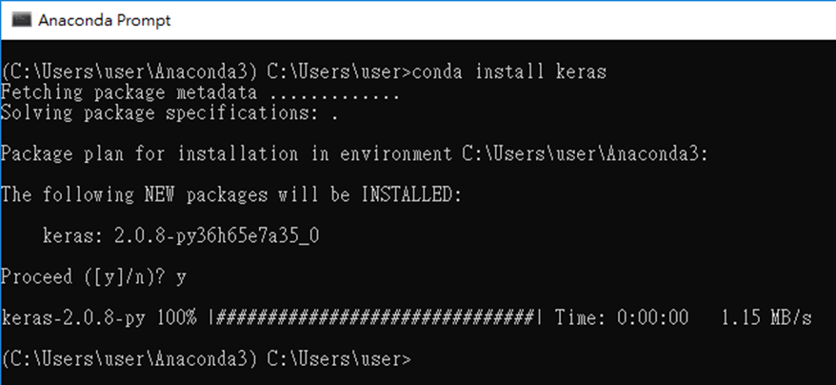
Install Tensorflow/keras
conda install keras

Slide 12
Anaconda Navigator

Slide 13
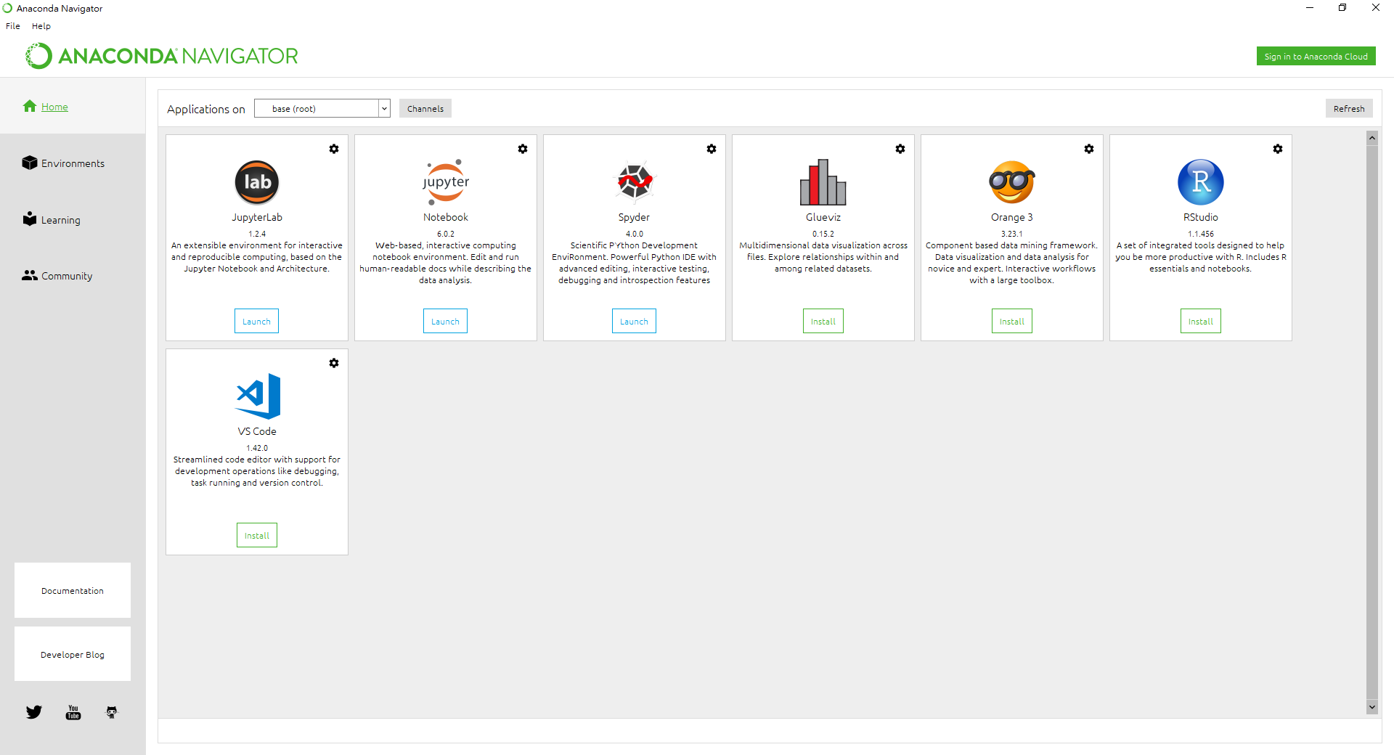
Anaconda Navigator

Slide 14
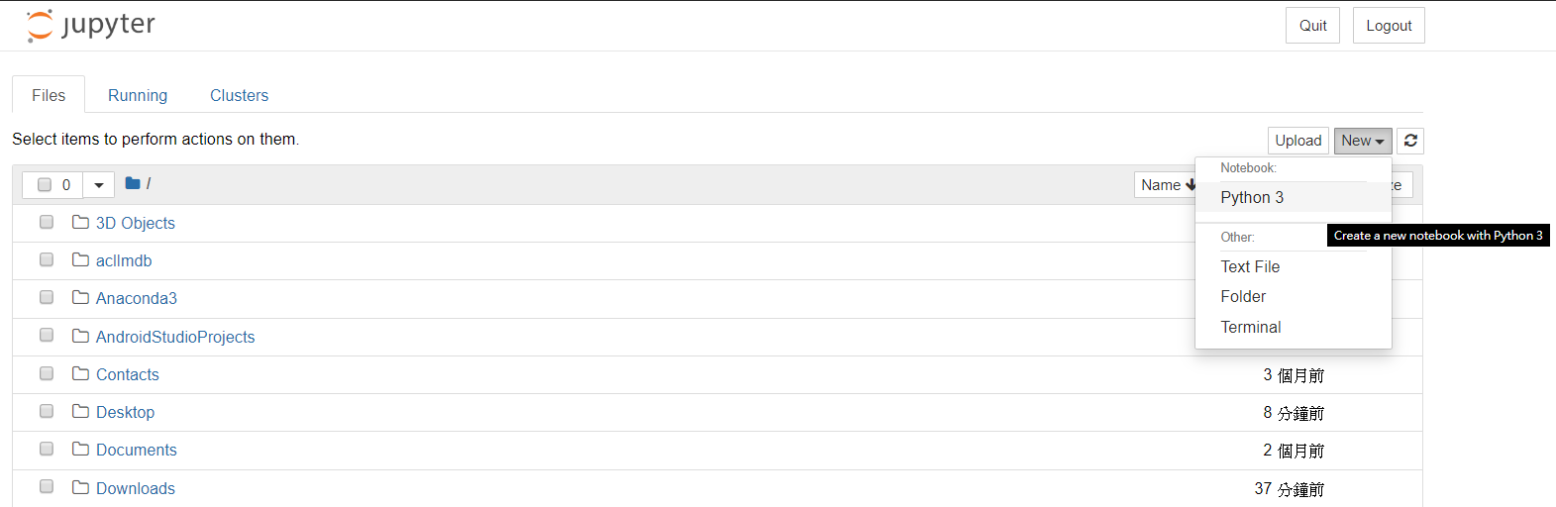
Jupyter Notebook

Slide 15
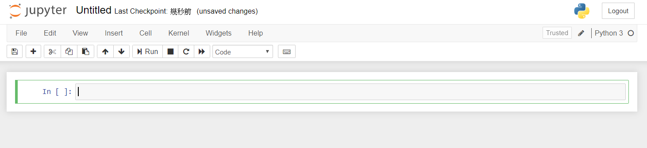
Jupyter Notebook

Slide 16
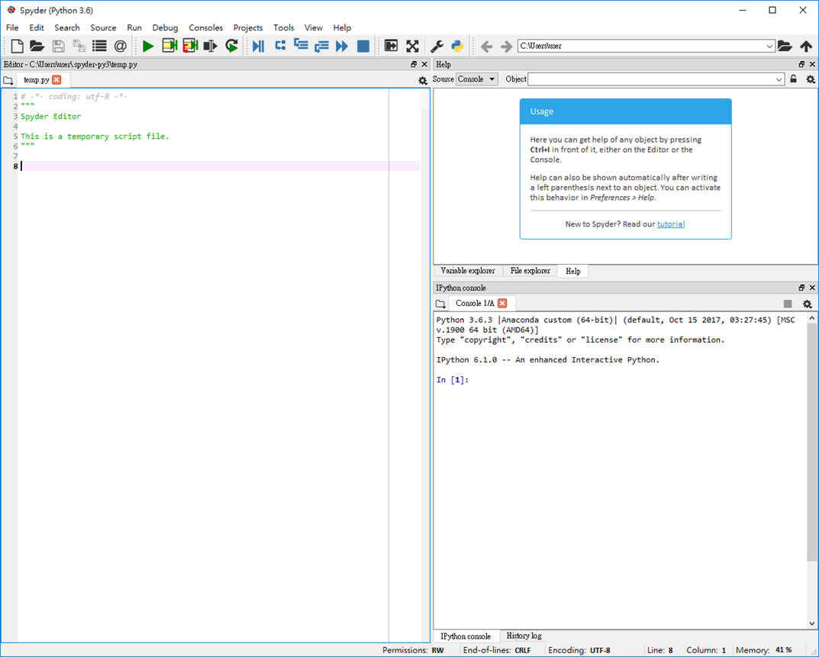
Spyder

