Slide 1
Algorithm Small Talk
Prof. Jehn-Ruey Jiang
National Central University, Taiwan

Slide 2
Algorithm is IPO
Traditional Algorithm
E.G.:
Process
Input
Output
An Integer n, n>0
Process
true or false:
n is odd (true)
or even (false)

Slide 3
Algorithm Example 1
Algorithm OddNumberTest
Input: n, n∈Z⁺
Output: true (n is odd) or false (n is even)
1: r ← n % 2
2: if r≠0
3: return true
4: else
5: return false

Slide 4
Algorithm Implementation 1
def OddNumberTest(n):
r=n%2
if r!=0:
return True
else:
return False
print OddNumberTest(3)
Result: True

Slide 5
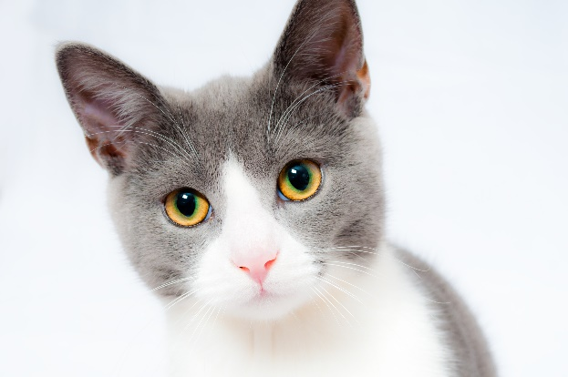
Algorithm is IPO
Machine Learning Algorithm
E.G.:
Process
Input
Output
A 64 x 64 x 256 Image M
Process
true or false:
M is a cat (true) or not (false)

Slide 6
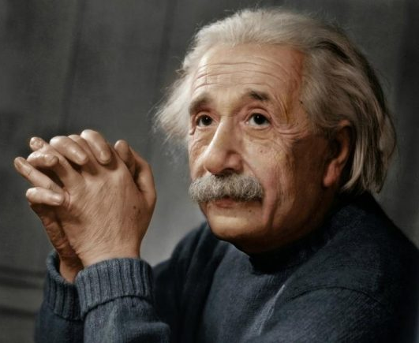
Algorithm Example 2
A 64 x 64 x 256 Image M
Process
true or false:
M is a cat (true) or not (false)

Slide 7
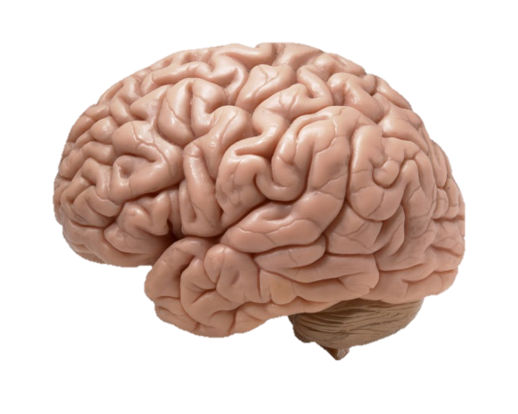
Algorithm Example 2 (Cont’d)
A 64 x 64 x 256 Image M
Process
true or false:
M is a cat (true) or not (false)

Slide 8
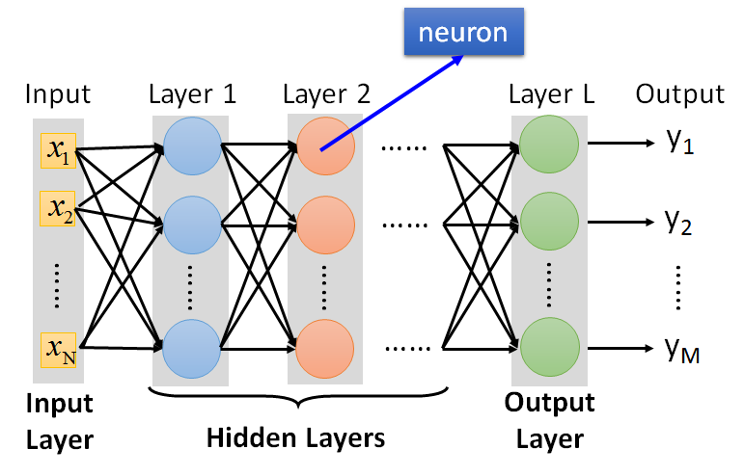
Algorithm Example 2 (Cont’d)
A 64 x 64 x 256 Image M
Process
(DNN)
true or false:
M is a cat (true) or not (false)

Slide 9
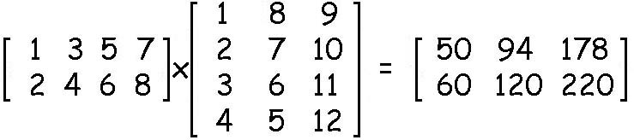
Python Programming
To calculate:
By python codes
import numpy as np
a=np.array([[1,3,5,7], [2,4,6,8]])
b=np.array([[1,8,9], [2,7,10], [3,6,11], [4,5,12]])
print np.matmul(a,b)
Result:
[[ 50 94 178]
[ 60 120 220]]

Slide 10
To be Continued

