Slide 1
歐拉旅途/路徑演算法 Eulerian Tour/Path Algorithm
國立中央大學 資訊工程系
江振瑞
Jehn-Ruey Jiang

Slide 2
無向圖的歐拉旅途/路徑演算法 Eulerian Tour/Path Algorithm for Undirected Graphs
由一空堆疊及空旅途(路徑)開始 - 若全部節點的相鄰節點數(也就是「度」(degree))皆為偶數 ，則任意挑選一節點為當前節點 - 若剛好有兩節點相鄰數為奇數 – 從兩者中挑其一為當前節點 - 否則回傳歐拉旅途(路徑)不存在
若當前節點沒有鄰居 – 將其加入旅途，將堆疊中的最後一個節點從堆疊中移除並將其設為當前節點。反之，若當前節點具有鄰居 – 將此當前節點加入堆疊，選取此節點的任一鄰居，移除當前節點與所選取鄰居之間的邊，並設此鄰居為新的當前節點
重覆步驟二直到當前節點沒有相鄰節點且堆疊已為空
Notes:
Start with an empty stack and an empty circuit (Eulerian path). - If all vertices have even degree - choose any of them. - If there are exactly 2 vertices having an odd degree - choose one of them. - Otherwise no euler circuit or path exists.
If current vertex has no neighbors - add it to circuit, remove the last vertex from the stack and set it as the current one. Otherwise (in case it has neighbors) - add the vertex to the stack, take any of its neighbors, remove the edge between selected neighbor and that vertex, and set that neighbor as the current vertex.
Repeat step 2 until the current vertex has no more neighbors and the stack is empty.

Slide 3
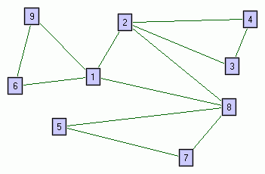
堆疊: 空 當前節點: 無 旅途: 空

Slide 4
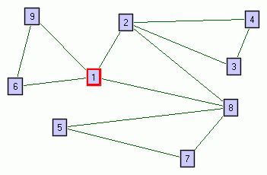
堆疊: 空 當前節點: 1 旅途: 空

Slide 5
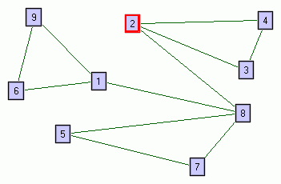
堆疊: 1 當前節點: 2 旅途: 空

Slide 6
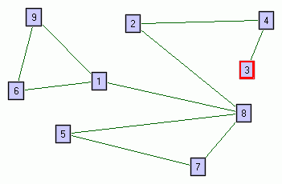
堆疊: 1, 2 當前節點: 3 旅途: 空

Slide 7
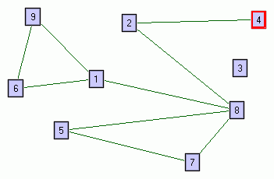
堆疊: 1, 2, 3 當前節點: 4 旅途: 空

Slide 8
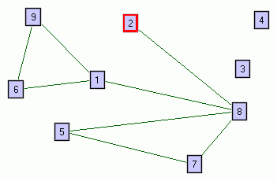
堆疊: 1, 2, 3, 4 當前節點: 2 旅途: 空

Slide 9
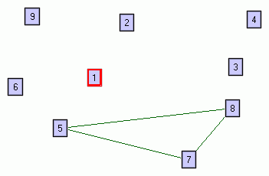
堆疊: 1, 2, 3, 4, 2, 8, 1, 6, 9 當前節點: 1 旅途: 空

Slide 10
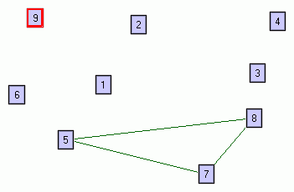
堆疊: 1, 2, 3, 4, 2, 8, 1, 6 當前節點: 9 旅途: 1

Slide 11
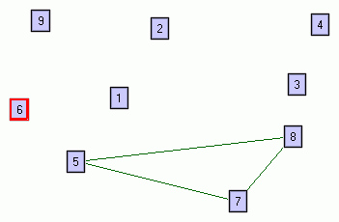
堆疊: 1, 2, 3, 4, 2, 8, 1 當前節點: 6 旅途: 1, 9

Slide 12
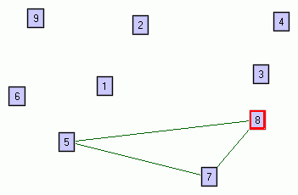
堆疊: 1, 2, 3, 4, 2 當前節點: 8 旅途: 1, 9, 6, 1

Slide 13
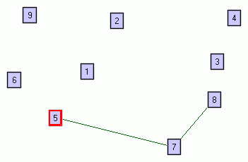
堆疊: 1, 2, 3, 4, 2, 8 當前節點: 5 旅途: 1, 9, 6, 1

Slide 14
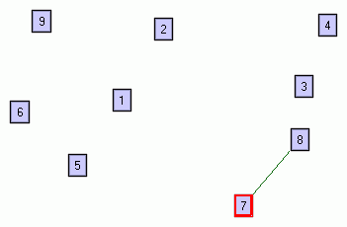
堆疊: 1, 2, 3, 4, 2, 8, 5 當前節點: 7 旅途: 1, 9, 6, 1

Slide 15
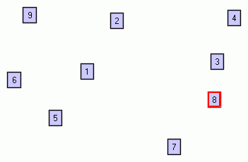
堆疊: 1, 2, 3, 4, 2, 8, 5, 7 當前節點: 8 旅途: 1, 9, 6, 1

Slide 16
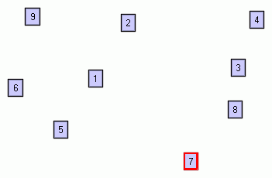
堆疊: 1, 2, 3, 4, 2, 8, 5 當前節點: 7 旅途: 1, 9, 6, 1, 8

Slide 17
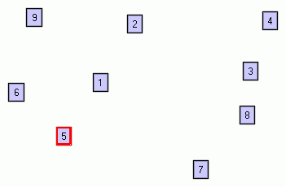
堆疊: 1, 2, 3, 4, 2, 8 當前節點: 5 旅途: 1, 9, 6, 1, 8, 7

Slide 18
旅途: 1, 9, 6, 1, 8, 7, 5, 8, 2, 4, 3, 2, 1 在無向圖中不須考慮節點順序，但是在有向圖中則需要考慮節點順序。因此，在有向圖中必須反轉以上節點順序以求得歐拉旅途: 1, 2, 3, 4, 2, 8, 5, 7, 8, 1, 6, 9, 1
Notes:
Here the order doesn't matter, but for directed graphs - it's crucial. So let's consider the Eulerian Tour for this graph to be the reverse of the above circuit:

Slide 19
Exercise
將以自然語言撰寫的「無向圖歐拉旅途/路徑演算法」改為以虛擬碼撰寫
以自然語言撰寫「有向圖歐拉旅途/路徑演算法」(應考慮「入度(in-degree)」與「出度(out-degree)」的相差值)
以虛擬碼撰寫「有向圖歐拉旅途/路徑演算法」
分析兩個演算法的時間複雜度
Notes:
http://www.graph-magics.com/articles/euler.php
Algorithm for directed graphs:
Start with an empty stack and an empty circuit (eulerian path). - If all vertices have same out-degrees as in-degrees - choose any of them. - If all but 2 vertices have same out-degree as in-degree, and one of those 2 vertices has out-degree with one greater than its in-degree, and the other has in-degree with one greater than its out-degree - then choose the vertex that has its out-degree with one greater than its in-degree. - Otherwise no euler circuit or path exists.
If current vertex has no out-going edges (i.e. neighbors) - add it to circuit, remove the last vertex from the stack and set it as the current one. Otherwise (in case it has out-going edges, i.e. neighbors) - add the vertex to the stack, take any of its neighbors, remove the edge between that vertex and selected neighbor, and set that neighbor as the current vertex.
Repeat step 2 until the current vertex has no more out-going edges (neighbors) and the stack is empty.
Complexity: The complexity of both algorithms is O(N+M), where N is the number of vertices and M is the number of edges.

Slide 20
Q&A

