Slide 1
Eulerian Tour/Path Algorithm
Updated on 2012/12/25

Slide 2
Eulerian Tour/Path Algorithm for Undirected Graphs
Start with an empty stack and an empty circuit (eulerian path). - If all vertices have even degree - choose any of them. - If there are exactly 2 vertices having an odd degree - choose one of them. - Otherwise no euler circuit or path exists.
If current vertex has no neighbors - add it to circuit, remove the last vertex from the stack and set it as the current one. Otherwise (in case it has neighbors) - add the vertex to the stack, take any of its neighbors, remove the edge between selected neighbor and that vertex, and set that neighbor as the current vertex.
Repeat step 2 until the current vertex has no more neighbors and the stack is empty.

Slide 3
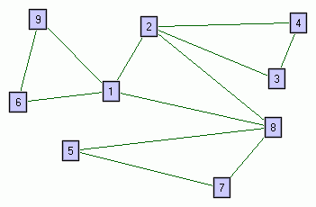
Stack: empty Location: none Circuit: empty

Slide 4
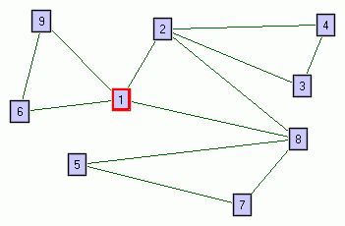
Stack: empty Location: 1 Circuit: empty

Slide 5
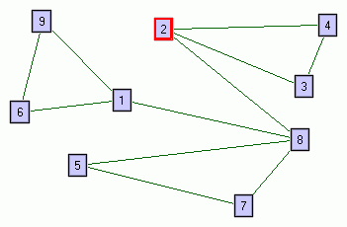
Stack: 1 Location: 2 Circuit: empty

Slide 6
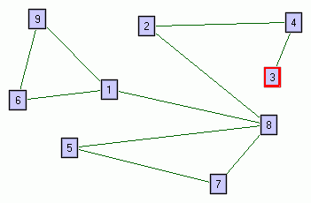
Stack: 1, 2 Location: 3 Circuit: empty

Slide 7
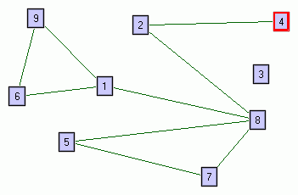
Stack: 1, 2, 3 Location: 4 Circuit: empty

Slide 8
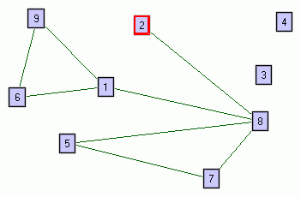
Stack: 1, 2, 3, 4 Location: 2 Circuit: empty

Slide 9
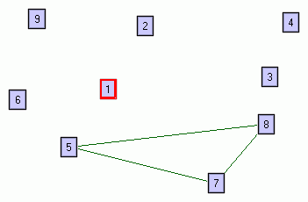
Stack: 1, 2, 3, 4, 2, 8, 1, 6, 9 Location: 1 Circuit: empty

Slide 10
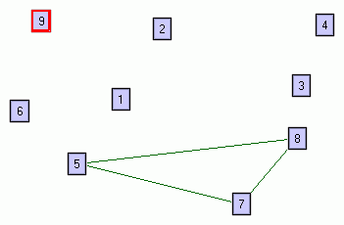
Stack: 1, 2, 3, 4, 2, 8, 1, 6 Location: 9 Circuit: 1

Slide 11
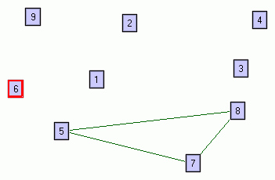
Stack: 1, 2, 3, 4, 2, 8, 1 Location: 6 Circuit: 1, 9

Slide 12
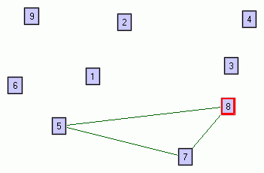
Stack: 1, 2, 3, 4, 2 Location: 8 Circuit: 1, 9, 6, 1

Slide 13
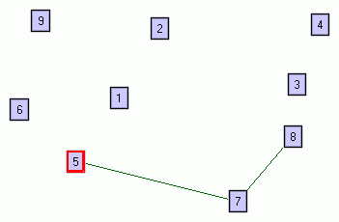
Stack: 1, 2, 3, 4, 2, 8 Location: 5 Circuit: 1, 9, 6, 1

Slide 14
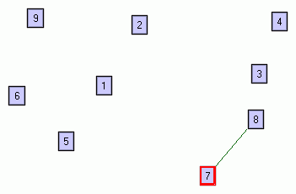
Stack: 1, 2, 3, 4, 2, 8, 5 Location: 7 Circuit: 1, 9, 6, 1

Slide 15
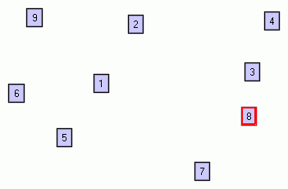
Stack: 1, 2, 3, 4, 2, 8, 5, 7 Location: 8 Circuit: 1, 9, 6, 1

Slide 16
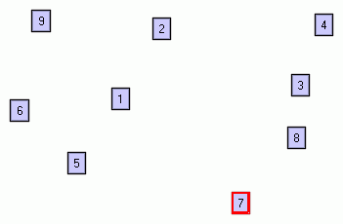
Stack: 1, 2, 3, 4, 2, 8, 5 Location: 7 Circuit: 1, 9, 6, 1, 8

Slide 17
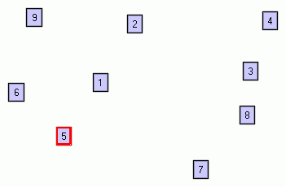
Stack: 1, 2, 3, 4, 2, 8 Location: 5 Circuit: 1, 9, 6, 1, 8, 7

Slide 18
Circuit: 1, 9, 6, 1, 8, 7, 5, 8, 2, 4, 3, 2, 1 Here the order doesn't matter, but for directed graphs - it's crucial. So let's consider the Eulerian Tour for this graph to be the reverse of the above circuit: 1, 2, 3, 4, 2, 8, 5, 7, 8, 1, 6, 9, 1

Slide 19
Q&A

