Slide 1
Constructing Multiple Steiner Trees for Software-Defined Networking Multicast
Presented by Professor Jehn-Ruey Jiang
Advanced Computing and Networking Laboratory
Department of Computer Science and Information Engineering
National Central University, Taiwan

Slide 2
Outline
SDN
Multicast
Steiner + Dijkstra + McKeown
Evaluation
Conclusion

Slide 3
Outline
SDN
Multicast
Steiner + Dijkstra + McKeown
Evaluation
Conclusion

Slide 4
SDN (Software Defined Networking) is changing the network
Feature
…
Feature
Network OS
Feature
Feature
OS
Custom Hardware
Feature
Feature
OS
Feature
Feature
Custom Hardware
OS
Feature
Feature
Custom Hardware
OS
Custom Hardware
Feature
Feature
OS
Custom Hardware
Adapted from: Dr. Nick McKeown’s presentation

Slide 5

Software Defined Networking (SDN)
Feature
Feature
Application Plane (Apps)
…
Consistent, up-to-date global network view
Open Interface (Northbound API)
Network OS
Control Plane
(Controller)
Open Interface (Southbound API)
Packet
Forwarding
Packet
Forwarding
Data Plane
(Switches)
Packet
Forwarding
Packet
Forwarding
Packet
Forwarding
Adapted from Dr. Nick McKeown’s presentation

Slide 6
OpenFlow Basics
Control Program A
Control Program B
Network OS
“If header = b, drop it”
“If header = p, send to port 4”
Packet
Forwarding
“If header = q, overwrite header with r, add header s, and send to ports 5,6”
“If header = ?, send to me”
Flow
Table(s)
Packet
Forwarding
Packet
Forwarding
Adapted from Dr. Nick McKeown’s presentation

Slide 7
Flow Table Entry
Matching Fields
Action
Statistics
Packet + byte counters
Forward packet to port(s)
Encapsulate and forward to controller
Drop packet
Send to normal processing pipeline
Switch
In Port
MAC
src
MAC
dst
Eth
type
VLAN
ID
IP
Src
IP
Dst
IP
Prot
TCP
sport
TCP
dport
Adapted from Dr. McKeown’s presentation

Slide 8
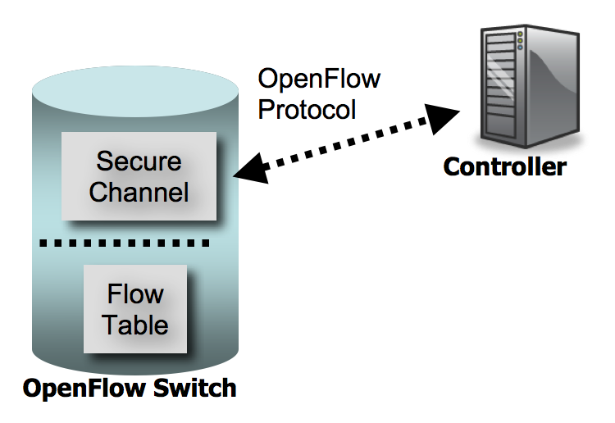
Controller and Switch
SSL (Secure Socket Layer)
Notes:
Controller 可以是一部或多部共同運作的機器，(也可以在雲端運作?)。
An OpenFlow controller is an application that manages flow control in a software-defined networking (SDN) environment. Most current SDN controllersare based on the OpenFlow protocol.
The SDN controller serves as a sort of operating system (OS) for the network. All communications between applications and devices have to go through the controller. The OpenFlow protocol connectscontroller software to network devices so that server software can tell switches where to sendpackets. The controller uses the OpenFlow protocol to configure network devices and choose the best path for application traffic. Because the network control plane is implemented in software, rather than the firmware of hardware devices, network traffic can be managed more dynamically and at a much more granular level.

Slide 9
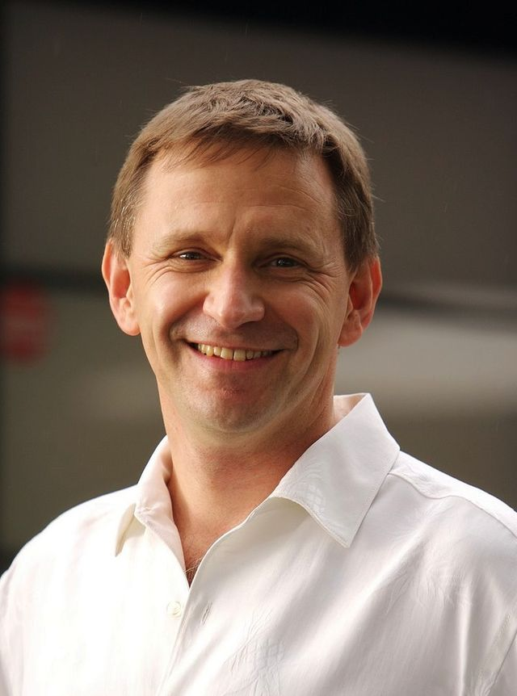
Nick McKeown and SDN
Dr. Nick McKeown
Biography
Became faculty director of the Clean Slate Program at Stanford University in 2006
Casado, McKeown and Shenker co-founded Nicira Networks in 2007
McKeown and Shenker co-founded the Open Networking Foundation (ONF) in 2011
Nicira was acquired by VMWare for $1.26 billion in July 2012
(1963-
Source: http://en.wikipedia.org/wiki/Nick_McKeown

Slide 10
Outline
SDN
Multicast
Steiner + Dijkstra + McKeown
Evaluation
Conclusion

Slide 11
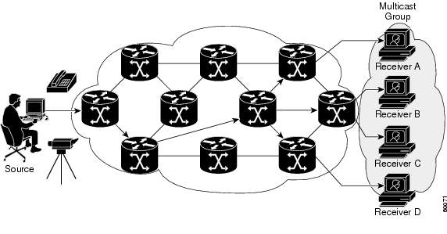
Multicast
Source: http://www.cisco.com/c/en/us/td/docs/ios/solutions_docs/ip_multicast/White_papers/mcst_ovr.html
Notes:
http://www.cisco.com/c/en/us/td/docs/ios/solutions_docs/ip_multicast/White_papers/mcst_ovr.html

Slide 12

Multicast Application-- IPTV
Source: http://www.199it.com/archives/tag/iptv
Notes:
2018年全球IPTV用户数将达1亿

Slide 13


Multicast Application – Live Streaming
Source: http://www.prepare1.com/live-streaming-future-social-media/&https://hired.com/companies/twitch
Notes:
2018年全球IPTV用户数将达1亿

Slide 14
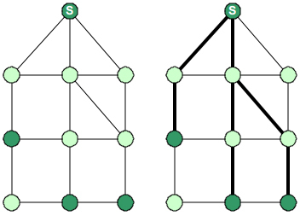
Multicast routing as a graph problem
Problem: Embed a tree within the network such that the source and all multicast subscribers (receivers) are connected by the tree
Given Graph
Shortest Path
Tree
Minimum Steiner
Tree
Solution 1: Shortest Path Tree (PIM-SM) Build a tree that minimizes the path cost from the source to each receiver
Solution 2: Minimum Steiner Tree Build a tree that minimizes the total cost of the edges
Notes:
（PIM-SM：Protocol Independent Multicast-Sparse Mode）
RFC 4601 - Protocol Independent Multicast - Sparse Mode

Slide 15
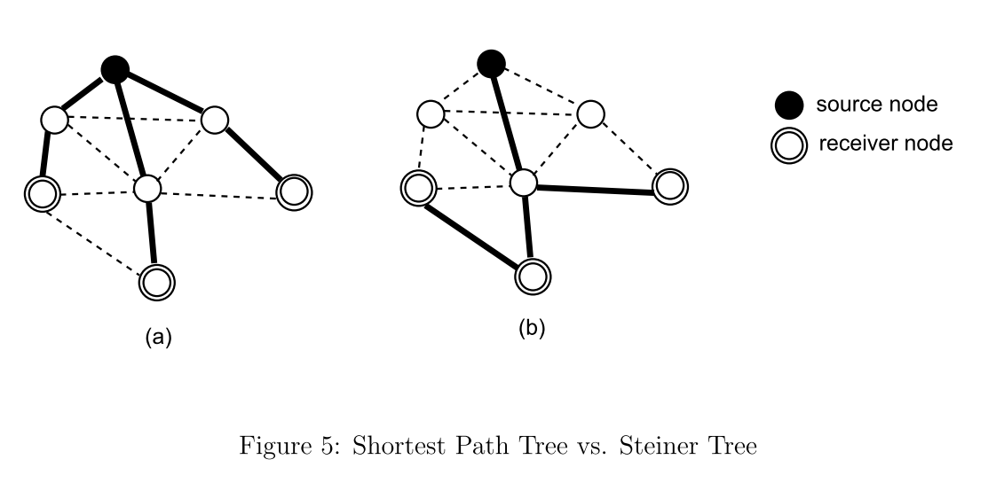
Multicast Tree
Shortest Path Tree
Steiner Tree

Slide 16
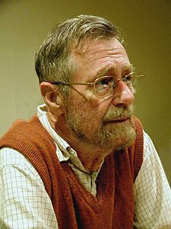

Dijkstra’s Shortest Path (SP) Algorithm
a 20-mimute invention during coffee drinking
Dr. E. W. Dijkstra, a Dutch scientist, said: “One morning I was shopping in Amsterdam with my young fiancée, and tired, we sat down on the café terrace to drink a cup of coffee and I was just thinking about whether I could do this, and I then designed the algorithm for the shortest path. As I said, it was a 20-minute invention. In fact, it was published in 1959, three years later.”
Thomas J. Misa (Editor), "An Interview with Edsger W. Dijkstra," Communications of the ACM 53 (8): 41–47, 2010.
E. W. Dijkstra
(1930~2002)

Slide 17
Dijkstra's SP Algorithm
Solves the single-source all-destination shortest path problem for a graph with non-negative edge weights, producing a shortest path tree.
Source: http://en.wikipedia.org/wiki/Dijkstra%27s_algor

Slide 18
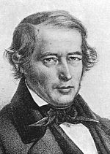
Minimum Steiner Tree Problem
The NP-hard problem is named after Jakob Steiner, a Swiss mathematician who worked primarily in geometry.
Def: Given a weighted undirected graph G(V,E) and a subset S of V, find the minimum-cost tree that spans the nodes in S.
The nodes in S are identified as terminals, others are called nonterminals or Steiner vertices (Steiner nodes).
Jakob Steiner
(1796-1863)
Notes:
If |S|=|V|, the tree is the minimum spanning tree.

Slide 19
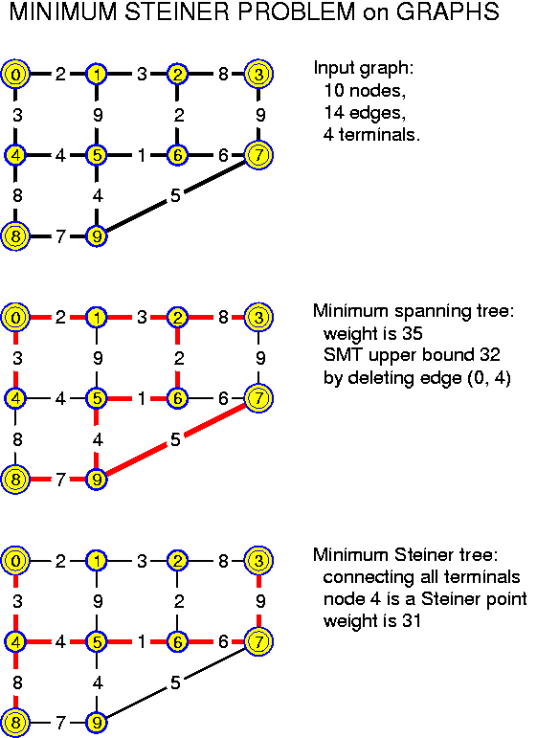
Minimum Steiner Tree Example

Slide 20
Outline
SDN
Multicast
Steiner + Dijkstra + McKeown
Evaluation
Conclusion

Slide 21
Our Goal
To build a set of multiple multicast trees
under the SDN architecture proposed by MeKeown
based on
the extended Dijkstra’s algorithm
the modified SCTF Steiner tree algorithm
for the purpose of
minimize the source-to-receiver delay
minimize the bandwidth consumption

Slide 22
Extended Dijkstra’s Algorithm

Slide 23
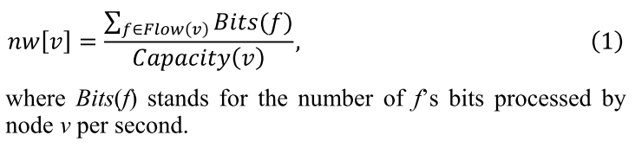
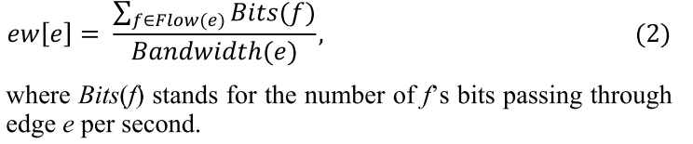
Node Weight & Edge Weight
The node weight nw[v] of v is defined according to Eq. (1)
The edge weight ew[e] of e is defined according to Eq. (2).

Slide 24
SCTF (Selective Closest Terminal First) Alg.
A heuristic algorithm to find the minimum Steiner tree T
The heuristic:
the Steiner tree T includes the source initially
repeatedly include a terminal u closest to a node v in T and every node in the path from v to u until all terminals are in T
Closest Terminal Computation (CTC): Use a shortest path alg. (e.g., Dijkstra’s) to find the closest terminal
Use a priority queue Q to store all nodes in T and perform CTC only for top κ (kappa) nodes in Q (Priority : Source > terminal > nonterminal) to save computation

Slide 25
SCTF Algorithm Example
Terminals not include in tree
3
Nonterminals not include in tree
2
Terminals include in tree
Nonterminals include in tree
7
1
source
6
Priority queue (κ=4)
4
5
Priority : Source > terminal > nonterminal

Slide 26
SCTF Algorithm Example
Terminals not include in tree
3
Nonterminals not include in tree
2
Terminals include in tree
Nonterminals include in tree
7
1
source
6
Priority queue (κ=4)
4
1
3
2
5
Priority : Source > terminal > nonterminal

Slide 27
SCTF Algorithm Example
Terminals not include in tree
3
Nonterminals not include in tree
2
Terminals include in tree
Nonterminals include in tree
7
1
source
6
Priority queue (κ=4)
4
1
3
5
2
4
5
Priority : Source > terminal > nonterminal

Slide 28
SCTF Algorithm Example
Terminals not include in tree
3
Nonterminals not include in tree
2
Terminals include in tree
Nonterminals include in tree
7
1
source
6
Priority queue (κ=4)
4
1
3
5
7
2
4
6
5
Priority : Source > terminal > nonterminal

Slide 29
Proposed Alg.: M-SCTF/EDA (modified SCTF algorithm with Extended Dijkstra's algorithm)
Multiple sources
➔ Multiple multicast trees
Use extended Dijkstra's algorithm considering both node weight and edge weight
➔ Node delay and link delay are both considered
Modified SCTF Priority: source > nonterminals (less hop count from source first) > terminals
➔ Minimize both delay and bandwidth consumption

Slide 31
M-SCTF/EDA
Terminals not include in tree
3
Nonterminals not include in tree
2
Terminals include in tree
Nonterminals include in tree
7
1
source
6
Priority queue (κ=4)
4
5
Priority : source > nonterminals (less hop count from source first) > terminals

Slide 32
M-SCTF/EDA
Terminals not include in tree
3
Nonterminals not include in tree
2
Terminals include in tree
Nonterminals include in tree
7
1
source
6
Priority queue (κ=4)
4
1
2
3
5
Priority : source > nonterminals (less hop count from source first) > terminals

Slide 33
M-SCTF/EDA
Terminals not include in tree
3
Nonterminals not include in tree
2
Terminals include in tree
Nonterminals include in tree
7
1
source
6
Priority queue (κ=4)
4
1
2
4
3
5
5
Priority : source > nonterminals (less hop count from source first) > terminals

Slide 34
M-SCTF/EDA
Terminals not include in tree
3
Nonterminals not include in tree
2
Terminals include in tree
Nonterminals include in tree
7
1
source
6
Priority queue (κ=4)
4
1
2
4
3
5
7
5
Priority : source > nonterminals (less hop count from source first) > terminals

Slide 35
Outline
SDN
Multicast
Steiner + Dijkstra + McKeown
Evaluation
Conclusion

Slide 36


Emulation
Emulator: EstiNet
Controller: NTT Ryu
Traffic Pattern: CBT (constant bit rate), HD 720p @ H.264 high profile 2500 kbps (20 MB/minute)

Slide 37
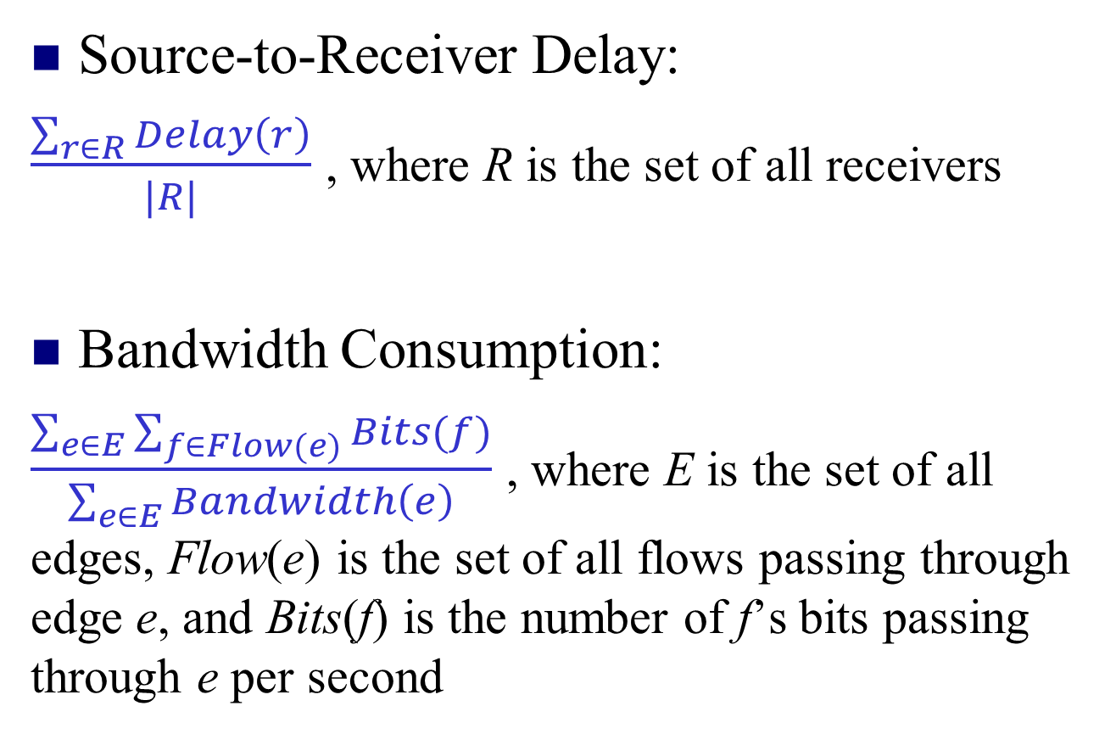
Metrics
Source-to-Receiver Delay:
$\frac{\sum_{r∈R}{Delay\left(r\right)}}{|R|}$ , where R is the set of all receivers
Bandwidth Consumption:
$\frac{\sum_{e∈E}{\sum_{f∈Flow(e)}{Bits(f)}}}{\sum_{e∈E}{Bandwidth\left(e\right)}}$ , where E is the set of all edges, Flow(e) is the set of all flows passing through edge e, and Bits(f) is the number of f’s bits passing through e per second

Slide 38
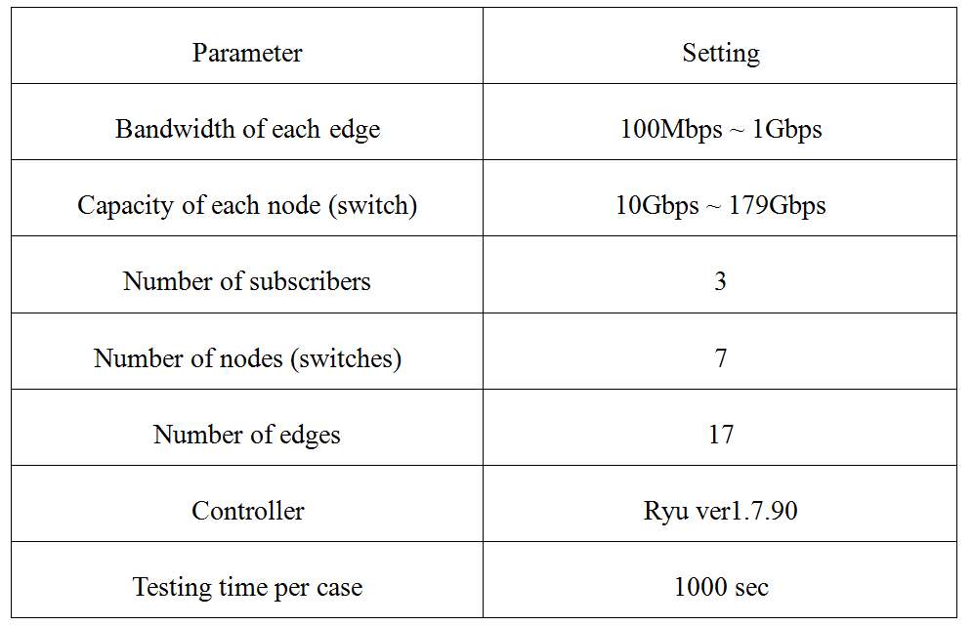
Topology1 Parameter Setting
Notes:
NEC：ProgrammableFlow PF5248 Switch
Xinguard：Pica8 3290 Switch
HP：HP 3500 Switch Series

Slide 39
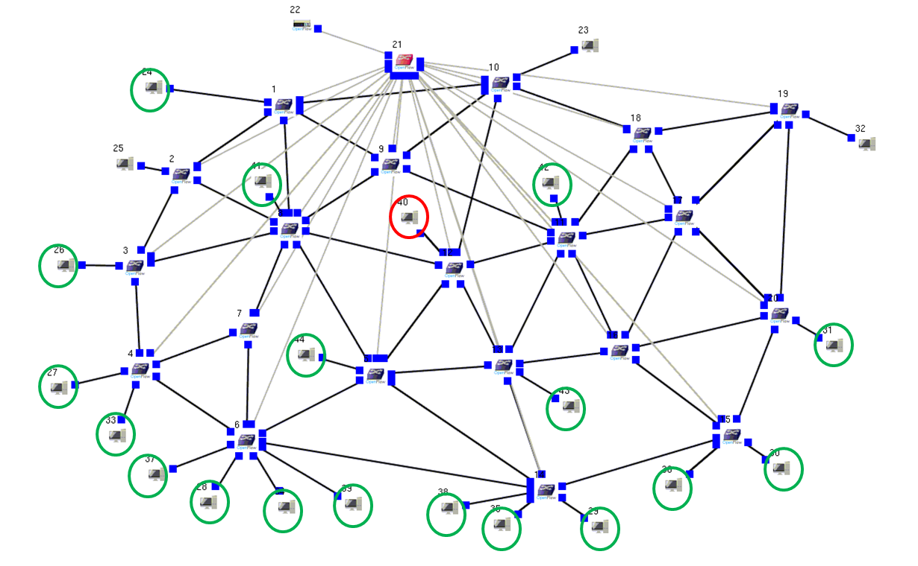
Scenario 1
receivers
source
….
….

Slide 40
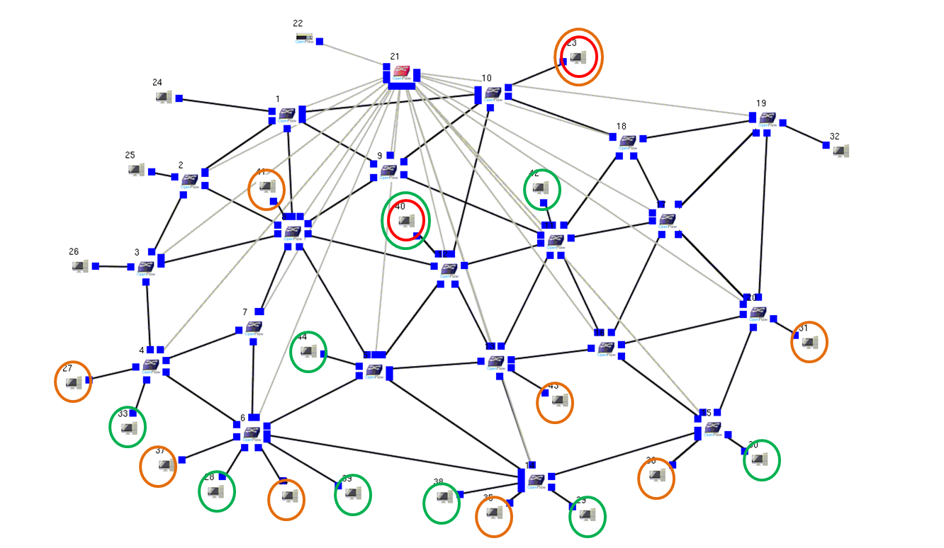
Scenario 2
source 2
receivers of group 2
receivers of group 1
source 1
….
….

Slide 41
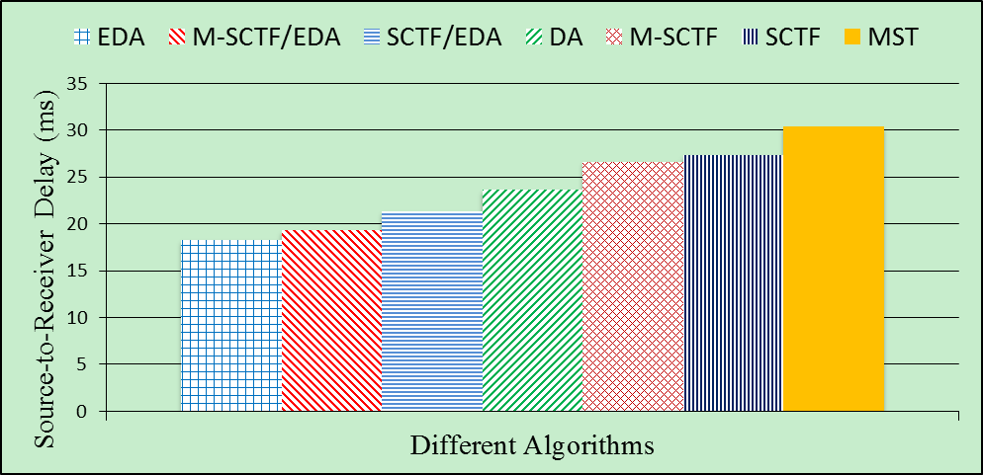
Source-to-Receiver Delay

Slide 42
Bandwidth Consumption

Slide 43
Outline
SDN
Multicast
Steiner + Dijkstra + McKeown
Simulation
Conclusion

Slide 44
Conclusion
M-SCTF/EDA (Modified SCTF Algorithm with Extended Dijkstra’s Algorithm) can construct good Steiner trees for multicasting under the SDN architecture
The performance is good (only worse than the optimal one) in terms of both the source-to-receiver delay and the bandwidth consumption

Slide 45
Thank You!
Email: jrjiang@csie.ncu.edu.tw

