Slide 1
Multi-Level Region Matching for Fine-Grained Sketch-Based Image Retrieval
Zhixin Ling
1069066484@qq.com
Fudan University
Zhen Xing
zxing20@fudan.edu.cn
Fudan University
Jiangtong Li
keep_moving-Lee@sjtu.edu.cn
Shanghai Jiao Tong University
Li Niu*
ustcnewly@sjtu.edu.cn
Shanghai Jiao Tong University

Slide 2
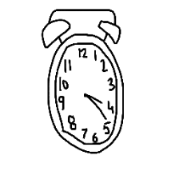
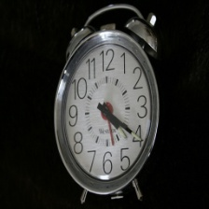
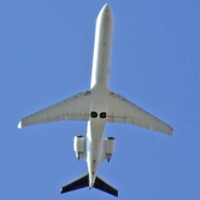
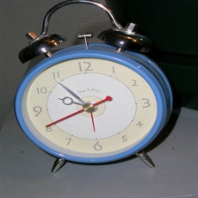
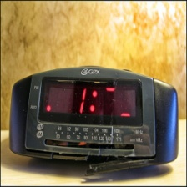
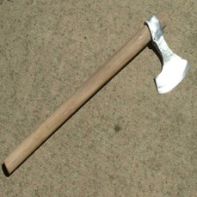
1. Task of FG-SBIR
Coarse-Grained Sketch-Based Image Retrieval (CG-SBIR)
Fine-Grained Sketch-Based Image Retrieval (FG-SBIR)
The Query Sketch
The Query Sketch
Positive Cases
Negative Cases
Negative Cases
Positive Case

Slide 3
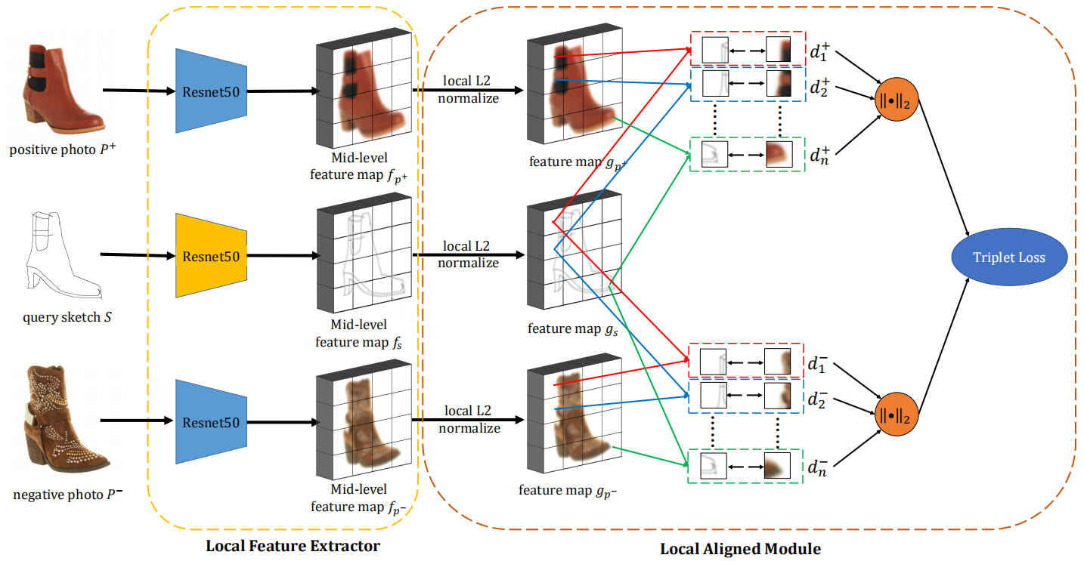
2. Related Work: LA-Net for FG-SBIR
LA-1. Local alignment between sketch and photo.
LA-2. Only mid-level feature maps.
LA-3. Assume that the same location of sketch and photo is strictly aligned.
LA-4. A bit higher computation overhead.
LA-5. A grid region might contain few semantic information.

Slide 4
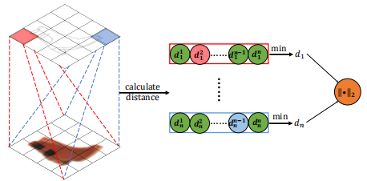
2. Related Work: DLA-Net for FG-SBIR
DLA-1. *Dynamically local alignment between sketch and photo.
DLA-2. *Relax the assumption that the same location of sketch and photo is strictly aligned.
DLA-3. *Good matching accuracies.
DLA-4. Only mid-level feature maps.
DLA-5. *A far higher computation overhead (grids² × vanilla retrieval time).
DLA-6. A grid region might contain few semantic information.

Slide 5
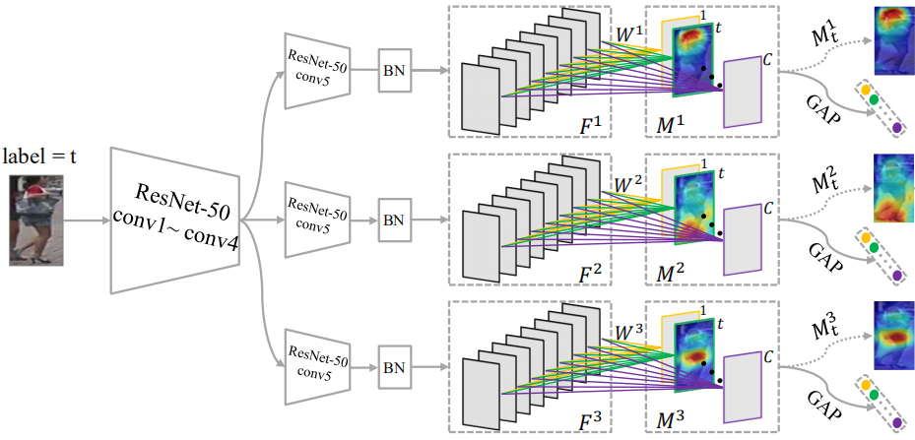
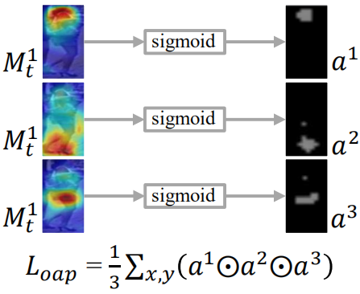
2. Related Work: CAMA for discriminative region extraction
We are motivated to learn self-adaptive regions to enable local matching to overcome DLA-5 and DLA-6.
A naive solution is to adopt CAMA:
CAMA-1. Three copies of Conv5 block of ResNet to obtain three CAMs.
CAMA-2. A cama overlapping penalty to enable regions to be geometrically discriminative.
CAMA-3. Large number of additional model parameters.
CAMA-4. Does not explicitly ensure the regions to be semantically discriminative.

Slide 6
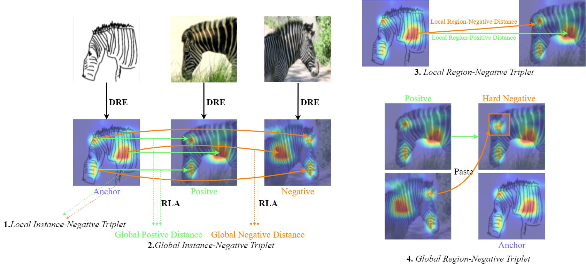




3. Our method: Multi-Level Region Matching
DRE extracts discriminative regions, instead of grids;
RLA gives a global matching distance based on local region features.
Triplet loss 1: targets at semantic correspondence between paired regions.
Triplet loss 2: targets at global matching distance.
Triplet loss 3: targets at semantic distinctiveness across unpaired regions.
Triplet loss 4: targets at hard negative samples.

Slide 7
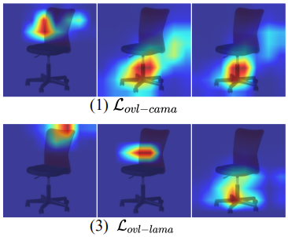
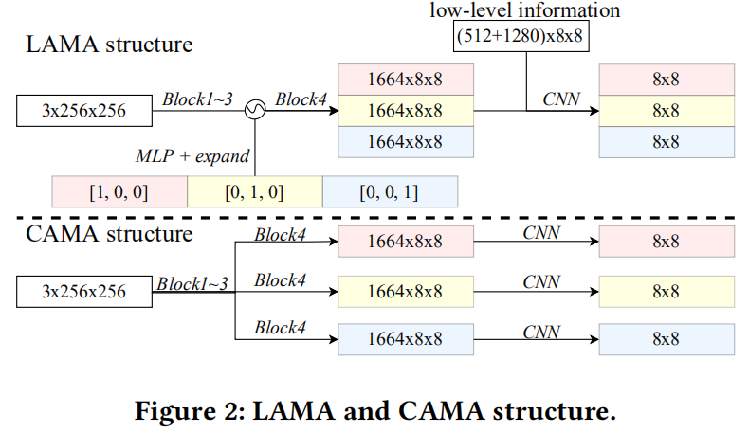
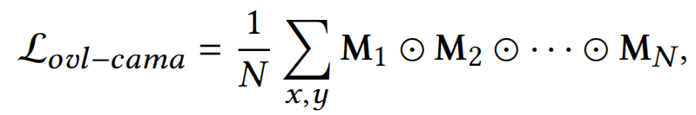
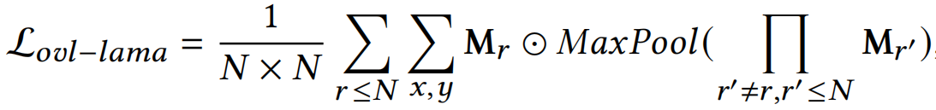
3. Our method: DRE via LAMA
We propose Light Activation Map Augmentation (LAMA) for Discriminative Region Extraction(DRE).
LAMA-1. Merges copied blocks in CAMA into one.
LAMA-2. Distinguish different region features via a pre-defined one-hot input vector.
LAMA-3. Improved overlapping panelty to obtain better geometrically discriminative regions.

Slide 8
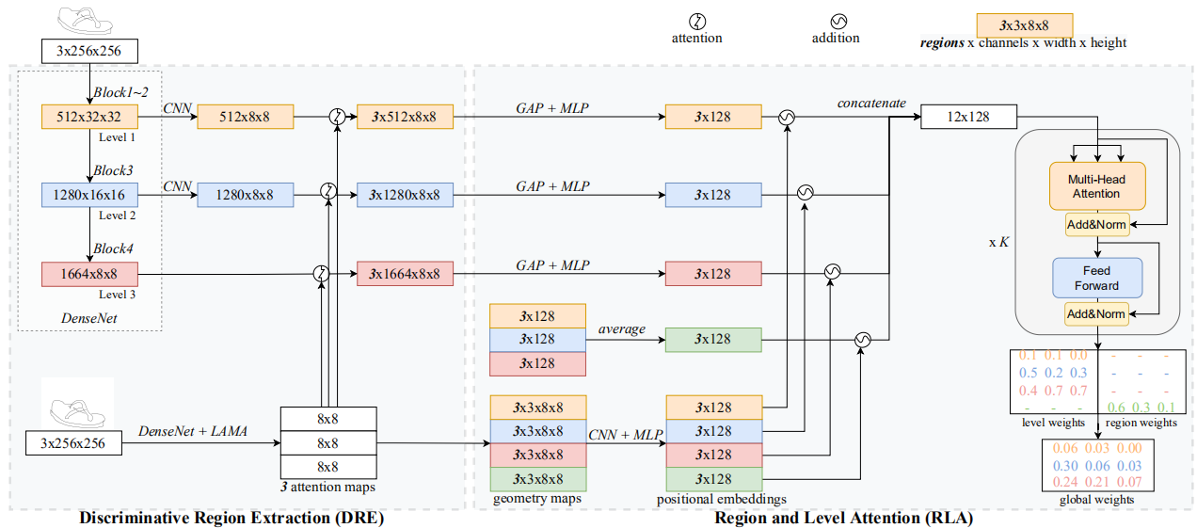
3. Our method: MLRM structure overview
total loss = weight × triplet losses + overlapping penalty
Further take advantage of low-level, mid-level and high-level features.
Integrate geometry information to obtain positional encodings to decide important regions.

Slide 9
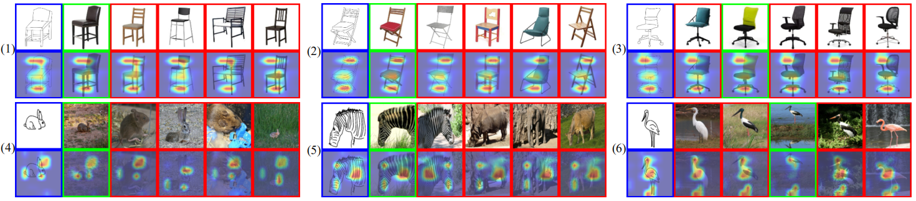
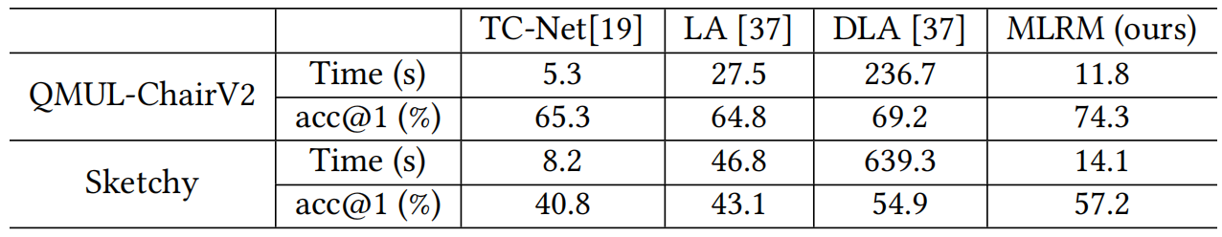
4. Results

