Slide 1
AI HomeWork
授課老師：張宏慶教授
助教：陳君虹

Slide 2
Pseudo codes documentation
Slide pages: 14, 28, 43, 48, 77

Slide 3
Explain precisely how to modify the AND-OR-GRAPH-SEARCH algorithm to generate a cyclic plan if no acyclic plan exists. You will need to deal with three issues: labeling the plan steps so that a cyclic plan can point back to an earlier part of the plan, modifying OR-SEARCH so that it continues to look for acyclic plans after finding a cyclic plan, and augmenting the plan representation to indicate whether a plan is cyclic. Show how your algorithm works on (a) the slippery vacuum world, and (b) the slippery, erratic vacuum world.
Hint : Slide page p.65, Use the property of AND-OR-SEARCH cycle back to a state on path.

Slide 4
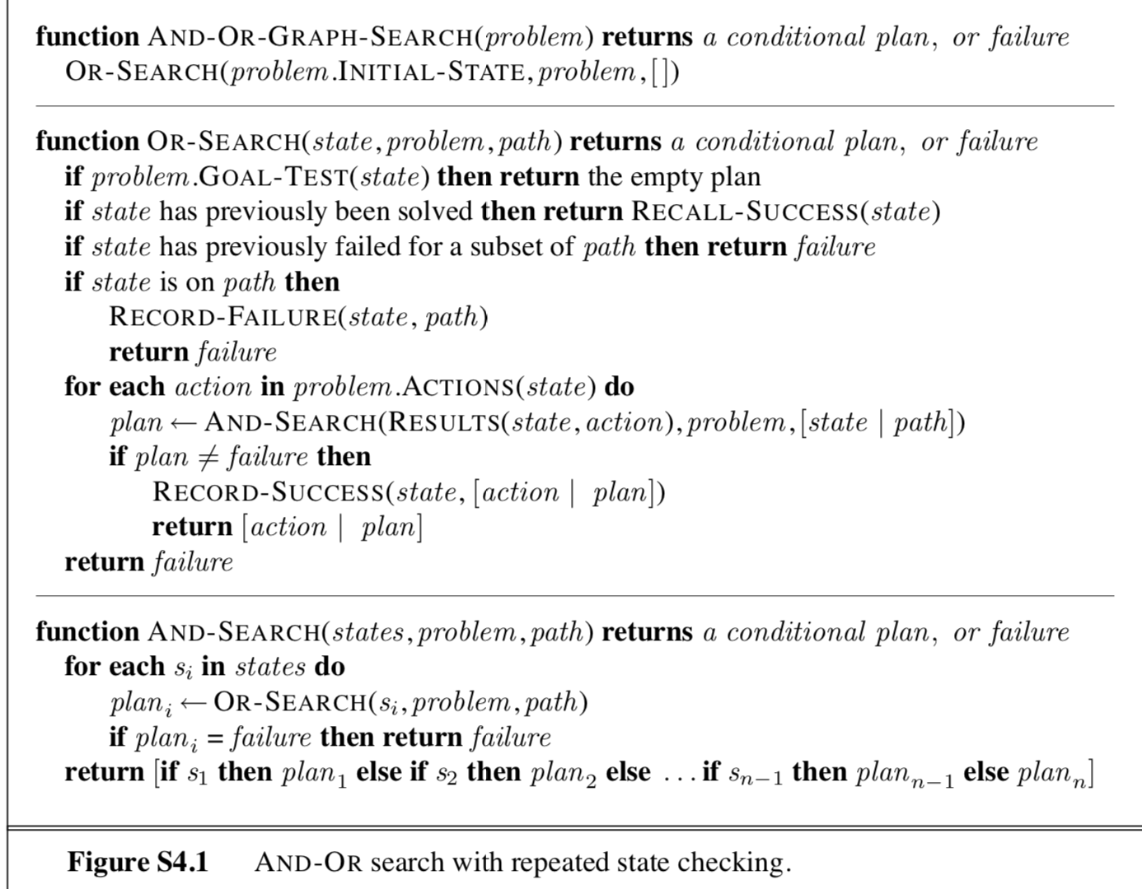

Slide 5
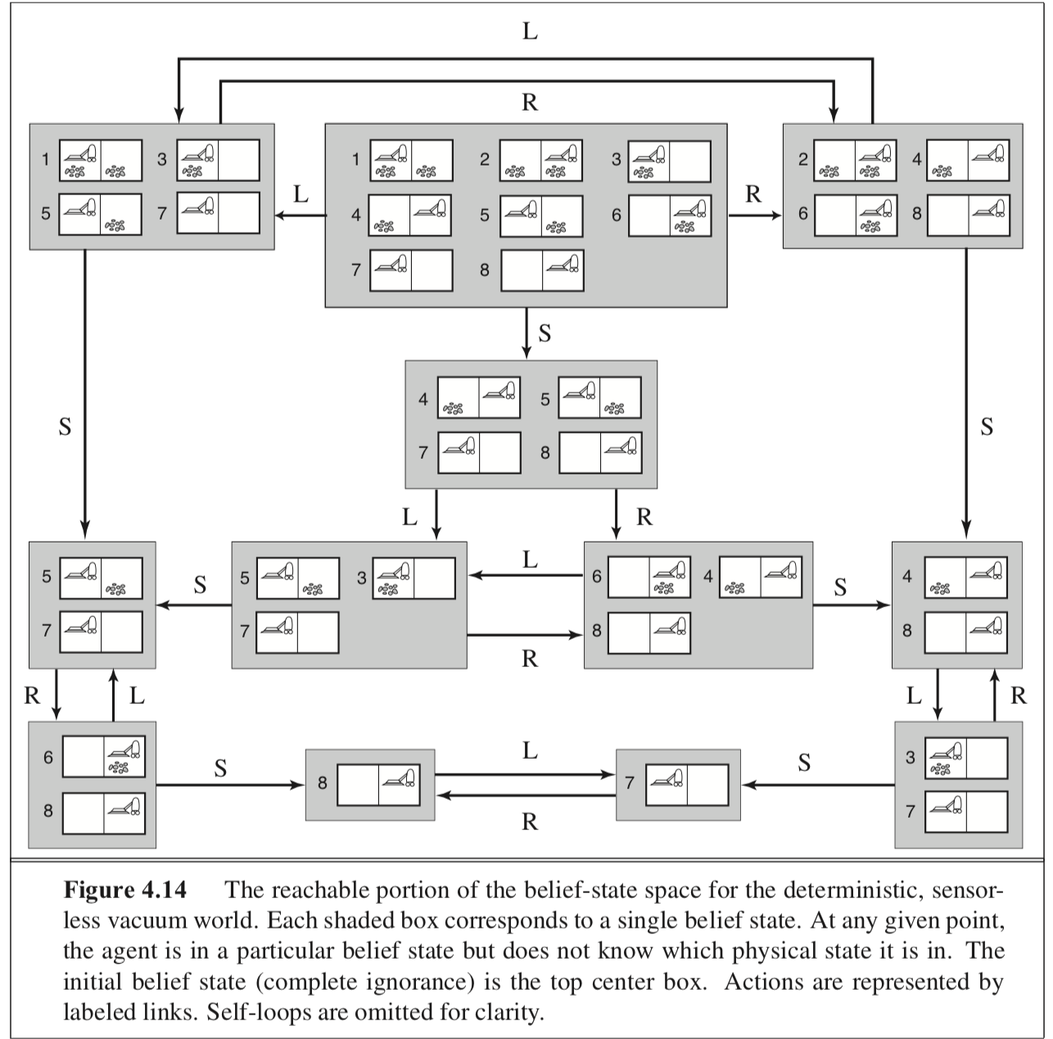
In Section 4.4.1 we introduced belief states to solve sensorless search problems. A sequence of actions solves a sensorless problem if it maps every physical state in the initial belief state b to a goal state. Suppose the agent knows h*(s), the true optimal cost of solving the physical state s in the fully observable problem, for every state s in b. Find an admissible heuristic h(b) for the sensorless problem in terms of these costs, and prove its admissibilty. Comment on the accuracy of this heuristic on the sensorless vacuum problem of Figure 4.14. How well does A* perform?
Hint: Slide page p.50

Slide 6
This exercise explores subset-superset relations between belief states in sensorless or partially observable environments.
Prove that if an action sequence is a solution for a belief state b, it is also a solution for any subset of b. Can anything be said about supersets of b?
Hint: Any state in a subset of b is in b, the result is immediate.
(b) Explain in detail how to modify graph search for sensorless problems to take advantage of your answers in (a).
Hitnt: Do not add to the frontier any child belief state
(c) Explain in detail how to modify AND—OR search for partially observable problems, beyond the modifications you describe in (b).
Hint: Slide page p.50

Slide 7
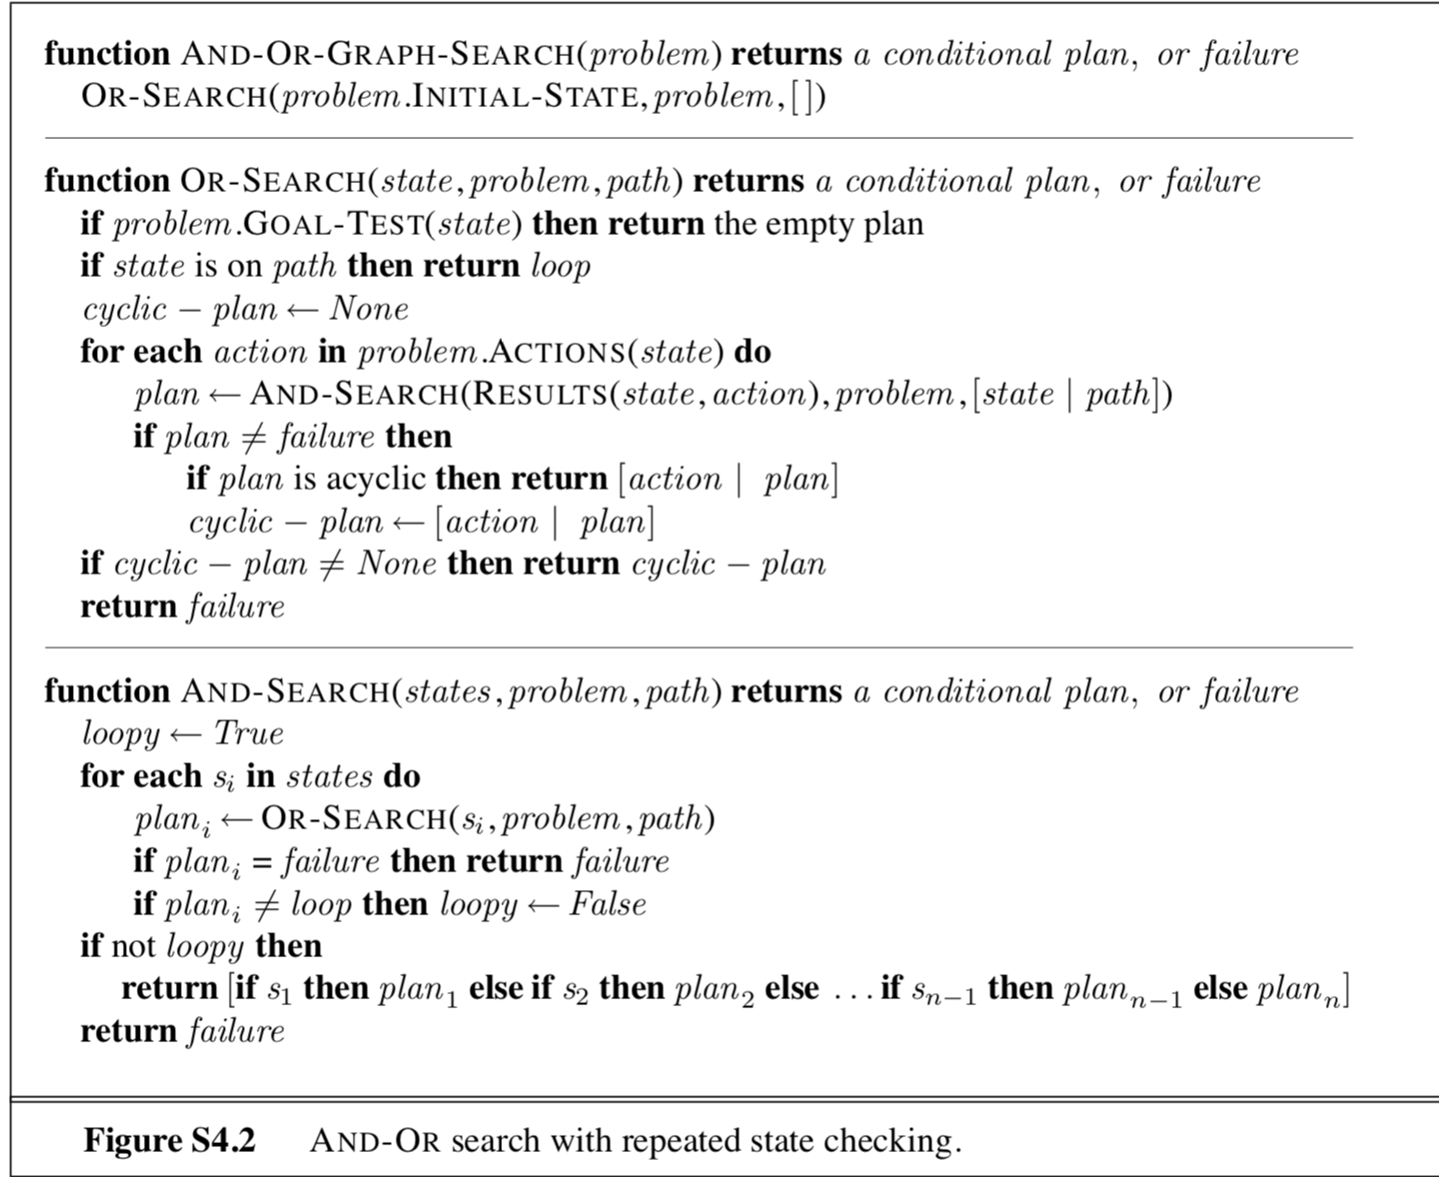

Slide 8
On page 139 it was assumed that a given action would have the same cost when executed in any physical state within a given belief state. (This leads to a belief-state search problem with well-defined step costs.) Now consider what happens when the assumption does not hold. Does the notion of optimality still make sense in this context, or does it require modification? Consider also various possible definitions of the "cost" of executing an action in a belief slate; for example, we could use the minimum of the physical costs; or the maximum; or a cost interval with the lower bound being the minimum cost and the upper bound being the maximum; or just keep the set of all possible costs for that action. For each of these, explore whether A* (with modifications if necessary) can return optimal solutions.
Hint: Slide page p.50,consider the property of belief state, A*, Bellman’s principle of optimality

Slide 9
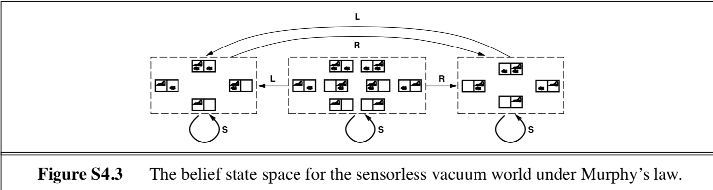
5.Consider the sensorless version of the erratic vacuum world. Draw the belief-state space reachable from the initial belief state { 1, 3, 5, 7}, and explain why the problem is unsolvable.
Hint:

Slide 10
6. Suppose that an agent is in a 3 x 3 maze environment like the one shown in Figure 4.19. The agent knows that its initial location is (3,3), that the goal is at (1,1), and that the actions Up, Down, Left, Right have their usual effects unless blocked by a wall. The agent does not know where the internal walls are. In any given state, the agent perceives the set of legal actions; it can also tell whether the state is one it has visited before or is a new state.
(a) Explain how this online search problem can be viewed as an offline search in belief-state space, where the initial belief state includes all possible environment configurations. How large is the initial belief state? How large is the space of belief slates?
Hint : Successor belief-state is constructed by taking the previous belief-state
(b) How many distinct percepts are possible in the initial state?
Hint : Assuming the external walls are known
(c) Describe the first few branches of a contingency plan for this problem. How large (roughly) is the complete plan? Notice that this contingency plan is a solution for every possible environment fitting the given description. Therefore, interleaving of search and execution is not strictly necessary even in unknown environments.

Slide 11
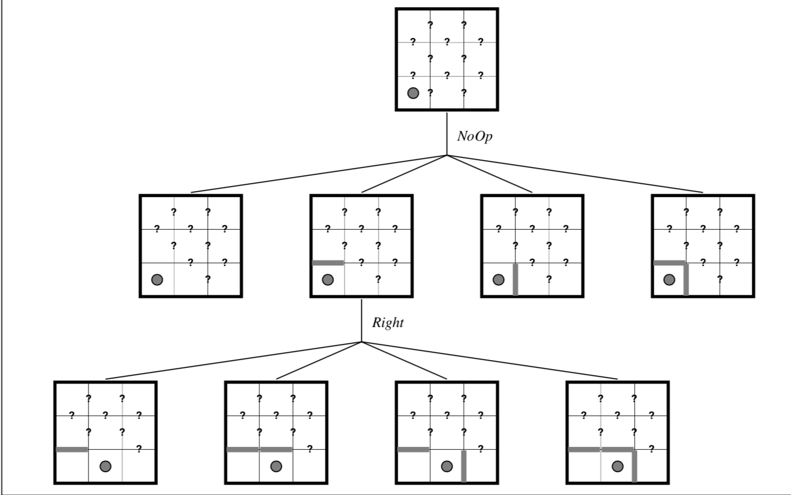

Slide 12
7. Like DFS, online DFS is incomplete for reversible state spaces with infinite paths. For example, suppose that states are points on the infinite two-dimensional grid and actions are unit vectors (1, 0), (0, 1), (-1, 0), (0, -1), tried in that order. Show that online DFS starting at (0, 0) will not reach (1, -1). Suppose the agent can observe, in addition to its current state, all successor states and the actions that would lead to them. Write an algorithm that is complete even for bidirected state spaces with infinite paths. What states does it visit in reaching (1, -1)?

Slide 13
Thanks for Listening

