Slide 1

https://drive.google.com/file/d/1aBLCyAwAPEEnh9H19OJDn8yxYSA-eaRK/view?usp=sharing
Project Presentation Link:-

Slide 2
Project on Excel Dash boarding-Titanic Survival
-Pooja Shree R

Slide 3
What is excel ?

Slide 4
Introduction
The sinking of titanic is one of the most historic shipwrecks of all time. The tragedy killed thousands,1502 out of 2224 passengers, and led many wondering what could have been done better.
My Project is with the passenger’s data from the Titanic from a data platform Kaggle to find out about this survival livelihood.
It is done using Excel techniques and visualized through Dash boards

Slide 5
Project Explanation

Slide 6

Problem Statement
The Titanic Survival data is one of the most popular dataset.
The problem statement is generated based on the dataset.
It includes the survival rate by Gender , Age, Cabin ,Pclass ,Parch ,SibSp ,Embarkation.
And also given the average count of passengers by gender and fare by Pclass and embarked.

Slide 7
Outcomes
Survival rate
Results
On average of 74%female and 19%male
Count of 608 is the highest from SibSp
Highly 76% in 3rd Pclass
Highly about 646 count survived in S-embarkation
On total 314 female and 544 male by age survived.
The highest average fare was on Pclass-1 is $84.15 and $59.95 in C-embarkation
The highest survival count of 684 was in the cabin M

Slide 8
Excel Techniques
The dataset has been cleaned using remove duplicates.
The unfilled data columns are filed through formulae.
Pivot table-Tables were created using this.
Pivot charts-Used in data visualizing.
Slicer-Used to filter and in reporting connections.

Slide 9
Basic Analysis
Average fare of P class
Count of people by gender

Slide 10
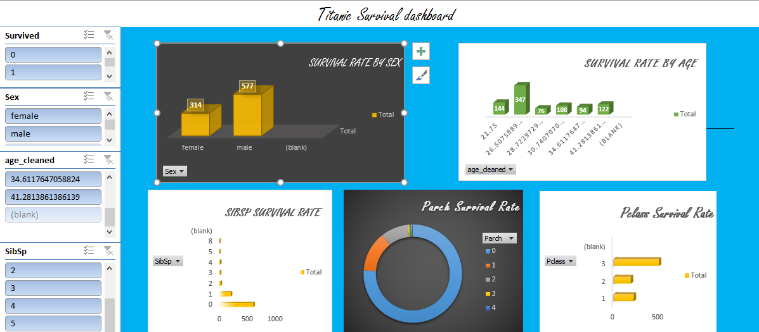
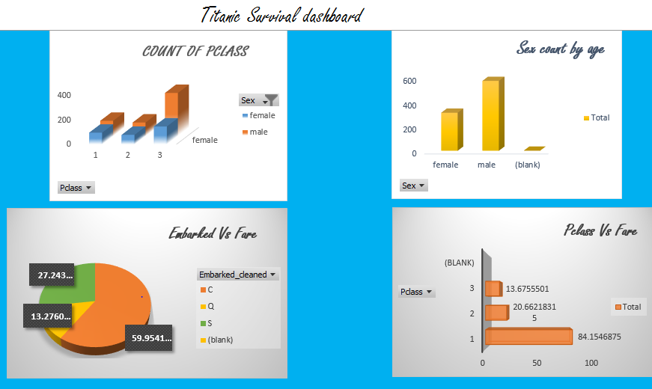
Dashboard

Slide 11
Analysis of dataset
Cleaning of dataset
Creating problem statements
Pivoting
Visualize
Slicing and Dash boarding

Slide 12
Conclusion
The Titanic was a British passenger liner that weighs 52,000 tons and its length was 269m
The dataset is based on the survival rate of the titanic passengers
It was cleaned and analyzed using Excel Techniques and Dash boarding.
The final workbook includes actual data ,cleaned data , pivot tables and a dash board

Slide 13
Thank you

