Slide 1
Tableau Capstone Project
Sales in Supermarket
Pooja Shree R

Slide 2
What is Tableau?

Slide 3
Introduction
Supermarket is a self-service shop offering a wide variety of food , beverages and household products organized into sections
The data is related to income analysis of the supermarket
It is visualized using Tableau tool
The source of dataset is from kaggle.

Slide 4
Problem Statements
What is unit price/product?
What is average income/day?
What is the total income/month?
What is average rating from customers?
Comparison on Average rating and Gross margin percentage?
What is the average gross income in each city?
Which mode of payment has the highest income?
Which product has highest tax percent by cogs?

Slide 5
Story Explanation

Slide 6
Outcomes
The outcomes of the project are
Average income per day and total income per week has been found.
Rating of each product has been found.
Percentage of tax has been analyzed.
Unit price per product has been found.
Average income of each city has been found.
Different types of charts and parameters have been used.

Slide 7
Results
The highest average gross income is on Saturday of March.
January holds the highest total income.
The most top rated product is Health and beauty from female and Electronic accessories from male.
Average income of Naypyidaw city holds the highest of about 16.502
Fashion accessories holds the highest unit price of ~57
Electronic accessories hold the highest tax of 1.2%
Maximum income is earned through the cash mode of payment
Gross margin percentage remains constant .

Slide 8
Process
Choosing data
Analyzing data
Visualizing data
Making Dash boards
Presenting in stories
Final Report

Slide 9
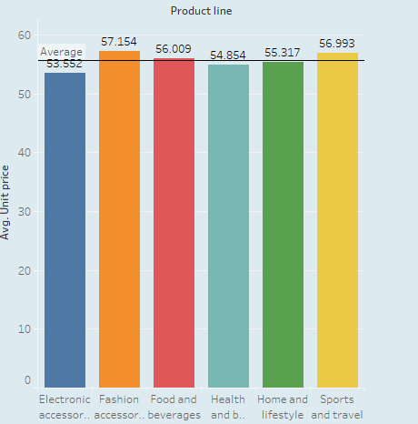
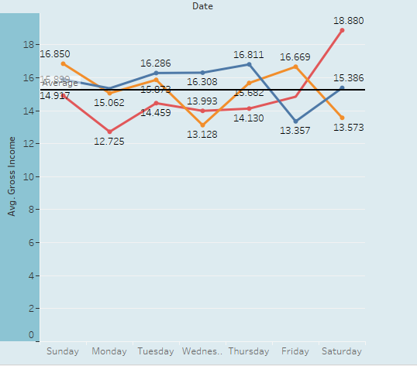
Basic Analysis

Slide 10
Conclusion
The analysis is purely based on the sales of the supermarket.
In general the supermarket sales is based on quality of the products and customer type.
The rating for all product above 6 in the scale of 8.
Sales are increasing gradually every month.
The supermarket also of offers different mode of payment for the ease of the customers.
The most used mode of payment is E-wallet for normal customers and Credit card by member customers but on looking for a total cash mode of payment tops the list.
The month of March has the highest average gross income and that was also on Saturdays.
I hereby end my presentation.

Slide 11
Thank You

Slide 12
Links
Source
https://www.kaggle.com/aungpyaeap/supermarket-sales
Video
https://drive.google.com/file/d/19xC8GJNf9hQGKWlnDOj23yB1IK852v0p/view?usp=sharing
Project
https://public.tableau.com/views/Tableau_project_15929809962660/Incomebydayandmonth?:language=en&:display_count=y&publish=yes&:origin=viz_share_link

