Slide 1

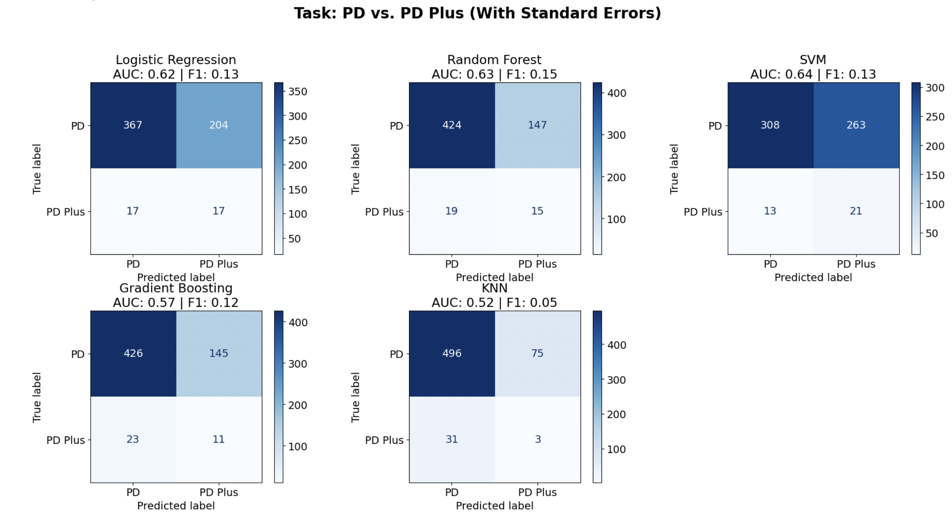
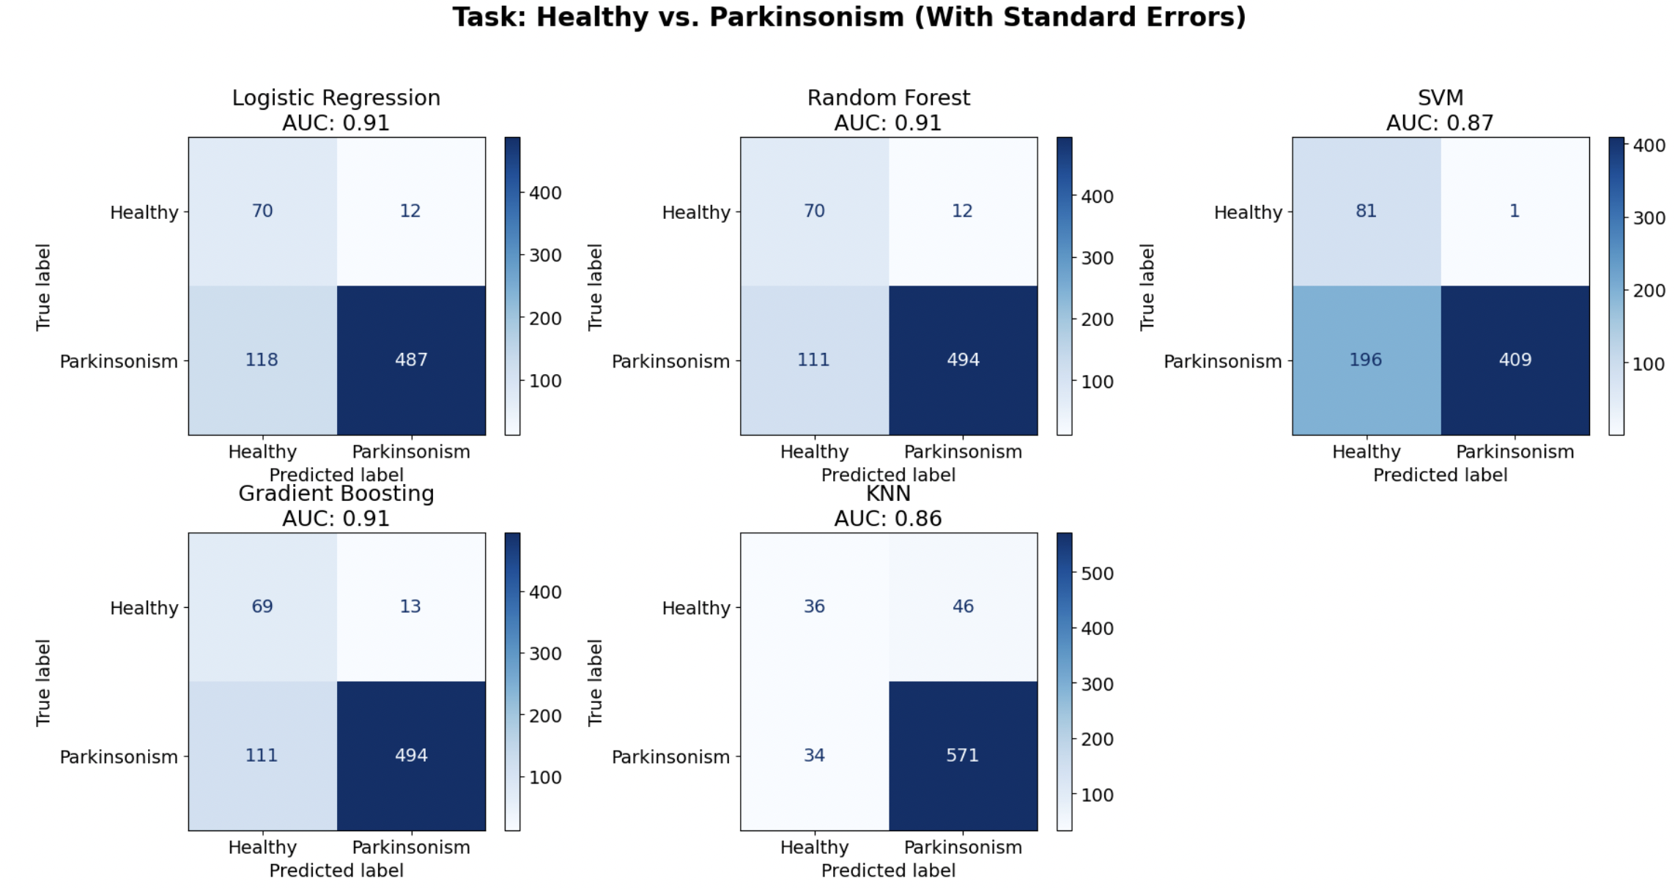
Differential Diagnosis across the Parkinsonian Spectrum
Multi-Center Validation of Classification Models for PD, PD-Plus, and Neurologically Healthy Controls
Shuxi Wu¹, Vivienne Wang¹, Jianyue Bai¹, Javier Mencia Ledo¹
¹Dalla Lana School of Public Health, Biostatistics Division
Overview
Results
Parkinson's disease (PD) and atypical parkinsonism (PD-plus) are clinically difficult to distinguish. Using C-OPN data (n = 3,433), we applied a two-stage classification approach — first separating healthy controls from parkinsonism cases, then distinguishing PD from PD-plus — comparing five machine learning models via 5-fold cross-validation.
Data
2. PD vs PD-Plus
 | Overall | PD | Healthy control | PD-Plus
Sample Size (n) | 3541 | 2852 | 410 | 171
Current Age | 66.20 (10.04) | 66.59 (9.59) | 62.54 (12.22) | 66.64 (11.71)
Number of Males | 1804 (50.9%) | 1612 (56.5%) | 181 (44.1%) | 78 (45.6%)
Disease Duration | 9.64 (6.01) | 9.83 (5.98) | --- | 6.05 (5.50)
MoCA Score | 26.70 (2.71) | 26.58 (2.53) | 27.78 (3.15) | 22.00 (nan)
BDI Score | 9.65 (7.53) | 9.66 (7.35) | 6.24 (5.93) | 16.76 (10.45)
MBI Score | 0 .94 (4.22) | 0.93 (4.09) | 0.33 (2.01) | 3.24 ( 8.62)
EHI Score | 0.71 (0.46) | 0.72 (0.44) | 0.66 (0.56) | 0.72 (0.50)
Loss of Smell | 2537 (72.6%) | 2090 (73.3%) | 240 (58.5%) | 101 (59.1%)
Right Hand Dominant | 1888 (53.3%) | 1765 (61.9%) | 20 (4.9%) | 102 (59.6%)
Regular Exercise | 1795 (50.7%) | 1555 (54.5%) | 162 (39.5%) | 72 42.1%)
Coffee Drinker | 1735 (49.0%) | 1480 (51.9%) | 160 (39.0%) | 90 (52.6%)
Model | C-index | Sensitivity | Specificity | PPV | NPV | F1-Score
Logistic Regression | 0.616 | 0.500 | 0.643 | 0.077 | 0.372 | 0.133
Random Forest | 0.633 | 0.441 | 0.743 | 0.093 | 0.387 | 0.153
SVM | 0.638 | 0.618 | 0.539 | 0.074 | 0.292 | 0.132
Gradiant Boosting | 0.570 | 0.324 | 0.746 | 0.071 | 0.383 | 0.116
KNN | 0.517 | 0.088 | 0.869 | 0.038 | 0.514 | 0.054
Background
PD is the 2nd most common neurodegenerative disorder, affecting 110,000+ Canadians.
PD-PLus (PSP,MSA, CSB, DLB) shares motor features with PD but progresses faster and responds poorly to levodopa
No Reliable Clinical tool existes to distinguish PD and PD-Plus at scale.
Confusion matrices: Healthy Controls vs. Parkinsonism
Objectives
Evaluate and compare the efficacy of various models in differentiating healthy controls from PD cases.
Deploy the optimal model to further categorize PD cases into PD and PD-plus subgroups.
Interpret individual predictions and identify key risk drivers through SHAP analysis.
Methods
3. Risk Drivers of Predictions
Variables:
Demographics: Age at visit, Gender
Clinical: disease duration, age at diagnosis, current symptoms, symptom laterality, loss of smell, dominant hand, exercise, coffee intake
Behavioural: MBI-C, BDI-II, MoCA, EHI score
Preprocessing:
Median imputation for continuous variables; constant "missing" imputation for categorical variables to handle high missingness rates.
StandardScaler for continuous variables; one-hot encoding for categorical variables
SMOTE applied to address class imbalance.
5 Candidate Models:
Logistic Regression, Random Forest, SVM, Gradient Boosting, K-Nearest Neighbors (KNN)
Model Selection:
5-fold cross-validation optimized on Macro F1
Hyperparameter tuning via GridSearchCV
Final model selected based on highest Macro F1 score on a stratified held-out test set (20%)
Modelling Diagnosis:
Stage 1: Classify all participants as Healthy Control vs. Parkinsonism
Stage 2: Among identified parkinsonism cases, further classify as PD vs. PD-plus.
All five models applied independently at each stage using the same preprocessing pipeline.
1. Healthy Controls vs Parkinson’s
SHAP analysis (Gradient Boosting model) identified four key predictors consistent across both classification stages. Symptom laterality dominates Stage 1, reflecting its role as a hallmark of parkinsonism. Loss of smell becomes the primary discriminating signal in Stage 2, as it is more pronounced in PD than PD-plus. Gender and Age contribute。 consistently across both stages.
Model | C-index | Sensitivity | Specificity | PPV | NPV | F1-Score
Logistic Regression | 0.908 | 0.805 | 0.854 | 0.976 | 0.372 | 0.882
Random Forest | 0.912 | 0.817 | 0.854 | 0.976 | 0.387 | 0.889
SVM | 0.873 | 0.676 | 0.988 | 0.988 | 0.292 | 0.806
Gradiant Boosting | 0.908 | 0.817 | 0.841 | 0.974 | 0.383 | 0.888
KNN | 0.858 | 0.944 | 0.439 | 0.925 | 0.514 | 0.935
Stage 1&2:
Symptom Lateraity
Loss of Smell
Gender
Age at Visit
Conclusion
Stage 1 (Healthy vs. Parkinsonism) achieved strong classification performance across all five models (AUC up to 0.91), demonstrating that routine clinical variables can reliably distinguish parkinsonism from healthy controls.
Stage 2 (PD vs. PD-Plus) remained challenging for all models, with a best sensitivity of 0.618 (SVM), primarily driven by severe class imbalance in the PD-plus group (4.6% of sample).
Logistic Regression was selected as the final recommended model, offering competitive performance (Stage 1 AUC = 0.91, C-index = 0.908; Stage 2 AUC = 0.62, C-index = 0.616) and great implementation feasibility makes it the most suitable choice for real-world deployment.
Future work should incorporate larger PD-plus cohorts, longitudinal biomarkers and site-based external validation to improve differential diagnosis。
Confusion matrices: Healthy Controls vs. Parkinsonism.

