Slide 1
01
Introduction
Motivation / Dataset / Methods

Slide 2
Models & Results
1. Baseline
2. Transfer Learning
3. Ensemble
Future Work
1. Data Augmentation
2. Siamese Net & Triplet Loss
01
03
Introduction
1. Introduction
2. Dataset
3. Methods
Error Analysis
1. Confusion Matrix
2. Occlusion-based Saliency Map
02
04

Slide 3
03
Error Analysis
Confusion Matrix / Occlusion-based Saliency Map

Slide 4
Confusion Matrix
A specific table layout that allows visualization of the performance of an (often supervised) learning algorithm
instances in an actual class
TP FP
instances in a
predicted class
FN TN

Slide 5
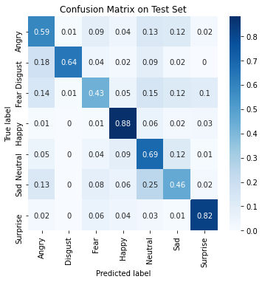
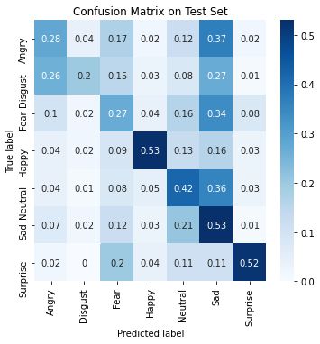
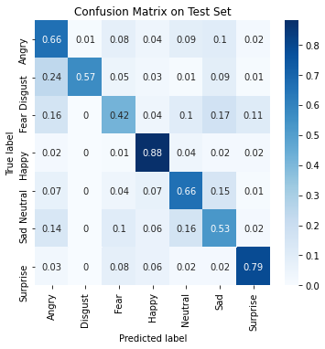
Baseline | Resnet18 | VGG16

Slide 6
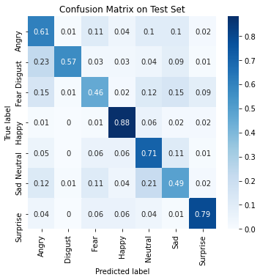
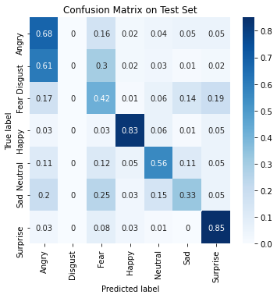
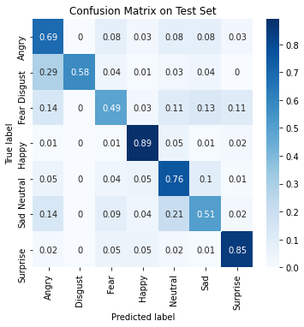
Resnet50 | Senet50 | Ensemble

Slide 7
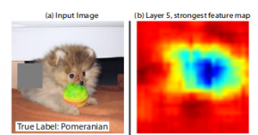

Occlusion-based Saliency Map
Image occlusion: systematically occlude different portions of the input image and observe the output of the classifier
Saliency map: compute the gradient of the output category with respect to the input image
Source: https://www.kaggle.com/blargl/simple-occlusion-and-saliency-maps

Slide 8
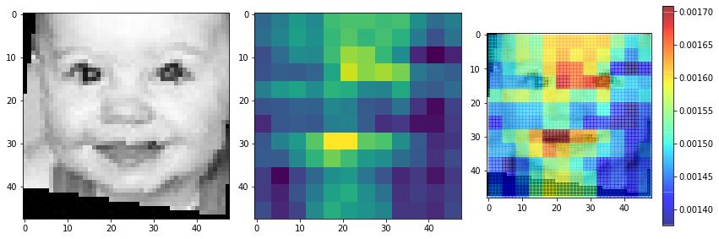
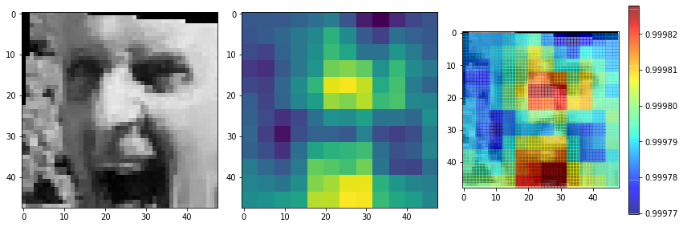
Interpretability

Slide 9
04
Future Works
Data Augmentation / Siamese Net / Triplet Loss

Slide 10
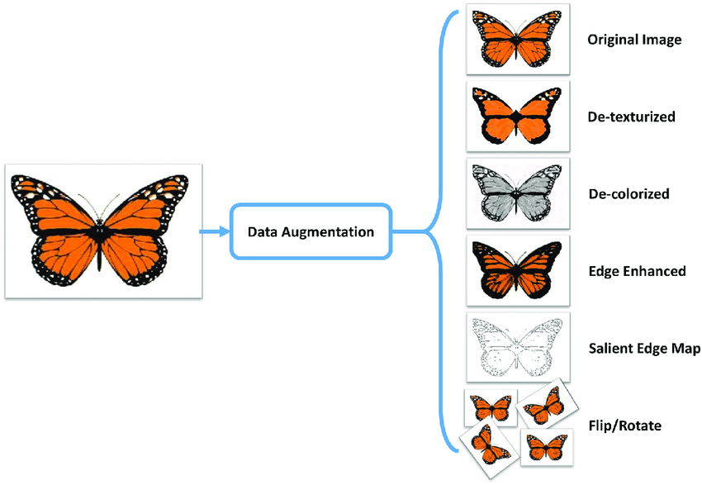
Data Augmentation
increases the amount of data by adding slightly modified copies or newly created synthetic data from existing data
acts as a regularizer and helps reduce overfitting
Source: Data augmentation-assisted deep learning of hand-drawn partially colored sketches for visual search

Slide 11
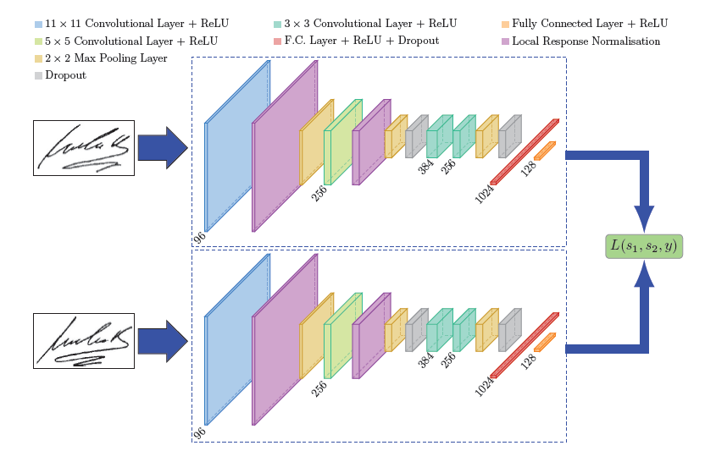
Siamese Network (SNN)
a class of neural network architectures that contain two or more ‘identical’ subnetworks
find the similarity of the inputs by comparing their feature vectors
learn a similarity function
Source: Siamese Network used in Signet

Slide 12
Pros
More robust to class imbalance
Nicely ensembled with other supervised classifiers
Learning from Semantic similarity
Cons
More training time
Doesn’t output probabilities

Slide 13
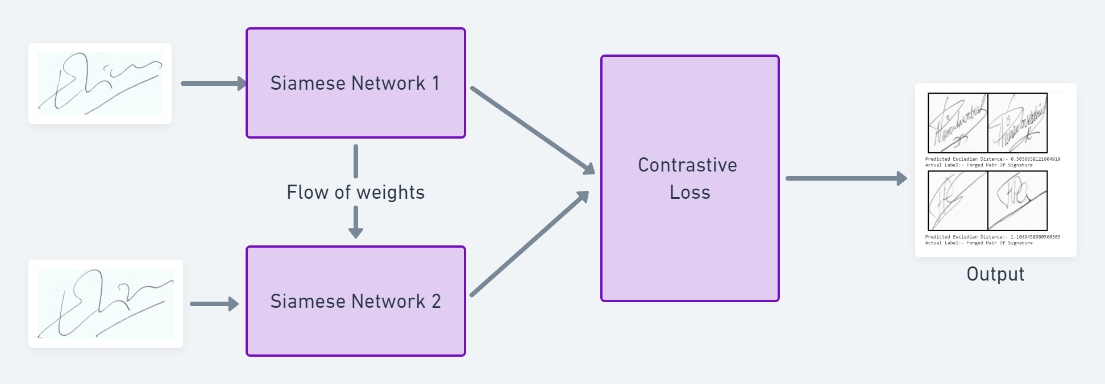
Triplet Loss (Contrastive Loss)
Triplet loss is a loss function where a baseline (anchor) input is compared to a positive (truthy) input and a negative (falsy) input
Contrastive loss is a distance-based loss used to learn closest embeddings of two similar instances and farthest embeddings otherwise (as opposed to conventional error-prediction loss)
Source: https://towardsdatascience.com/a-friendly-introduction-to-siamese-networks-85ab17522942

Slide 14
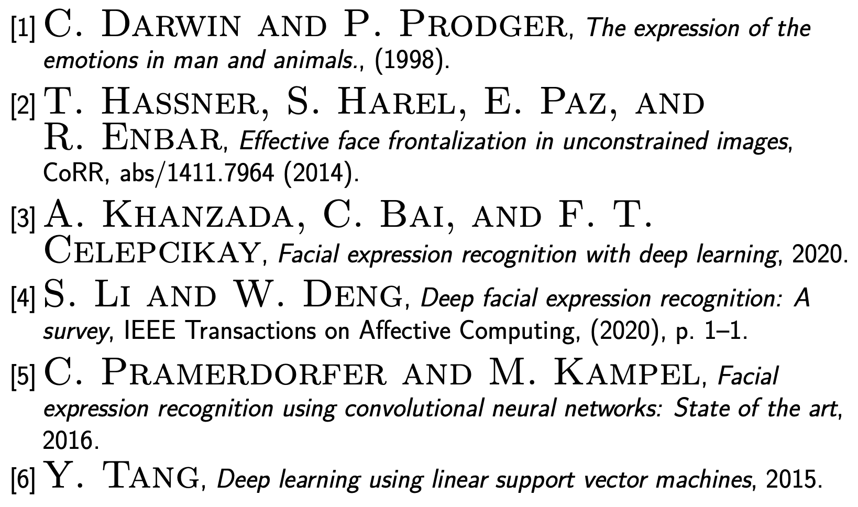
Acknowledgement
References
This work is inspired by the awesome project by Khanzada et al.

