Slide 1
Dat Air
107753027 李右元 X
107155018 楊晴焱
2019-01-15
Data
Science
In Practice

Slide 2
Presentation Flow
Preparation
Research Motivation
Analysis
Model Picking
Find-outs
By Months
Data Collection
Data Handling
Feature Selection
Model Scoring
By Cities
Conclusions & Acknowledgment
Data
Science
In Practice

Slide 3
Preparation Motivation, Data Collection & Handling
Data
Science
In Practice

Slide 4
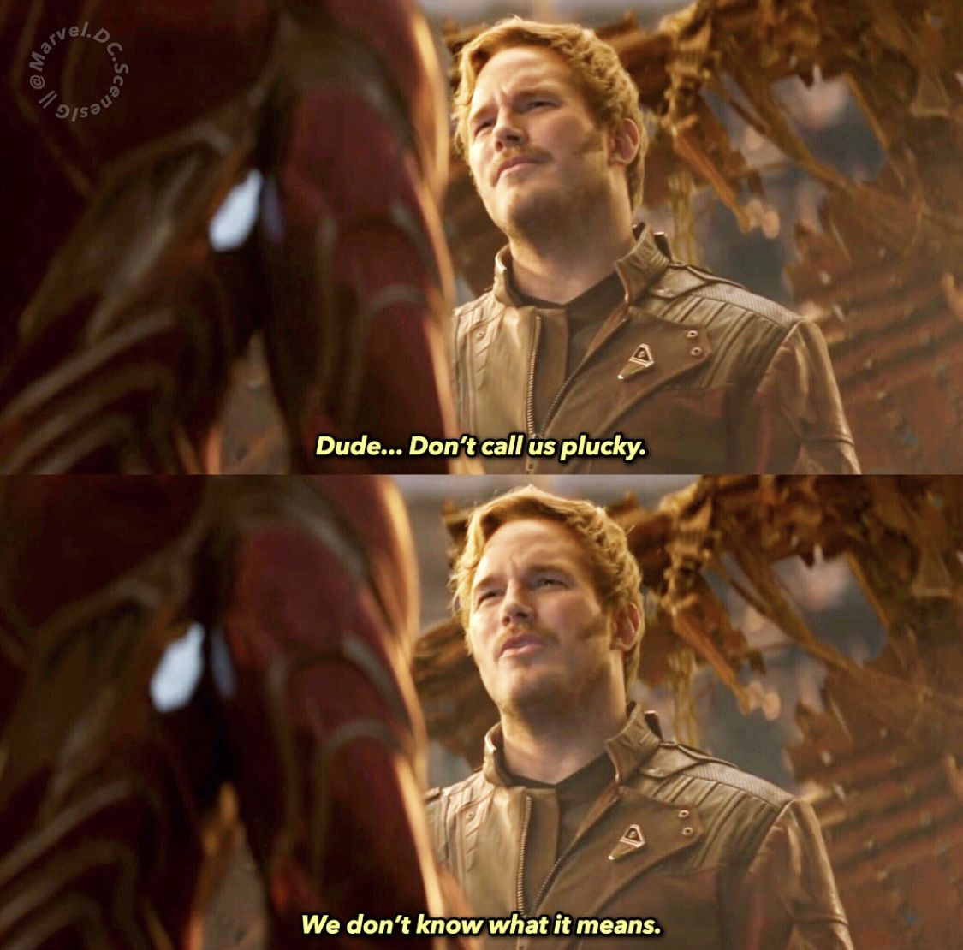

Research Motivation
Air Quality Index
Data
Science
In Practice

Slide 5



Research Motivation
Air Quality Index
Data
Science
In Practice

Slide 6


Data Collection
2005 – 2017 , Monthly
Across 22 cities of Taiwan.
Data
Science
In Practice

Slide 7
Data Collection
Data Dimension: 3432 records * 14 features
Feature Details: 2 traffic types --- Sum of Motorcycles & Cars
6 waste index ---
Normal & Massive & Recyclable & Leftover waste,
Sum of all waste, waste per person
3 penalty types ---
Construction & Site & Mobile fine
3 auditory types ---
Construction & Site & Mobile auditory
Data
Science
In Practice

Slide 8

Data Handling
Standardize those features.
Data
Science
In Practice
Skip those Records with NA values. 2 cities , 2005-2010, 312 records.

Slide 9
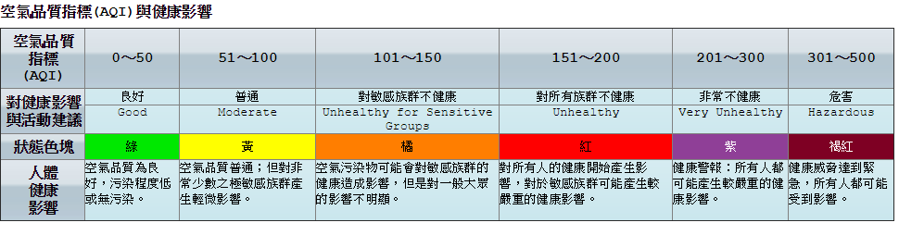
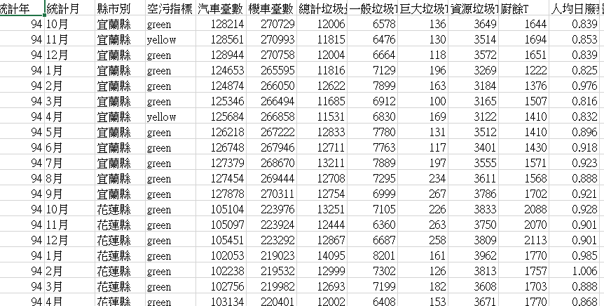
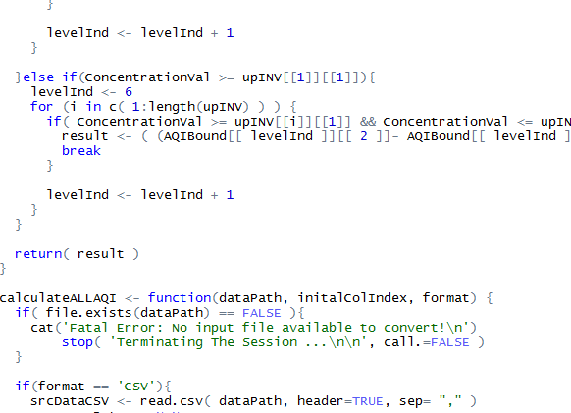
Data Handling
Data
Science
In Practice

Slide 10
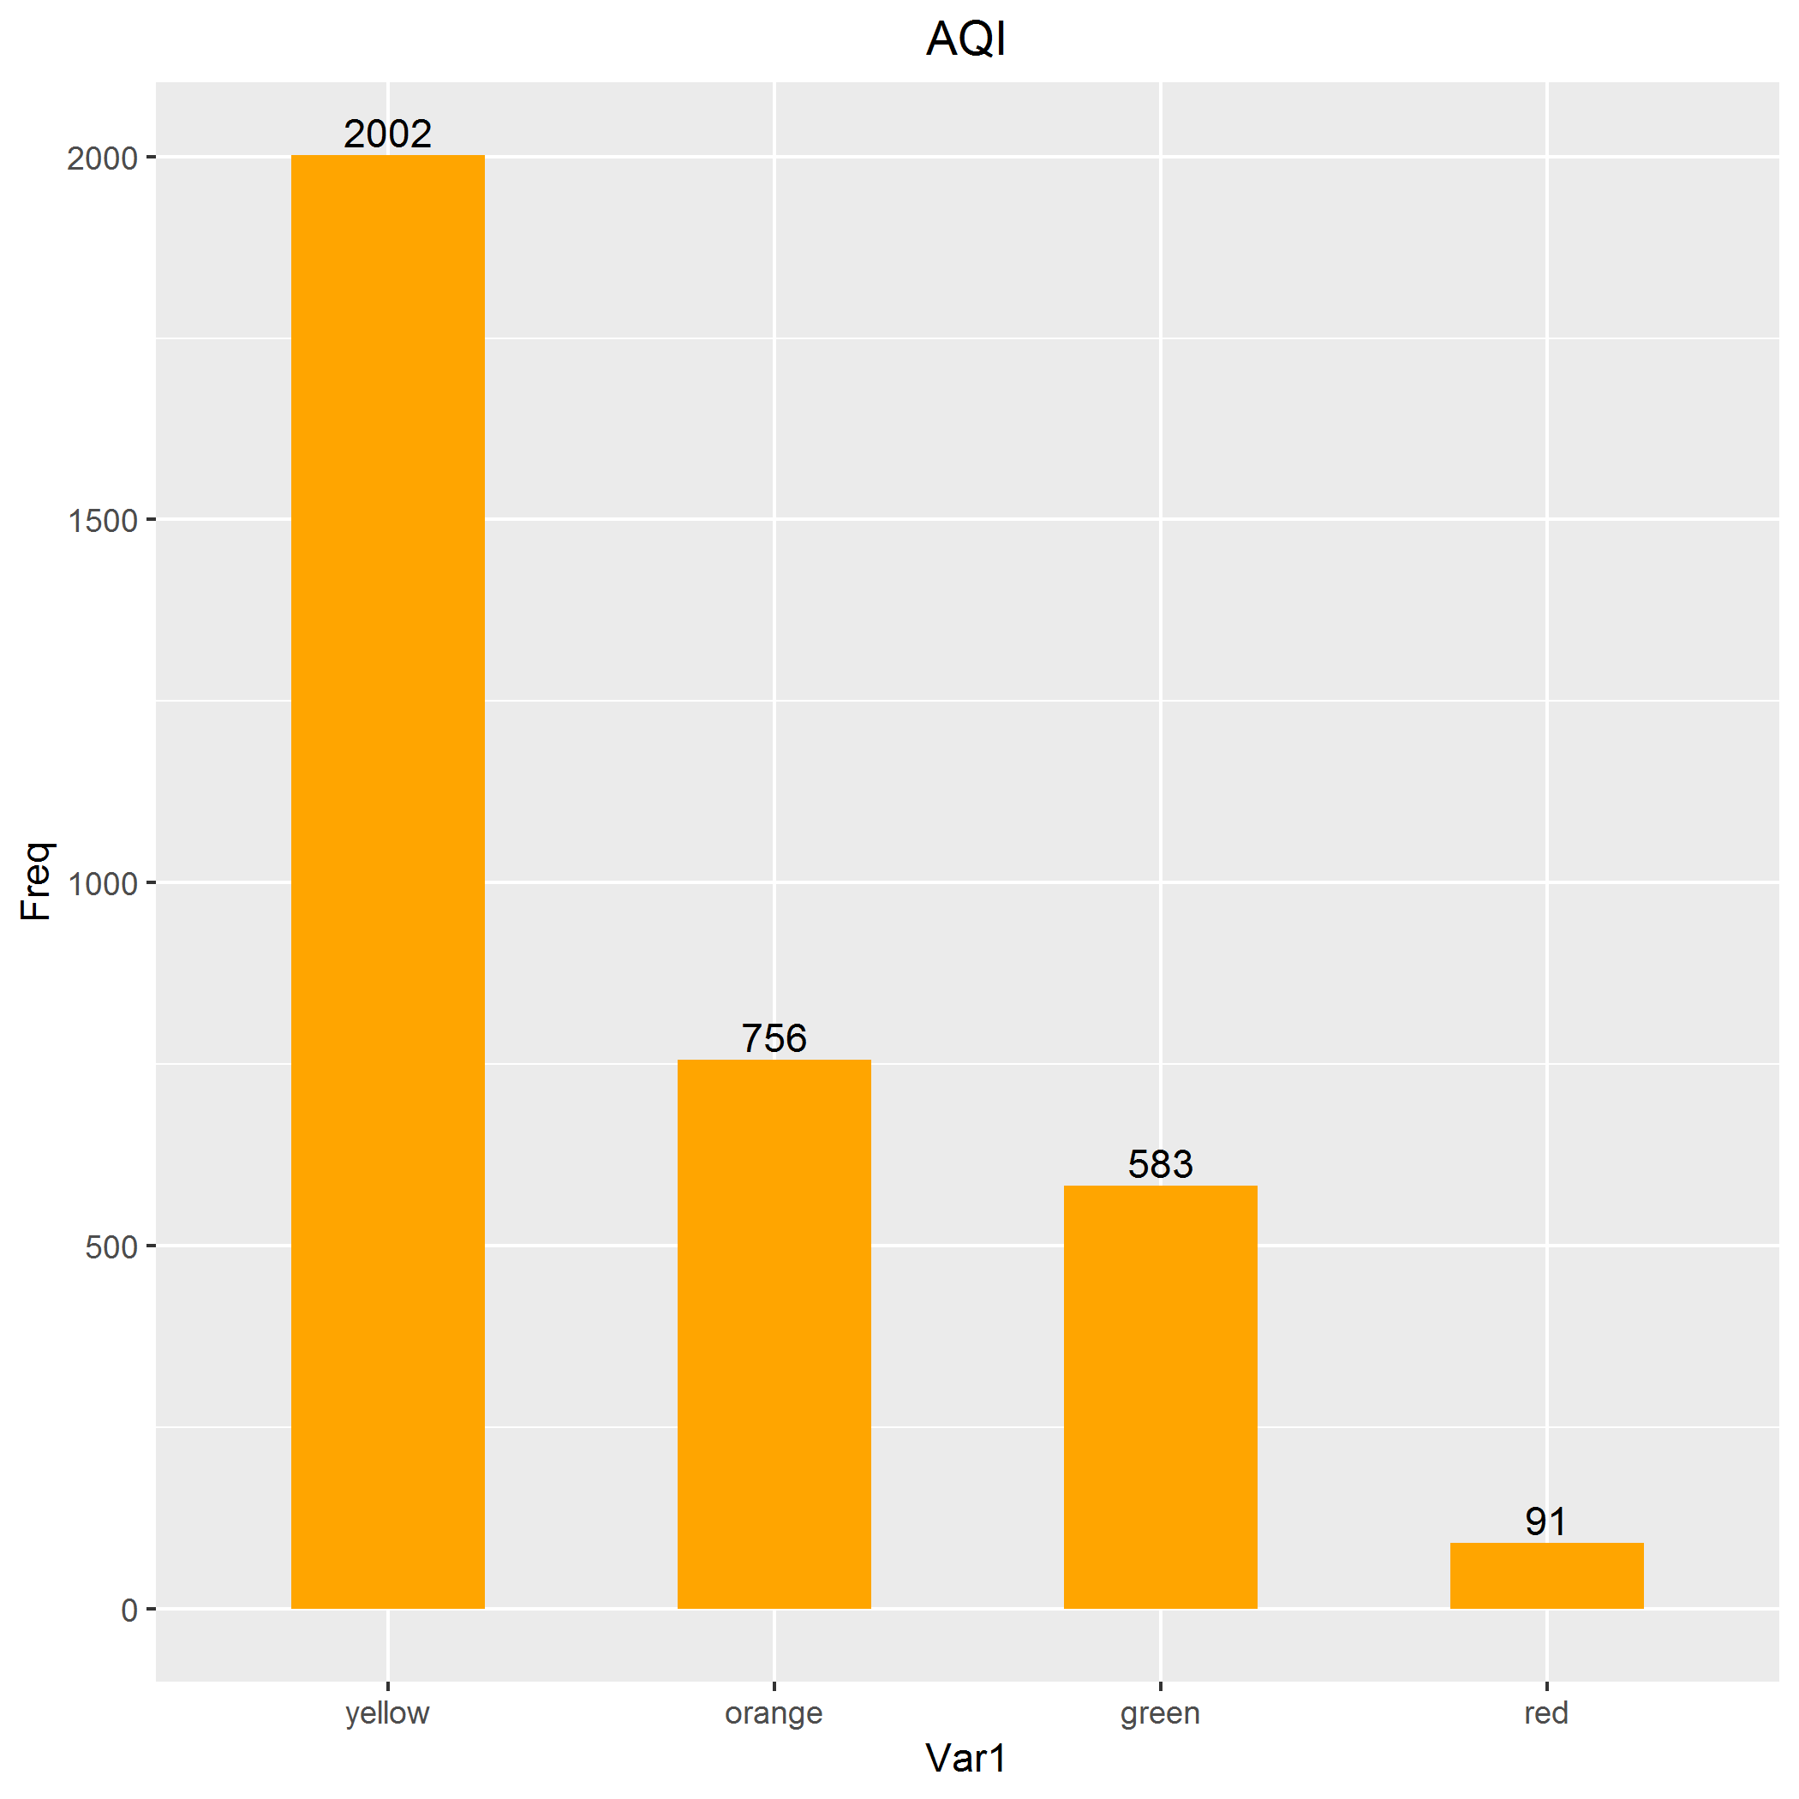
Data Handling
Data
Science
In Practice

Slide 11
Analysis Model Picking, Feature Selection, Model Scoring
Data
Science
In Practice

Slide 12
Model Picking
KNN
Decision Tree
Random Forest
5 folds cross validation
Data
Science
In Practice

Slide 13

Feature Selection
Car, Bike
TotalGarbageT, GeneralGarbageT, HugeGarbageT, RecycleGarbageT, KitchenWasteT, WastePerPersonKG
PenaltyConstruction, PenaltyPollution, PenaltyMobilePollution
ExamConstruction, ExamPollution ExamMobliePollution
Data
Science
In Practice

Slide 14
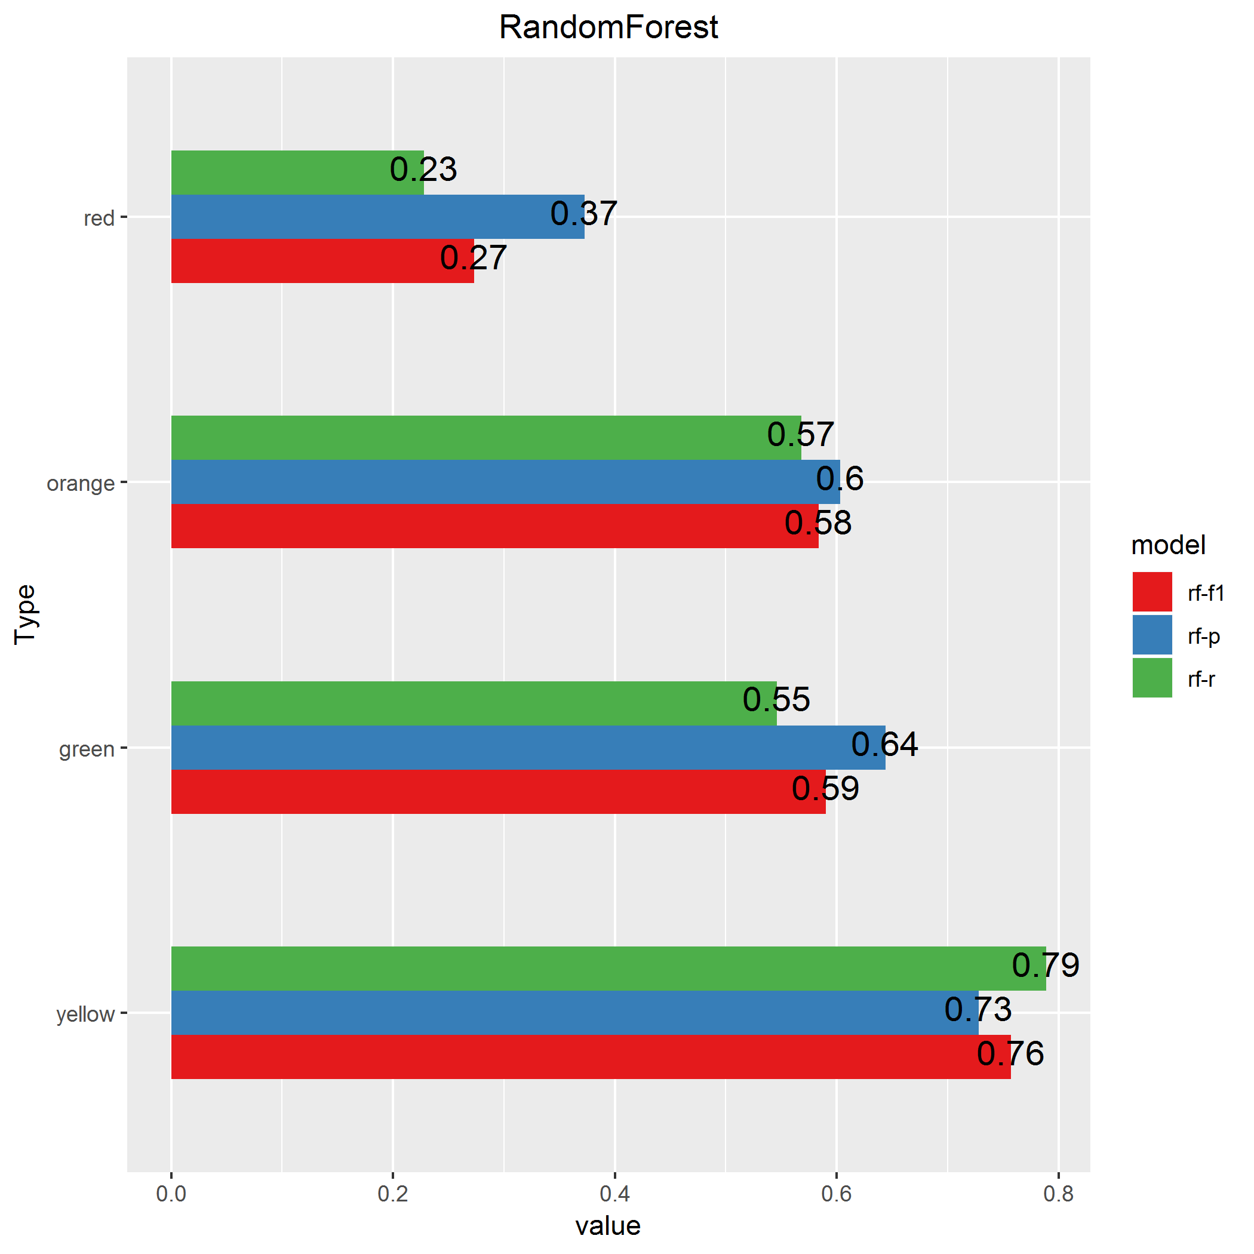
Model Scoring
F1 Score
Precision
Recall
Data
Science
In Practice

Slide 15
Find-outs By Month, By Cities, Conclusions & Acknowledgment
Data
Science
In Practice

Slide 16
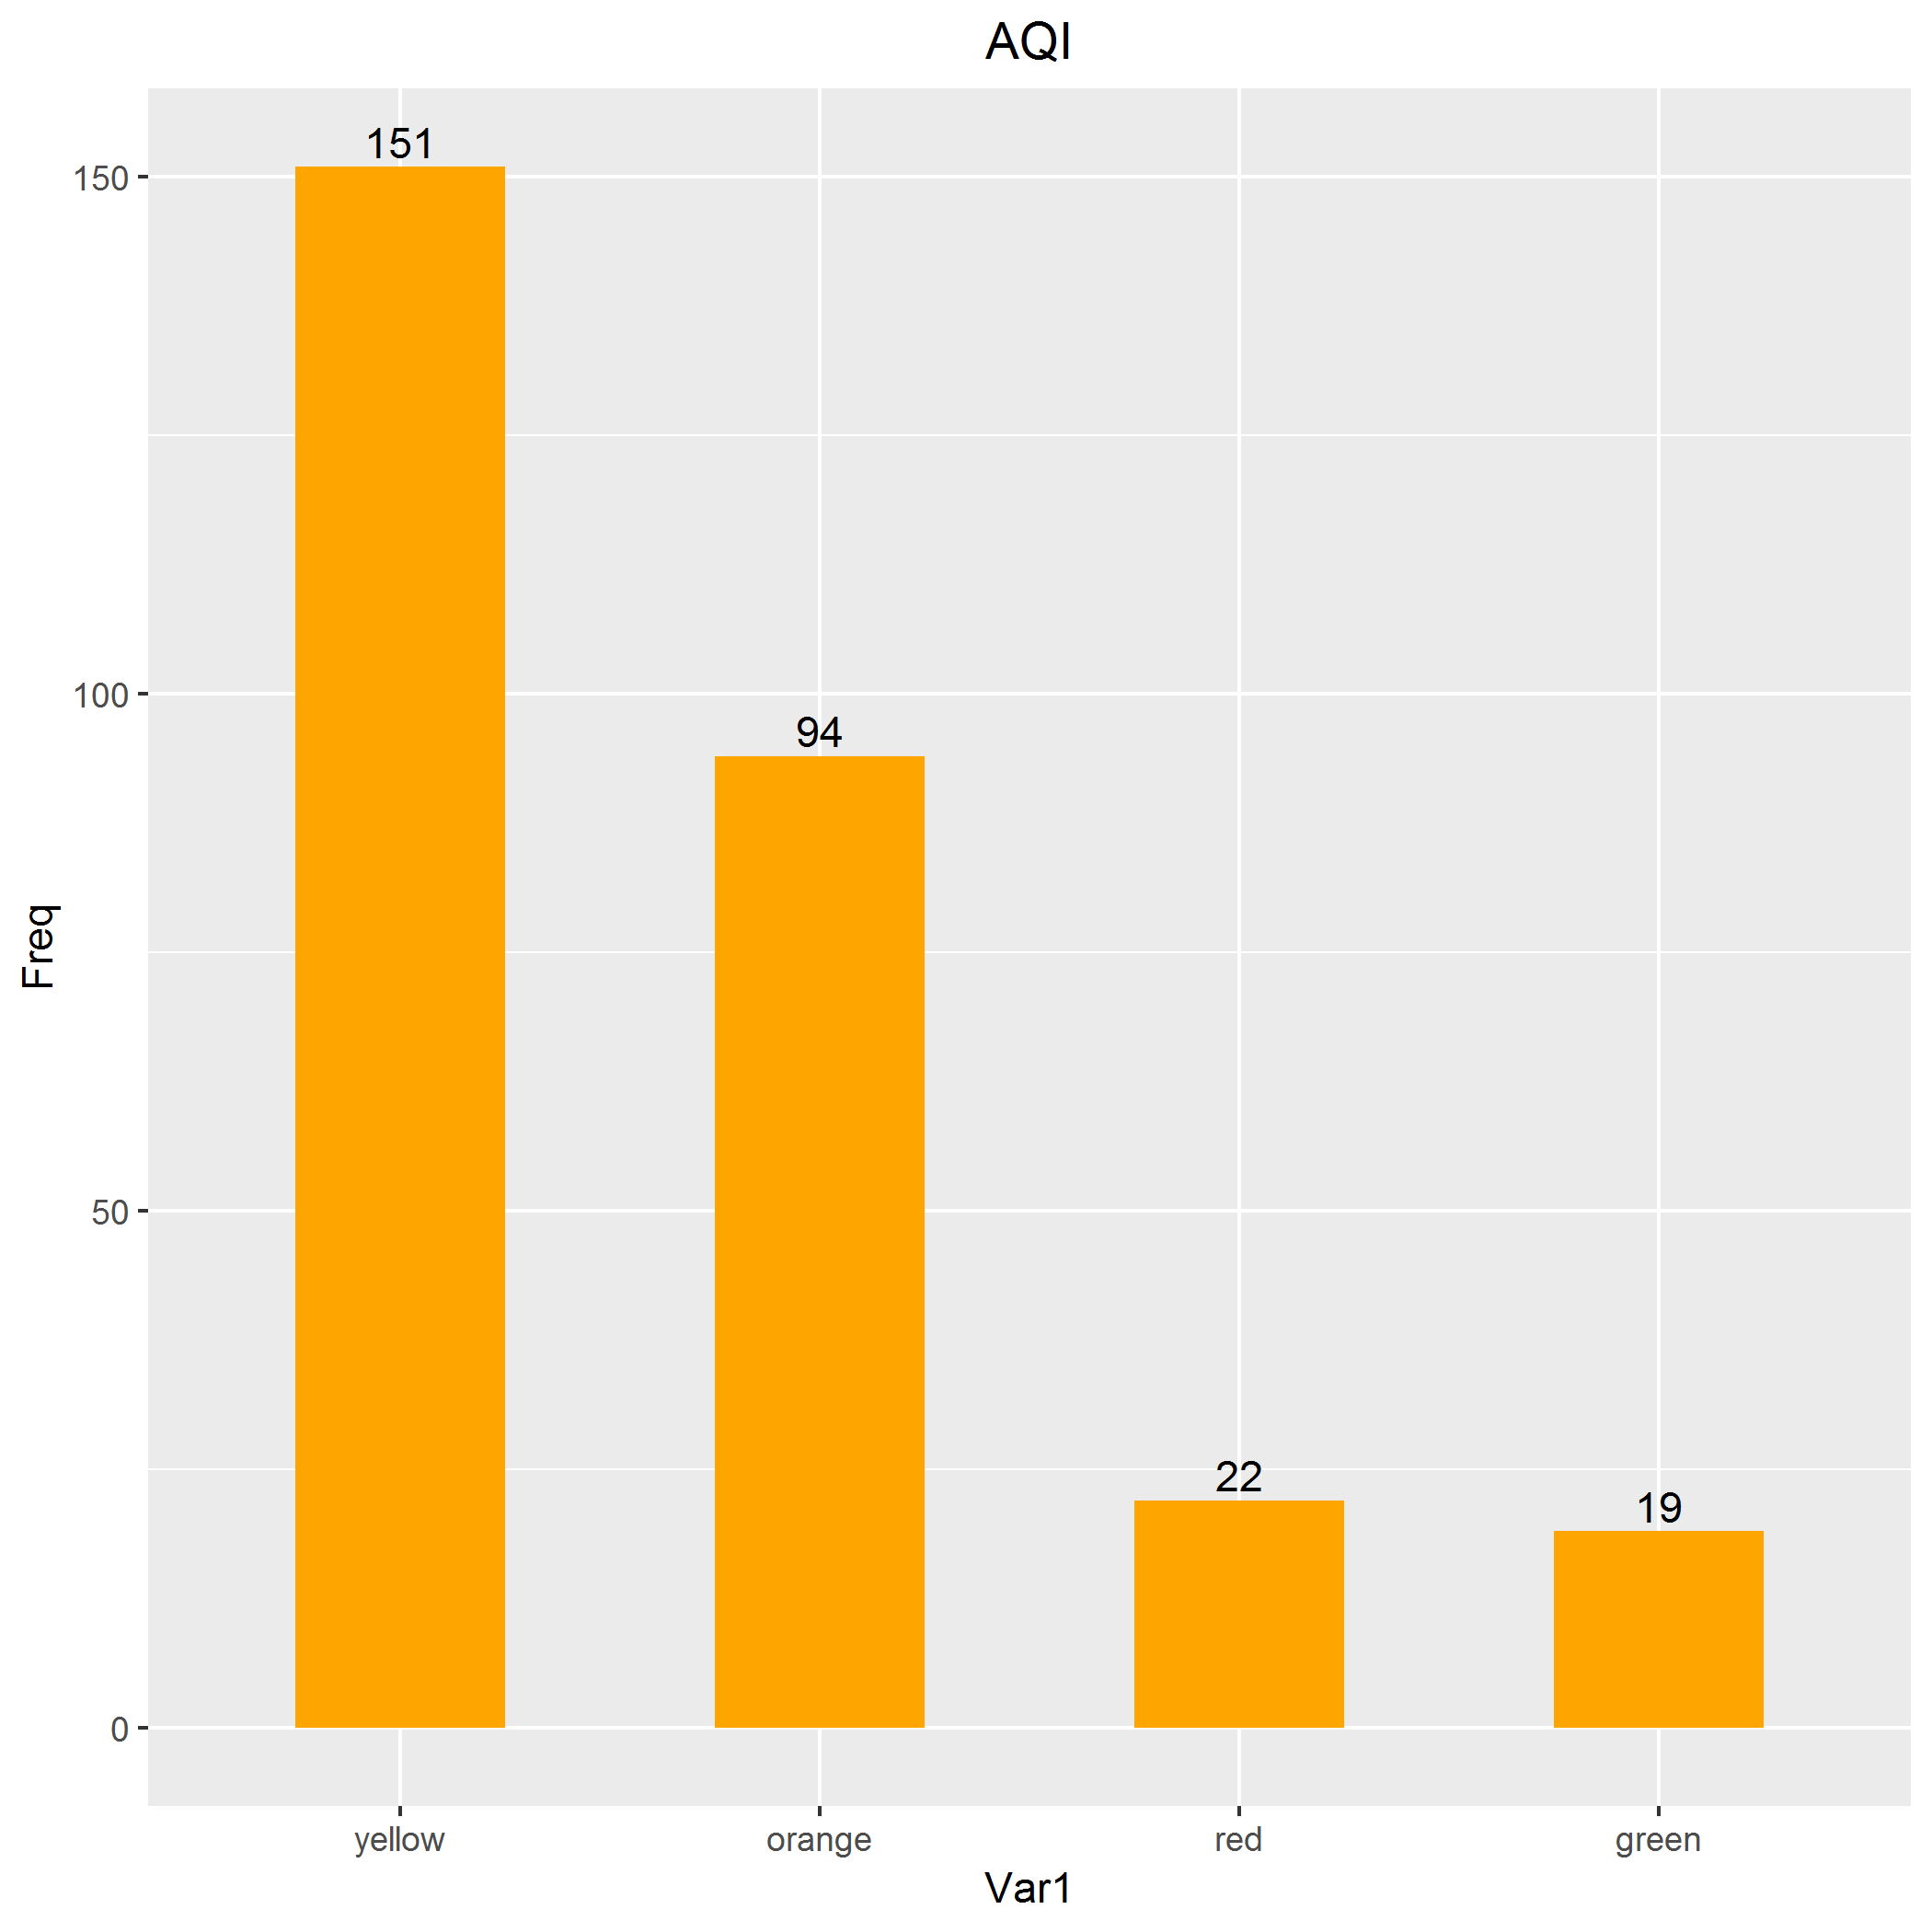
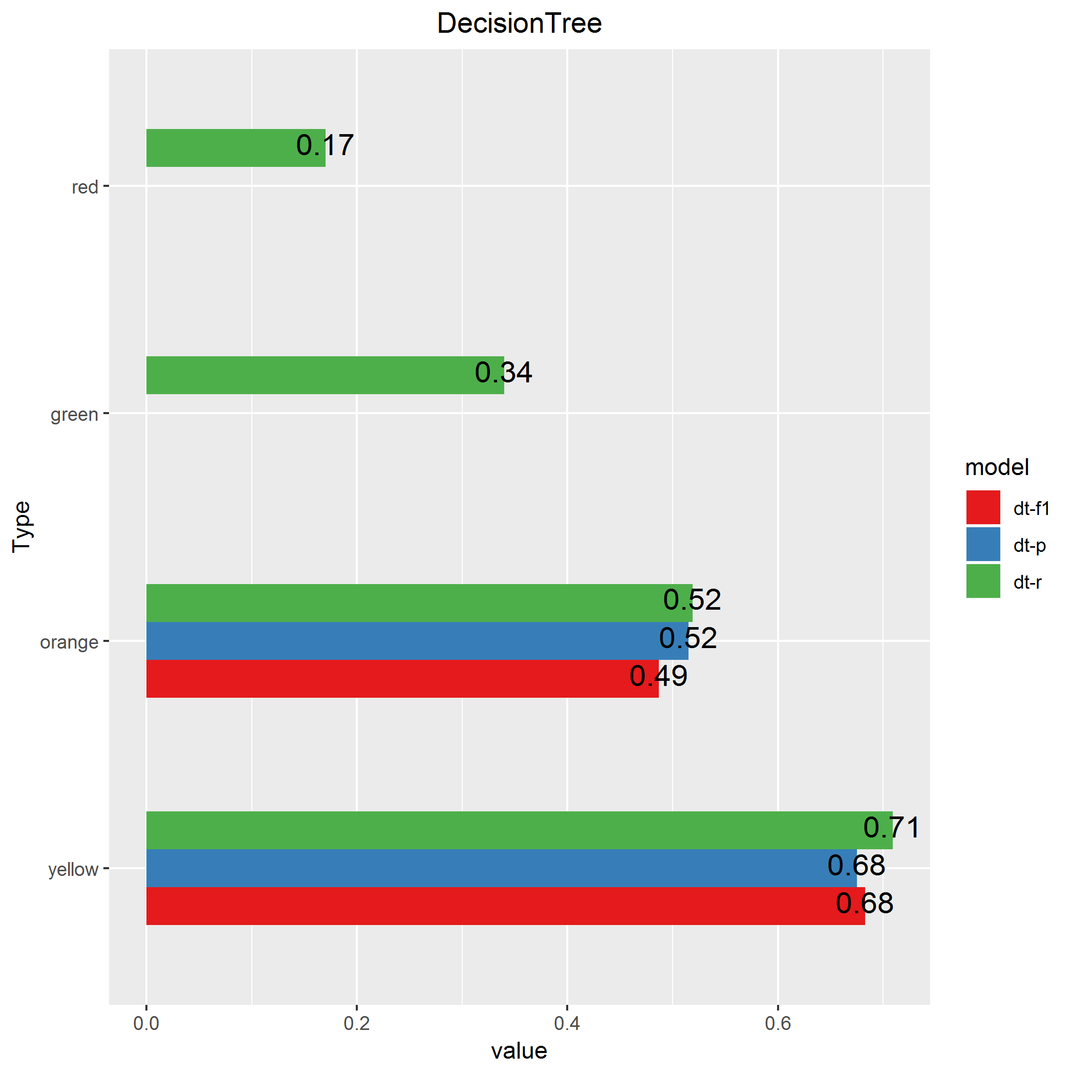
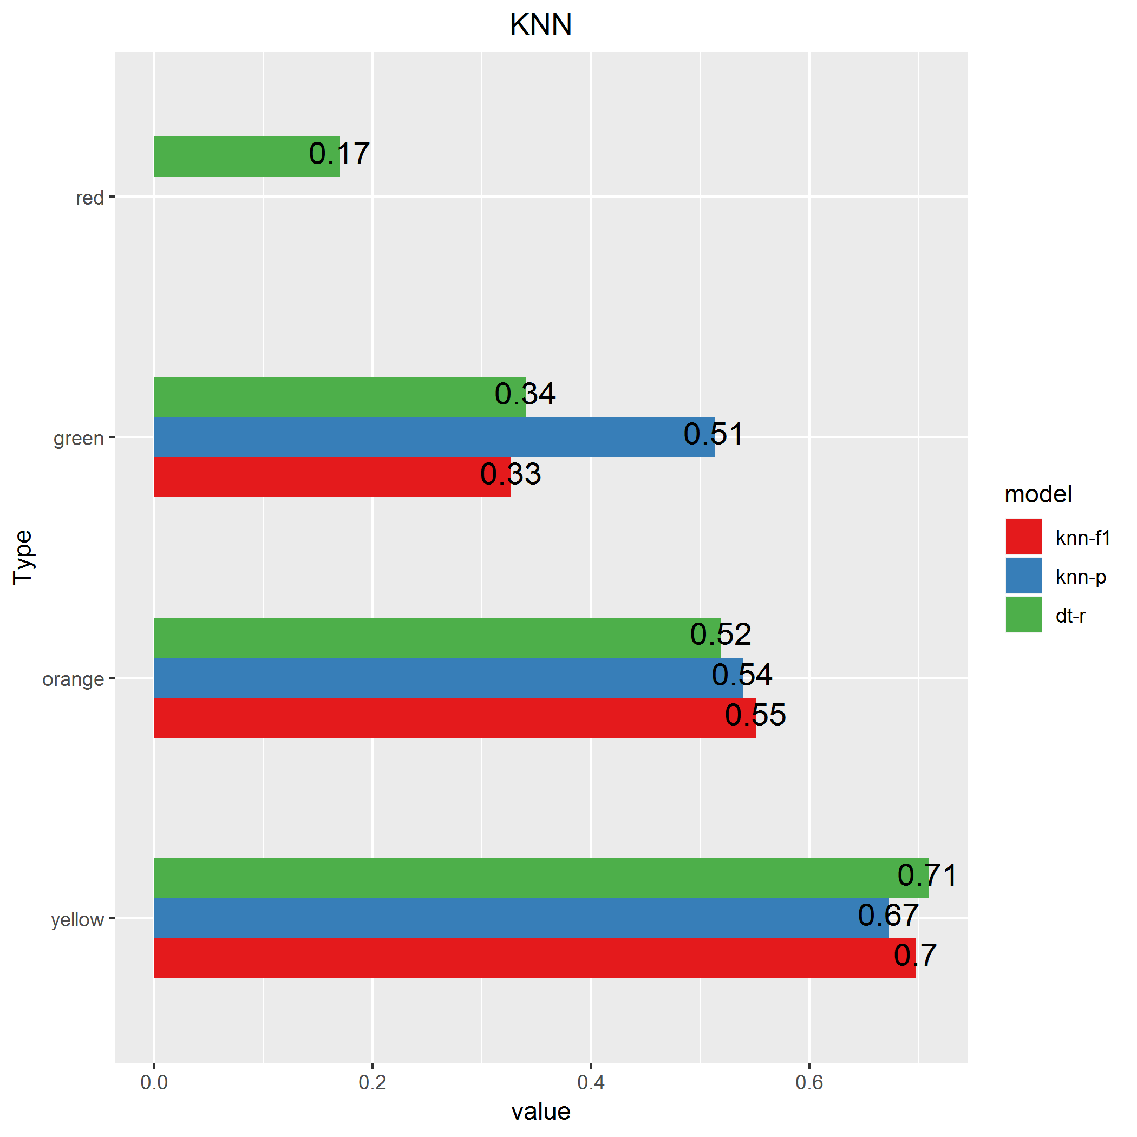
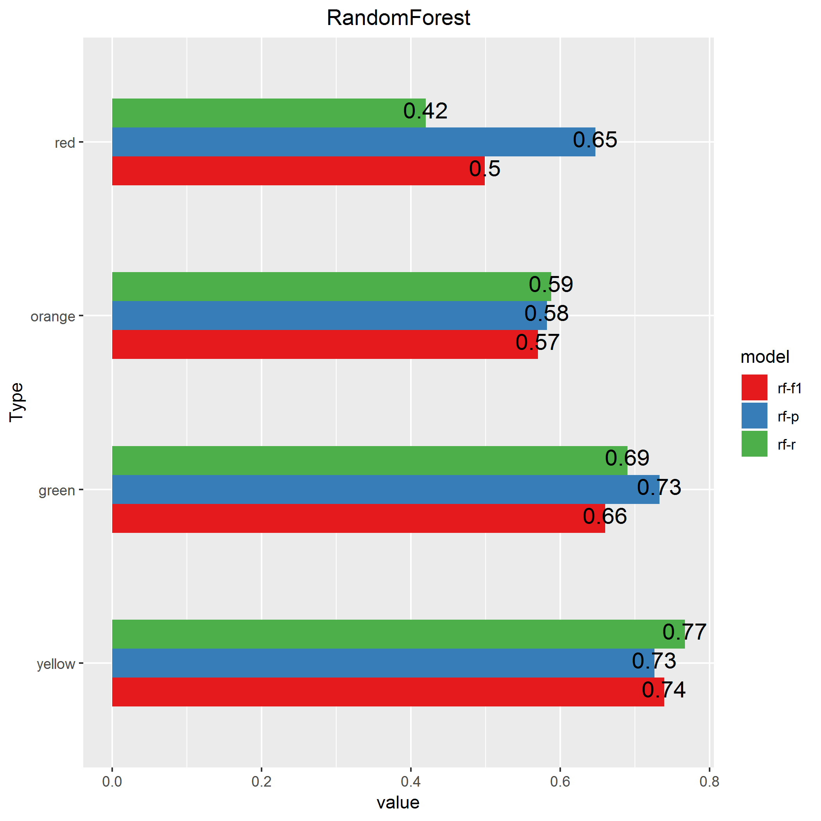
By Months
Decembers of 2005-2017
Data
Science
In Practice

Slide 17
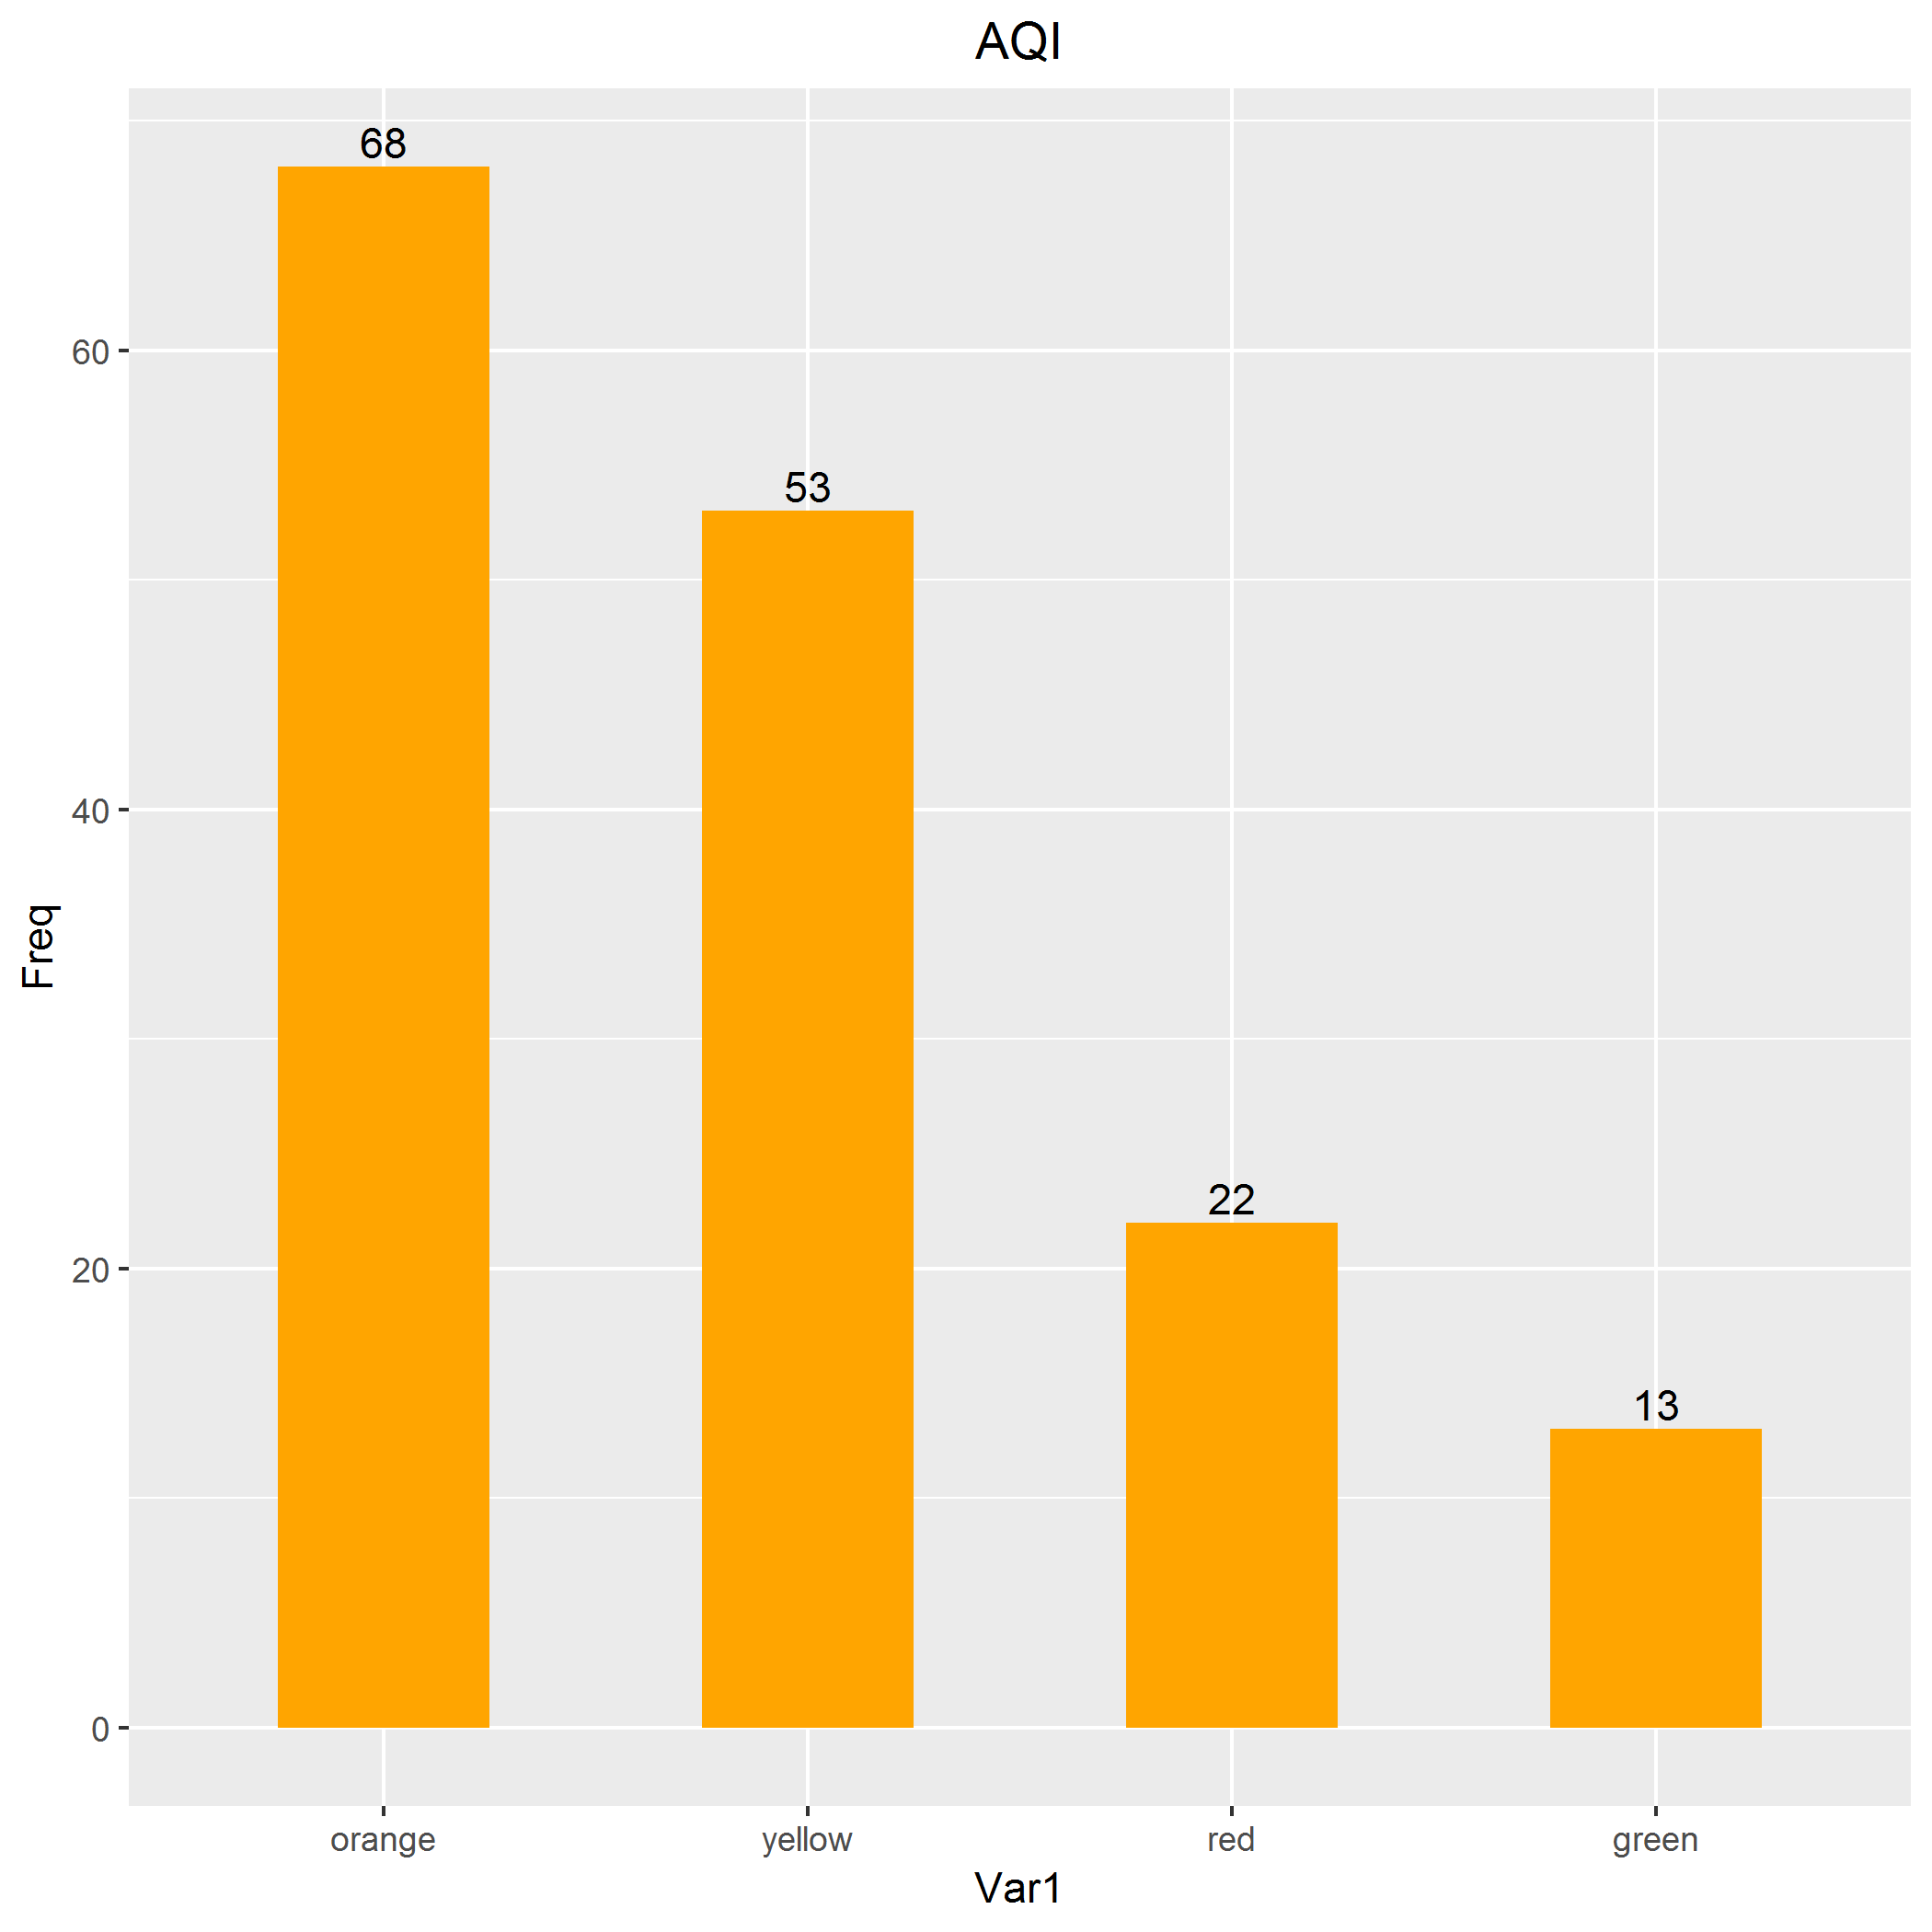
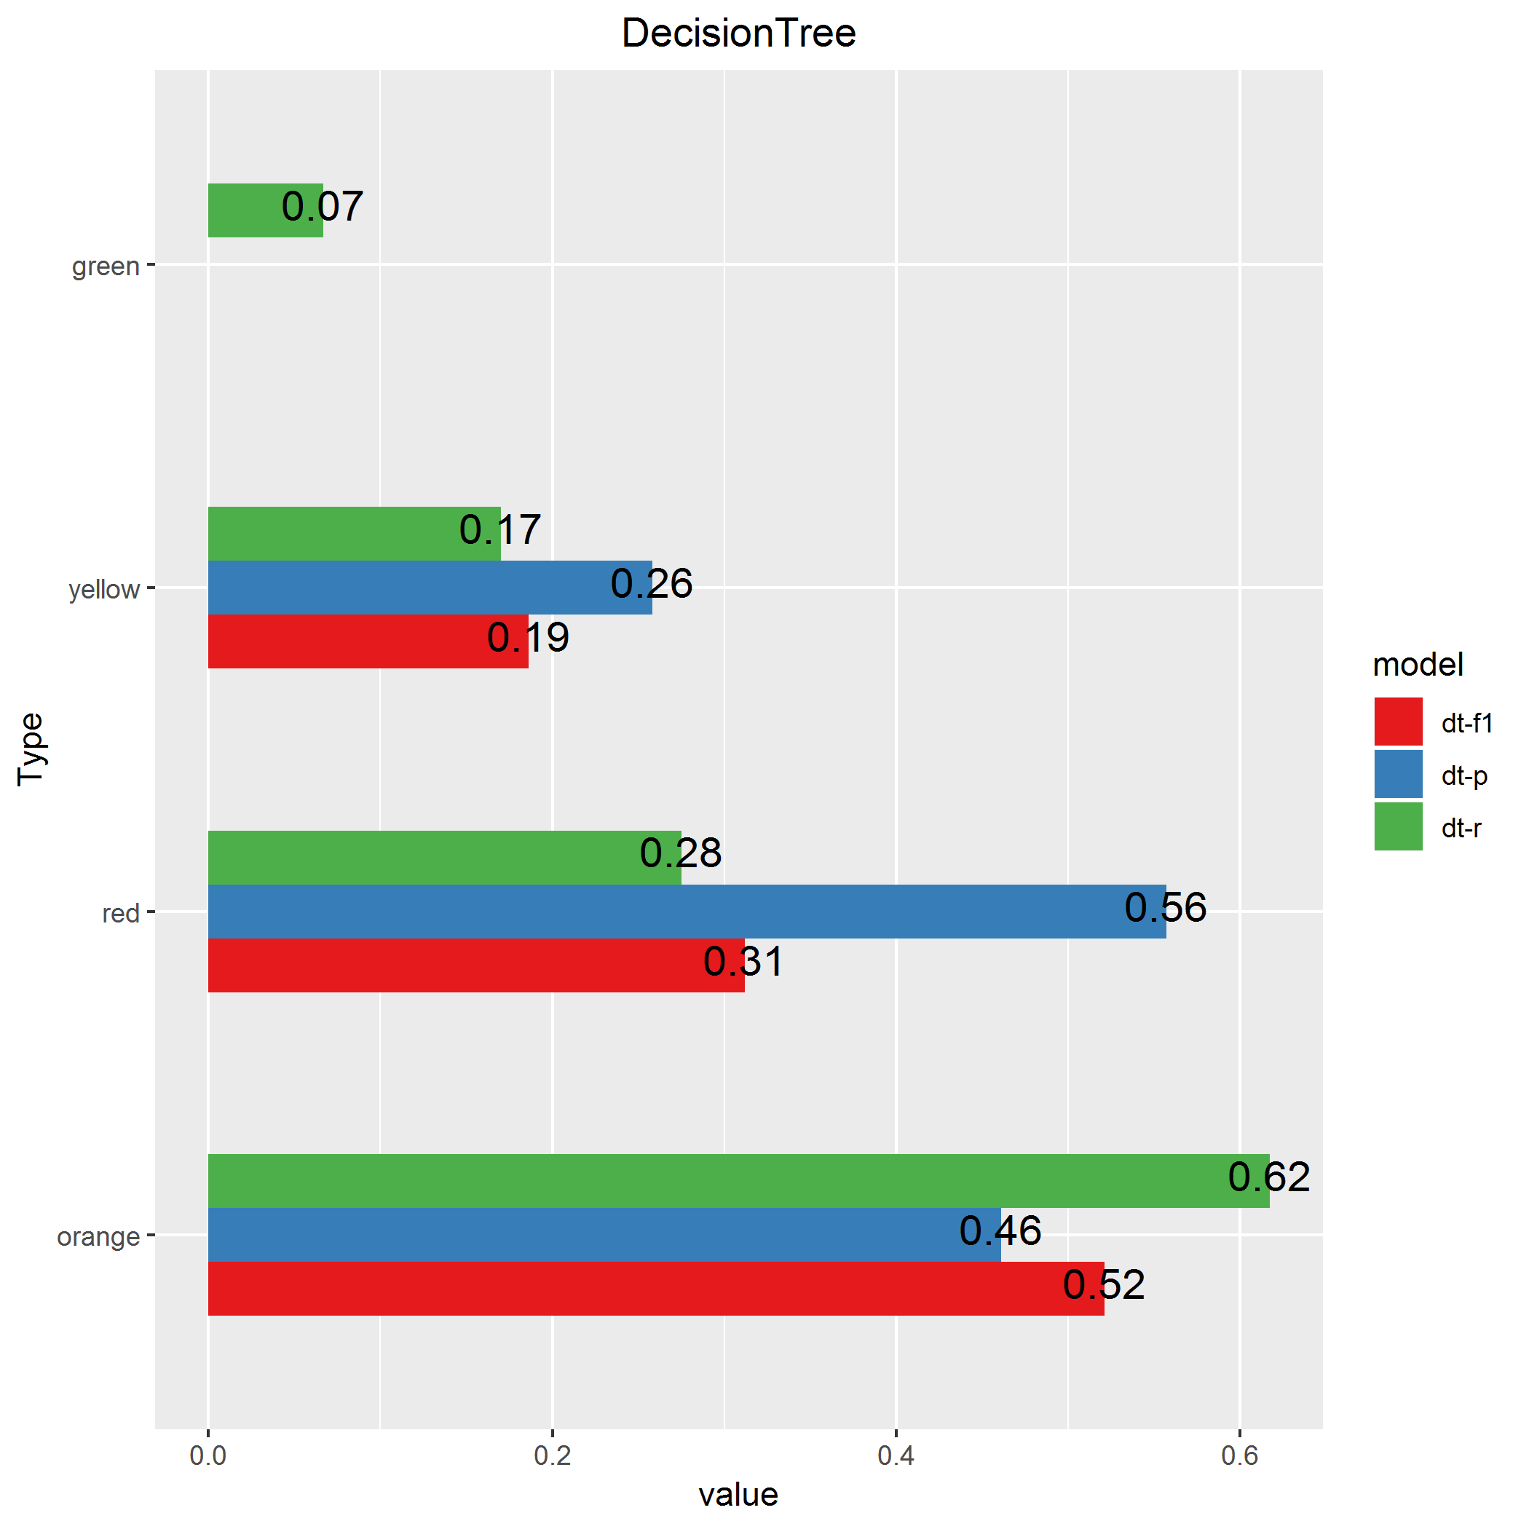
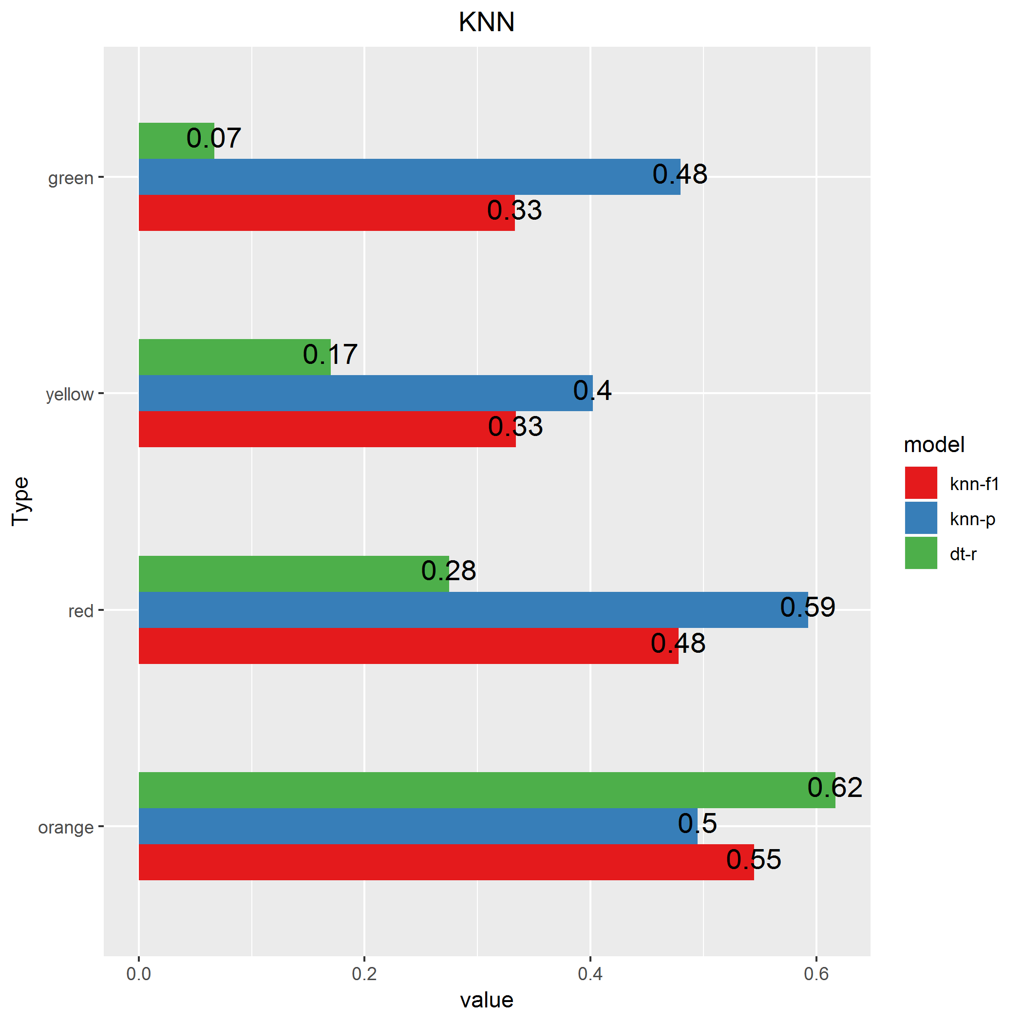
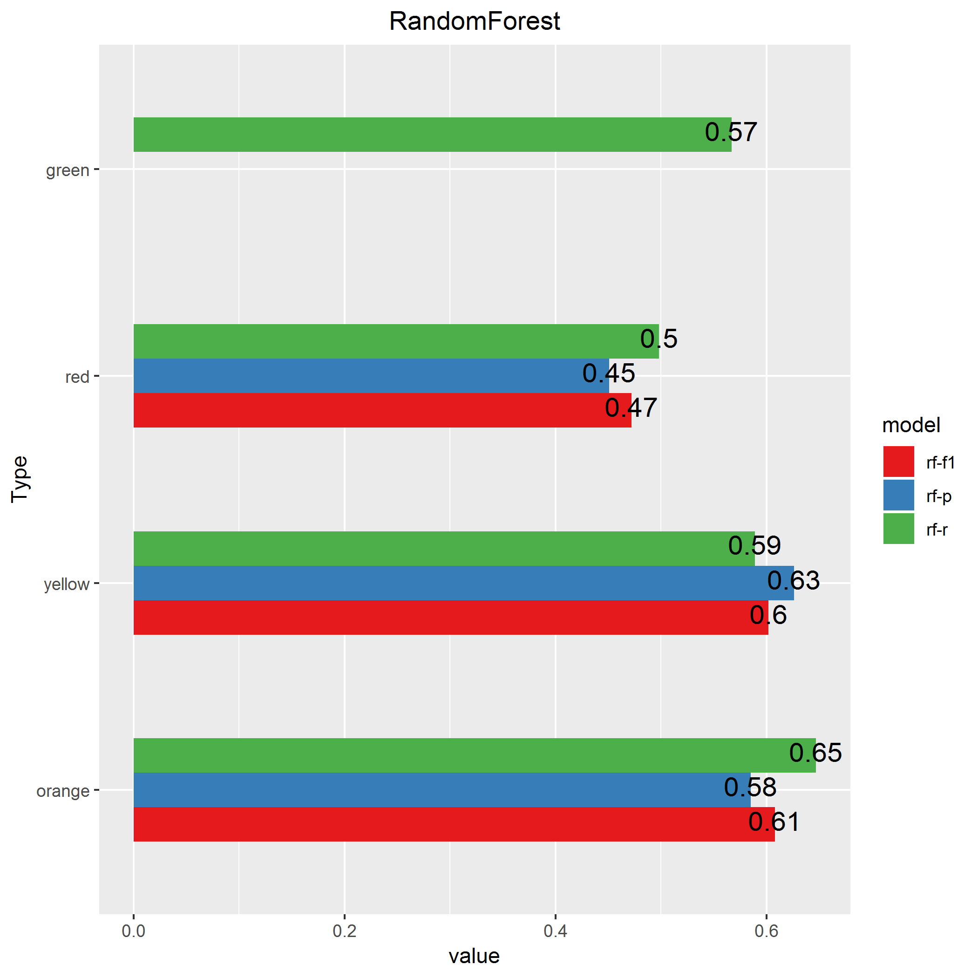
By Cities
Kaosiung City
Data
Science
In Practice

Slide 18
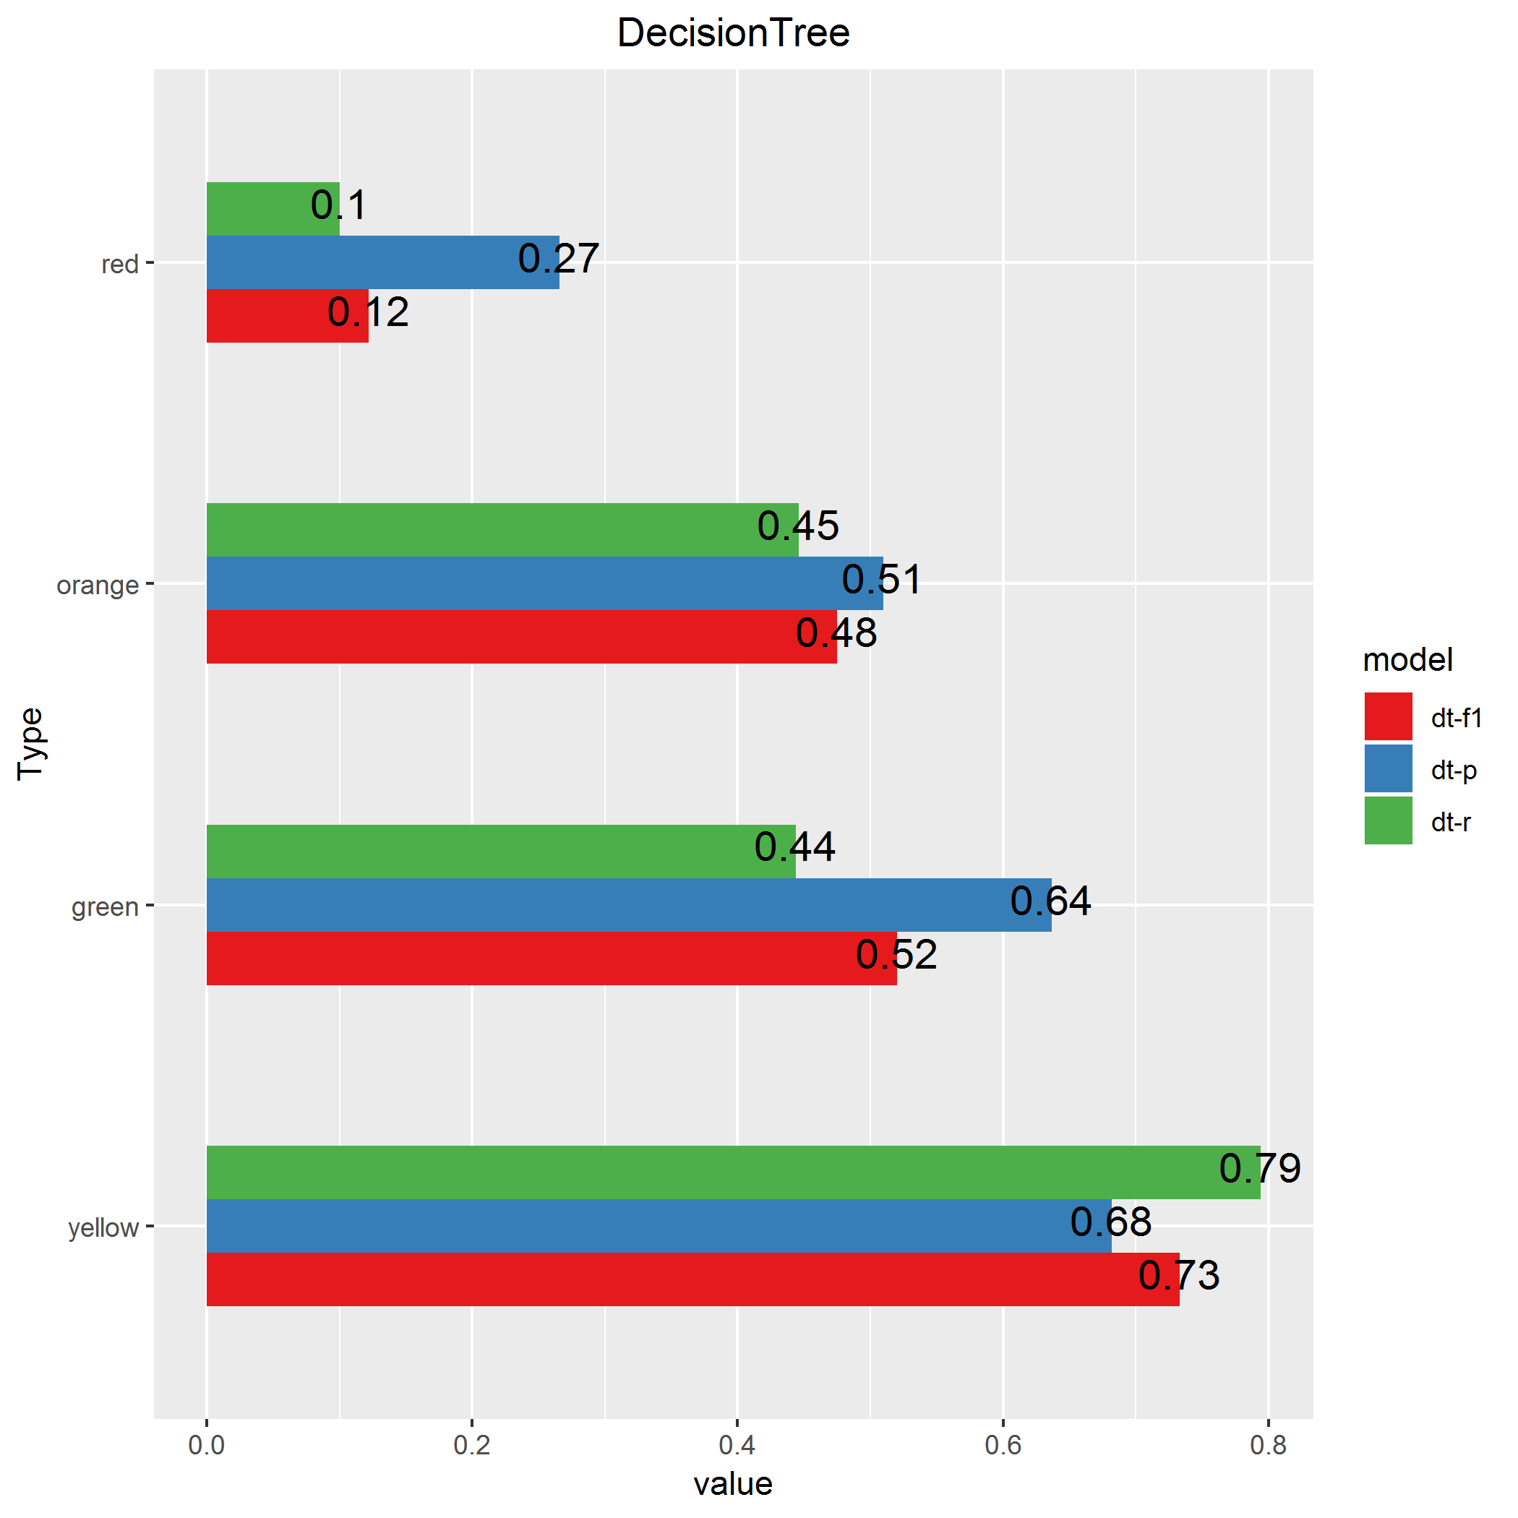
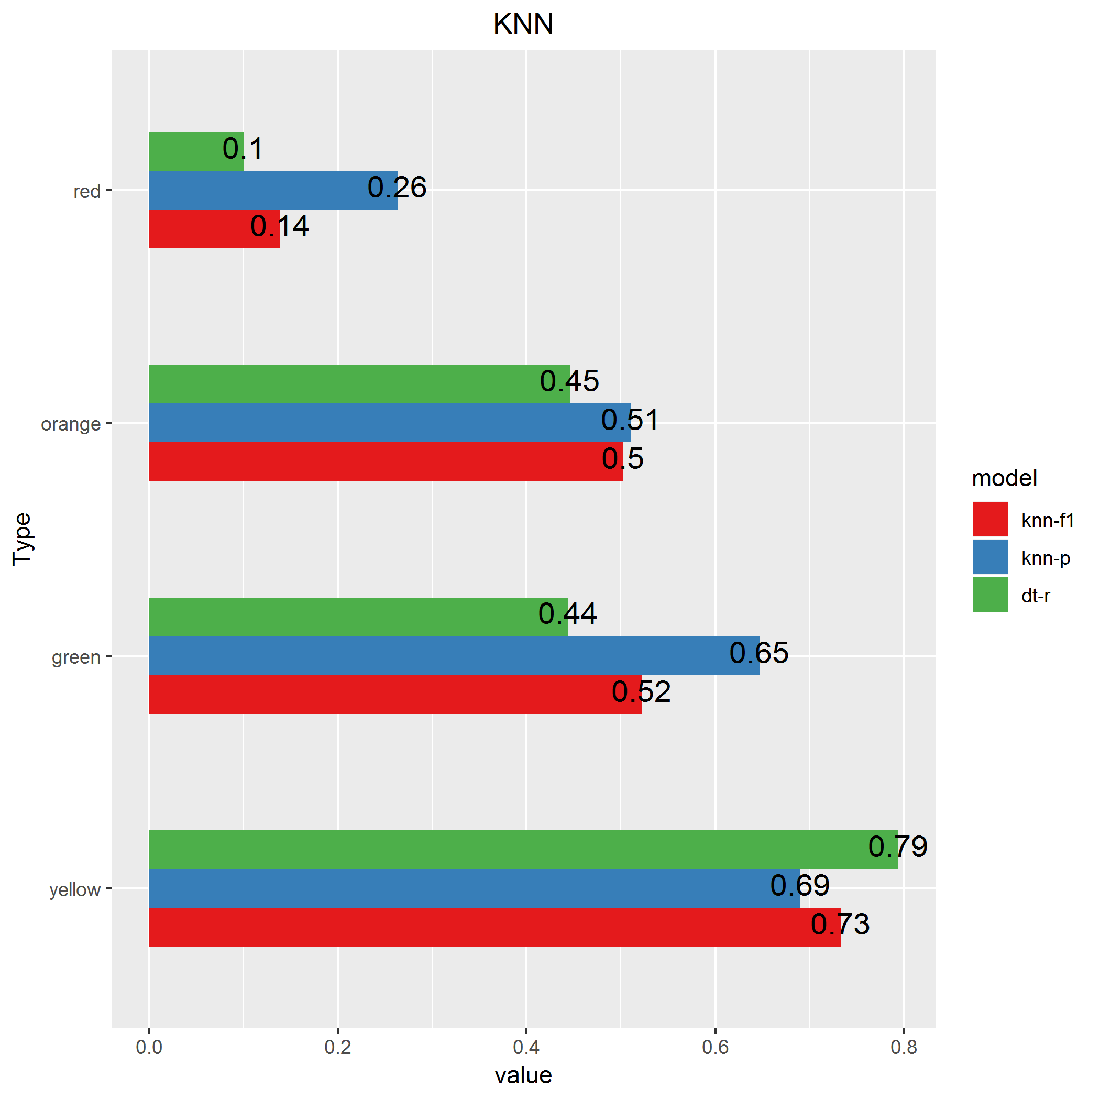
Conclusions & Acknowledgment
All Data
Data
Science
In Practice

Slide 19
Conclusions & Acknowledgment
Features are not so diversified as we expected <-> Open Data? Poor Back Ground.
Imbalanced Data Distribution <-> United it stands, Divided it fails.
To balance or not to balance <-> Honesty Problem…
Proper Data Sets
Data
Science
In Practice

Slide 20
Thank You!
Data
Science
In Practice

Slide 21
Q & A?
Data
Science
In Practice

