Slide 1
Modeling Second Language Acquisition
彭賢訓，107753030
陳研佑，107753021

Slide 2
Duolingo
Popular language learning app
Uses learner data to improve experience
Half-life Regression

Slide 3
SLAM Shared Task on SLAM
NLP, machine learning, cognitive science
Predicting student mistakes
Shared task, with 15 teams in 2018/1 ~ 2018/4
Very useful overview paper
System papers
Three tracks: en_es, es_en, fr_en
http://sharedtask.duolingo.com

Slide 4
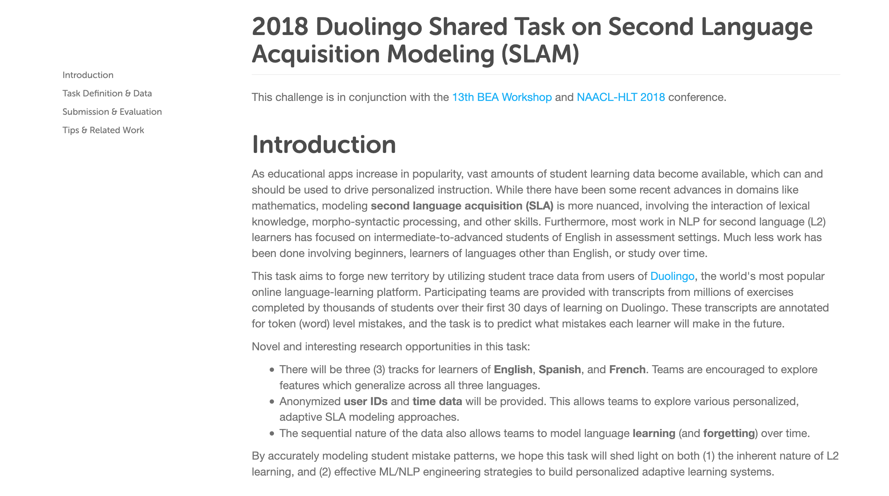

Slide 5
Dataset Format
# user:YjS/mQOx countries:CA days:20.133 client:web session:lesson format:reverse_translate time:9
/A/dQZMu0101 Je PRON Number=Sing|Person=1|PronType=Prs|fPOS=PRON++ nsubj 3
/A/dQZMu0102 suis VERB Mood=Ind|Number=Sing|Person=1|Tense=Pres|VerbForm=Fin|fPOS=VERB++ cop 3
/A/dQZMu0103 sûr ADJ Gender=Masc|Number=Sing|fPOS=ADJ++ ROOT 0
# user:YjS/mQOx countries:CA days:20.136 client:web session:lesson format:reverse_translate time:17
QtTuzqbZ0101 Ce DET Gender=Masc|Number=Sing|fPOS=DET++ det 2
QtTuzqbZ0102 cheval NOUN Gender=Masc|Number=Sing|fPOS=NOUN++ nsubj 4
QtTuzqbZ0103 est VERB Mood=Ind|Number=Sing|Person=3|Tense=Pres|VerbForm=Fin|fPOS=VERB++ cop 4
QtTuzqbZ0104 nul ADJ Gender=Masc|Number=Sing|fPOS=ADJ++ ROOT 0

Slide 6
Our Model
Logistic Regression
Feature:
Word length
Morphological complexity
Part of speech
Dependency Label
Token Index and Exercise Index
Session, format, client
Days and time (relative)
Not much feature engineering

Slide 7
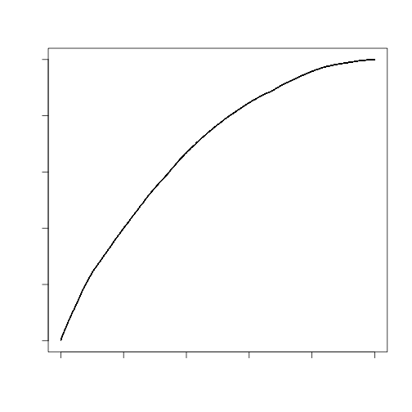
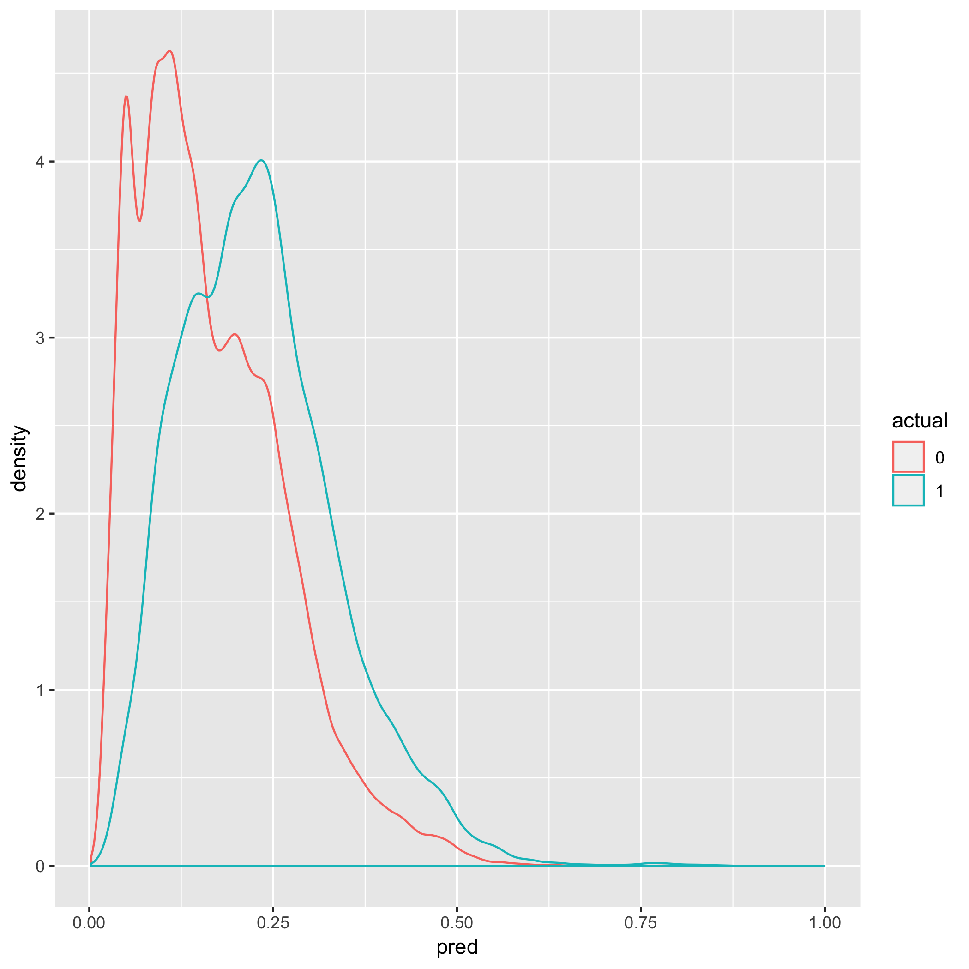

Slide 8
Result: Not Better Than Baseline
Tried random forest, but OOM
Various models also OOM
Finally: AUC of 0.684, baseline 0.771
……wait, gradient descent?
glm uses IWLS (Iterative (Re)Weighted Least Square)
Time series features
Moral: Algorithm matters

Slide 9
Conclusion
Learned many ultimately unused things
Value imputation
GBDT
NLP (not much)
Computational resource restriction
Data from beginners
Next step: try different algorithm again

