Slide 1
Speaker Recognition
107753017
107753045

Slide 2
Goal
Identify a voice as male or female

Slide 3
Data
Input format: .csv
20 columns features
3168 datas
Male : Female
1584 : 1584 = 1 : 1

Slide 4
Cross-validation
10 folds
training : testing
= 9 : 1
use folds[3] for test data in seed(1111)

Slide 5
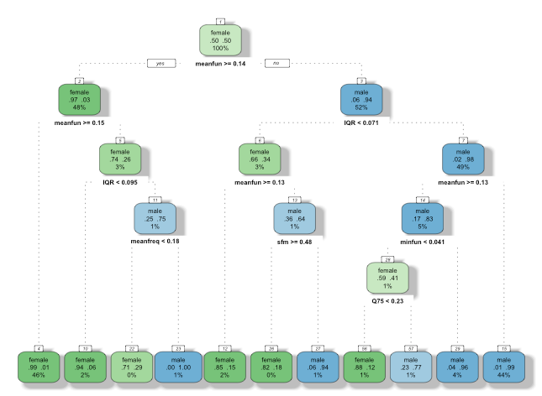
Extra separated data (dession tree)
meanful
IQR
minfun
sfm
maxdom

Slide 6
Method
Libsvm
介紹，原理
Package
一些圖表

Slide 7
Libsvm
library(e1071)
NTU Professor Chih-Jen Lin

Slide 8
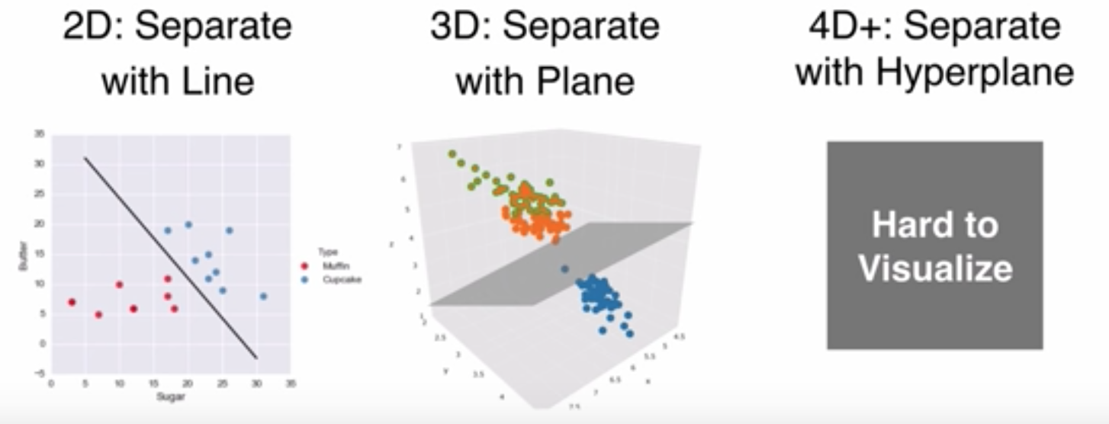
Libsvm
Source: https://www.youtube.com/watch?v=N1vOgolbjSc

Slide 9
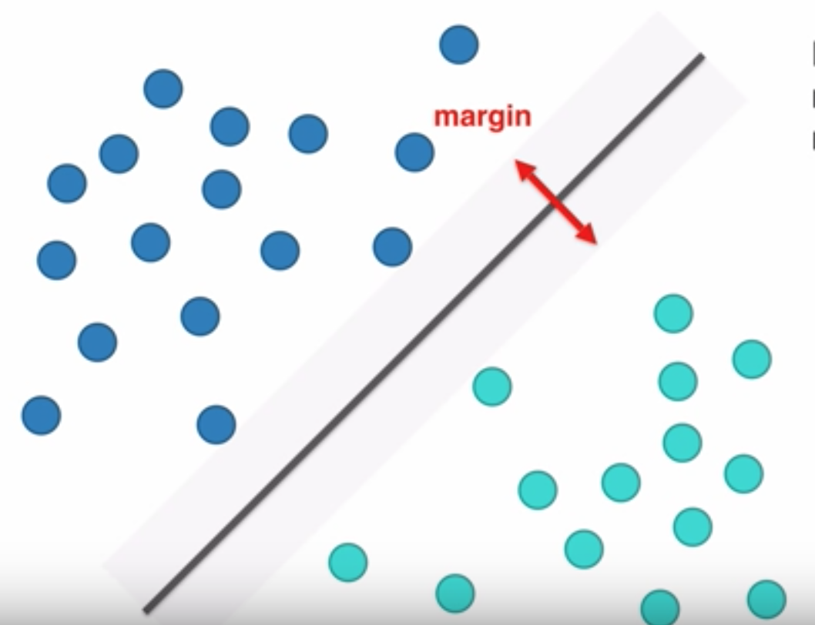
Libsvm
Source: https://www.youtube.com/watch?v=N1vOgolbjSc

Slide 10
Libsvm 圖表

Slide 11
Results
Testdata
Traindata
 | Sensitivity | Specificity | Accuracy
SVM | 0.9932 | 0.9586 | 0.9748
SVM(with 10 folds) | 1 | 1 | 1
 | Sensitivity | Specificity | Accuracy
SVM | 0.9868 | 0.9845 | 0.9856

Slide 12
Baseline ROC

Slide 13
Comparison
 | Sensitivity | Specificity | Accuracy
SVM | 0.9932 | 0.9586 | 0.9748
SVM (with cross-validation ) | 1.0000 | 1.0000 | 1.0000
Random Forest | 0.9932 | 0.9586 | 0.9748
Random Forest (with cross-validation ) | 0.9937 | 0.9937 | 0.9937
Decision Tree | 0.9865 | 0.9583 | 0.9715
Decision Tree (with cross-validation ) | 0.9873 | 1.0000 | 0.9937
Naïve Bayes | 0.8986 | 9.8876 | 0.8927
Naïve Bayes (with cross-validation ) | 0.8797 | 0.9119 | 0.8959
KNN | 0.7095 | 0.7041 | 0.7066
KNN (with cross-validation ) | 0.7342 | 0.7547 | 0.7445

Slide 14
Improvment
Cross-validation can improve model performance
 | Accuracy |  | Accuracy
SVM | 0.9748 | (with cross-validation ) | 1.0000
Random Forest | 0.9748 | (with cross-validation ) | 0.9937
Decision Tree | 0.9715 | (with cross-validation ) | 0.9937
Naïve Bayes | 0.8927 | (with cross-validation ) | 0.8959
KNN | 0.7066 | (with cross-validation ) | 0.7445

Slide 15
Challenge
Reasons of high Accuracy:
Numerical features
Balanced classification
Small dataset (traindata)
folds | accuracy
3 | 0.9867
5 | 0.9826
7 | 0.9845
9 | 0.9844
10 | 1.0

Slide 16
Reference

