Slide 1
Speaker Recognition
107753017
107753045

Slide 2
Goal
Identify a voice as male or female

Slide 3
Preprocessing

Slide 4
Data
Input format: .csv
20 columns Numerical features
3168 datas
Male : Female
1584 : 1584 = 1 : 1

Slide 5
Cross-validation
10 folds
training : testing
= 9 : 1
use folds[3] for test data in seed(1111)

Slide 6
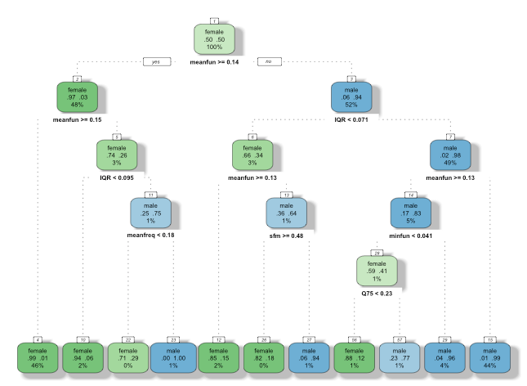
Extra separated data (dession tree)
meanful
IQR
minfun
sfm
maxdom

Slide 7
Method
Libsvm

Slide 8
Comparison

Slide 9
Publish to Shiny App

Slide 10
Results

Slide 11
Challenge

Slide 12
Reference

