Slide 1





Data Science in Practice
Cut Down the Cost
of Uncertainty Travel Order
─ Final Project
instructor ：Jia-Ming Chang（張家銘）
Teammate：
Dept. of MIS - Jack, Lin（林聖翔）
Dept. of Statistics - Steve, Yu（余佑駿）
Notes:
Hello, everyone!
This is our Final project
The topic is cut down the cost of uncertainty travel order
And I am Steve, this is Jack

Slide 2
Content
Introduction
Data Preprocessing
Glimpse at the Dataset (EDA)
Modeling
Performance & Result
Demo
Notes:
This is content of today presentation
First of all, we will fast introduce the whole project and out goal
Then discuss some data processing and Explore it
After Glimpse the dataset, we will try to build a model to predict
At last, we will show our performance and result
And take these to compare the competition leader board
To see if we participate this competition where we locate
Finally, show how to preduce our work and the challenge of future

Slide 3

Introduction
Data Source,
Input Format,
Out Goal
come from a website of data analysis
Just like Kaggle, but in Taiwan
Notes:
So, let’s move on
Our datasets is from a website like Kaggle
The only different is that it is in Taiwan, so the whole description on the website is in Chinese
這是一個數據分析比賽的網站
就像Kaggle依樣會定期舉辦比賽

Slide 4
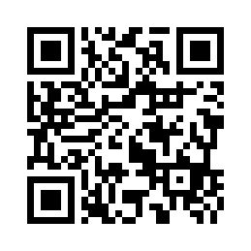
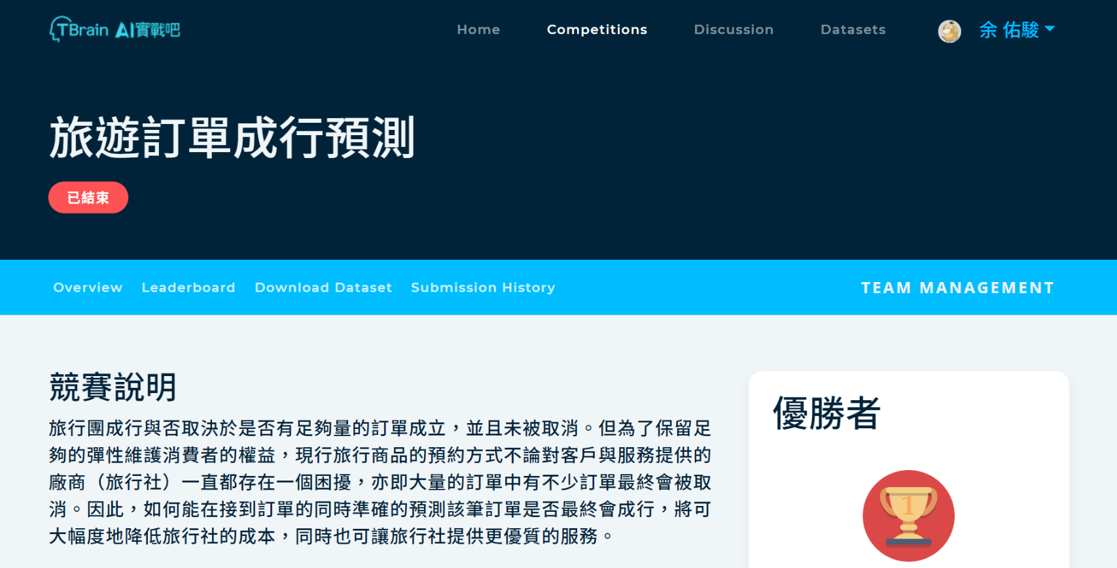
Introduction
Data Source,
Input Format,
Out Goal
This is #4 compitition
Website : https://tbrain.trendmicro.com.tw/Competitions/Details/4
Notes:
As I said, the data is from the competition, which is the fourth competition on this website
It is about a problem from travel agency
The want to know whether a travel order would be canceled or not in the end.
So, they wish participant to predict the order will be deal or not by using the data about time, price, people amount, airline, day schedule and so on
https://arxiv.org/pdf/1506.00327.pdf?fbclid=IwAR2V1FWccc0qYlNNL2HVvr_BbdrqVDSxjX6EjaclUiPt0xzzhF1NfA2ed80

Slide 5
Introduction
Data Source,
Input Format,
Out Goal
About 300,000 rows. Each row is one travel order.
Notes:
Total we have almost 300,000 travel orders
Ideally, we want to make each row is one travel order
And these is our features we input finally, we will talk about these features more detail later.
Then we will predict each is 1 or 0. It means the travel order will be deal or not deal
每一列是一筆旅遊訂單
我們會輸入以下的特徵，來預測該訂單是否會成行，1或0
右邊是特徵的描述，這個表後面還會看到
20個feature，37個feature(包含dummy variable)

Slide 6
Introduction
Data Source,
Input Format,
Out Goal
About 300,000 rows. Each row is one travel order.
The following are our input features.
There are about 37 features. (including dummy variables)
Notes:
Total we have almost 300,000 travel orders
Ideally, we want to make each row is one travel order
And these is our features we input finally, we will talk about these features more detail later.
Then we will predict each is 1 or 0. It means the travel order will be deal or not deal
每一列是一筆旅遊訂單
我們會輸入以下的特徵，來預測該訂單是否會成行，1或0
右邊是特徵的描述，這個表後面還會看到
20個feature，37個feature(包含dummy variable)

Slide 7
Introduction
Data Source,
Input Format,
Out Goal
About 300,000 rows. Each row is one travel order.
The following are our input features.
There are about 37 features. (including dummy variables)
To predict order will deal or not.
Notes:
Total we have almost 300,000 travel orders
Ideally, we want to make each row is one travel order
And these is our features we input finally, we will talk about these features more detail later.
Then we will predict each is 1 or 0. It means the travel order will be deal or not deal
每一列是一筆旅遊訂單
我們會輸入以下的特徵，來預測該訂單是否會成行，1或0
右邊是特徵的描述，這個表後面還會看到
20個feature，37個feature(包含dummy variable)

Slide 8
Data Preprocessing
generate new variable,
missing data
Originally, competition provides five raw datasets.
Using merged and summarized skill to let “One row is one travel order”
group.csv
order.csv
airline.csv
day_schedule.csv
cache_map file
Notes:
So let’s talk about the whole data processing
Originally, competition provides five raw datasets. Group, order, airline, day schedule and cache_map file
Using merged and summarized skill to let these four csv become to something like this
For example, Jack and I want to do to Japan. So we place an order to a Japan travel group.
Then we will get a order_id, and some features like how many people in these order (2), how many people in your group (38)…
It’s a pity that we DO NOT use cache_map file, it contain the graph for promotion. Like banner on the top of website.
And so far, we did NOT know how to transform image data to numeric. So we leave it for now.
Place an order 下訂單
原本比賽只提供五個資料集
因為目標是預測訂單是否會成行 Our goal is to predict the order will deal or not.
所以我們先利用簡單的merge和summarise，先把資料合併成一列是一筆order
接著，我們參考一些專業領域的知識，產生出不同的新變數
可以看到
藍底是我們原本就有或是透過合併得出的變數
綠底則是透過合併、轉換、計算得出的新變數
特別是關於旅行團、sub_line、area的熱門程度

Slide 9




Data Preprocessing
generate new variable,
missing data
Originally, competition provides five raw datasets.
Using merged and summarized skill to let “One row is one travel order”
Then, refer to domain knowledge in Travel agency, we decided to generate some new variables!!
Agency Familiarity
times
Popularity
Tour quality
flights
Notes:
About attraction popularity, Tour quality,
familiarity of customer service in agency,
how many flight for arriving destination,
how long do you plan for traveling
原本比賽只提供五個資料集
因為目標是預測訂單是否會成行 Our goal is to predict the order will deal or not.
所以我們先利用簡單的merge和summarise，先把資料合併成一列是一筆order
接著，我們參考一些專業領域的知識，產生出不同的新變數

Slide 10
Data Preprocessing
generate new variable,
missing data
Features already have
Features we generate
Notes:
可以看到
藍底是我們原本就有或是透過合併得出的變數
綠底則是透過合併、轉換、計算得出的新變數
特別是關於旅行團、sub_line、area的熱門程度
要說明wait_duration, group_amount, people_amount, area_heat, unit

Slide 11
Data Preprocessing
generate new variable,
missing data
Features already have
Features we generate
Notes:
可以看到
藍底是我們原本就有或是透過合併得出的變數
綠底則是透過合併、轉換、計算得出的新變數
特別是關於旅行團、sub_line、area的熱門程度
要說明wait_duration, group_amount, people_amount, area_heat, unit_group_agency
The reason I want to talk about these feature (popularity) is because when you face category data.
You can use one-hot encoding to transform it to numeric.
But the problem is if it has too many category, then we will get a sparse matrix
And that is not good for predicting.
So maybe calculate counts to be feature like popularity is better way to transform category variable.

Slide 12
Data Preprocessing
generate new variable,
missing data
missing data? The airline.csv and day_schedule.csv DO NOT contain all group information.
Missing data is quite low, so we decided to remove
Left data about 295926 records
Notes:
最終，我們有297020筆數據，缺失值有1094筆
比例大約是0.003683254 = 0.37%
非常地少，所以我們決定移除。

Slide 13
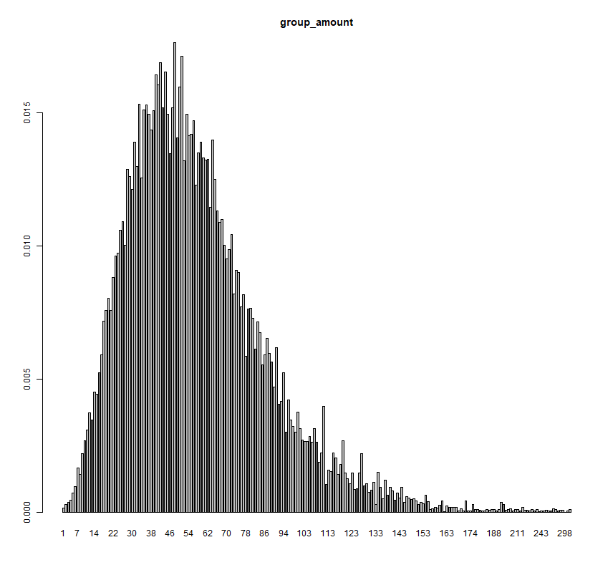
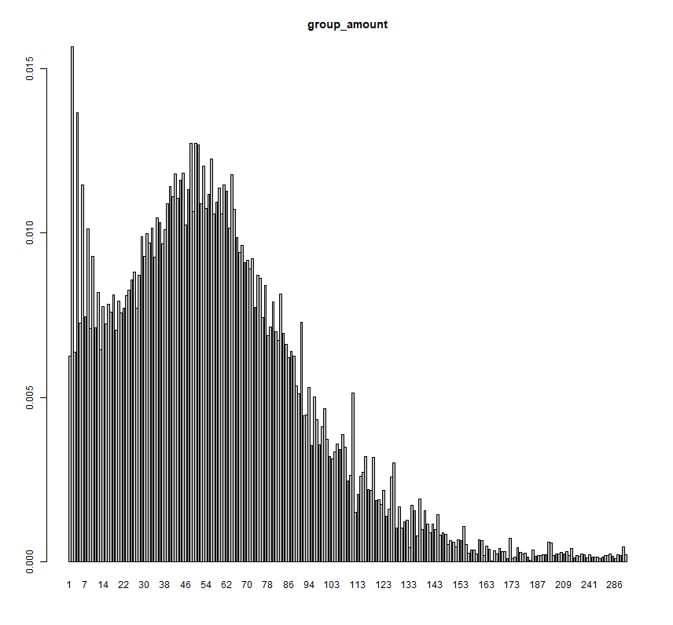
Glimpse at the Dataset (EDA)
Group_amount,
group_order_heat,
source_2,
unit
[DEAL]
Label = 1
[NOT DEAL]
Label = 0
When group have little people, it's more likely the order is NOT DEAL
Notes:
我們先簡單看一下，成行與不成行，在每個feature上面的分布情形
在此我們拿出????來做觀察
Group_amount, group_order_heat

Slide 14
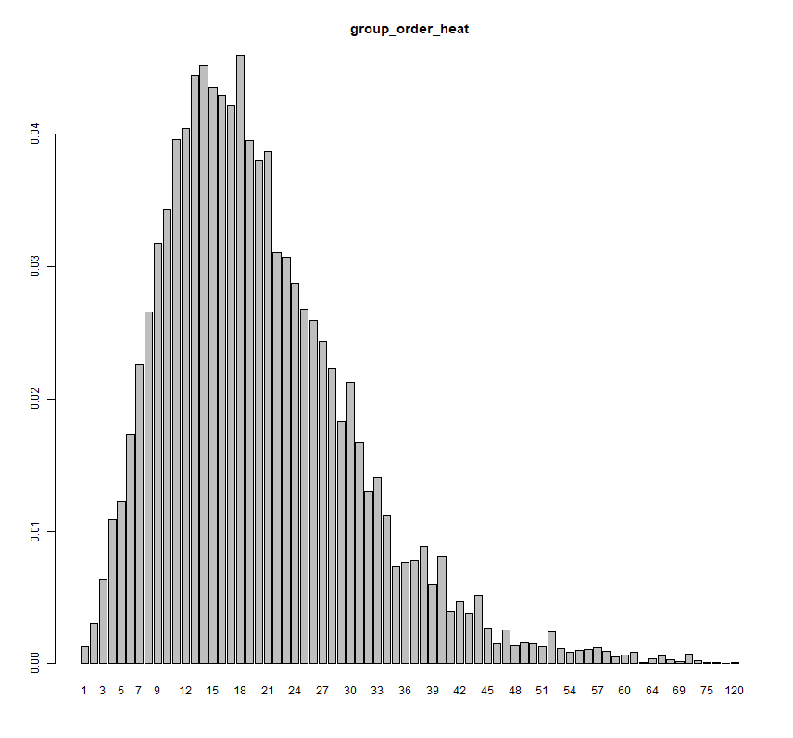
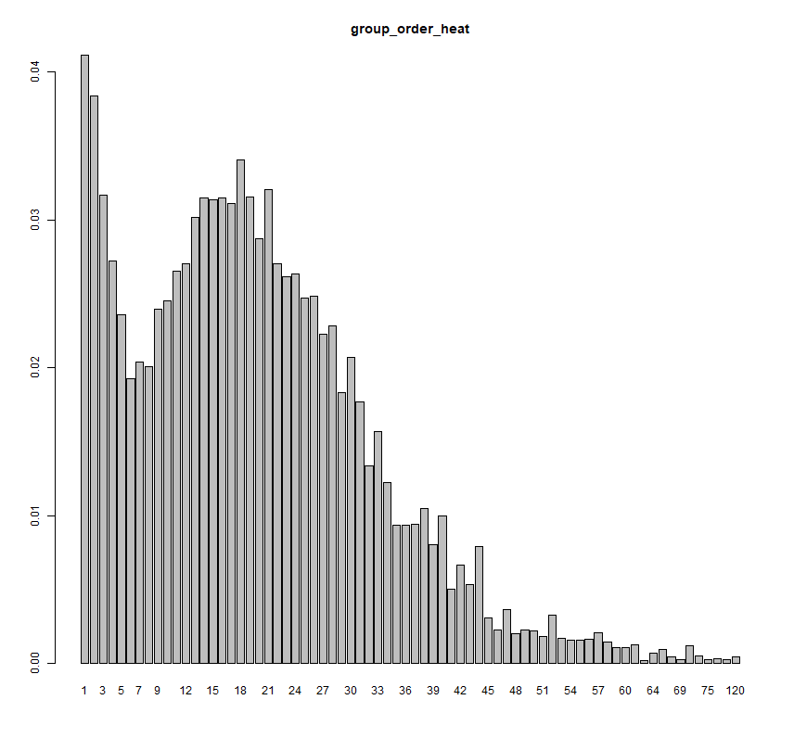
Glimpse at the Dataset (EDA)
Group_amount,
group_order_heat,
source_2,
unit
[DEAL]
Label = 1
[NOT DEAL]
Label = 0
When group is NOT POPULAR, it's more likely the order is NOT DEAL
14
Notes:
我們先簡單看一下，成行與不成行，在每個feature上面的分布情形
在此我們拿出????來做觀察
Group_amount, group_order_heat

Slide 15
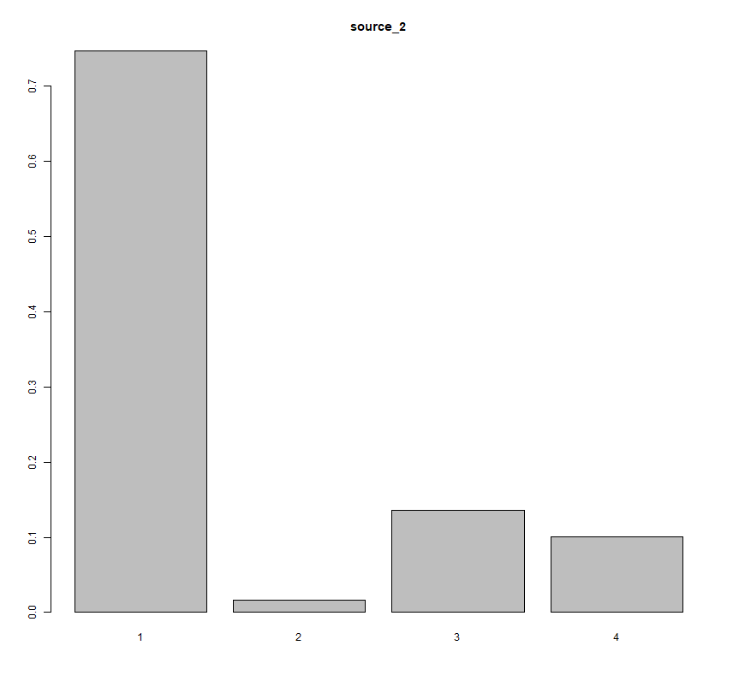
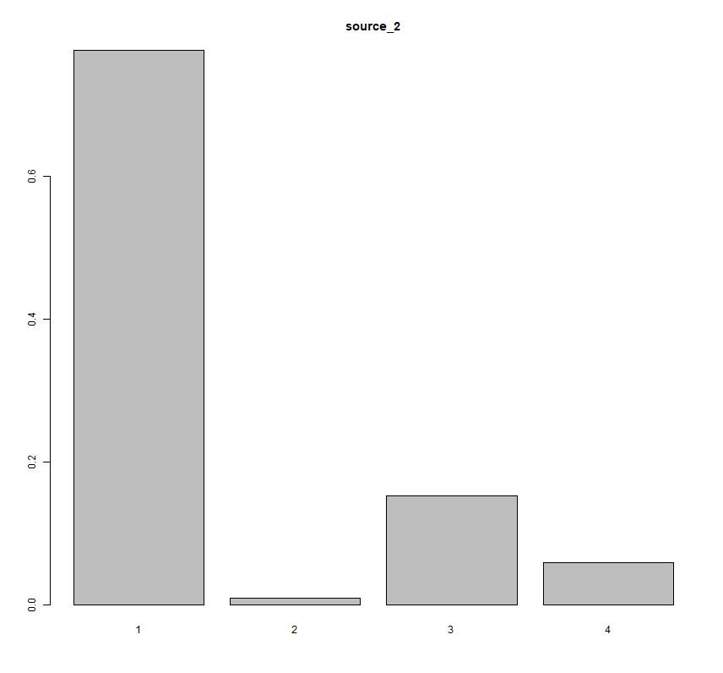
Glimpse at the Dataset (EDA)
Group_amount,
group_order_heat,
source_2,
unit
[DEAL]
Label = 1
[NOT DEAL]
Label = 0
When source_2 = 4, it's more likely the order is DEAL
Notes:
我們先簡單看一下，成行與不成行，在每個feature上面的分布情形
在此我們拿出????來做觀察
Group_amount, group_order_heat

Slide 16
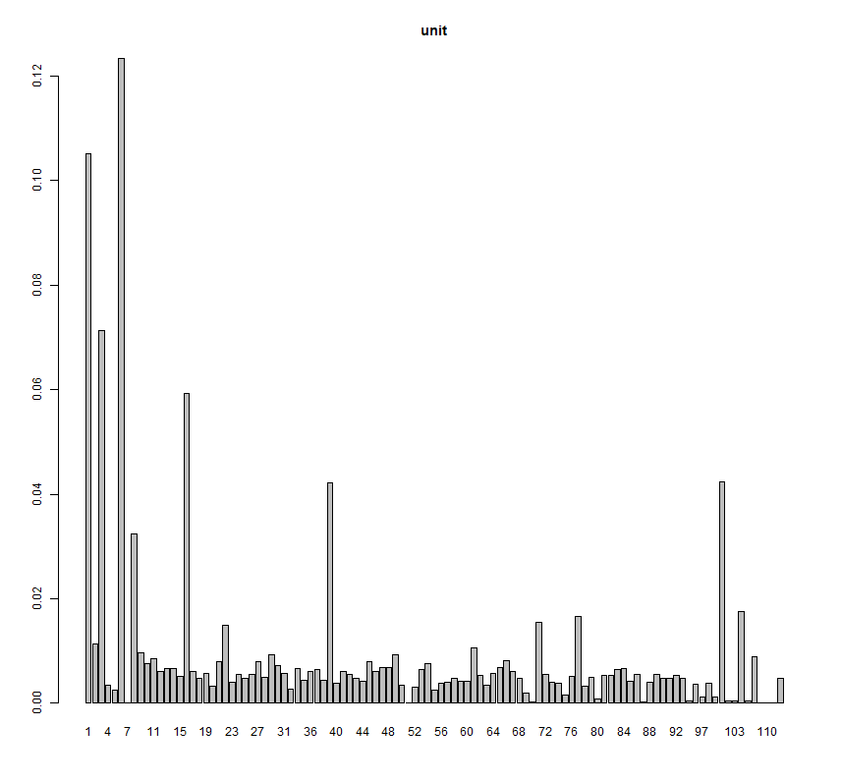
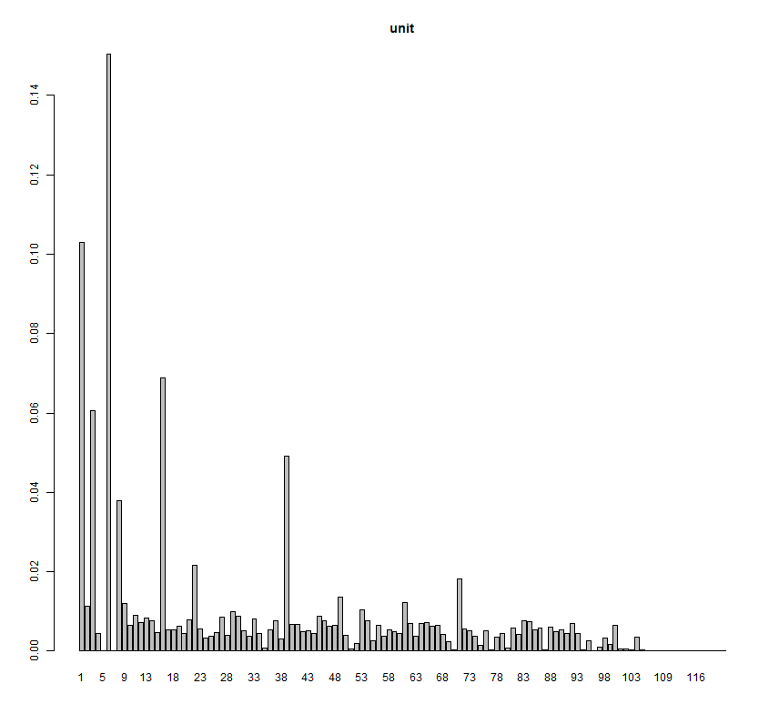
Glimpse at the Dataset (EDA)
Group_amount,
group_order_heat,
source_2,
unit
[DEAL]
Label = 1
[NOT DEAL]
Label = 0
The order from some unit is more likely DEAL
Notes:
我們先簡單看一下，成行與不成行，在每個feature上面的分布情形
在此我們拿出????來做觀察
Group_amount, group_order_heat

Slide 17
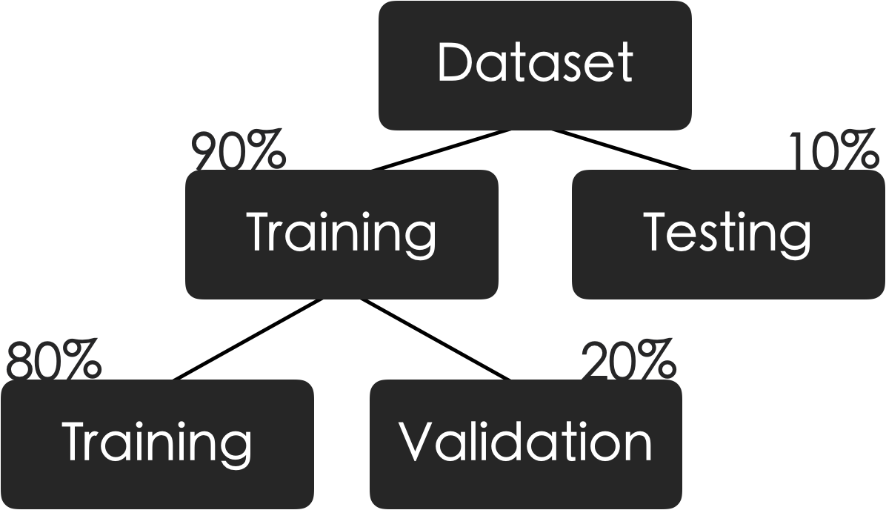
Modeling
Data Split,
Choose Model (cons & pros)
Notes:
We use about two 250 thousands row of order data, according to the proportion of label0: label1 8:2
And split the dataset to Training / Testing about 90/10
When Cross Validation, we use 5 fold, so the proportion is about 80/20

Slide 18


Modeling
Data Split,
Choose Model (cons & pros)
Notes:
As for model, we choose the tree-based model
The Random Forest, and XGBoost
We can predict and also get the feature importance
Meanwhile we can also avoid the problem due to correlation of feature

Slide 19
Modeling
Data Split,
Choose Model (cons & pros)
Notes:
Random forests are an ensemble learning method

Slide 20
Modeling
Data Split,
Choose Model (cons & pros)

Slide 21
Modeling
Data Split,
Choose Model (cons & pros)
Notes:
Extreme gradient boosting, it’s a regression tree based model, and it’s also one of the most popular model to get Kaggle competition championship in 2015

Slide 22
Modeling
Data Split,
Choose Model (cons & pros)
Notes:
Min_child_weight : If the tree partition step results in a leaf node with the sum of instance weight less than min_child_weight, then the building process will give up further partitioning.
Sub sample : Setting it to 0.5 means that XGBoost would randomly sample half of the training data prior to growing trees. and this will prevent overfitting. Subsampling will occur once in every boosting iteration
Learning_rate : After each boosting step, we can directly get the weights of new features, and eta shrinks the feature weights to make the boosting process more conservative

Slide 23

Performance & Result
Null Model,
Performance of Our Model,
Compare
Notes:
Because of the imbalance data, order not to deal has 80%, so our null model guess all the label are 0

Slide 24

Performance & Result
Null Model,
Performance of Our Model,
Compare

Slide 25
Performance & Result
Null Model,
Performance of Our Model,
Compare

Slide 26
Performance & Result
Null Model,
Performance of Our Model,
Compare
TOP 10 importance features in RF & Xgboost:
common importance variable：
wait_duration
group_order_heat
people_amount
source_1
unit_group_count
Black is original feature
Blue features are we generate

Slide 27
Performance & Result
Null Model,
Performance of Our Model,
Compare
Sampling
Imbalance: label_0 : label_1 = 213712 : 52609
Sample the label_0 data to match the labe_1's count : 52609
5-fold cross validation with balance data generated by 5 different seed ( 105218 rows )
Testing with balance data ( 105218 rows )

Slide 28
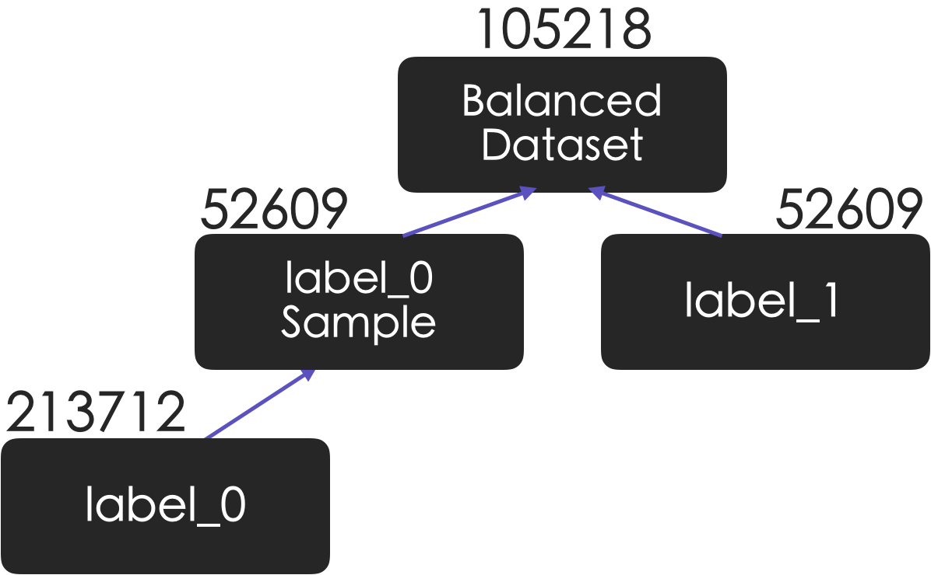
Performance & Result
Null Model,
Performance of Our Model,
Compare

Slide 29

Performance & Result
Null Model,
Performance of Our Model,
Compare
Notes:
把訓練資料的label =0/1 取成平衡之後
Recall會顯著提高，這也正是我們希望的，也就是說從實務上來講
Label=1的order很少，所以旅行社應該是希望多注重訂單會成行的人
然而比賽看的是accuracy就是了。

Slide 30

Performance & Result
Null Model,
Performance of Our Model,
Compare

Slide 31
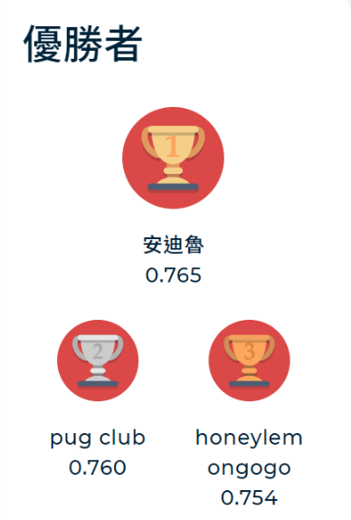
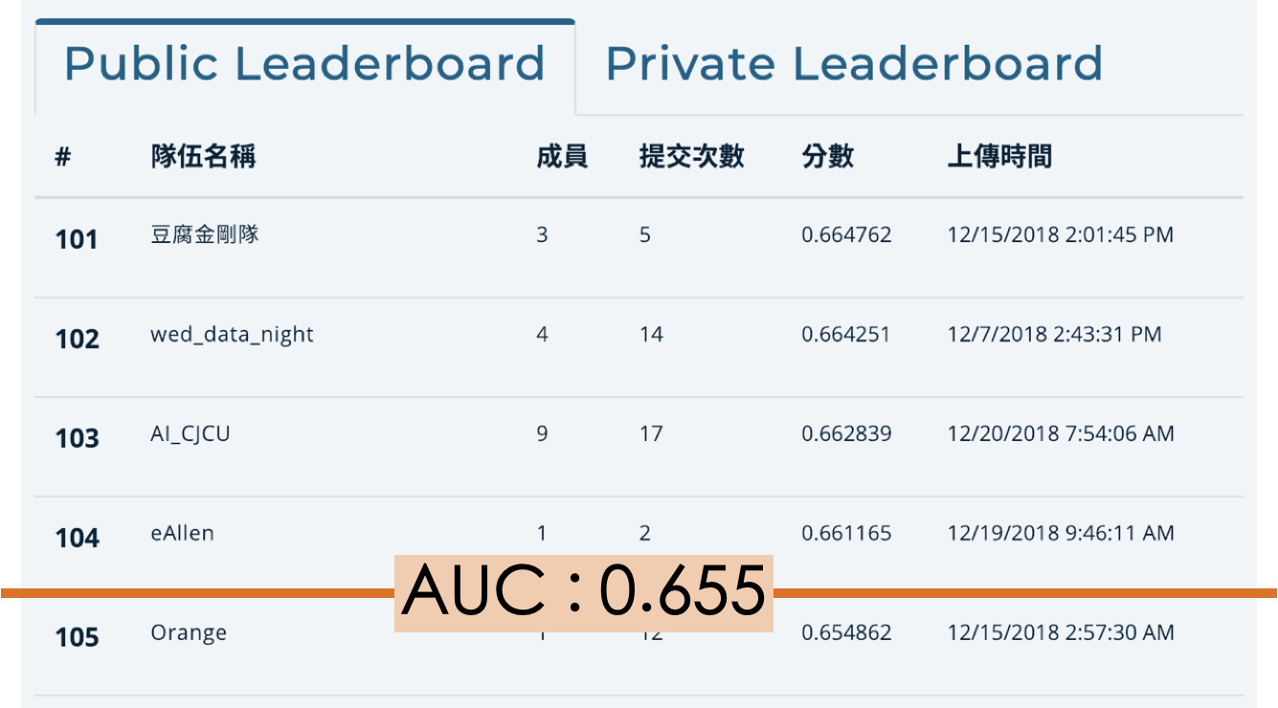
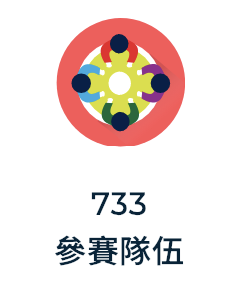
Performance & Result
Null Model,
Performance of Our Model,
Compare
Notes:
When we compare our best score AUC in the Tbrain competion,
we can rank 105 over 733 teams, and the best score is 0.765, however, the training set and testing set is not truly the same
So it just a reference

Slide 32
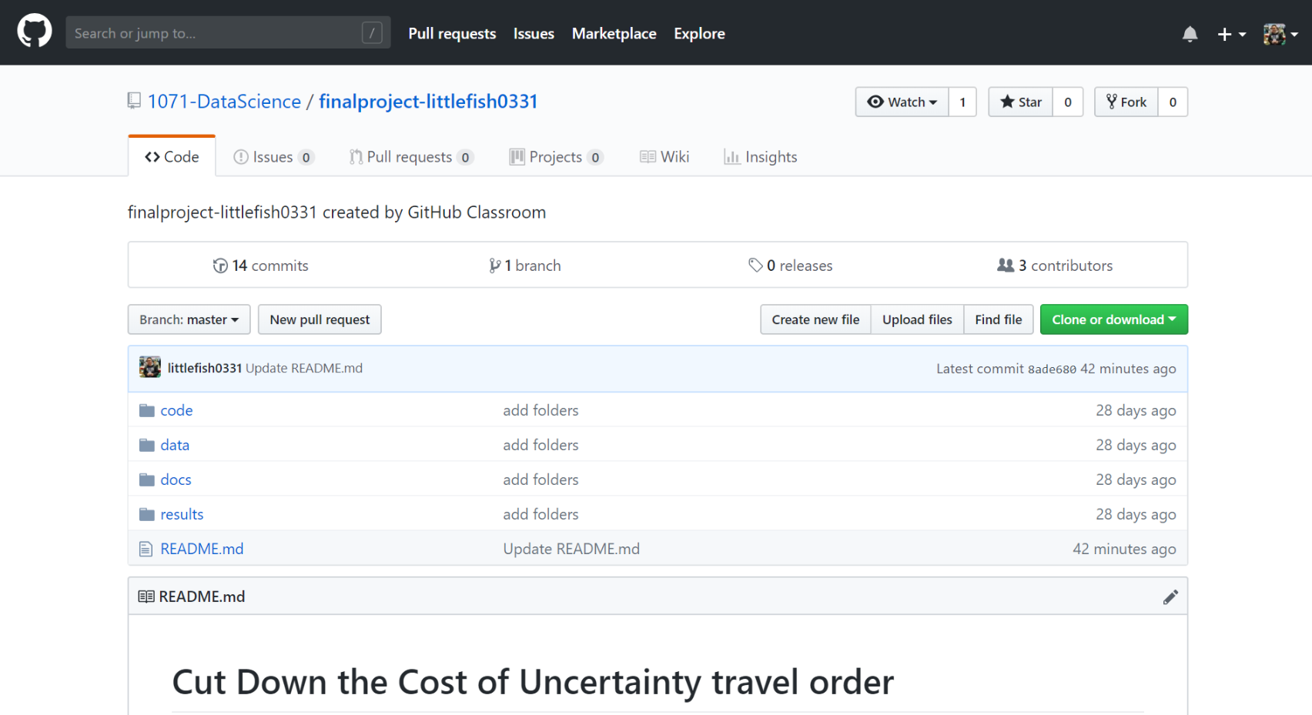
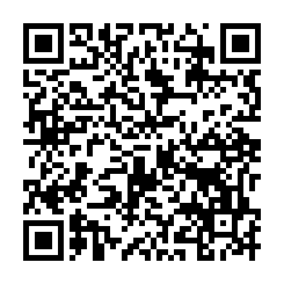
Demo & Future Work
Reproduce,
Challenge
Go to our github
Click "code" and "data"
Website : https://github.com/1071-DataScience/finalproject-littlefish0331
Notes:
Some problem about data, because the website say the data can only use in competition.

Slide 33

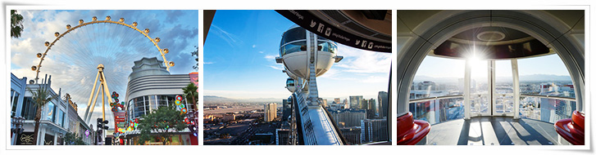
Demo & Future Work
Reproduce,
Challenge
Remember cache_map file? We NOT use image data yet!!

Slide 34
THANK YOU

Slide 35
Demo & Future Work
Visualization,
Reproduce,
Challenge

