Slide 1
Employee Data Analysis using Excel
STUDENT NAME:THRISHA.V
REGISTER NO:122200104
DEPARTMENT:B.COM(C.S)
COLLEGE: PACHAIYAPPA'S COLLEGE FOR WOMEN

Slide 2
PROJECT TITLE
SALARY AND COMPENSATION ANALYSIS THROUGH EXCEL DATA MODELING

Slide 3


AGENDA
Problem Statement
Project Overview
End Users
Our Solution and Proposition
Dataset Description
Modelling Approach
Results and Discussion
Conclusion
3/21/2024 Annual Review

Slide 4

PROBLEM STATEMENT
The primary challenge we aim to address with our salary prediction project is the accurate estimation of salaries for individuals based on a diverse set of attributes, including but not limited to education level, years of experience, specialized skills, industry sector, and geographic location. Additionally, we seek to account for the complex interactions between these factors and their impact on salary levels across different job rules and industries

Slide 5

PROJECT OVERVIEW
Analyze salary and compensation data to identify trends, disparities, and areas for improvement Develop a data model in Excel to organize, visualize, and interpret salary and compensation data • Provide insights and recommenda- tions for salary and compensation adjustments
.
STUDENT NAME:
REGISTER NO:
DEPARTMENT:
COLLEGE

Slide 6

WHO ARE THE END USERS?
HR Professionals: HR man- agers, compensation analysts, and benefits administrators use the analysis to inform salary decisions, ensure equity, and maintain competitive compensation packages.
Recruiters: Recruiters and talent acquisition specialists use the data to determine competitive salary ranges for job postings and make informed offers to candidates.

Slide 7

OUR SOLUTION AND ITS VALUE PROPOSITION
Accurate and Reliable Insights: Trustworthy data analysis to inform business decisions. 2. Time and Cost Savings: Auto- mated reporting and stream- lined processes reduce manual effort and increase efficiency

Slide 8
Dataset Description
This dataset contains employee salary and compensation data, including demographic, job-related, and compensation information. Variables: 1. Employee ID (Unique identifier for each employee) 2. Name 3. Job Titl

Slide 9

THE "WOW" IN OUR SOLUTION
Automated Salary Benchmarking. Instantly compare your organization's salaries to industry standards and market averages with our automated benchmarking tool. Predictive Analytics: Unlock the power of predictive modeling to forecast future salary trends, identify potential talent gaps, and make proactive decisions.
3/21/2024 Annual Review
9

Slide 10
MODELLING
Data Input: Collect and import salary and compensation data from various sources (HR systems, payroll, surveys, etc.) 2. Data Cleaning: Ensure data ac- curacy, handle missing values, and format data consistently 3. Data Transformation: Convert data into suitable formats for analysis (e.g., pivot tables, indexes)
10

Slide 11
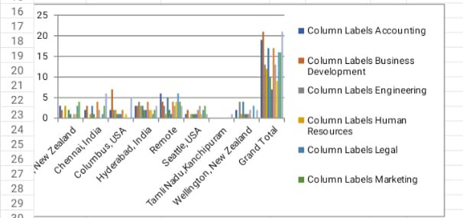
RESULTS
Salary Ranges: Identified salary ranges for each job title, department, and location. 2. Market Benchmarking: Compared salaries to industry standards and market averages, highlighting areas for adjustment. 3. Pay Disparities: Detected pay disparities based on gender, ethnicity, and other factors, enabling targeted corrections
11

Slide 12
conclusion
The salary and compensation analysis through Excel data modeling has provided valuable insights and recommendations for optimizing salary and compensation practices. By leveraging Excel's data modeling capabilities, we have: 1. Identified salary ranges and market benchmarks 2. Detected pay disparities and areas for adjustment 3. Analyzed performance-based compensation and turnover risk

