Slide 1
Chapter 2 The Relational Model

Slide 2
Ch2 The Relational Model
Data Model (数据模型)
is a set of definitions describing how real-world data is conceptually represented as computerized information.
It also describes the types of operations available to access and update this information.
Database Principles & Programming

Slide 3
2.2 Naming the Parts of a Database
关系模型 | 关系数据库管理系统(SQL) | 文件系统
Relation （关系） | Table （表） | File of Records
Attribute （属性） | Column （列） | Field
Tuple （元组） | Row （行） | Record
Schema （模式） | Table Heading （表头） | Type of Record
Database Principles & Programming

Slide 4
2.2 Naming the Parts of a Database
Definition
database
a set of named tables, or relations.
CAP = { CUSTOMERS, AGENTS,
PRODUCTS, ORDERS }
Heading of table (schema)
a set of named columns
Head(CUSTOMERS) =
{ cid, cname, city, discnt }
Database Principles & Programming

Slide 5
2.3 Relational Rules
Rule 1. First Normal Form Rule
Can't have multi-valued fields.
Rule 2. Access Rows by Content Only Rule
No order to the rows
No order to the columns
Rule 3. The Unique Row Rule
Entity Integrity Rule (实体完整性)
Database Principles & Programming

Slide 6
2.4 Keys and Superkeys
Superkey
is a set of columns that has the uniqueness property
key
is a minimal superkey: no subset of columns also has uniqueness property.
Database Principles & Programming

Slide 7
2.4 Keys and Superkeys
Theorem 2.4.2. Every table T has at least one key.
Proof. Given a table T with Head(T) = {A₁ . . . A_{n}}.
令 K := Head(T), 则K是表T的一个超键(superkey)
While (K是表T的超键)
{
IF (存在K的一个真子集S，且S也是T的超键)
THEN { K:=S; continue; }
ELSE break;
}
Return key ‘K’ for T;
Database Principles & Programming

Slide 8
2.4 Null Values (空值)
A null value is placed in a field of a table when a specific value is either unknown or inappropriate.
空值是关系数据库中的一种特殊的属性值，它既不是数值0，也不是空字符串(the null string)
空值没有‘类型’概念，它可以被用作任意类型属性上的取值
当用户向表中插入一条新元组t时，如果没有明确为该元组的某个属性A进行赋值，那么系统将元组t在属性A上的取值自动置为‘空值’。
现有的商用关系数据库管理系统必须具备空值处理能力 (空值的存储、比较、算术运算和统计计算)
Database Principles & Programming

Slide 9
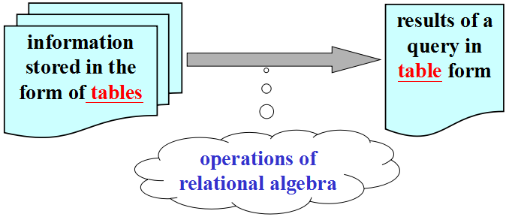
2.5 Relational Algebra
Relational Algebra ( 关系代数 )
set-theoretic operations: 并，交，差
Product（笛卡尔积）
Projection（投影）, Selection（选择）
Compatible Tables (相容表)
Database Principles & Programming

Slide 10
Compatible Tables (相容表)
Tables R and S are compatible if they have the same headings
Head(R)=Head(S)
attributes chosen from the same domains and with the same meanings.
Database Principles & Programming

Slide 11
2.6 Union, Intersection, Difference
Let R and S be two compatible tables, where Head(R) = Head(S)
R ∪ S
a table with the same heading as R (or S)
for each row t in R or in S, t in R ∪ S
R ∩ S
a table with the same heading as R (or S)
for each row t in R, if t appear in S, then t in R ∩ S
R – S
a table with the same heading as R (or S)
for each row t in R, if t don’t appear in S, then t in R – S
Database Principles & Programming

Slide 12
2.6 Set-Theoretic Operations
Def 2.6.4 Product R × S
The product of the tables R and S is a table T that
if Head(R)={A₁,…,A_{n}}, Head(S)={B₁,…,B_{m}}, then：
Head(T) = {R.A₁, …, R.A_{n}, S.B₁, …, S.B_{m}}
t is a row in T if and only if
There are two rows u in R and v in S such that
t(R.A_{i}) = u(A_{i}) for 1≤i≤n, and
t(S.B_{k}) = v(B_{k}) for 1≤k≤m
Database Principles & Programming

Slide 13
Def 2.7.1 Projection: R [ A_{i1}, A_{i2}, …, A_{ik} ]
Head(R) = {A₁,A₂,…,A_{n}}
A_{ij}∈Head(R) for all 1≤j≤k
the projection of R on attributes A_{i1}, A_{i2}, …, A_{ik}, is a table T that
Head(T) = { A_{i1},…,A_{ik} }
for every row r in the table R there will be a single row t in the table T such that
r[A_{ij}] = t[A_{ij}] for 1≤j≤k
can be writed as π_{Ai1,…,Aik} (R)
cast out duplicate rows in the result of projection!
Database Principles & Programming

Slide 14
2.7 Native Relational Operations
Def 2.7.2 Selection
Assume Head(S) = {A₁,A₂,…,A_{n}}, the selection operation on S creates a new table, denoted by
S where C or δ_{C} (S)
with the same set of attributes, and consisting of those rows of S that obey the selection condition C.
Database Principles & Programming

Slide 15
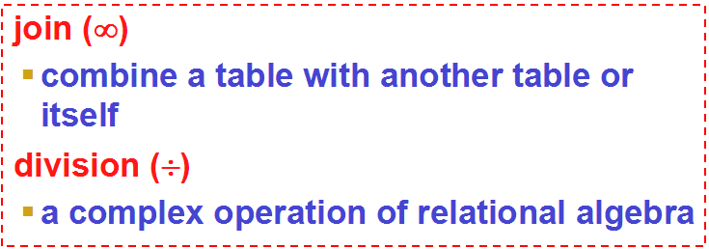
2.7 Native Relational Operations
When & How to use product or join or division?
Why we use division ?
what kind of question does it answer about the data.
Database Principles & Programming

Slide 16
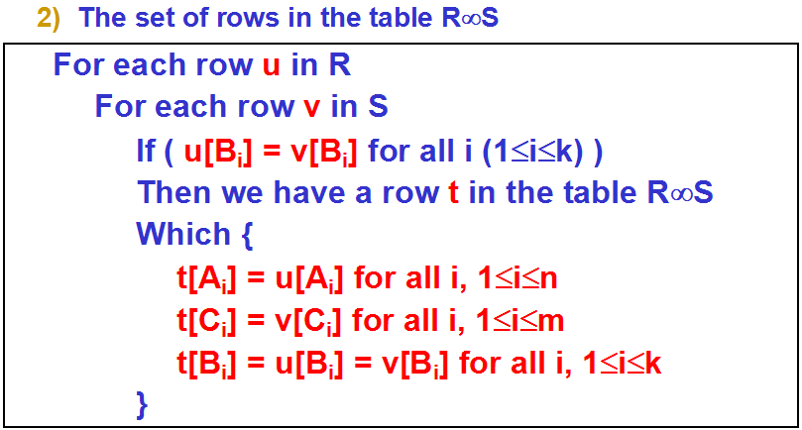
Def 2.7.4 Join (natural join, equal join)
We have two tables R and S, with headings:
Head(R) = { A₁, …, A_{n}, B₁, …, B_{k} }
Head(S) = { B₁, …, B_{k}, C₁, …, C_{m} }
Then
Head(R∞S) = {A₁,…,A_{n},B₁,…,B_{k},C₁,…,C_{m}}
Database Principles & Programming

Slide 17
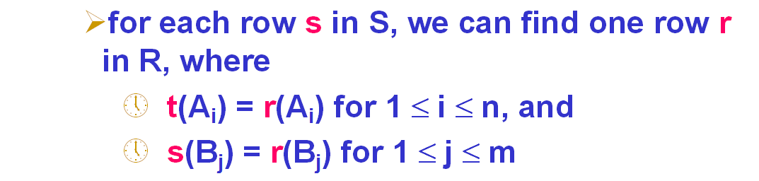
Def 2.7.5 The Division Operation
Consider two tables R and S, where
Head(S) ⊂ Head(R)
Specifically, assume that
Head(R) = { A₁,A₂,…,A_{n}, B₁,B₂,…,B_{m} }
Head(S) = { B₁,B₂,…,B_{m} }
The table T is the result of the division R÷S if
Head(T) = { A₁,A₂,…,A_{n} }
T contains the largest possible set of rows t
Database Principles & Programming

Slide 18
why we use division ?
what kind of question does it answer about the data.
We can answer the request which use keyword ‘all’ by ‘division’ operation.
Example:
Get name of customers who order all products.
Get name of customers who order products.

Slide 19
Example 2.7.11: Get names of customers who order all products ?
1) Why must project PRODUCTS on pid ?
2) Why must project ORDERS on cid, pid ?
3) Why use join after division?
columns of divisor must be subset of columns of dividend.
We only try to find the value of cid in ORDERS the same for all pid.
Database Principles & Programming

