Slide 1
Final Project Presentation
賴彥儒 應數三 105701027
黃郁軒 資科二 106703049
廖禾豪 資科二 106703045
林煜翰 應數三 105701037

Slide 2




Programming language
PYTHON
COMPILER
Anaconda 2.6
Jupyter Notebook

Slide 3
INPUT

Slide 4
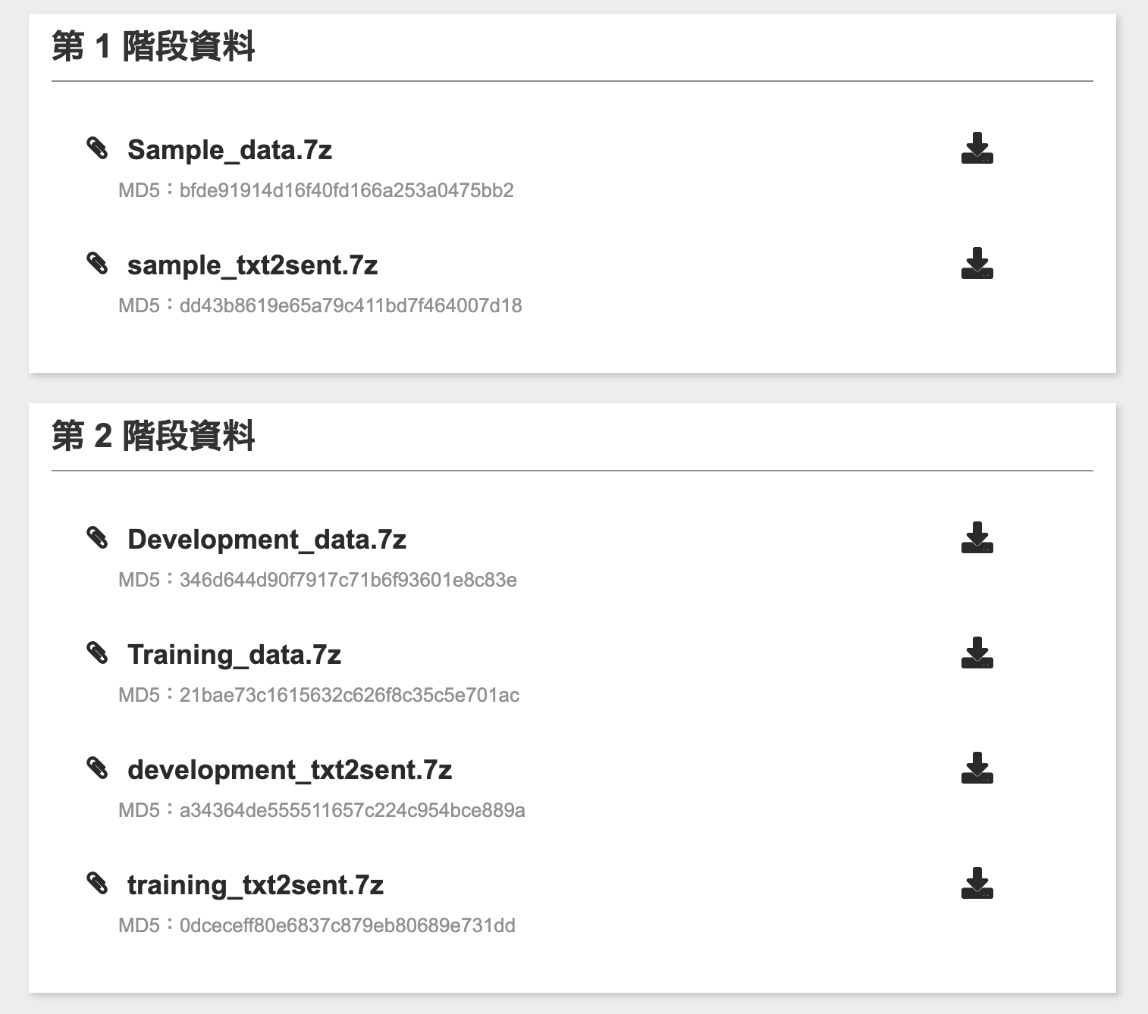

DATA Source
AI CUP 2019
生醫論文自動分析正式賽 – 生醫關聯擷取

Slide 5
gaol
「從 PubMed 的生物醫學文獻摘要中辨識和提取具有蛋白質交互作用（Protein-protein Interaction，PPI）資訊之描述句子，並針對所擷取出來具有 PPI 的句子進行評估，確認關聯性的類型（例如：target/regulate/post-translation）。」

Slide 6
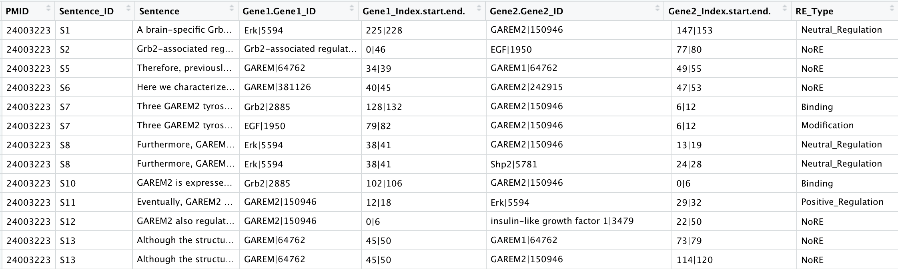
Input format
tsv
import pandas as pd
filepath = 'train.tsv'
df = pd.read_csv(filepath, sep='\t')

Slide 7
DATA Details
Headers
PMID : The id of the paragraph
Sentence : The sentences that contain two or more gene names in the paragraph
Sentence_ID : The id of the sentence in the paragraph
Gene1/2.Gene1/2_ID : The gene’s name and it’s id
Gene1/2_index.start.end : where the gene first and last appears in the paragraph
RE_Type : the relation between the two genes

Slide 8
PREPROCESSING

Slide 9
natural language processing
NLTK ( Natural Language Tool Kit )
Stopwords - Filter out common words before processing
Sent_tokenize - Separate sentences in a text
Word_tokenize - Separate words in a sentence

Slide 10
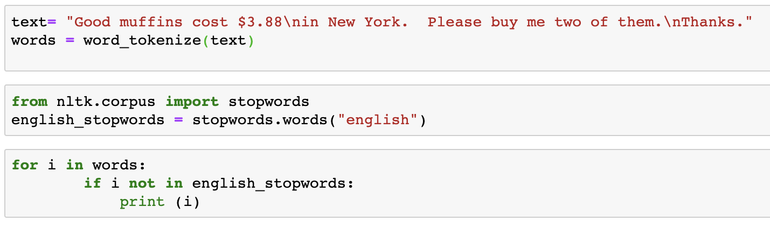
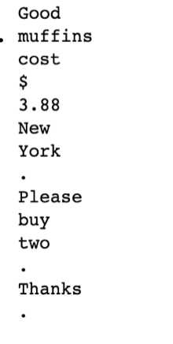
NLTK
Stopwords
words which are filtered out before or after processing of the natural language
EX.

Slide 11
NLTK
Sent_tokenize
A tokenizer that divides a string into substrings by splitting on the specified string
sen1 = [ ] for i in sentences : sen.append( sent_tokenize( i ) )

Slide 12
NLTK
Word_tokenize
A tokenizer that divides a string into substrings by splitting on the specified string
sen = [ ] for i in sentences : sen.append( word_tokenize( i ) )

Slide 13
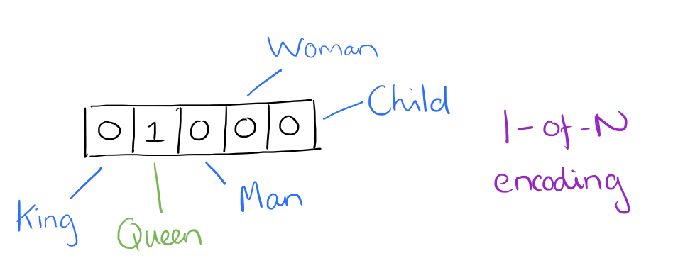
NLTK
1-hot enconding
one-hot is a group of bits among which the legal combinations of values are only those with a single high (1) bit and all the others low (0)
from keras.utils import to_categorical target_int = [ label_dict [ ll ] for ll in target ] target_onehot = to_categorical ( target_int, num_classes=len( label_dict ) )
The amazing power of word vectors

Slide 14
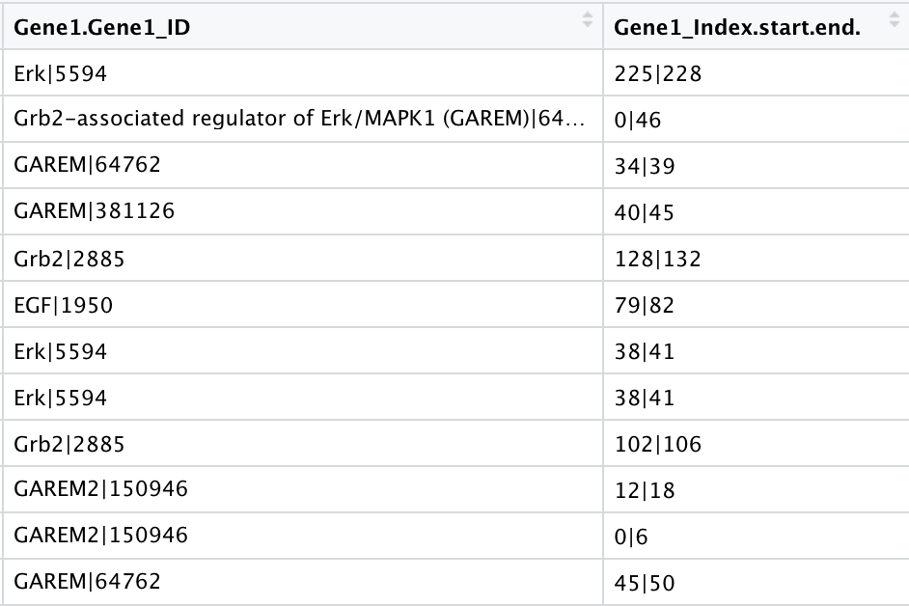
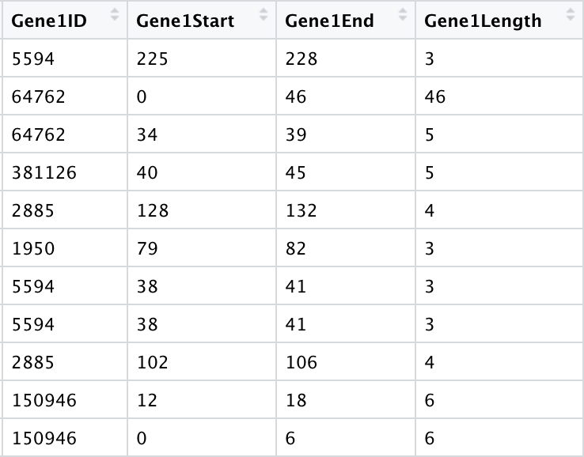
preprocessing
Separate “ | ”

Slide 15
MODELING

Slide 16
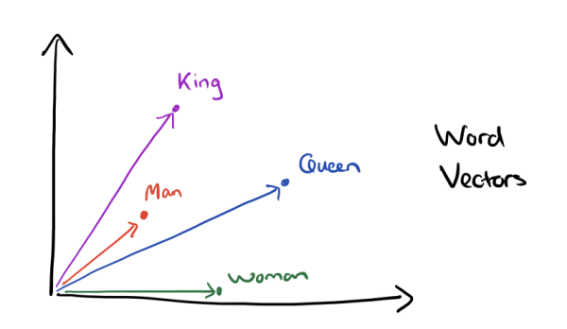
Models
Word2vec
Word2vec is an open source tool made by google
Word2vec changes words into vectors and calculates the similarities between each vectors
Word2vec calculates the cosine between two vectors. It is set between [0,1]. The higher the value is, the more similar they are.
The amazing power of word vectors

Slide 17
Word2vec
from gensim.models.word2vec import Word2Vec
model = Word2Vec(sen)
def most_similar(w2v_model, words, topn=10):
similar_df = pd.DataFrame()
for word in words:
try:
similar_words =
pd.DataFrame(w2v_model.wv.most_similar(word, topn=topn), columns=[word, 'cos']) similar_df =
pd.concat([similar_df, similar_words], axis=1)
except:
print(word, "not found in Word2Vec model!")
return similar_df

Slide 18
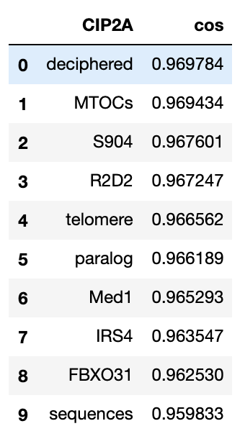
Word2vec
most_similar(model, ['CIP2A'])

Slide 19
Word2vec
def similarity(word1, word2):
try: val = model.similarity(word1, word2)
except: val = 0
return val
gene1 = [ ]
gene2 = [ ]
for i in range(0, len(Gene1)):
gene1.append ( Gene1 [ i ].split ( '|' )[ 0 ] )
gene2.append ( Gene2 [ i ].split ( '|' )[ 0 ] )

Slide 20
Word2vec
cos = [ ]
for i in range(0, len( gene1 ) ) :
cos.append ( similarity ( gene1 [ i ], gene2 [ i ] ) )
X = cos
X = np.array(X)
y = target_onehot
y = np.array(y)
train_X, test_X, train_y, test_y = train_test_split(X, y, test_size = 0.3)

Slide 21
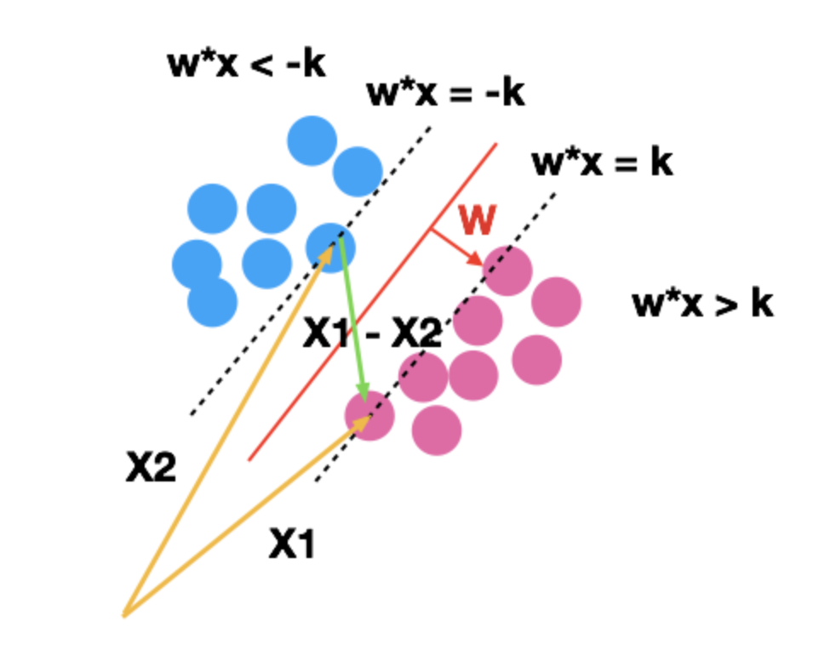
Models
SVM ( Support Vector Machine )
A supervised learning model
Uses the principle of risk minimization in statistic to estimate a hyperplane of a label
Basic concept : to find a decision boundary that maximize the margins of two categories such that they can be perfectly seperated

Slide 22
Models
KNN (K-nearest neighbor )
summaries of the k pieces of training data that are closest to the example to be scored.
KNN models usually store all of their original training data instead of an efficient summary
Truly memorize the training data

Slide 23
NULl model
Random Forest
# 建立 random forest 模型
forest = ensemble.RandomForestClassifier(n_estimators = 100)
forest_fit = forest.fit(train_X.reshape(-1, 1), train_y)
# 預測
test_y_predicted = forest.predict(test_X.reshape(-1, 1))
# 績效
accuracy = metrics.accuracy_score(test_y, test_y_predicted)print(accuracy)

Slide 24
evaluation
Cross Validation
To partition the data into a number of subsets
Hold out a set at a time and train the model on remaining set
Test model on hold out set

Slide 25
OUTPUT

Slide 26
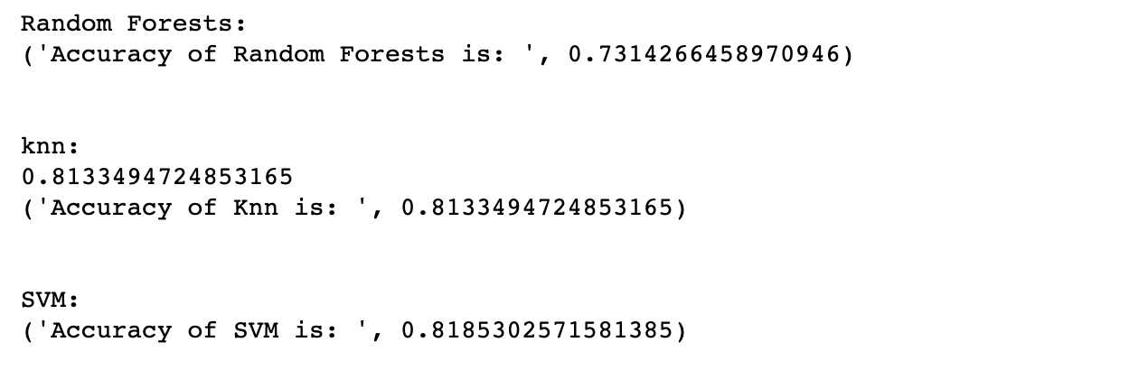
prediction

Slide 27
DEMO

Slide 28
challenges
Nature language processing
R cannot handle this amount of data
Some of us aren’t familiar with python

Slide 29
What we’ve tried
Digitalize the sentences
CountVectorizer from sklearn.feature_extraction.text import CountVectorizer vectorizer = CountVectorizer(min_df = 1) #Integer digitals vectorizer.fit(sentences) #Build a library vectorizer.transform(sentences).toarray() #Convert sentences to a matrix

Slide 30
What we’ve tried
TF-IDF ( Term Frequency–Inverse Document Frequency )
TF ( Term Frequency )：The frequency of a term occurring in a text file tf(w,d) = count(w, d) / size(d) where w is a term and d is a text file
IDF ( Inverse Document Frequency )：The log of the frequency of a text file containing the term idf = log(n / docs(w, D)) where n is the number of files and w is a term
tf-idf(q, d) = sum { i = 1..k | tf-idf(w[i], d) } , = sum { i = 1..k | tf(w[i], d) * idf(w[i]) }

Slide 31
What we’ve tried
TfidfVectorizer : The combination of the previous two from sklearn.feature_extraction.text import TfidfVectorizer tfidf2 = TfidfVectorizer() re = tfidf2.fit_transform(sentence)

Slide 32
references
Jiazhi Guo, 2018, accessed 24 June 2019 < https://www.kaggle.com/jerrykuo7727/word2vec >
Adrian Colyer, 21 APRIL 2016 , accessed 24 June 2019 <https://blog.acolyer.org/2016/04/21/the-amazing-power-of-word-vectors/>
Youngmi huang, 16 June 2017, accessed 24 June 2019 <https://medium.com/pyladies-taiwan/%E8%87%AA%E7%84%B6%E8%AA%9E%E8%A8%80%E8%99%95%E7%90%86%E5%85%A5%E9%96%80-word2vec%E5%B0%8F%E5%AF%A6%E4%BD%9C-f8832d9677c8>
Youngmi huang, 30 July 2018, accessed 24 June 2019 < https://medium.com/pyladies-taiwan/nltk-%E5%88%9D%E5%AD%B8%E6%8C%87%E5%8D%97-%E4%BA%8C-%E7%94%B1%E5%A4%96%E8%80%8C%E5%85%A7-%E5%BE%9E%E8%AA%9E%E6%96%99%E5%BA%AB%E5%88%B0%E5%AD%97%E8%A9%9E%E6%8B%86%E8%A7%A3-%E4%B8%8A%E6%89%8B%E7%AF%87-e9c632d2b16a>
Yeh James, 3 Nov 2017, accessed 24 June 2019 < https://medium.com/jameslearningnote/%E8%B3%87%E6%96%99%E5%88%86%E6%9E%90-%E6%A9%9F%E5%99%A8%E5%AD%B8%E7%BF%92-%E7%AC%AC3-4%E8%AC%9B-%E6%94%AF%E6%8F%B4%E5%90%91%E9%87%8F%E6%A9%9F-support-vector-machine-%E4%BB%8B%E7%B4%B9-9c6c6925856b >

Slide 33
THANK YOU

