Slide 1

Predicting JPY using machine learning
金碩一 彭昱齊 金碩一 賴映筑
統計四 劉書宏 統計三 許凱淳 統計三 游凱全

Slide 2

目錄
1.摘要介紹
2.資料描述
3.資料處理
4.模型建立
5.分析討論
6.結論
7.後續探討
8.參考資料

Slide 3
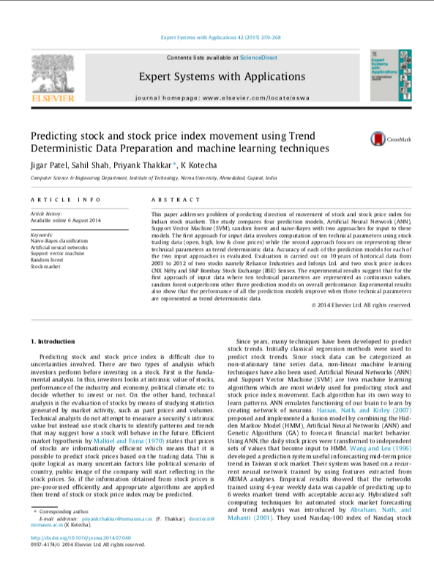
摘要介紹
研究動機從這篇論文得來，本次報告使用日本匯市自2000年1月開始到2019年6月的指數資料，從基本交易數據中加入10種技術指標，研究各模型（ANN, SVM, random forest, naïve-Bayes）對資料作分析後的結果。

Slide 4
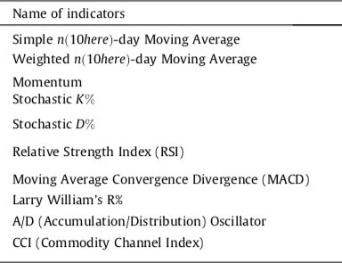
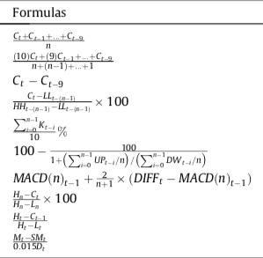
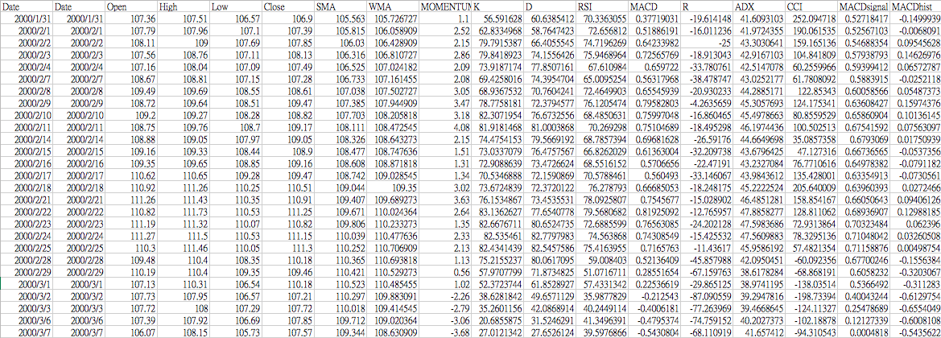
資料描述
目標值：dir
日本匯市/台灣股市？

Slide 5
資料處理
找適當參數
訓練測試集
分連續離散
從資料集中選取20%的數據，替模型找適當參數。
將資料切割為50%訓練集和50%測試集。
技術指標為連續型變數，試著更近一步分割為離散型變數，探討變數的間斷對目標值影響。

Slide 6
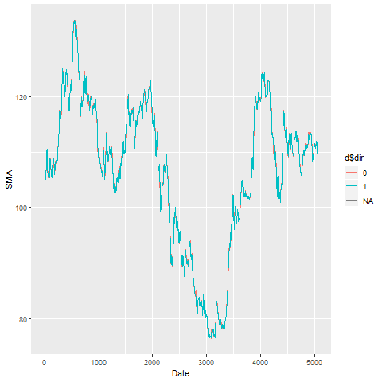

資料處理
Continuous

Slide 7
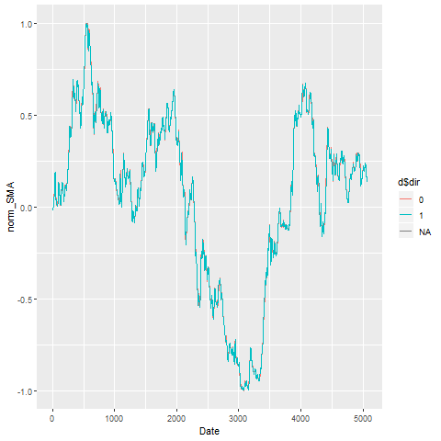
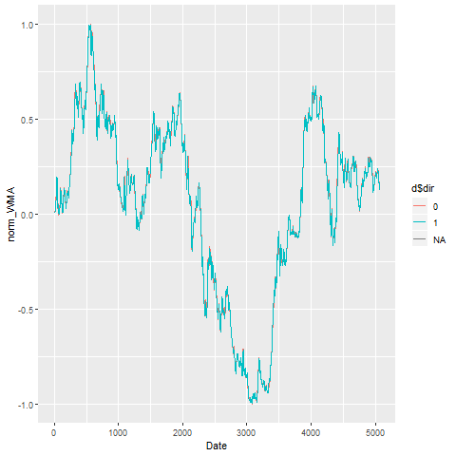
資料處理
Continuous need scale

Slide 8
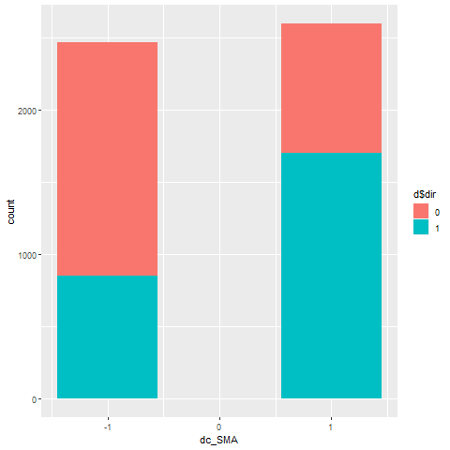
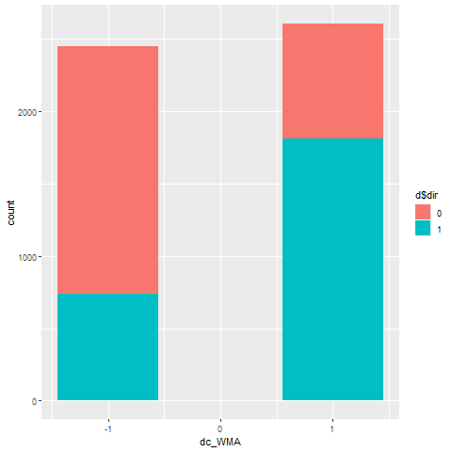
資料處理
Continuous transform discrete

Slide 9
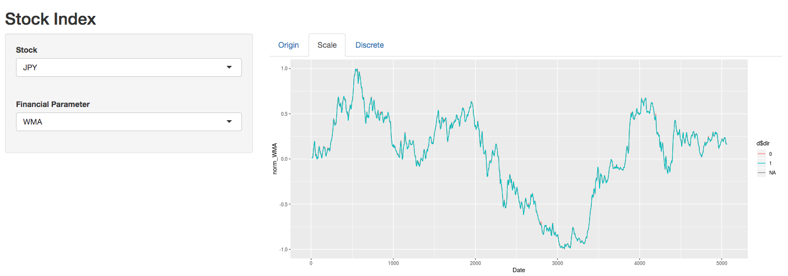
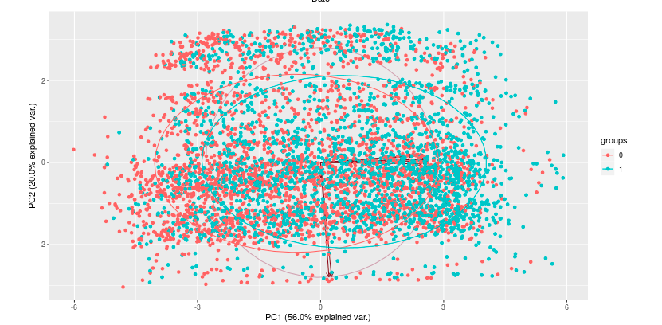
資料處理

Slide 10
模型建立
ANN
ann_model <-
neuralnet(dir=='1' ~., data=d_ps_train, hidden=n,
learningrate=0.1,linear.output = FALSE,stepmax=1e+06)
svm_model <-
ksvm(dir~., data=d_ps_train, kernel=kernel,
degree=degree, C=c)
SVM
rf_model <- randomForest(dir~.,
data=d_ps_train, ntree=i,importance = T)
Random Forest

Slide 11
模型建立
naive Bayes
NB_model <-
naive_bayes(dir ~ ., data = d_train[,c('dir',norm_vars)])
KNN
knn_pred_train <-
knn(train=d_train[,norm_vars],
test=d_train[,norm_vars], cl=d_train[,'dir'],k=k)
logit_model <-
glm(dir ~ ., data = d_train[,c('dir',norm_vars)],
family = binomial(link="logit"))
logit

Slide 12
分析討論（連續）
$ANN
n accuracy_train accuracy_holdout f1_train f1_holdout accuracy_mean f1_mean
1 80 0.9787942 0.7860717 0.9788995 0.7894953 0.8824330 0.8841974
2 70 0.9758836 0.7927440 0.9760132 0.7978853 0.8843138 0.8869493
3 100 0.9858628 0.7835696 0.9859155 0.7892814 0.8847162 0.8875984
$SVM
kernel degree gamma c accuracy_train accuracy_holdout f1_train f1_holdout accuracy_mean f1_mean
1 polydot 1 NA 10 0.8282744 0.8302752 0.8268344 0.8310502 0.8292748 0.8289423
2 rbfdot NA 3 10 0.8698545 0.8202669 0.8705006 0.8238660 0.8450607 0.8471833
$RandomForest
ntree accuracy_train accuracy_holdout f1_train f1_holdout accuracy_mean f1_mean
1 120 1 0.8060884 1 0.8085632 0.9030442 0.9042816
2 140 1 0.8081735 1 0.8108553 0.9040867 0.9054276
3 150 1 0.8085905 1 0.8110333 0.9042952 0.9055167

Slide 13
分析討論（連續）
$NB
accuracy_train accuracy_holdout f1_train f1_holdout accuracy_mean f1_mean
1 0.6407484 0.6309425 0.6366695 0.6362515 0.6358454 0.6364605
$KNN
k accuracy_train accuracy_holdout f1_train f1_holdout accuracy_mean f1_mean
1 1 1.0000000 0.7018349 1.0000000 0.7073271 0.8509174 0.8536635
2 3 0.8623701 0.7368641 0.8632796 0.7404360 0.7996171 0.8018578
3 14 0.8037422 0.7689741 0.8038238 0.7723911 0.7863582 0.7881074
$logit
accuracy_train accuracy_holdout f1_train f1_holdout accuracy_mean f1_mean
1 0.8282744 0.8311093 0.8284171 0.8327138 0.8296918 0.8305654

Slide 14
分析討論（離散）
$ANN
n accuracy_train accuracy_holdout f1_train f1_holdout accuracy_mean f1_mean
1 10 0.9646570 0.9599666 0.9647741 0.9601990 0.9623118 0.9624866
2 30 0.9650728 0.9599666 0.9652605 0.9602649 0.9625197 0.9627627
3 40 0.9650728 0.9603837 0.9652605 0.9606299 0.9627282 0.9629452
$SVM
kernel degree gamma c accuracy_train accuracy_holdout f1_train f1_holdout accuracy_mean f1_mean
1 polydot 1 NA 0.5 0.9559252 0.9612177 0.9558701 0.9612338 0.9585714 0.9585520
2 rbfdot NA 0.5 5.0 0.9638254 0.9603837 0.9641237 0.9607276 0.9621045 0.9624256
$RandomForest
ntree accuracy_train accuracy_holdout f1_train f1_holdout accuracy_mean f1_mean
1 60 0.9629938 0.9603837 0.9630245 0.9605973 0.9616887 0.9618109
2 150 0.9625780 0.9616347 0.9625935 0.9617940 0.9621063 0.9621938
3 180 0.9625780 0.9612177 0.9625935 0.9613948 0.9618978 0.9619941

Slide 15
分析討論（離散）
$NB
accuracy_train accuracy_holdout f1_train f1_holdout accuracy_mean f1_mean
1 0.9397089 0.9482902 0.939759 0.9482902 0.9439996 0.9440246
$KNN
k accuracy_train accuracy_holdout f1_train f1_holdout accuracy_mean f1_mean
1 6 0.9509356 0.9557965 0.9509151 0.9557596 0.9533660 0.9533374
2 4 0.9563410 0.9570475 0.9566653 0.9572081 0.9566942 0.9569367
3 7 0.9509356 0.9557965 0.9509151 0.9558333 0.9533660 0.9533742
$logit
accuracy_train accuracy_holdout f1_train f1_holdout accuracy_mean f1_mean
1 0.95842 0.9608007 0.9582986 0.9607679 0.9596103 0.9595333

Slide 16
結論
accuracy_norm f1_norm accuracy_dc f1_dc
ANN 0.884 0.886 0.963 0.963
SVM 0.837 0.838 0.960 0.960
RF 0.904 0.905 0.962 0.962
NaiveBayes 0.636 0.636 0.944 0.944
KNN 0.812 0.815 0.954 0.955
logit 0.830 0.831 0.960 0.960

Slide 17
結論
accuracy_norm f1_norm accuracy_dc f1_dc
ANN 0.884 0.886 0.963 0.963
SVM 0.837 0.838 0.960 0.960
RF 0.904 0.905 0.962 0.962
NaiveBayes 0.636 0.636 0.944 0.944
KNN 0.812 0.815 0.954 0.955
logit 0.830 0.831 0.960 0.960

Slide 18
後續探討
一開始我們是針對股價做預測，但發現股價（台指期）並不如預期容易預測，於是轉而向波動相對較小的匯率市場做分析。
困難與挑戰
除了對日元匯率做模型分析以外，也對英鎊做了同樣研究，證明結果有可複製性。
https://shutong.shinyapps.io/shiny/
其他研究

Slide 19
參考資料
Predicting-stock-and-stock-price-index-movement-using-Trend-Deterministic-Data-Preparation-and-machine-learning-techniques .pdf
library(randomForest)library(neuralnet)library(nnet)library(caret)library(kernlab)library(e1071)library(naivebayes)

Slide 20

謝謝聆聽

