Slide 1
IDHM of Brazilian Cities
第四組: DS_fadatsai
金融四 張璟榮
資碩一 陳海坤
資碩一 黃清昱
資科四 郭芷瑄
資科四 莊凱鈞

Slide 2
Outline
1
Goal
2
Feature
3
Feature Engineering
4
Model

Slide 3

Goal: 預測IDHM(人類發展指數)
LEI: life expectancy index
EI: education index
II: income index
HDI = (${LEI∗EI∗II\text{)}}^{1/3}$

Slide 4
Packages
pandas
matplotlib
Numpy
seaborn
scipy
Math
os
sklearn

Slide 5
PART ONE
Feature

Slide 6
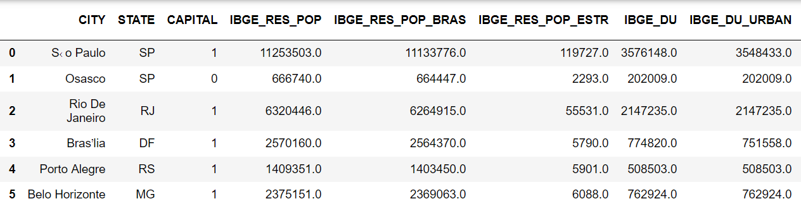
First few rows
5576 Row * 81 column

Slide 7
IDHM: 人類發展指數
IDHM Ranking 2010: int, HDI排名
IDHM : float -> IDHM_y : categorical (LABEL)
IDHM_Renda: float, GNI 指標 = GDP + factor incomes earned by foreign residents - income earned in the domestic economy by nonresidents
IDHM_Longevidade: float, 預期壽命
IDHM_Educacao: float, 教育程度
原數值 | 新類別
HDI>=0.8 | 3
0.8>HDI>=0.7 | 2
0.7>HDI>=0.55 | 1
0.55>HDI>=0 | 0
Notes:
定義: 極高 高 中 低

Slide 8
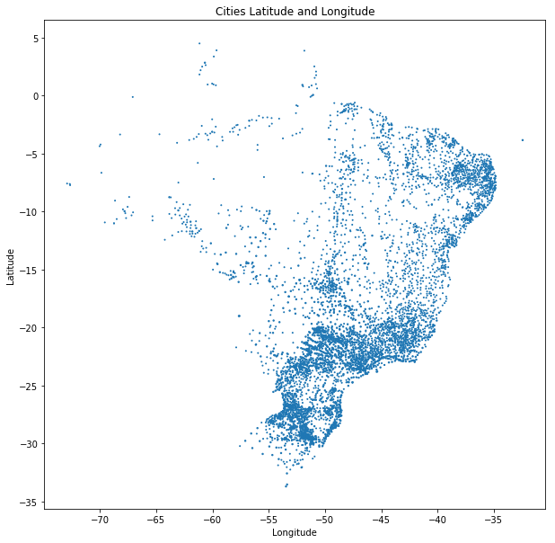
City
City: string
AREA: float, City area (square kilometers)
RURAL_URBAN: category, Rural or Urban

Slide 9
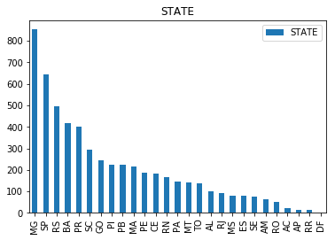
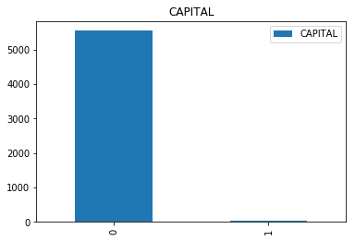
City
State: category
州 城市數
MG 853
SP 646
RS 498
BA 418
Capital: Boolean
州首都 城市數
0 5549
1 27

Slide 10
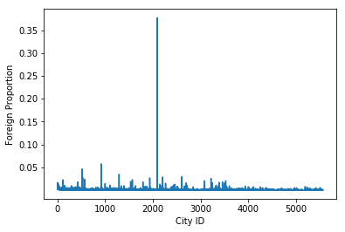
Population
IBGE_RES_POP: int, 人口數
IBGE_RES_POP_ESTR: int, 外國人數
IBGE_RES_POP_BRAS: int, 本地人口數

Slide 11
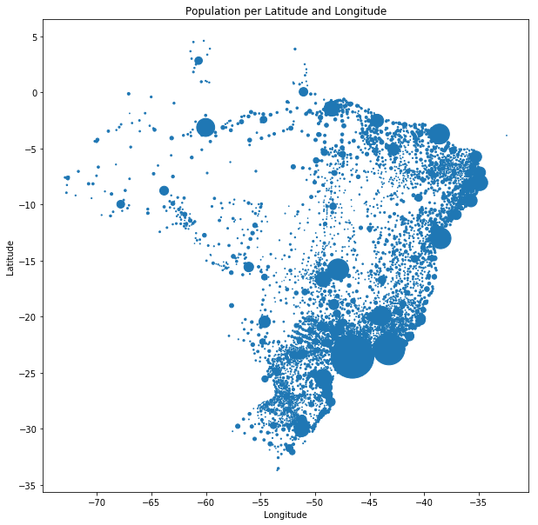
Estimated population
ESTIMATED_POP: int,
Estimated Population the next year

Slide 12
經緯度/海拔
LONG: float, City Longitude
LAT: float, City Latitude
ALT: float, City Elevation (meters)

Slide 13
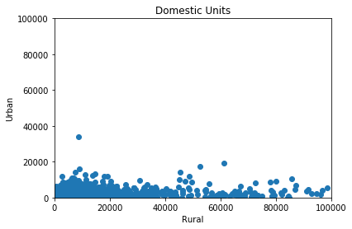
Domestic units
IBGE_DU: int, Domestic Units Total
IBGE_DU_URBAN: int, Domestic Units Urban
IBGE_DU_RURAL: int, Domestic Units Rural

Slide 14
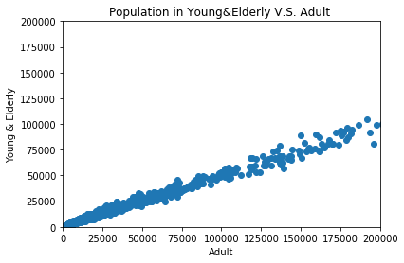
Age
IBGE_POP: int
IBGE_1: int
IBGE_1-4: int
IBGE_5-9: int
IBGE_10-14: int
IBGE_15-59: int
IBGE_60+: int

Slide 15
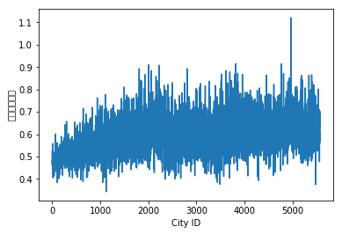
扶養比: (小孩+老人)/(15~59歲)

Slide 16
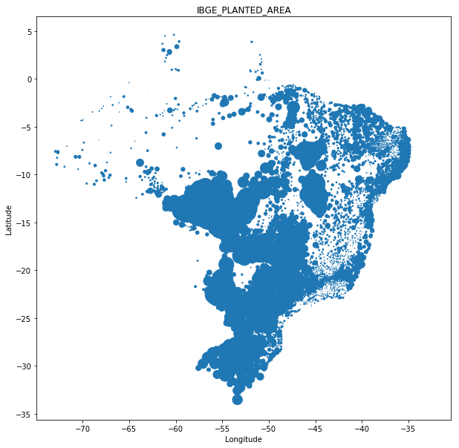
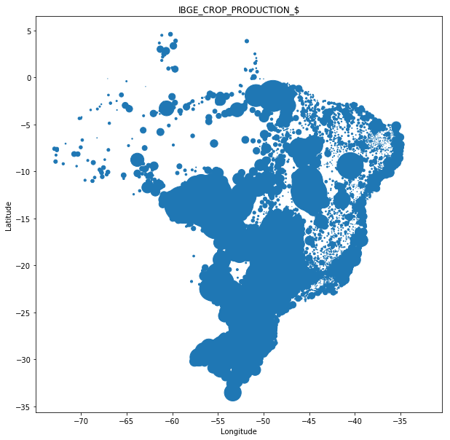
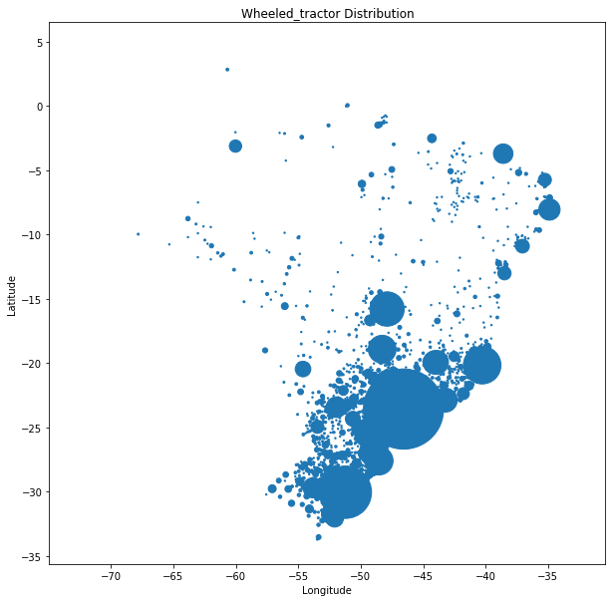
植被/農產品/拖拉機
IBGE_PLANTED_AREA: int, Planted Area (hectares)
IBGE_CROP_PRODUCTION_$: int, Crop Production
Wheeled_tractor(拖拉機): int, number of wheeled tractor

Slide 17
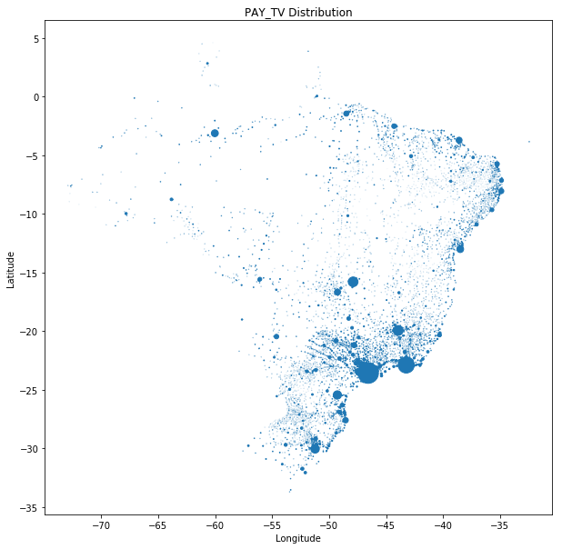
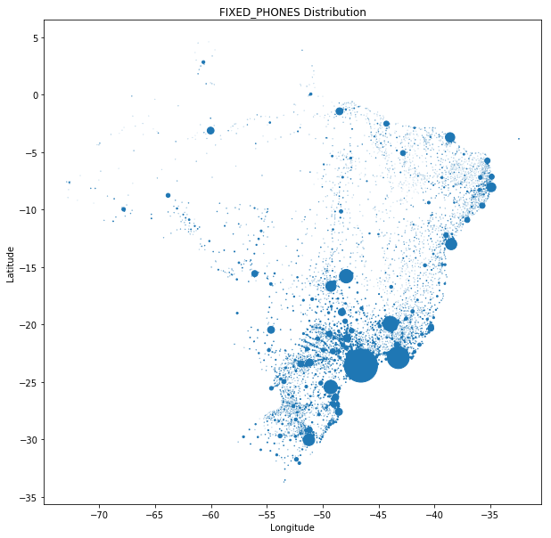
付費電視/市內電話
PAY_TV: int, PayTV users
FIXED_PHONES: int, Fixed Fones (not cell phones) users

Slide 18
觀光客
REGIAO_TUR: string, Turism Category Region
CATEGORIA_TUR: category, Turism Category

Slide 19
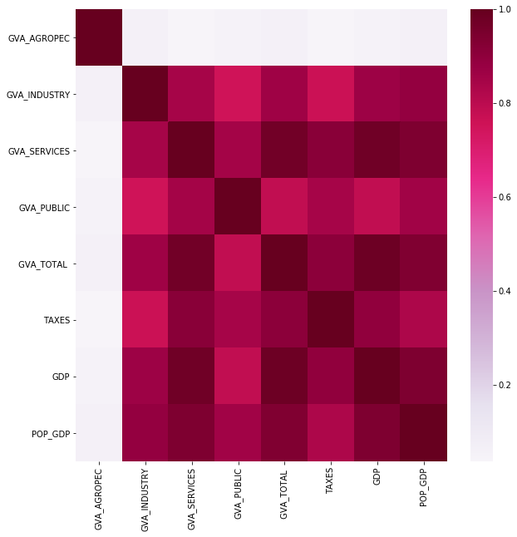
GVA + tax – subsidies= GDP
(GDP = GVA + tax – subsidies)
GVA_AGROPEC: float, 農業
GVA_INDUSTRY: float, 工業
GVA_SERVICES: float, 服務業
GVA_PUBLIC: float, 公共服務
GVA_TOTAL: float
TAXES: float
GDP: float
POP_GDP: int, population 2016

Slide 20
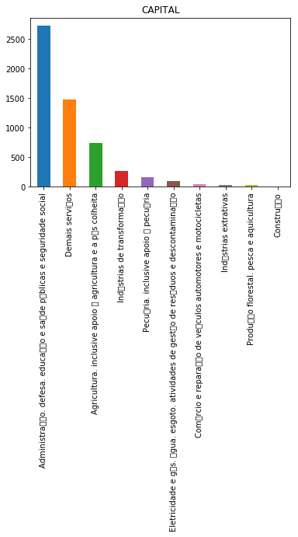
GVA + tax – subsidies= GDP
GDP_CAPITA: float,
GDP/population
GVA_MAIN: category,
GVA貢獻比例最高的產業
MUN_EXPENDIT: int, 政府支出

Slide 21
Company (numerical)
COMP_TOT: int, Total number of companies
COMP_A: int, Agriculture, livestock, forestry, fishing and aquaculture
COMP_B: int, Extractive industries
COMP_C: int, Industries of transformation
COMP_D: int, Electricity and gas
COMP_E: int, Water, sewage, waste management and decontamination activities
COMP_F: int, Construction
COMP_G: int, Trade; repair of motor vehicles and motorcycles
COMP_H: int, Transport, storage and mail

Slide 22
Company (numerical)
COMP_I: int, Accommodation and food
COMP_J: int, Information and communication
COMP_K: int, Financial, insurance and related services activities
COMP_L: int, Real estate activities
COMP_M: int, Professional, scientific and technical activities
COMP_N: int, Administrative activities and complementary services
COMP_O: int, Public administration, defense and social security
COMP_P: int, Education

Slide 23
Company (numerical)
COMP_Q: int, Human health and social services
COMP_R: int, Arts, culture, sport and recreation
COMP_S: int, Other service activities
COMP_T: int, Domestic services
COMP_U: int, International and other extraterritorial institutions

Slide 24
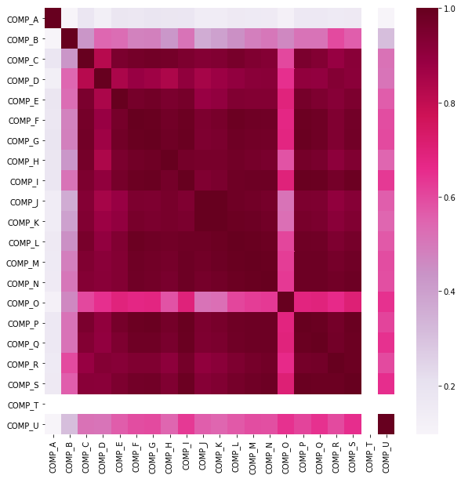

Slide 25
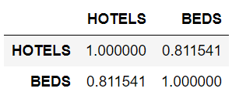
飯店
HOTELS: int, total number of hotels
BEDS: int, total number of hotel beds

Slide 26
銀行、資產
Pr_Agencies: int, private bank agencies
Pu_Agencies: int, public bank agencies
Pr_Bank: int, private banks
Pu_Bank: int, public banks
Pr_Assets: int, private bank assets
Pu_Assets: int, public bank assets

Slide 27
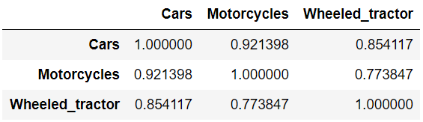
交通工具
Cars: int, number of cars
Motorcycles: int, number of motorcycles
UBER: boolean, True if UBER

Slide 28
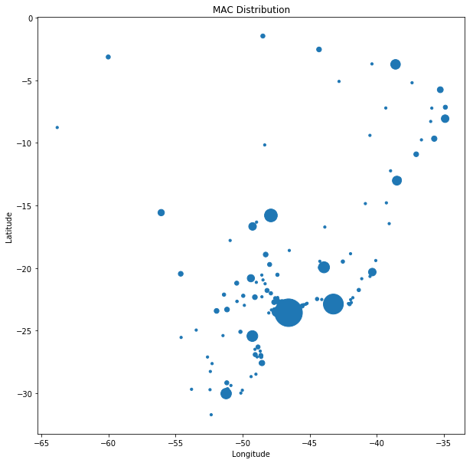
重點商家
MAC: int, number of Mac Donalds stores
WAL-MART: int, number of wal-mart
POST_OFFICES: int, number of post offices

Slide 29
PART TWO
Feature Engineering

Slide 30
Convert to dummy
STATE
CATEGORIA_TUR
RURAL_URBAN
UBER
GVA_MAIN

Slide 31
Deleted columns
CITY | IBGE_1 | IDHM_Renda | GDP
IBGE_RES_POP_BRAS | IBGE_1-4 | IDHM_Longevidade | GVA_TOTAL
IBGE_RES_POP_ESTR | IBGE_5-9 | IDHM_Educacao
IBGE_DU_RURAL | IBGE_10-14 | IDHM Ranking 2010
IBGE_DU_URBAN | IBGE_15-59 | IDHM
REGIAO_TUR | IBGE_60+
COMP類只留下: A,B,O,U, others

Slide 32
Added columns
IBGE_RES_Forpop
IBGE_DU_Pro
Pop_burden_ratio
COMP_others

Slide 33
Missing value
IDHM、經緯度缺失的row刪除
平均值填補:
IBGE_DU,
IBGE_DU_Pro,
Pr_Assets,
Pu_Assets,
Cars,
Motorcycles,
Wheeled_tractor,
MUN_EXPENDIT
以0填補:
HOTELS,
BEDS,
Pr_Agencies,
Pu_Agencies,
Pr_Bank,
Pu_Bank,
MAC,
WAL-MART,
POST_OFFICES

Slide 34
PART THREE
MODEL

Slide 35
Model
70% train, 30% test
 | Mean squared error | R-squared | accuracy
Logistic regression | 0.34 | 0.1451 | 0.7791
Decision tree | 0.24 | 0.3828 | 0.7522
Random Forest | 0.19 | 0.5154 | 0.8096
BaggingRegressor | 0.12 | 0.6636 | 0.3275
KNN | 0.28 | 0.2321 | 0.1976

Slide 36
Q & A

Slide 37
THANK YOU
FOR YOUR
LISTENING

