Slide 1
Auto crawl stock data tutorial
吳國瑋

Slide 2
File Intro.
stock
result
fixed : 不更動的資料
TW : 20年股票資料整理
sample : 副本資料
TW : 960股票資料
ex1.py : check python can execute
ex2.py : check library can import
task.py : crawl stock data everyday

Slide 3
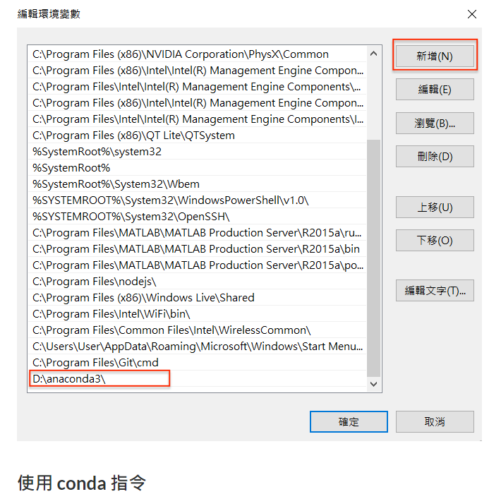
Anaconda 安裝
https://ithelp.ithome.com.tw/articles/10229662?sc=pt
執行到右圖編輯環境變數

Slide 4
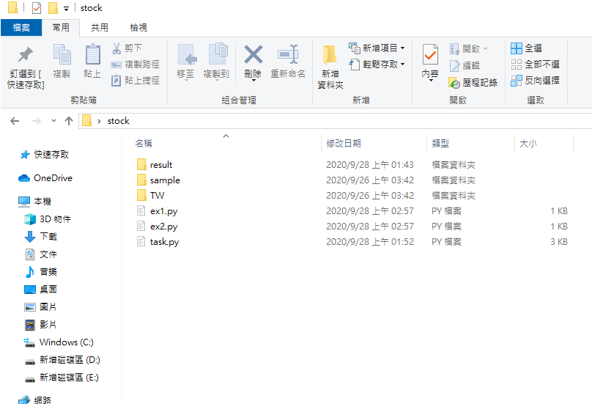
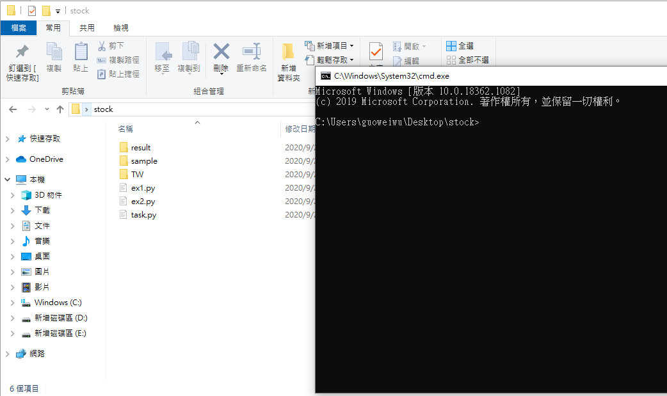
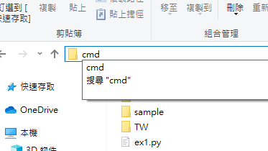
Call cmd.exe terminal(命令提示字元)
Step 1: unzip stock.zip
Step 2: in stock folder type "cmd" and Enter to come out 命令提示字元 window like below

Slide 5
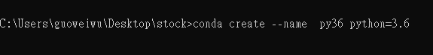
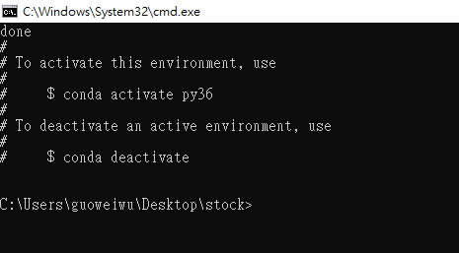
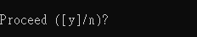
用anaconda建環境執行python(1)
Step 1: type "conda create --name py36 python=3.6"
Step 2: type "y"

Slide 6
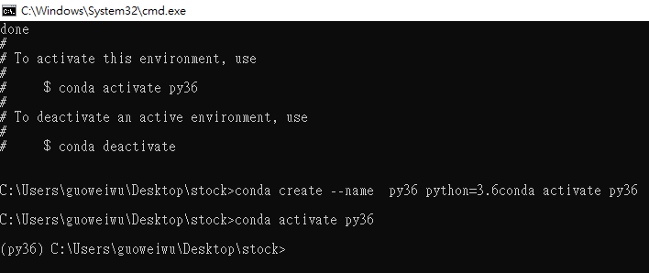
用anaconda建環境執行python(2)
Step 1: type "conda activate py36"
Step 2: check (py36)

Slide 7
用anaconda建環境執行python(3)
Step 1: type "conda activate py36"
Step 2: check (py36)

Slide 8
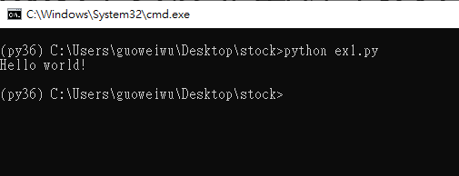
用anaconda建環境執行python(4)
Step 1: type "python ex1.py" to execute "ex1.py" like below

Slide 9
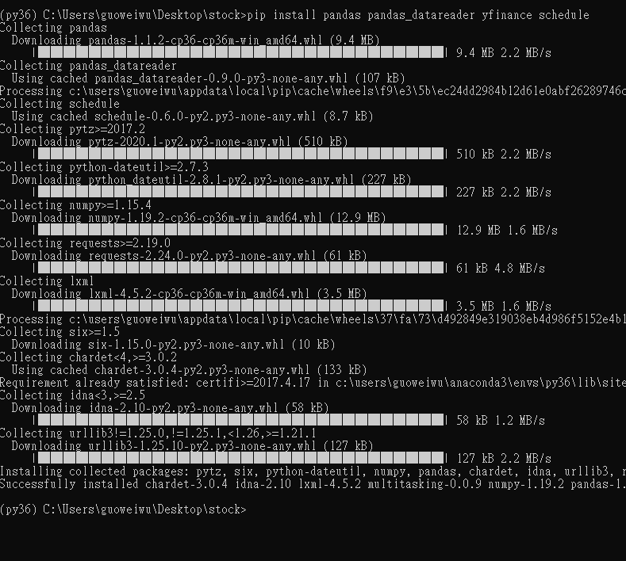
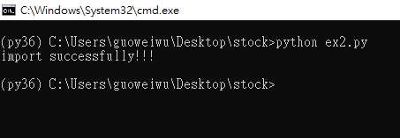
用anaconda建環境執行python(5)
Step 1: need to install library for successfully import
Step 2: type "pip install pandas pandas_datareader yfinance schedule xlrd openpyxl"
Step 3: type "python ex2.py" to execute "ex2.py"

Slide 10
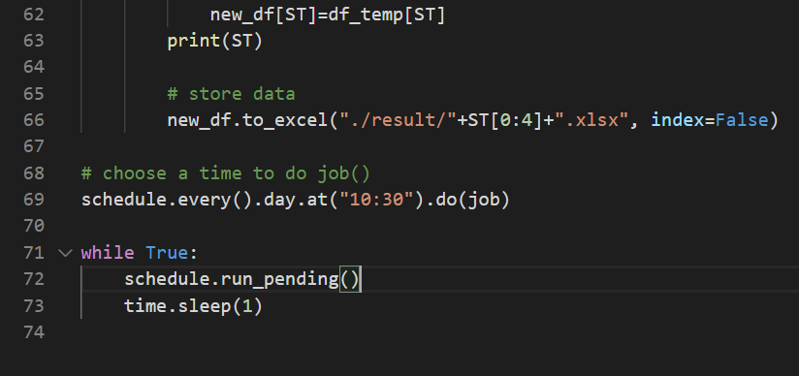
用anaconda建環境執行python(6)
Step 1: In task.py, choose a time in a day "00:00~23:59" to execute crawl stock data periodically
Step 2: In line 69(task.py), modify "10:30" and ctrl-s to save
Step 3: type "python task.py" to execute " task.py"

