Slide 1
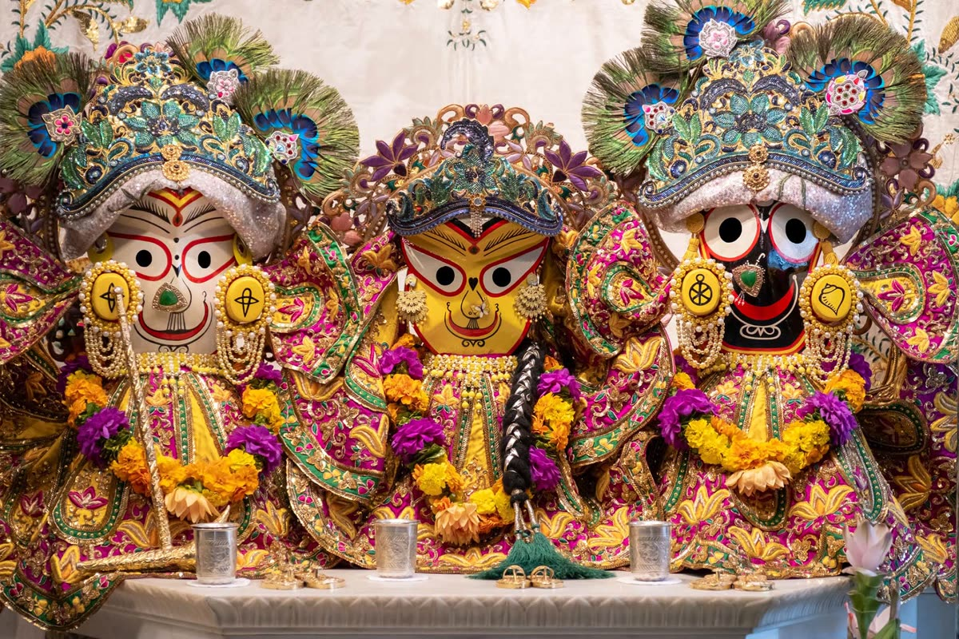
Bring Jagannath
Back to Amsterdam
Amsterdam Congregation Meeting
Led by HG Amala Bhakti Dasi
In presence of HH Mahavishnu Swami
Jagannatha Swami Nayana-patha-gami Bhavatu Me

Slide 2
Our Facilitator
HG Amala Bhakti Dasi
Amala Bhakti Dasi is a senior devotee and god-sister in ISKCON, long committed to the devotional community in the Netherlands.
She has dedicated years of service to supporting congregation life, nurturing bhakti, and preserving the legacy of Srila Prabhupada's mission in Europe.
Today she leads our congregation in a shared mission:
to bring Jagannath home to Amsterdam.

Slide 3
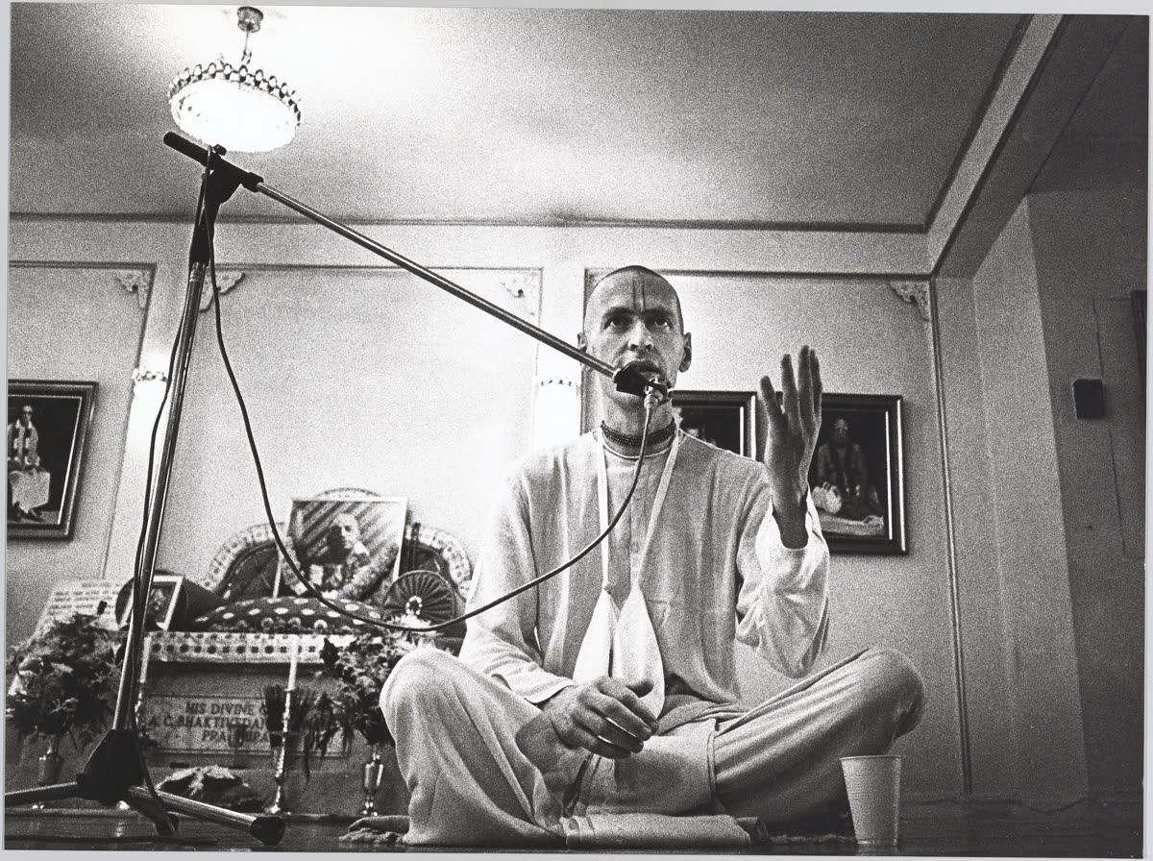
1
Srila Prabhupada's Heritage
in Amsterdam
GOAL
Understand why Amsterdam holds a unique and sacred place in ISKCON history — and why that legacy must not be forgotten.

Slide 4
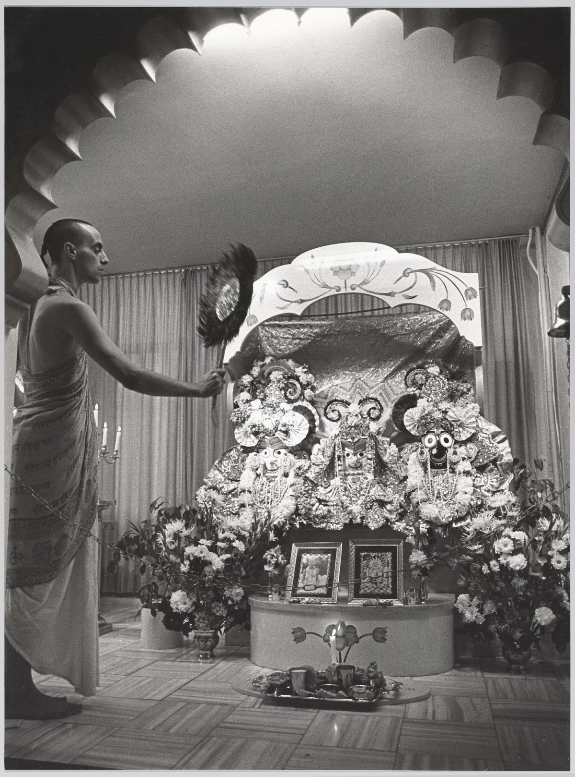
2
Why Does It Matter?
GOAL
Explore the spiritual and historical reasons why Jagannath's presence in Amsterdam is not just meaningful — it is essential for the devotional life of this community.

Slide 5
3
Build a Collective Desire
to Return Jagannath
GOAL
Unite the congregation around one shared aspiration: that Jagannath, Baladeva, and Subhadra return to Amsterdam and take up permanent residence here.

Slide 6
4
Find Solutions to
Arguments Against the Plan
GOAL
Openly address obstacles and objections — practical, financial, logistical — and find answers together so no challenge becomes a barrier.

Slide 7
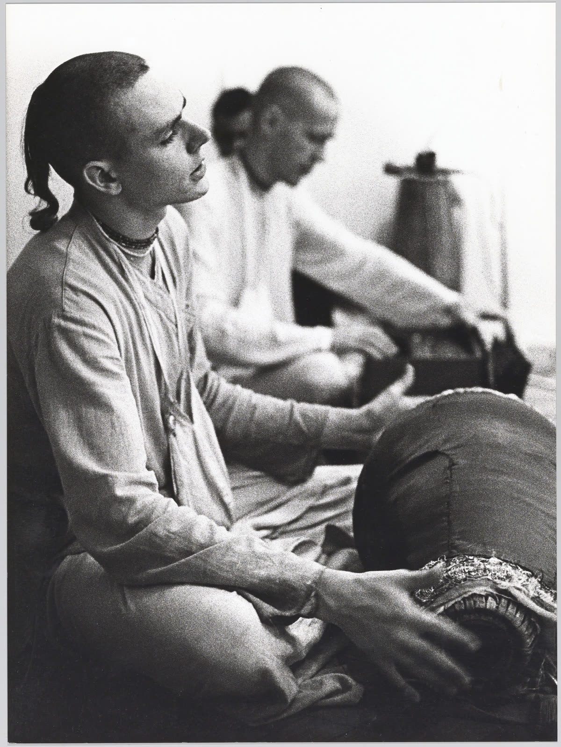
5
Write a Letter to
Our Local GBC
GOAL
Draft a respectful, well-reasoned letter from the congregation to the GBC representatives, formally expressing our desire and inviting their guidance.

Slide 8
6
Make a GBC Proposal
GOAL
Develop a clear, structured proposal that outlines the plan, timeline, resources needed, and community commitment — ready to present at GBC level.

Slide 9
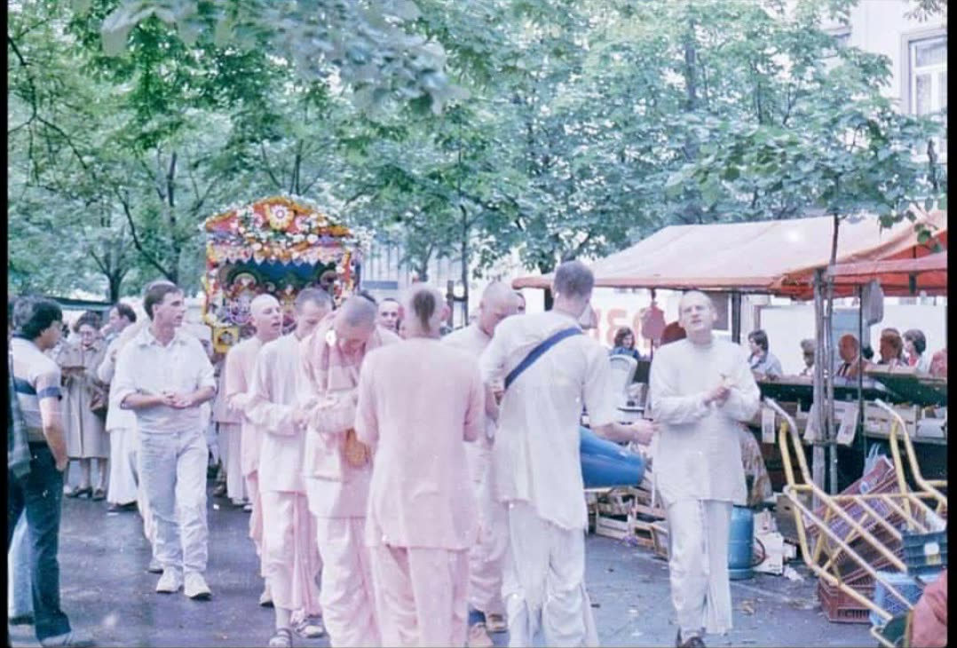
7
What Is Needed?
Who Can Help?
GOAL
Map out the practical requirements — people, places, resources, skills — and identify devotees and allies who can step forward in service.

Slide 10
8
Make ISKCON Amsterdam's
Early History Visible
GOAL
Document and share the founding story of ISKCON Amsterdam — including Srila Prabhupada's 1972 visit — so it inspires and educates current and future devotees.

Slide 11
The Altar Awaits.
Let us bring Jagannath home to Amsterdam.
Hare Krishna Hare Krishna · Krishna Krishna Hare Hare
Hare Rama Hare Rama · Rama Rama Hare Hare
All glories to Srila Prabhupada

