Slide 1
ITAI 2277 · SPRING 2026
CompoundIQ
Phase 2: Data Pipeline & Exploratory Analysis
Weeks 4 – 6 | Drug Combination Safety Analysis
Nicole Marcial · Oluchi Obinna · Oyinade Balogun · Sharise Griggs

Slide 2
Phase 2 Overview
WEEK 4
WEEK 5
WEEK 6
Data Acquisition & Collection
Preprocessing & Feature Engineering
Exploratory Data Analysis
Identify & access data sources
Implement data collection methods
Data storage & organization
Privacy & ethical considerations
Begin data documentation
Data cleaning & quality assessment
Feature engineering for project needs
Data transformation pipelines
Train / Validation / Test splitting
Continue documentation
Statistical analysis & visualization
Pattern identification
Baseline model creation
Insights documentation
Prepare data milestone deliverable
Datasets Used: DrugBank (XML) · TWOSIDES (NSIDES) · SIDER · ChEMBL · ZINC

Slide 3
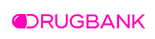
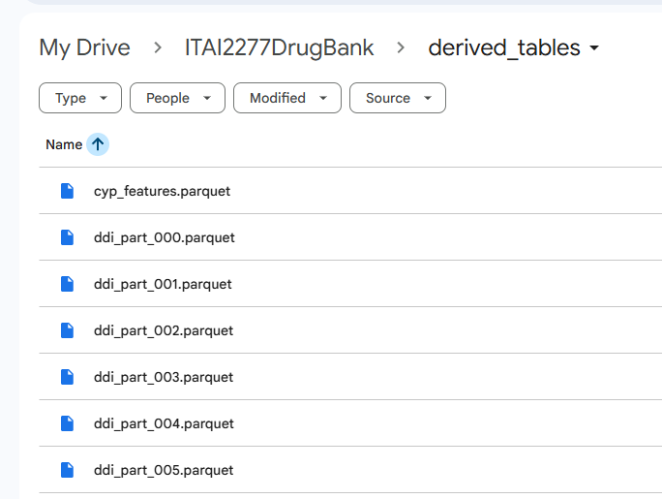
DrugBank Dataset : Data Acquisition and Collection
Selected because it aligns with project goal: drug combination safety analysis
Raw biomedical XML successfully transformed into structured, reusable datasets.
Source provided as a 1.76 GB XML file, processed using structure parsing in Google Colab
Stream-parse the XML and extract ONLY what we need. This creates 4 compact tables that align with CompoundIQ needs
TABLE | ROWS | SIZE | PURPOSE
drugs.parquet | 1,014,348 | 5.31 MB | Core drug metadata (from nested XML extraction)
drug_interactions.parquet | 2,910,010 | 55.15 MB | Drug-drug interaction relationships
targets.parquet | 24,231 | 0.56 MB | Drug-target associations
enzymes.parquet | 6,062 | 0.08 MB | Metabolic enzyme (CYP) data
Stored outputs as Parquet files for faster access and reduced storage.

Slide 4
Week 4 | Data Acquisition & Collection
WEEK 4
DrugBank Dataset
Additional Datasets
Source: 1.76 GB XML file · Processed in Google Colab
Stream-parsed into 4 compact Parquet tables
TWOSIDES: 738 MB · Adverse drug event pairs (NSIDES)
SIDER: 309,849 records · Drug side effect database
Table | Rows | Size | Purpose
drugs.parquet | 1,014,348 | 5.31 MB | Core drug metadata
drug_interactions.parquet | 2,910,010 | 55.15 MB | DDI relationships
targets.parquet | 24,231 | 0.56 MB | Drug-target assoc.
enzymes.parquet | 6,062 | 0.08 MB | CYP enzyme data
ChEMBL: 50,000 records · Molecular bioactivity data
ZINC: Drug-like molecules from clinical trials
# Download & verify all datasets
datasets = {
'ChEMBL': 'data/raw/chembl_molecules.csv',
'SIDER': 'data/raw/sider.csv',
'ZINC': 'data/raw/zinc_druglike.smi'
}
for name, path in datasets.items():
size = os.path.getsize(path)/(1024*1024)
df = pd.read_csv(path)
print(f"✅ {name} | {size:.1f}MB | {len(df):,} records")
Data Collection Verification Script

Slide 5
Data Pipeline Architecture
WEEK 4
DrugBank XML
(1.76 GB)
Stream-parsed to avoid
loading 1.76 GB into memory
▼
XML Parsing
(Structured Extraction)
4 tables aligned to
CompoundIQ project goals
url = "http://sideeffects.embl.de/media/download/meddra_all_se.tsv.gz"
df_sider = pd.read_csv(url, sep='\t', compression='gzip',
names=['stitch_id_flat','stitch_id_stereo',
'umls_id','side_effect','meddra_type'])
df_sider.to_csv('data/raw/sider.csv', index=False)
# ✅ SIDER: 309,849 side effect records
▼
Structured Parquet Tables
drugs | interactions | targets | enzymes
Parquet format: faster
access, reduced storage
▼
Organized Data Storage
(Ready for Feature Engineering)
Stored in Google Drive
for team collaboration
SIDER Download Code

Slide 6
Week 5 | Data Preprocessing & Feature Engineering
WEEK 5
Data Cleaning
Interaction Features
Metabolic (CYP) Features
Safety Complexity Score
Initial extraction: ~1M rows (duplicated entries from XML parsing)
Reduced to ~19K unique drugs (one row per DrugBank ID)
Standardized data types & handled missing values
No. of interactions as subject
No. of interactions as affected drug
Total interaction degree
Number of enzyme records
Number of CYP-associated records
Unique CYP enzymes per drug
Combines interaction + metabolic complexity
Single interpretable composite feature
Validated against known pharmacology
# Feature engineering: safety complexity score
df['safety_complexity_score'] = (
np.log1p(df['total_interactions']) +
df['n_unique_cyp']
)
# Dataset splits
from sklearn.model_selection import train_test_split
train, temp = train_test_split(df, test_size=0.30,
random_state=42)
val, test = train_test_split(temp, test_size=0.50,
random_state=42)
# Train: 70% | Val: 15% | Test: 15%
Pipeline Results
Full Dataset:
19,830 drugs
Active Subset:
4,657 drugs
Train Split:
70%
Val / Test:
15% / 15%
Max Interactions:
5,272
Max Unique CYP:
14

Slide 7
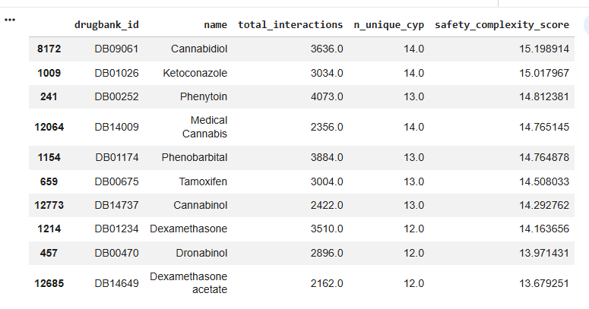
“Top Safety Complexity (not intrinsic danger)”
The highest scoring drugs correspond to well-known interaction-heavy medications, suggesting the engineered safety complexity score aligns with real pharmacological knowledge.

Slide 8
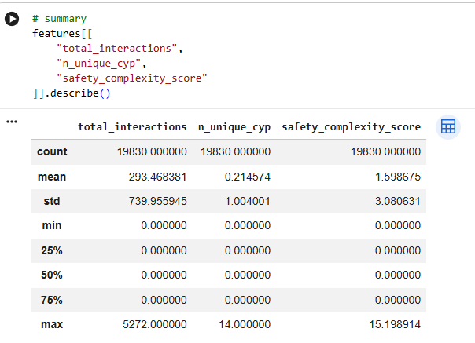
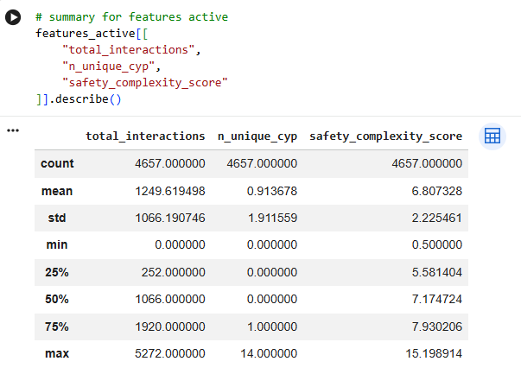
DrugBank Dataset : Data Preprocessing and Feature Engineering
FULL dataset vs ACTIVE dataset
Final merged feature table → 19,830 drugs
Active subset (interaction OR CYP info) → 4,657 drugs
Train / Validation / Test split (70 / 15 / 15)

Slide 9
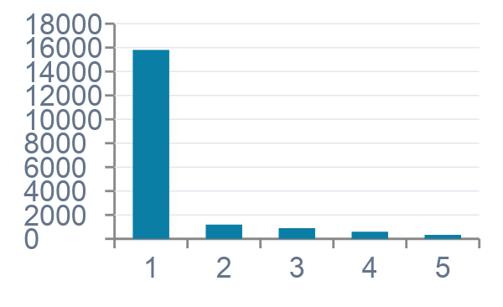
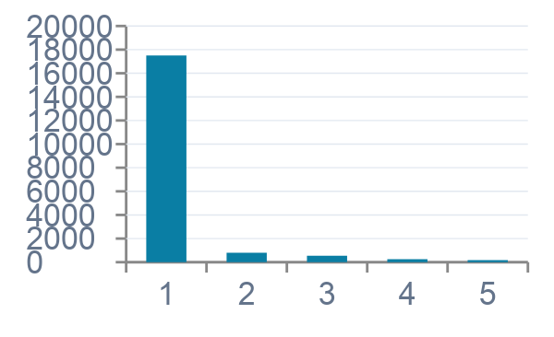
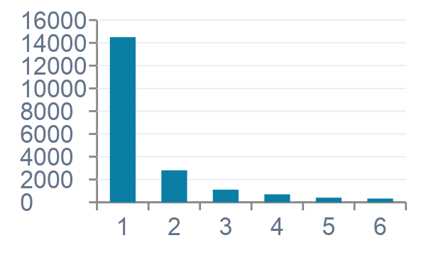
Week 6 | Exploratory Data Analysis
WEEK 6
Drug Interaction Distribution
CYP Enzyme Diversity
Safety Complexity Score
Most drugs have zero or few interactions; a small subset is highly connected — classic long-tail behavior.
Many drugs involve no CYP pathways. A smaller subset shows high metabolic complexity (up to 14 unique enzymes).
Combined feature cleanly separates high-complexity drugs (e.g., Cannabidiol, Ketoconazole) from the majority.
Top Safety Complexity Drugs (not intrinsic danger — reflects interaction & CYP breadth)
Drug | DrugBank ID | Total Interactions | Unique CYP | Safety Score
Cannabidiol | DB09061 | 3,636 | 14 | 15.20
Ketoconazole | DB01026 | 3,034 | 14 | 15.02
Phenytoin | DB00252 | 4,073 | 13 | 14.81
Phenobarbital | DB01174 | 3,884 | 13 | 14.76
Tamoxifen | DB00675 | 3,004 | 13 | 14.51

Slide 10
Data Characteristics: Sparsity & Long-Tail Behavior
Sparsity
Long-Tail Distribution
Large number of drugs with zero or near-zero recorded interaction/metabolism data.
A small subset of highly studied drugs accounts for most documented interactions and annotations.
Why Sparsity Occurs
Why Long-Tail Occurs
Experimental & newly studied compounds
Rare or discontinued drugs
Niche therapeutics with limited research
Insufficient annotation coverage
Research focuses on common & older drugs
Clinically important drugs accumulate citations
More reported interactions over decades
Regulatory attention drives annotation depth
Implication for CompoundIQ
Implication for CompoundIQ
Zero-imputation and active-drug subsetting (4,657 of 19,830) were applied to preserve signal quality.
Model training leverages well-annotated drugs while the pipeline remains extensible as annotations grow.

Slide 11
Code Deep-Dive | Key Implementation Snippets
TWOSIDES Streaming Download (738 MB)
Feature Engineering Pipeline
url = "https://tatonettilab-resources.s3.amazonaws.com/nsides/TWOSIDES.csv.gz"
response = requests.get(url, stream=True)
total = int(response.headers.get('content-length', 0))
with open('data/raw/TWOSIDES.csv.gz', 'wb') as f:
with tqdm(total=total, unit='B', unit_scale=True) as pbar:
for chunk in response.iter_content(8192):
f.write(chunk)
pbar.update(len(chunk))
# Decompress to CSV
with gzip.open('data/raw/TWOSIDES.csv.gz', 'rt') as f:
df = pd.read_csv(f)
df.to_csv('data/raw/twosides.csv', index=False)
# Merge interaction counts from both directions
df_feats = (
df_interactions
.groupby('drugbank_id_subject')['drugbank_id_affected']
.count()
.reset_index()
.rename(columns={'drugbank_id_affected': 'n_as_subject'})
)
# Merge CYP enzyme counts
df_cyp = (
df_enzymes[df_enzymes['enzyme'].str.startswith('CYP')]
.groupby('drugbank_id')['enzyme']
.nunique()
.reset_index()
.rename(columns={'enzyme': 'n_unique_cyp'})
)
# Composite safety score
df['safety_complexity_score'] = (
np.log1p(df['total_interactions']) + df['n_unique_cyp']
)
Verification Output
============================================================
WEEK 4: DATA COLLECTION COMPLETE
============================================================
✅ ChEMBL | 144.9 MB | 50,000 records
✅ SIDER | 14.7 MB | 309,849 records
✅ ZINC | 0.0 MB | 7 molecules
============================================================
🎉 Week 4 Complete – 3 Datasets Ready!

Slide 12
Phase 2 Summary
Data Pipeline & Exploratory Analysis Complete
Week 4
3 primary datasets collected & organized (DrugBank, SIDER, ChEMBL)
Week 5
19,830 drugs cleaned; safety complexity score engineered; 70/15/15 split applied
Week 6
EDA confirms long-tail distributions; top complexity drugs validated against pharmacology
Next: Phase 3 – Model Development & Training
Nicole Marcial · Oluchi Obinna · Oyinade Balogun · Sharise Griggs | ITAI 2277 Spring 2026

Slide 13
Sources - https://dev.drugbank.com/guides/drugbank/citing
Knox C, Wilson M, Klinger CM, et al. DrugBank 6.0: the DrugBank Knowledgebase for 2024. Nucleic Acids Res. 2024 Jan 5;52(D1):D1265-D1275. doi: 10.1093/nar/gkad976.
Wishart DS, Feunang YD, Guo AC, Lo EJ, Marcu A, Grant JR, Sajed T, Johnson D, Li C, Sayeeda Z, Assempour N, Iynkkaran I, Liu Y, Maciejewski A, Gale N, Wilson A, Chin L, Cummings R, Le D, Pon A, Knox C, Wilson M. DrugBank 5.0: a major update to the DrugBank database for 2018. Nucleic Acids Res. 2017 Nov 8. doi: 10.1093/nar/gkx1037.
Law V, Knox C, Djoumbou Y, Jewison T, Guo AC, Liu Y, Maciejewski A, Arndt D, Wilson M, Neveu V, Tang A, Gabriel G, Ly C, Adamjee S, Dame ZT, Han B, Zhou Y, Wishart DS. DrugBank 4.0: shedding new light on drug metabolism. Nucleic Acids Res. 2014 Jan 1;42(1):D1091-7.
Knox C, Law V, Jewison T, Liu P, Ly S, Frolkis A, Pon A, Banco K, Mak C, Neveu V, Djoumbou Y, Eisner R, Guo AC, Wishart DS. DrugBank 3.0: a comprehensive resource for 'omics' research on drugs. Nucleic Acids Res. 2011 Jan;39(Database issue):D1035-41.
Wishart DS, Knox C, Guo AC, Cheng D, Shrivastava S, Tzur D, Gautam B, Hassanali M. DrugBank: a knowledgebase for drugs, drug actions and drug targets. Nucleic Acids Res. 2008 Jan;36(Database issue):D901-6.
Wishart DS, Knox C, Guo AC, Shrivastava S, Hassanali M, Stothard P, Chang Z, Woolsey J. DrugBank: a comprehensive resource for in silico drug discovery and exploration. Nucleic Acids Res. 2006 Jan 1;34(Database issue):D668-72.
Nicole Marcial · Oluchi Obinna · Oyinade Balogun · Sharise Griggs | ITAI 2277 Spring 2026

