Slide 1
Data Leakage in Finance & Linear Models Introduction
報告人:陳昭維、林禹陞
日期: 03/04/22

Slide 2
Outline
Failure of K-fold CV in finance
Solution of K-fold CV training
Multiple Linear Regression
Diagnose and remedy problems
Regularizing linear regression using shrinkage
Logistic Regression

Slide 3
Outline
Failure of K-fold CV in finance
Normal leakage in machine learning
Leakage in finance data
Solution of K-fold CV training
Multiple Linear Regression
Diagnose and remedy problems
Regularizing linear regression using shrinkage
Logistic Regression

Slide 4
Normal leakage in machine learning
Overfitting an estimator is a hidden threat of machine learning, this often occur when data is not independent.
Dependency of IID data usually occurs when dealing NAN data by averaging them and filling
 | Avg
 |  | Avg
Original
Dataset
Dependency
 | Avg
 |  | Avg
 | Avg
 |  | Avg
Train
Dataset
Test
Dataset

Slide 5
Normal leakage in machine learning
Acquiring the average and filling the NAN data after splitting into sets can be a feasible solution.
This shows dependency can occur without being noticed and train a model with high accuracy on dataset but without forecasting ability.

Slide 6
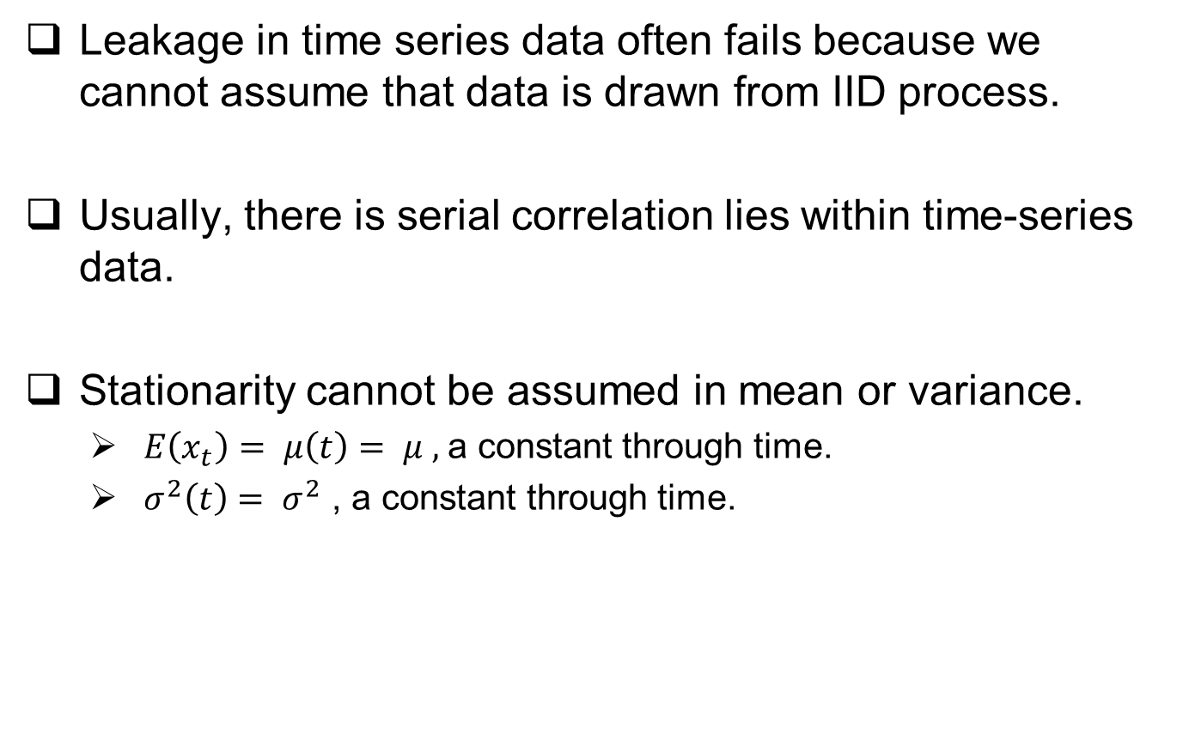
Leakage in finance data
Leakage in time series data often fails because we cannot assume that data is drawn from IID process.
Usually, there is serial correlation lies within time-series data.
Stationarity cannot be assumed in mean or variance.
$E\left(x_{t}\right)= μ\left(t\right)= μ ,$a constant through time.
$σ^{2}\left(t\right)= σ^{2}$ , a constant through time.

Slide 7
Outline
Failure of K-fold CV in finance
Solution of K-fold CV training
Multiple Linear Regression
Diagnose and remedy problems
Regularizing linear regression using shrinkage
Logistic Regression

Slide 8
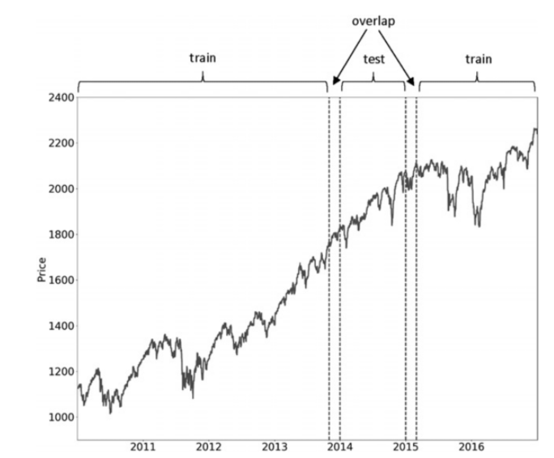
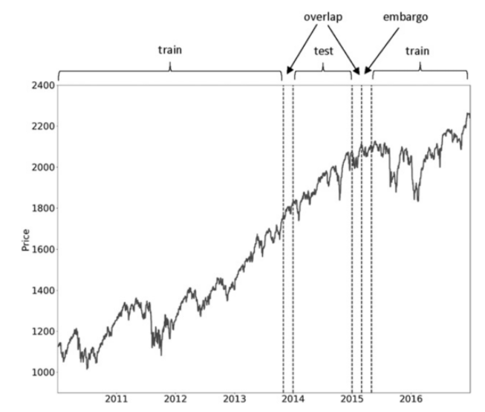
Solution of K-fold CV training
Challenges with cross-validation in finance:
Data is neither independently nor identically distributed because of serial correlation and time-varying standard deviation.
Leakage of information due to overlapped data points.
Purging – purge the overlaps to prevent leakage.
Embargoing – further eliminate training samples that follow a test period.

Slide 9
Outline
Failure of K-fold CV in finance
Solution of K-fold CV training
Multiple Linear Regression
Ordinary Linear Squares
Maximum Likelihood Estimation
The Gaussian-Markov theorem
Statistical Inference
Diagnose and remedy problems
Regularizing linear regression using shrinkage
Logistic Regression

Slide 10
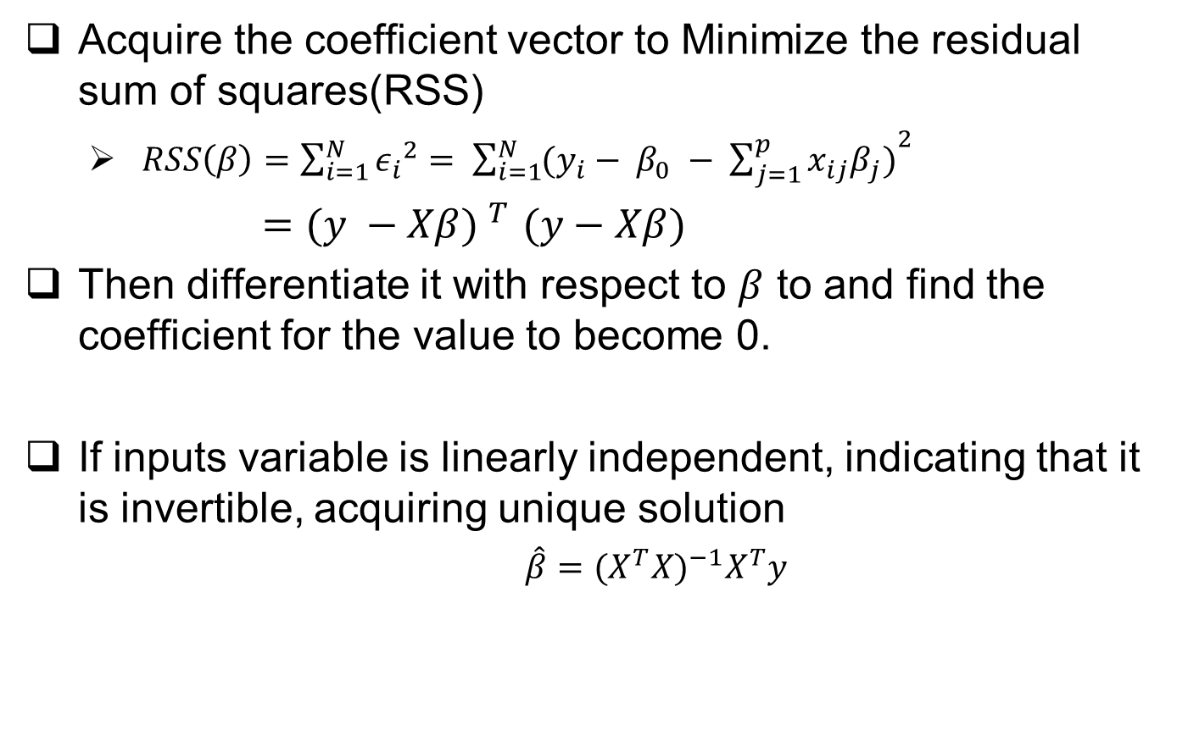
Ordinary least squares
Acquire the coefficient vector to Minimize the residual sum of squares(RSS)
$RSS\left(β\right)=\sum_{i=1}^{N}{{ε_{i}}^{2}= \sum_{i=1}^{N}{{(y_{i}− β_{0} − \sum_{j=1}^{p}{x_{ij}β_{j})}}^{2}}}$
${=(y −Xβ) }^{T}(y−Xβ)$
Then differentiate it with respect to $β$ to and find the coefficient for the value to become 0.
If inputs variable is linearly independent, indicating that it is invertible, acquiring unique solution
$\hat{β}={(X^{T}X)}^{−1}X^{T}y$

Slide 11
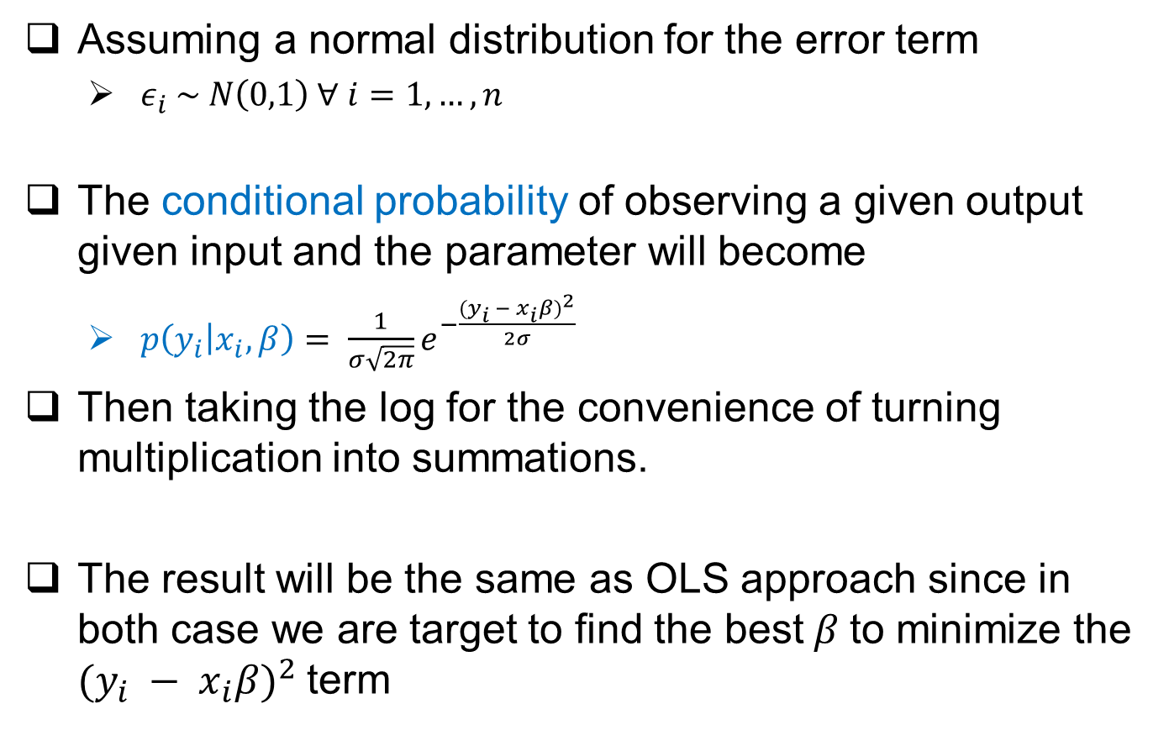
Maximum Likelihood Estimation
Assuming a normal distribution for the error term
$ε_{i} \sim N\left(0,1\right) ∀ i=1, …, n$
The conditional probability of observing a given output given input and the parameter will become
$p\left(y_{i} | x_{i},β\right)= \frac{1}{σ\sqrt{2π}}e^{−\frac{{(y_{i} − x_{i}β)}^{2}}{2σ}}$
Then taking the log for the convenience of turning multiplication into summations.
The result will be the same as OLS approach since in both case we are target to find the best$β$to minimize the ${(y_{i} − x_{i}β)}^{2}$term

Slide 12
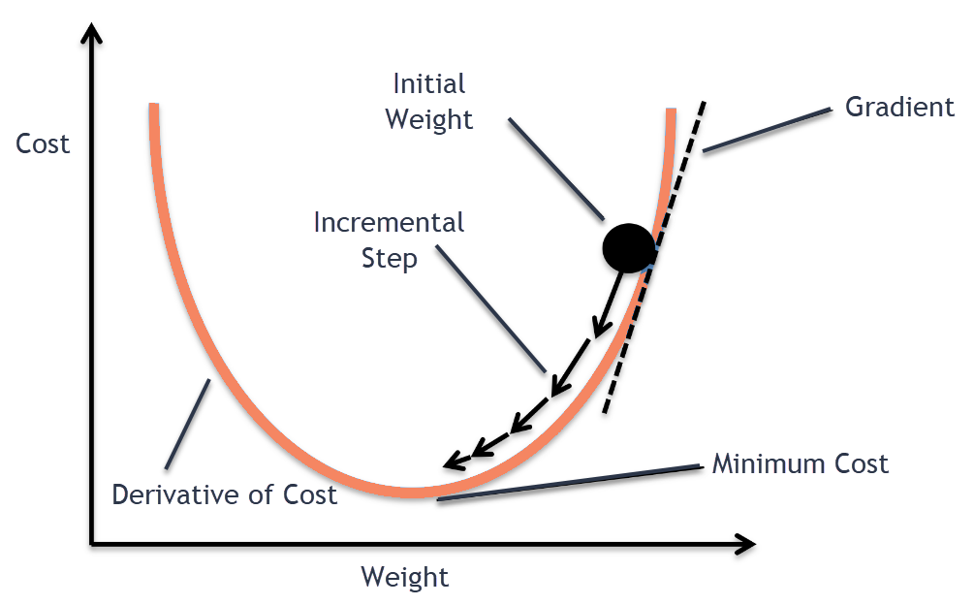
Gradient descent

Slide 13
The Gauss-Markov Theorem
The Gauss-Markov-theorem(GMT) defines the assumptions required for OLS to produce unbiased estimates of model parameter β, and to have the lowest standard error among all linear model.
There are five GMT assumption for multiple regression models
1. Linearity
2. Randomness
3. Noncollinearity
4. Exogeneity
5. Homoscedastic

Slide 14
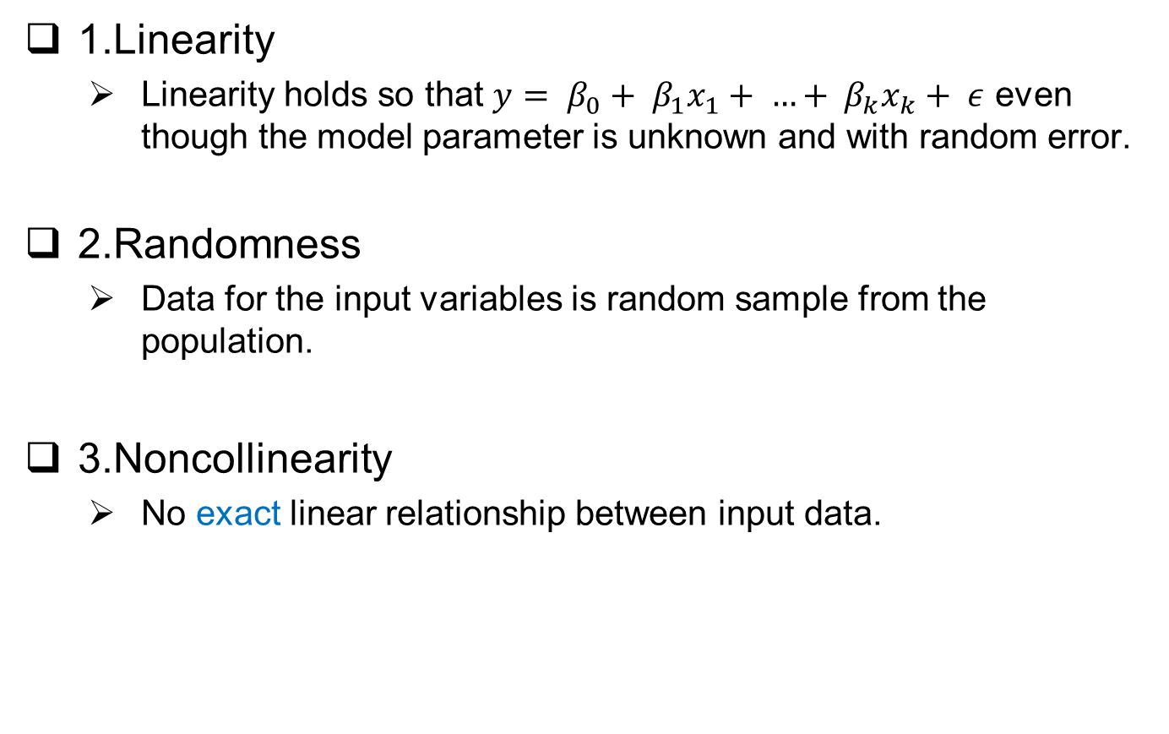
The Gauss-Markov Theorem
1.Linearity
Linearity holds so that $y= β_{0}+ β_{1}x_{1}+ …+ β_{k}x_{k}+ ε$ even though the model parameter is unknown and with random error.
2.Randomness
Data for the input variables is random sample from the population.
3.Noncollinearity
No exact linear relationship between input data.

Slide 15
The Gauss-Markov Theorem
4. Exogeneity
Error term has zero conditional mean
5.homoschedacity
Error term has constant variance
Under GMT 1 – 4, OLS method delivers unbiased estimates, but the model parameter is prone to be biased if the error is correlated with any input variables or the conditional mean is not zero.
With the fifth assumption, then OLS produces best linear unbiased estimates (BLUE).

Slide 16
The Gauss-Markov Theorem
BLUE implies that the estimates have the lowest standard error among all linear estimators.
If 5 assumption holds, then the goal is to achieve statistical inference.
For prediction, there are some estimators that trades bias for variation such that the model won’t overfit and loss it’s forecast ability.

Slide 17
Statistical inference
Aims to draw conclusions from the sample data about true relationship in the population.
Testing hypothesis
Typically uses test statistic with known distribution
Formulate hypothesis and then compute probability of observing the actual value for this statistics. -> p-value.

Slide 18

Statistical inference – p value
Supposed that in a two-trial coin toss, I had 2 head in a row, and I assume that my coin is rare and not normal.
So I will make an NULL hypothesis that my coin is just a normal coin, then test the hypothesis by calculating the p value.

Slide 19

Statistical inference – p value
The p-value of the 2 head in a row is 0.5
Consists of probability of this case: 0.25
Consists of probability of even rare case : 0.25
Consists of probability of rarer or more extreme case: 0
Usually we reject the hypothesis when the p-value
drops below 0.05, thus the NULL hypothesis stands
with this case.

Slide 20
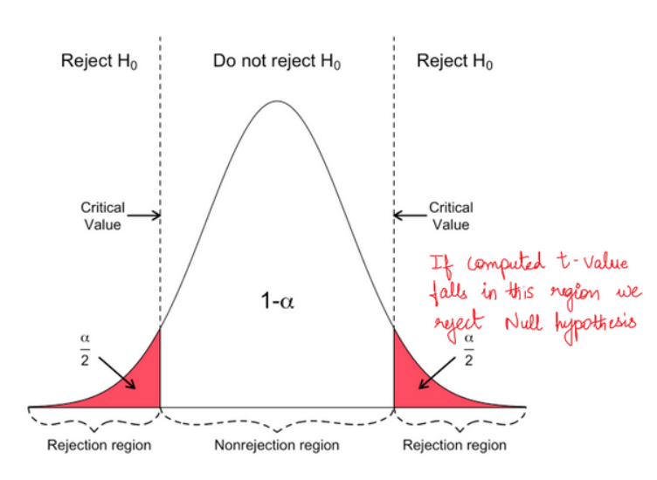
Statistical inference – t test

Slide 21
Outline
Failure of K-fold CV in finance
Solution of K-fold CV training
Multiple Linear Regression
Diagnose and remedy problems
Goodness of fit
Heteroskedasticity
Serial correlation
Multicollinearity
Regularizing linear regression using shrinkage
Logistic Regression

Slide 22
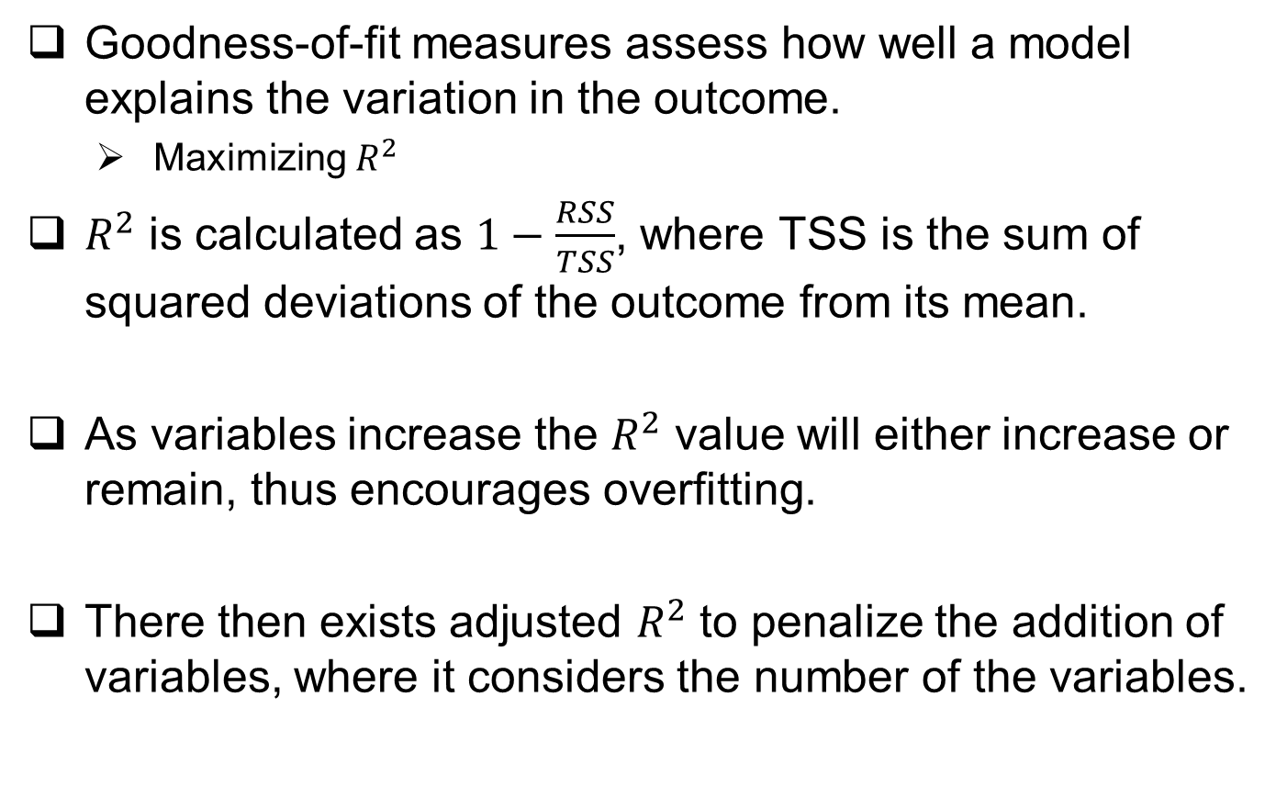
Goodness of fit
Goodness-of-fit measures assess how well a model explains the variation in the outcome.
Maximizing $R^{2}$
$R^{2}$ is calculated as $1−\frac{RSS}{TSS}$, where TSS is the sum of squared deviations of the outcome from its mean.
As variables increase the $R^{2}$ value will either increase or remain, thus encourages overfitting.
There then exists adjusted $R^{2}$ to penalize the addition of variables, where it considers the number of the variables.

Slide 23
heteroscedastic
GMT assumption 5 requires the residual covariance to be a diagonal matrix with entries equal to the constant variance of the error term.
Heteroscedastic occurs when residual variance is not constant but differ across observations.
If residual variance is positively correlated with input variable, then the OLS standard error will be too low. consequently leading to inflated t-statistics.

Slide 24
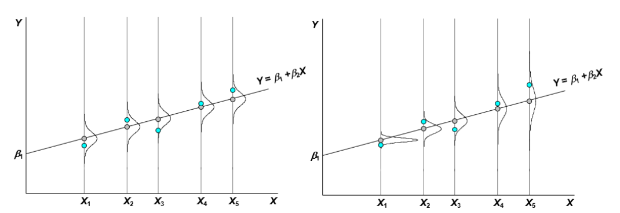
Homoscedasticity
Heteroscedasticity

Slide 25
Serial Correlation
Consecutive residuals produced by linear regression are correlated, which violates the fourth GMT assumption.
Positive serial correlation implies standard errors are underestimated, t-statics will be inflated.
The Durbin-Watson statistic diagnoses serial correlation.
The test statistics ranges from 0 to 4.
Value near 2 indicate non-autocorrelation.
Lower values 2 indicate positive autocorrelation.
Higher values 2 indicate negative autocorrelation.

Slide 26
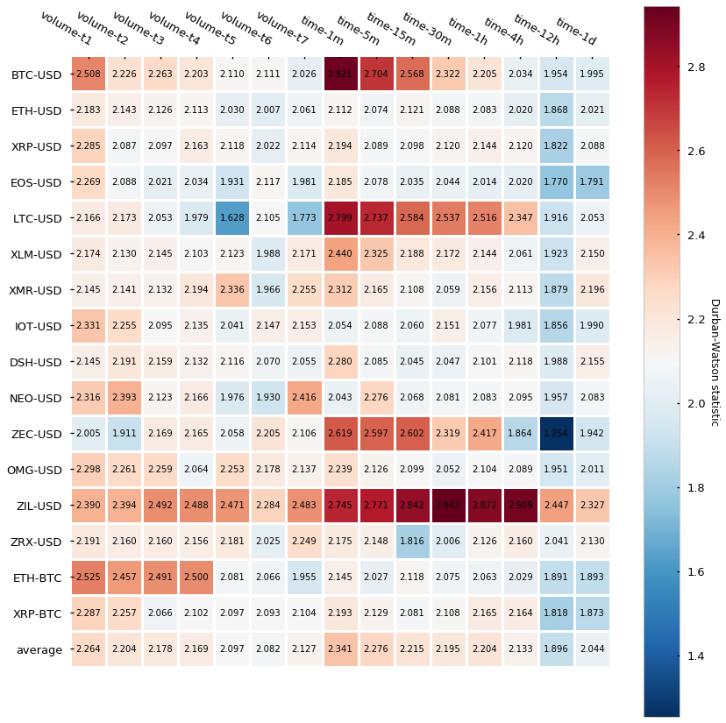

Slide 27
Multicollinearity
Occurs when two or more independent are highly correlated.
It is difficult to determine which factors influence the dependent variable
Individual p-value might mislead, although the value being high, it could still be important.
There is no theory based solution yet. The solution provided are removing possible correlated input or increasing the sample size.

Slide 28
Outline
Failure of K-fold CV in finance
Solution of K-fold CV training
Multiple Linear Regression
Diagnose and remedy problems
Regularizing linear regression using shrinkage
Hedging against overfitting
Ridge regression (L2 norm)
Lasso regression (L1 norm)
Logistic Regression

Slide 29
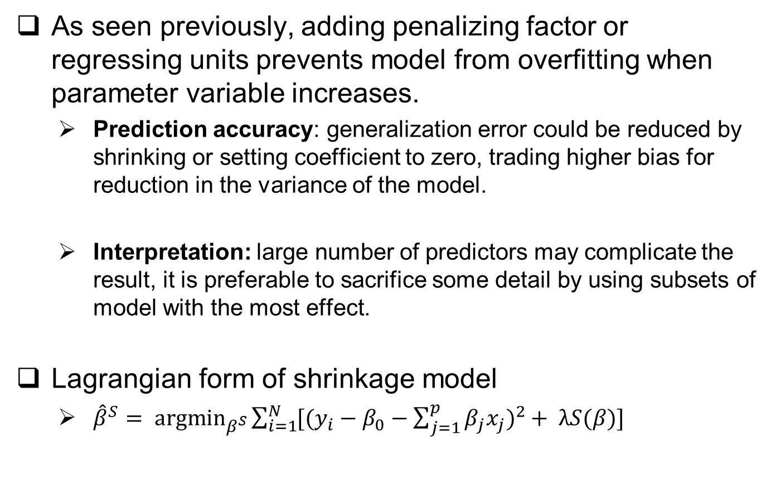
Hedging against overfitting
As seen previously, adding penalizing factor or regressing units prevents model from overfitting when parameter variable increases.
Prediction accuracy: generalization error could be reduced by shrinking or setting coefficient to zero, trading higher bias for reduction in the variance of the model.
Interpretation: large number of predictors may complicate the result, it is preferable to sacrifice some detail by using subsets of model with the most effect.
Lagrangian form of shrinkage model
${\hat{β}}^{S}= \underset{β^{S}}{argmin}{\sum_{i=1}^{N}{[{(y_{i}−β_{0}−\sum_{j=1}^{p}{β_{j}x_{j}})}^{2}}}+ λS(β)]$
Size of penalty effect

Slide 30
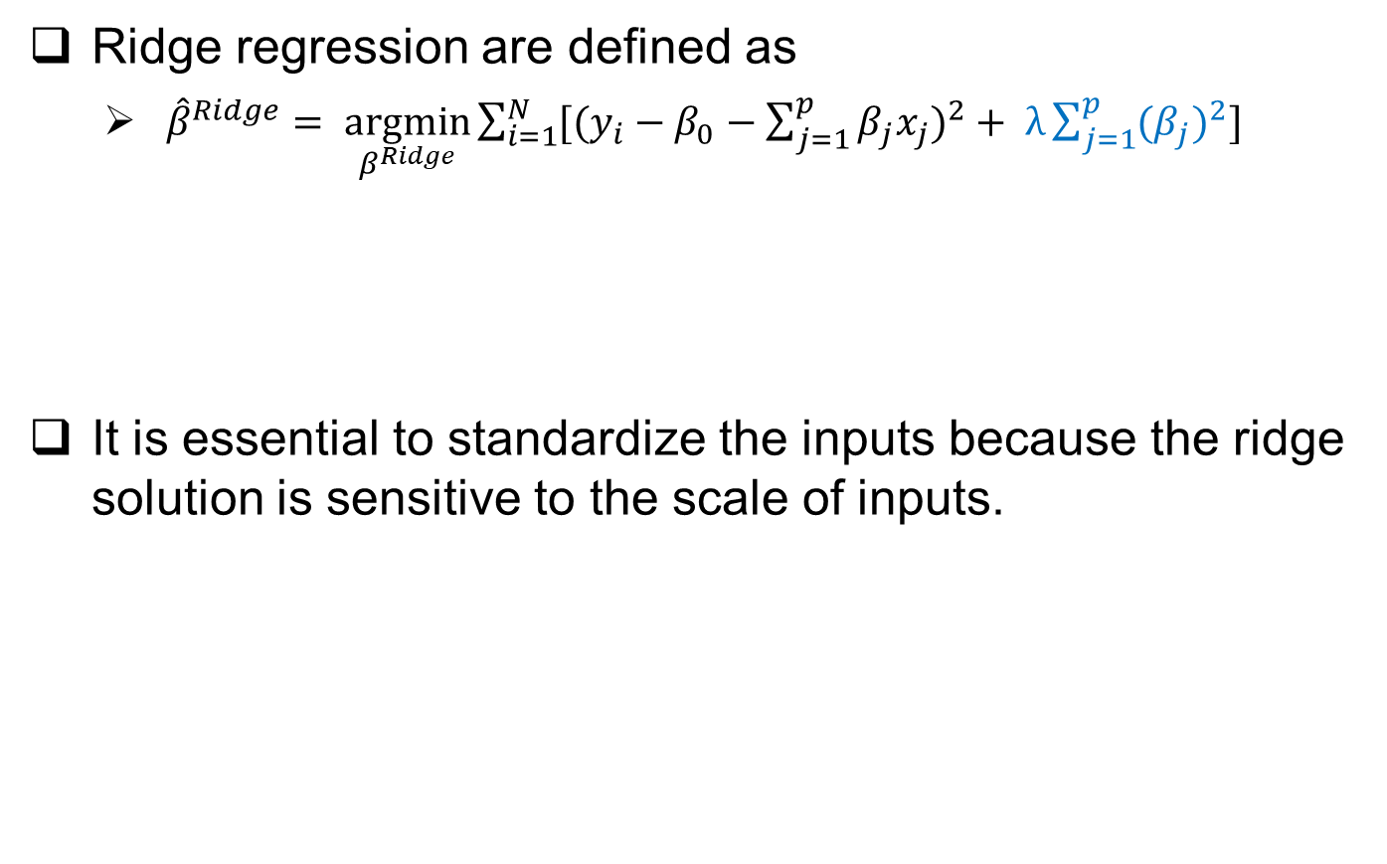
Ridge regression (L2 norm)
Ridge regression are defined as
${\hat{β}}^{Ridge}= \underset{β^{Ridge}}{argmin}{\sum_{i=1}^{N}{[{(y_{i}−β_{0}−\sum_{j=1}^{p}{β_{j}x_{j}})}^{2}}}+ λ\sum_{j=1}^{p}{{{(β}_{j})}^{2}}]$
It is essential to standardize the inputs because the ridge solution is sensitive to the scale of inputs.

Slide 31
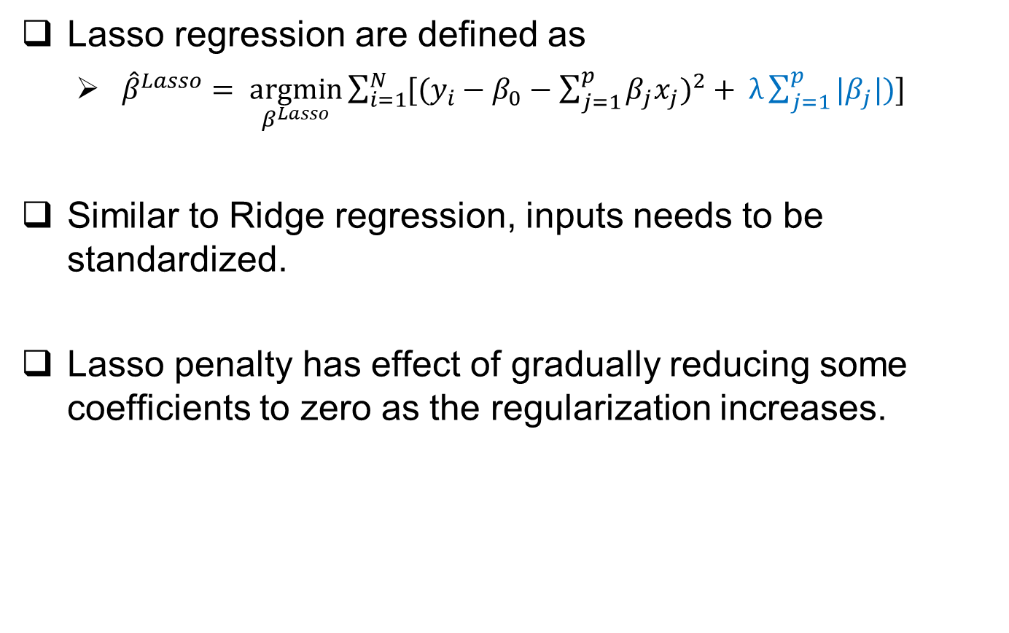
Lasso regression (L1 norm)
Lasso regression are defined as
${\hat{β}}^{Lasso}= \underset{β^{Lasso}}{argmin}{\sum_{i=1}^{N}{[{(y_{i}−β_{0}−\sum_{j=1}^{p}{β_{j}x_{j}})}^{2}}}+ λ\sum_{j=1}^{p}{{|β}_{j}|)}]$
Similar to Ridge regression, inputs needs to be standardized.
Lasso penalty has effect of gradually reducing some coefficients to zero as the regularization increases.

Slide 32
Outline
Failure of K-fold CV in finance
Solution of K-fold CV training
Multiple Linear Regression
Diagnose and Remedy Problems
Regularizing Linear Regression Using Shrinkage
Logistic Regression
The objective function
The logistic function
Maximum likelihood estimation

Slide 33
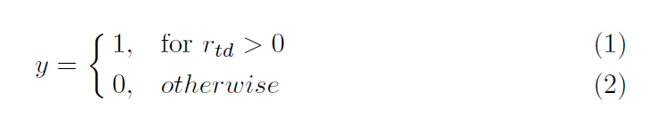
The Objective Function
Using the output variable y, taking value 1 if a stock return is positive return, or zero otherwise.
Three output model could be extended, where 0 or 2 reflects to price hitting negative or positive threshold. and 1 otherwise.

Slide 34
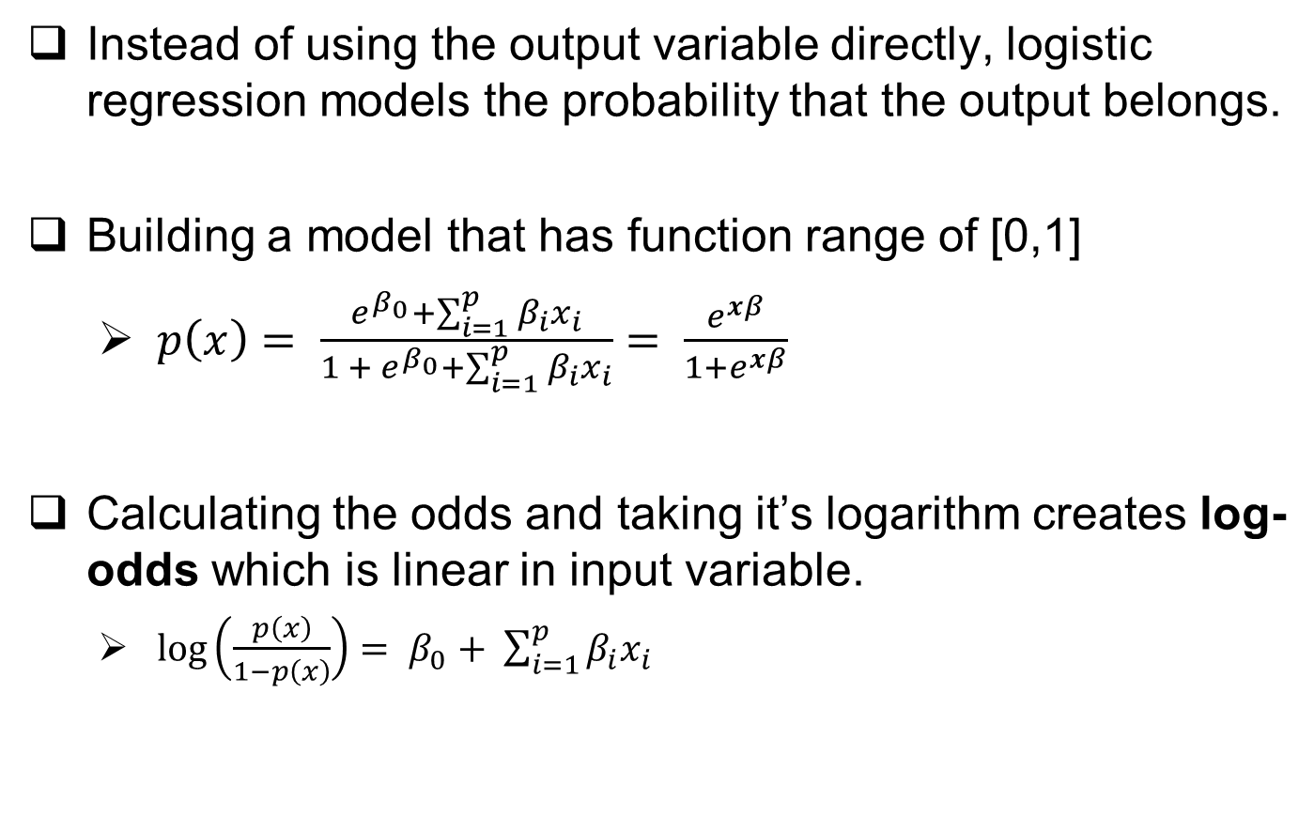
The Logistic Function
Instead of using the output variable directly, logistic regression models the probability that the output belongs.
Building a model that has function range of [0,1]
$p\left(x\right)= \frac{e^{β_{0}}+\sum_{i=1}^{p}{β_{i}x_{i}}}{{1 + e}^{β_{0}}+\sum_{i=1}^{p}{β_{i}x_{i}}}= \frac{e^{xβ}}{1+e^{xβ}}$
Calculating the odds and taking it’s logarithm creates log-odds which is linear in input variable.
$\log\left(\frac{p\left(x\right)}{1−p\left(x\right)}\right)= β_{0}+ \sum_{i=1}^{p}{β_{i}x_{i}}$
odds
logit

Slide 35
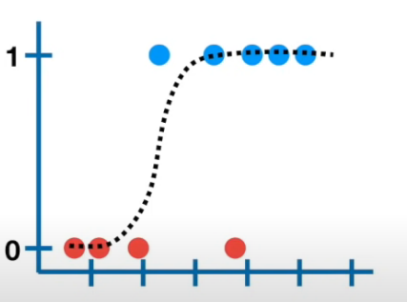
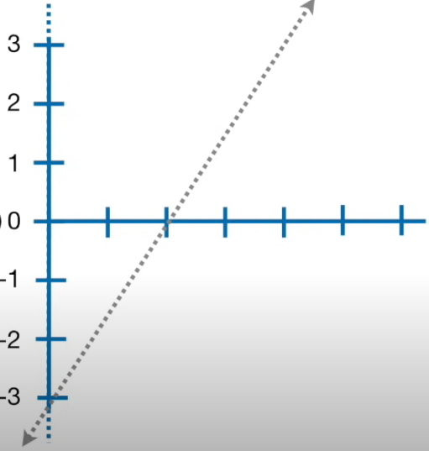

Slide 36
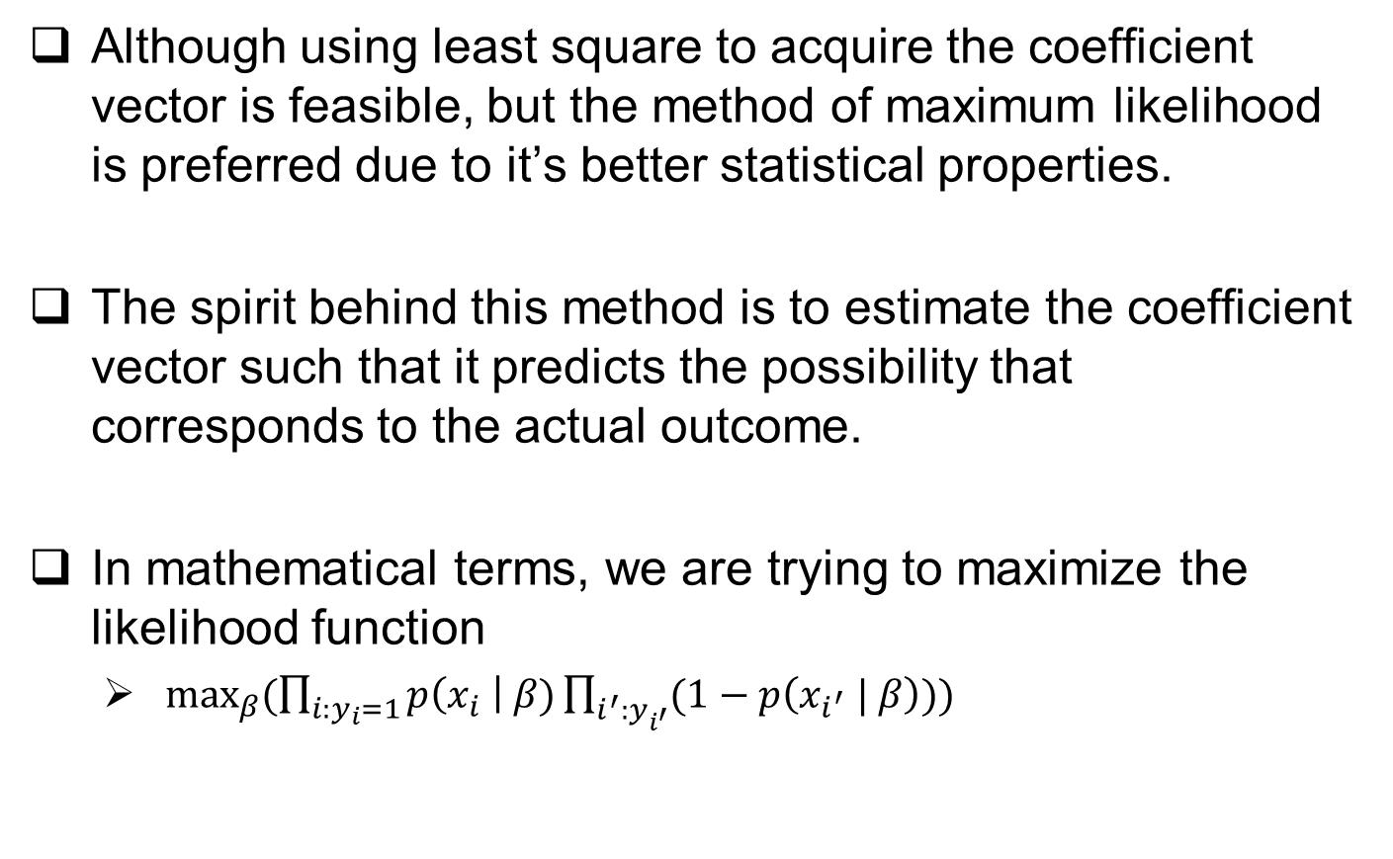
Maximum Likelihood Estimation
Although using least square to acquire the coefficient vector is feasible, but the method of maximum likelihood is preferred due to it’s better statistical properties.
The spirit behind this method is to estimate the coefficient vector such that it predicts the possibility that corresponds to the actual outcome.
In mathematical terms, we are trying to maximize the likelihood function
$\max_{β}{(\prod_{i:y_{i}=1}{p\left(x_{i} \right| β)\prod_{i^{′}:y_{i^{′}}}{(1−p\left(x_{i^{′}} | β\right)))}}}$

Slide 37
Maximum Likelihood Estimation
As mentioned earlier, it’s convenient to work with sum terms rather than product terms, thus taking logarithm on the function to get log-likelihood function.
The book suggest that setting the derivate of the function with respect to β to zero. But doing so yields non-linear score equations, thus iterative numerical methods should be applied.

Slide 38
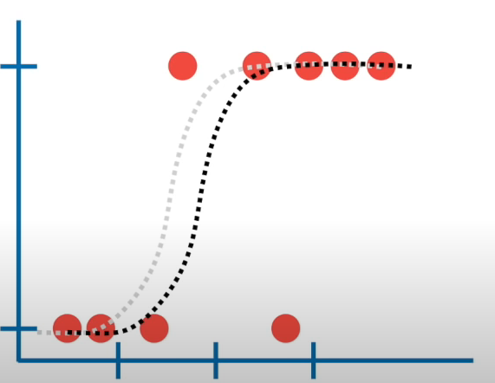
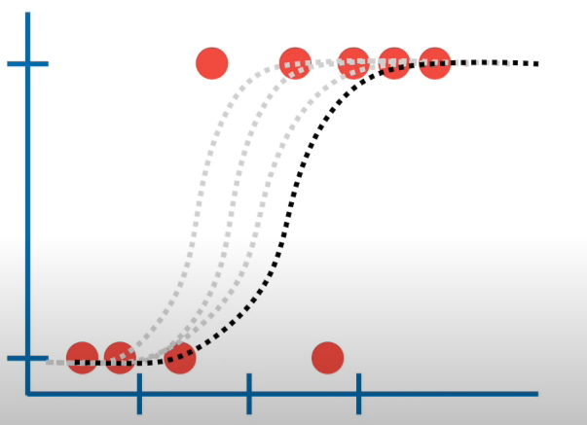

Slide 39
END

