Slide 1
Topic Modeling in machine learning
報告人: 陳昭維、林禹陞
日期: 04/01/22

Slide 2
Outline
Problems with Practical Topic Modeling
Latent Semantic Indexing
Probabilistic Latent Semantic Analysis
Latent Dirichlet Allocation

Slide 3
Outline
Problems with Practical Topic Modeling
Bag-of-Words and Document-Term-Matrix
Problems
Latent Semantic Indexing
Probabilistic Latent Semantic Analysis
Latent Dirichlet Allocation

Slide 4
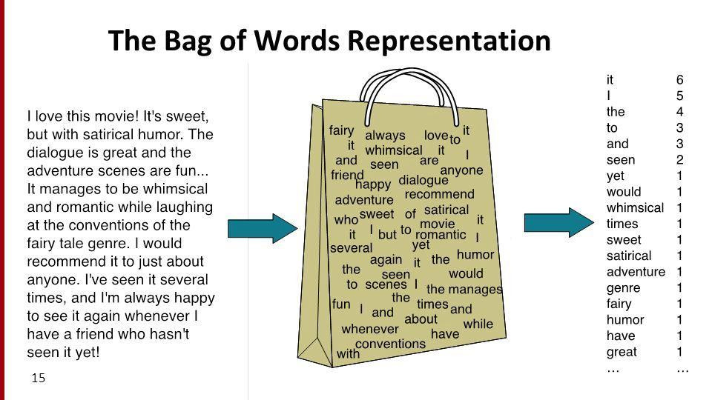
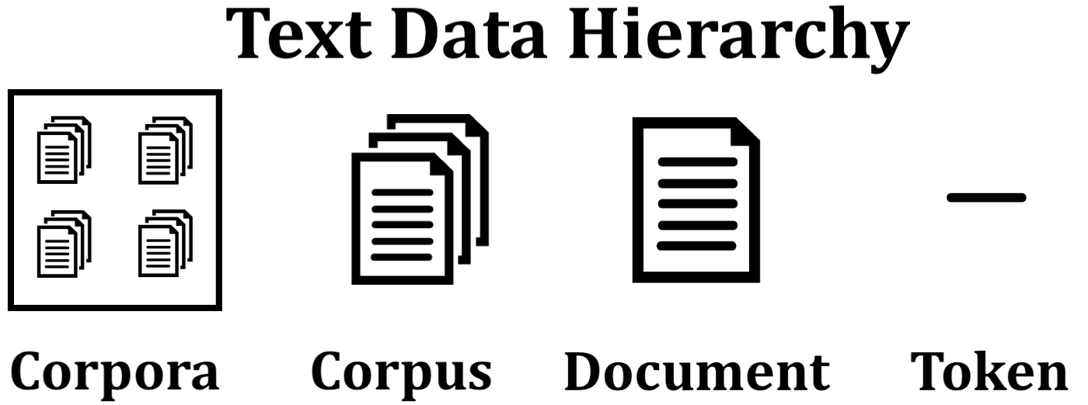
Bag-of-Words and Document-Term-Matrix

Slide 5
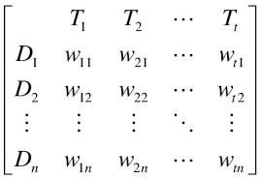
Bag-of-Words and Document-Term-Matrix
Practical type of processing with text data is forming it into Document-Term-Matrix, where the columns are the vocabularies, and the rows are the documents.
Alternatives of the matrix are the transpose of it, which is Term-Document-Matrix.

Slide 6
Problems
With multiple documents with content not necessary similar will leads to high dimensional vector/matrix.
This leads to curse of dimensionalities,
representing documents with high-dimensional sparse vectors makes similarities measures noisy, eventually leads to inaccurate measures, results in an overfitting model.

Slide 7
Problems
Curse of Dimensionality causes clustering data harder, also large vector space makes computation large without smart data preprocessing or data structures.
With increasing dimensions, the variance and the MSE increases.
Moreover, the BOW models loses context, and has zero ability of capturing synonym and polysemy

Slide 8

Problems
For the following two sentences
S1: “The petrol in this car is low.”
S2: “The vehicle is short on fuel.”
Although having small similarities in wording selection, the sentences carry identical meanings.
Creates the document term matrix for the above example
By calculating cosine similarities, the value is only 0.3086 which is very low considering the large scale of overlapping content.

Slide 9
Outline
Problems with Practical Topic Modeling
Latent Semantic Indexing
Probabilistic Latent Semantic Analysis
Latent Dirichlet Allocation

Slide 10
Latent Semantic Indexing
LSI improves the results of queries that omitted relevant documents containing synonyms of query terms.
This improves the problem previously mentioned of similar context with different word selection.
LSI uses singular value decomposition (SVD) to find the best lower-rank DTM approximation using k singular values and vectors.

Slide 11
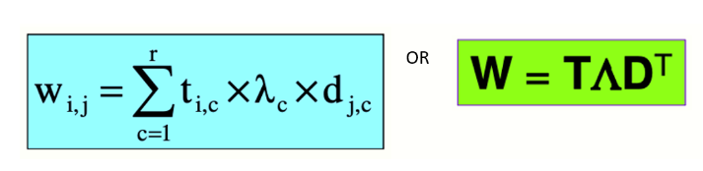
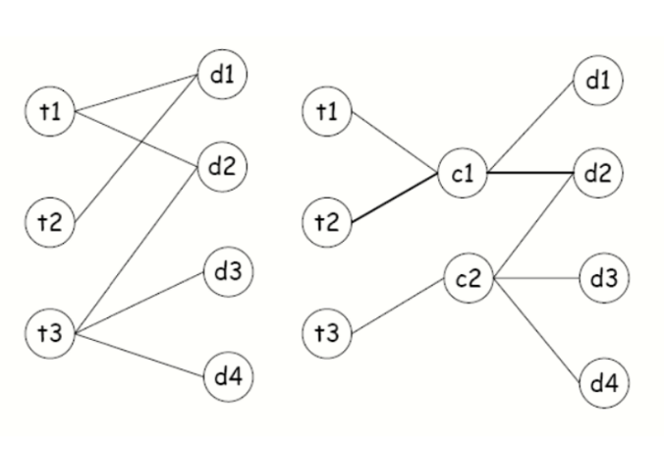
Latent Semantic Indexing
Through SVD, we can represent the terms and documents into a set of latent concepts.

Slide 12
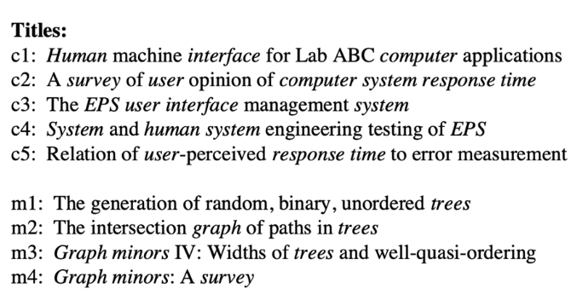
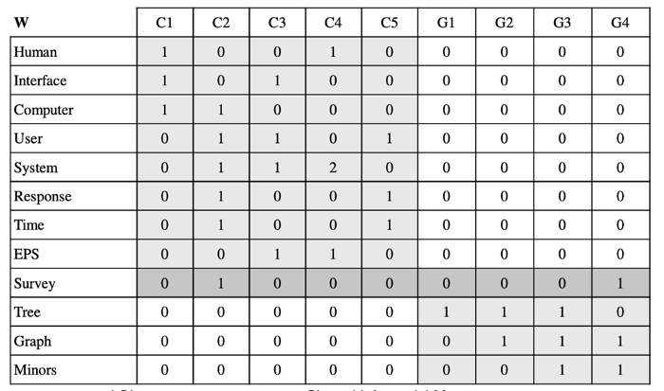
Latent Semantic Indexing

Slide 13
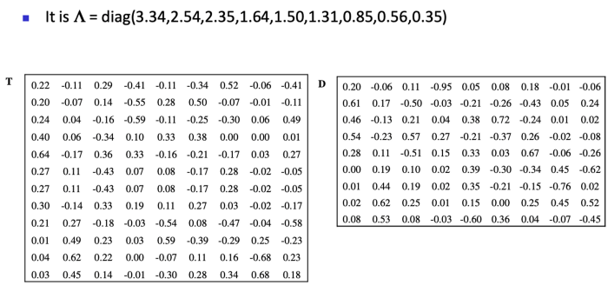
Latent Semantic Indexing

Slide 14
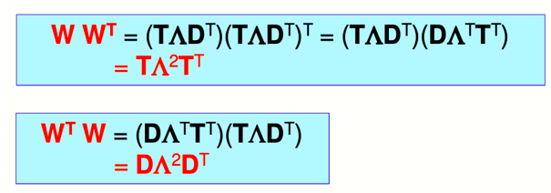
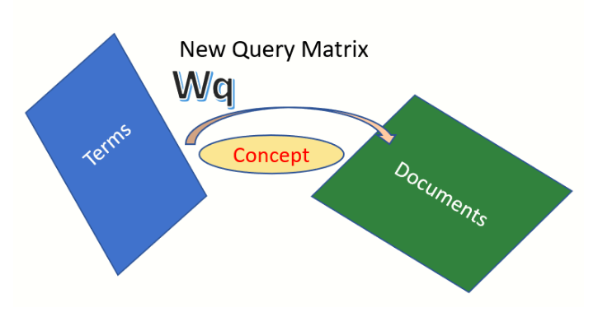
Latent Semantic Indexing
By expanding SVD, we can represent a document only with term-concept space or document-concept space.
Term plane and Document plane are orthogonal, concept Matrix support this transformation.

Slide 15
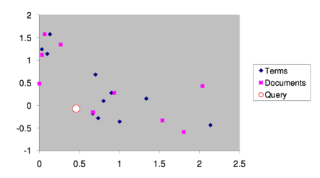
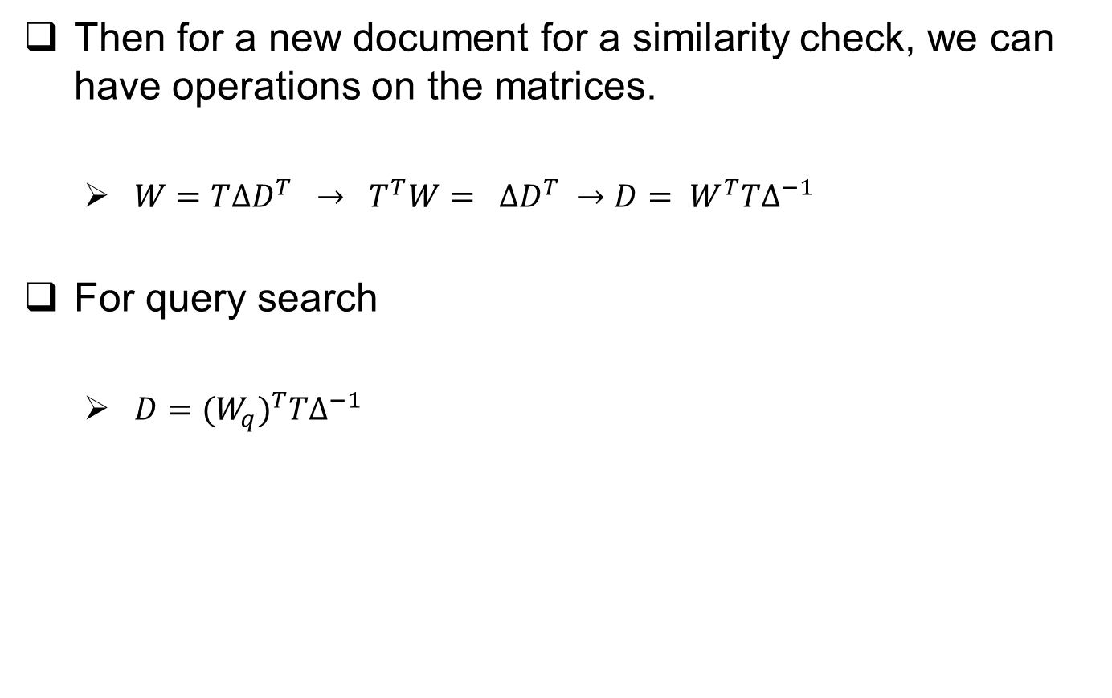
Latent Semantic Indexing
Then for a new document for a similarity check, we can have operations on the matrices.
$W=T∆D^{T} → T^{T}W= ∆D^{T} →D= W^{T}T∆^{−1}$
For query search
$D$ $={(W_{q})}^{T}T∆^{−1}$

Slide 16
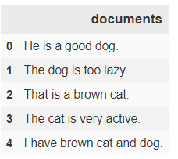
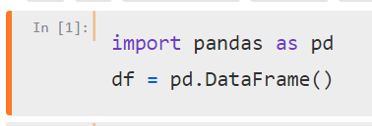
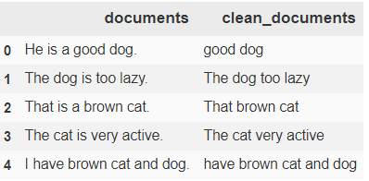
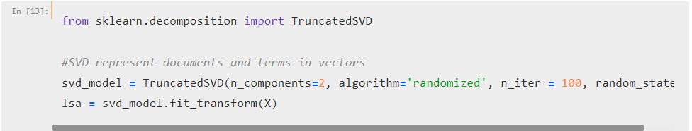
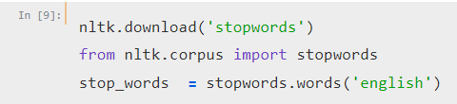
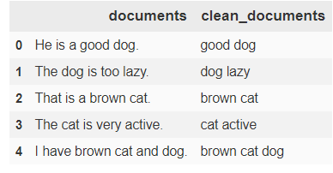
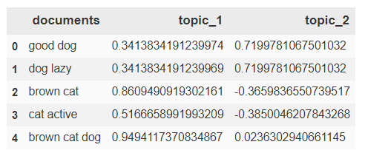
Latent Semantic Indexing

Slide 17
Latent Semantic Indexing
Strength:
LSI provides a method of removing noise and the mitigation the curse of dimensionality.
Captures some semantic aspects, like synonymy and clusters both documents and terms via topic associations.
Doesn’t require knowledge of the document language(?
Limitation:
Difficult to interpret because topics are word vectors with positive and negative entries.
There is no model that permit evaluation of fit when selecting dimensions or topics to use.

Slide 18
Outline
Problems with Practical Topic Modeling
Latent Semantic Indexing
Probabilistic Latent Semantic Analysis(brief intro)
Latent Dirichlet Allocation

Slide 19
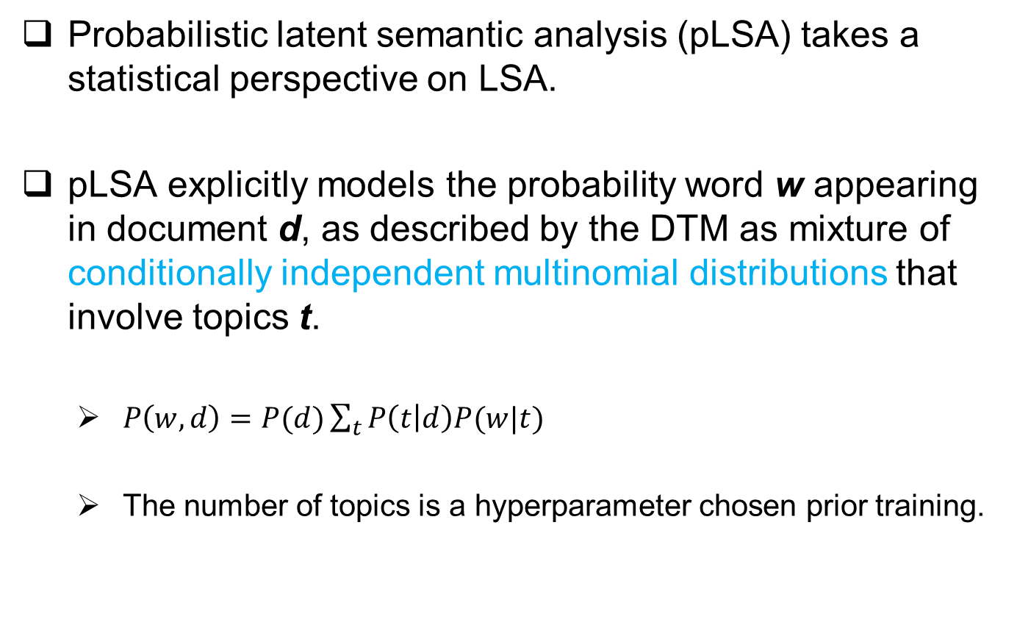
Probabilistic Latent Semantic Analysis
Probabilistic latent semantic analysis (pLSA) takes a statistical perspective on LSA.
pLSA explicitly models the probability word w appearing in document d, as described by the DTM as mixture of conditionally independent multinomial distributions that involve topics t.
$P\left(w,d\right)=P(d)\sum_{t}{P\left(t | d\right)P(w|t)}$
The number of topics is a hyperparameter chosen prior training.

Slide 20
Probabilistic Latent Semantic Analysis
Strength:
Using probability model is that we can now compare the performance of different models by the probability they assign to new documents.
pLSA captures more semantic information, including polysemy.
Limitation:
Increases computational complexity
May yield local but not global maximum
Doesn’t yield generative model for new document.

Slide 21
Outline
Problems with Practical Topic Modeling
Latent Semantic Indexing
Probabilistic Latent Semantic Analysis
Latent Dirichlet Allocation

Slide 22
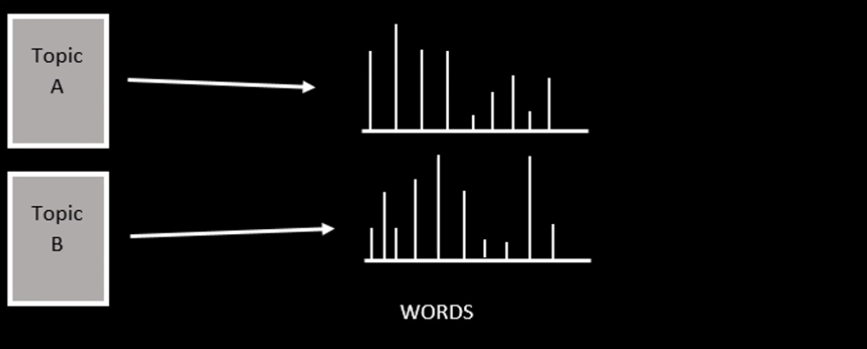
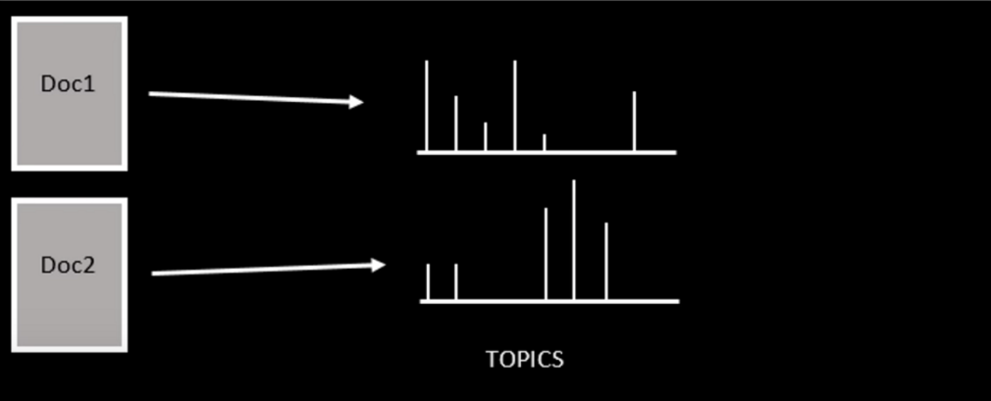
Latent Dirichlet Allocation
LDA assumes topics are probability distributions over words and documents are distributions over topics.
The model assumes that topic follow a sparse Dirichlet distribution, so the distribution reflect only a small set of topics, and uses limited number of terms only.

Slide 23
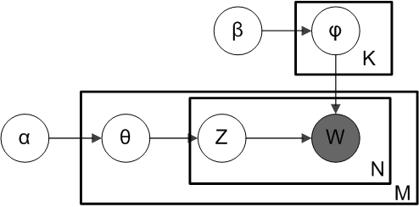
Latent Dirichlet Allocation
Plate Notation of the LDA
There is K topics where Dirichlet distribution is manipulated by hyperparameter β
There are M documents with N terms, where the grey circle w represents the observed terms.
Z tells what topic w corresponds to.
Θ is the Dirichlet distribution of the document which is manipulated by hyperparameter α

Slide 24
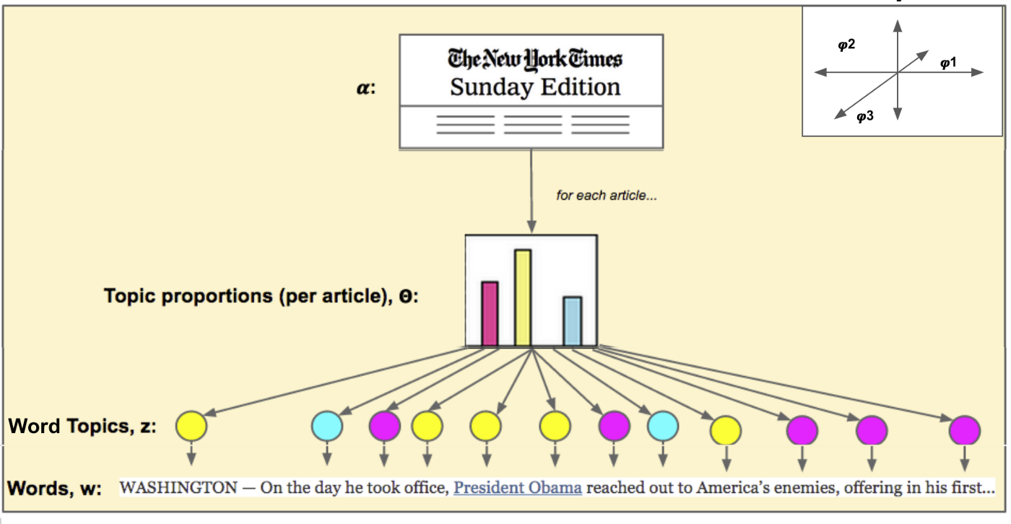

Latent Dirichlet Allocation
The generative process consists of three steps
Sample θ from a Dirichlet distribution${ θ}_{i}$ ~ Dir(⍺) for i from 1 to M
Sample φ from another Dirichlet distribution $φ_{k}\sim Dir\left(β\right)$ for k from 1 to K
Sample $z_{ij}\sim Multinomial(θ_{i})$ and sample $w_{ij}\sim Multinomial(φ_{z_{ij}})$ for i from 1 to M, and for j from 1 to M.

Slide 25
Latent Dirichlet Allocation
Generative Process Example
Suppose group of articles and all articles can be characterized by three topics: Animals, Cooking, Politics.
Each of those topics can be described by the following words:
Animals: dog, chicken, cat, nature, zoo
Cooking: oven, food, restaurant, plates, taste, delicious
Politics: Republican, Democrat, Congress, ineffective, divisive
Consider we want to generate document that is 80% about animals and 20% about cooking,
Choose length of the article. (1000 words)
Choose topic based on mixture, (about 800 words from animals, 200 words from cooking)
Choose word based on word distribution

Slide 26
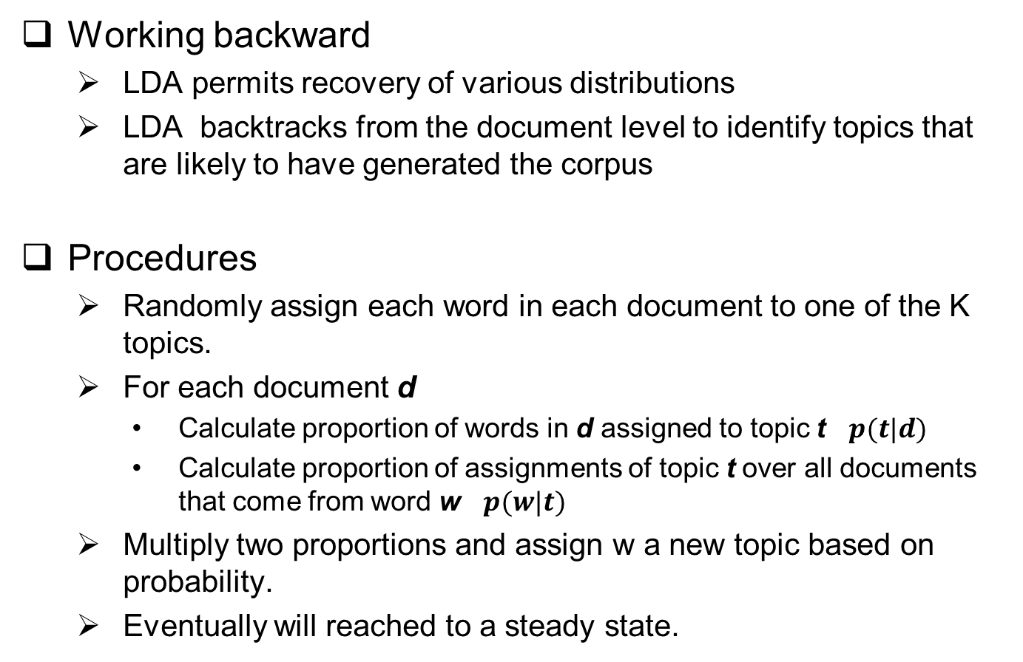
Latent Dirichlet Allocation
Working backward
LDA permits recovery of various distributions
LDA backtracks from the document level to identify topics that are likely to have generated the corpus
Procedures
Randomly assign each word in each document to one of the K topics.
For each document d
Calculate proportion of words in d assigned to topic t $p(t|d)$
Calculate proportion of assignments of topic t over all documents that come from word w $p(w|t)$
Multiply two proportions and assign w a new topic based on probability.
Eventually will reached to a steady state.

Slide 27
Latent Dirichlet Allocation
Conclusion
Documents are probability distribution over latent topic.
Topics are probability distributions over words.
LDA takes a number of documents. Assumes that words in each document are related. Then tries to figure out how each document have been created.
We need to tell the model how many topics to construct and generates topic and word distributions over a corpus.
Based on it, similar documents can be identified through it’s corpus.

Slide 28
Latent Dirichlet Allocation
Advantages
Effective tool for topic modeling
Easy to understand conceptually
Has been shown to produce good results over various domain
New applications
Limitation
Must know number of topics K in advanced
Dirichlet topic distribution cannot capture correlations among topics.

Slide 29
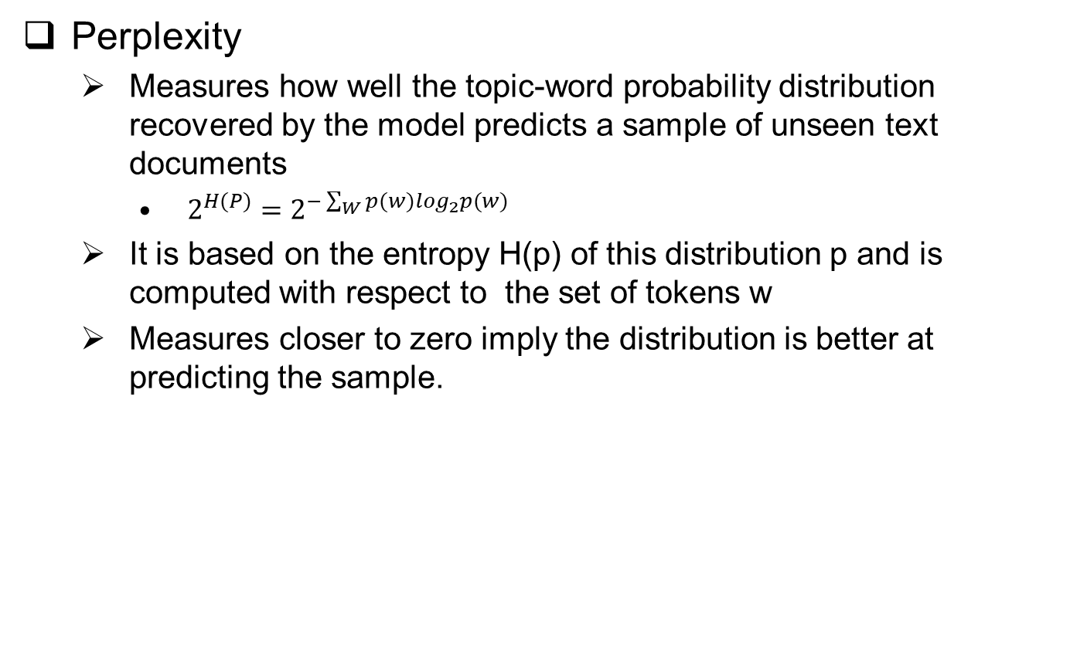
Evaluation of Latent Dirichlet Allocation
Perplexity
Measures how well the topic-word probability distribution recovered by the model predicts a sample of unseen text documents
$2^{H(P)}=2^{−\sum_{W}{p(w)\log_{2}p(w)}}$
It is based on the entropy H(p) of this distribution p and is computed with respect to the set of tokens w
Measures closer to zero imply the distribution is better at predicting the sample.

Slide 30


Evaluation of Latent Dirichlet Allocation
Topic Coherence
Measures the semantic consistency of the topic model results, that is, whether human would perceive the word and their probabilities associated with topics as meaningful.

Slide 31
Tools for LDA
Sklearn
pyLDAvis (visualization)
Gensim

Slide 32
Reference
https://dinu-thomas.medium.com/singular-value-decomposition-d6e13c55200d
https://towardsdatascience.com/latent-semantic-analysis-deduce-the-hidden-topic-from-the-document-f360e8c0614b
https://blog.rosetta.ai/a-deep-dive-into-latent-dirichlet-allocation-lda-and-its-applications-on-recommender-system-e2e8ea5e661c
https://www.youtube.com/watch?v=DWJYZq_fQ2A

Slide 33
END

